Slide 1
Preliminary Evaluations of the Navy's ACNFS versus NASA IceBridge Data
David Hebert¹, Richard Allard¹, Pamela Posey¹, Alan Wallcraft¹, Joseph Metzger¹, Ole Martin Smedstad², Michael Phelps³, Sinead Farrell⁴
¹Naval Research Lab, Oceanography Division, Stennis Space Center
²QinetiQ North America, Stennis Space Center
³Jacobs Engineering, Stennis Space Center
⁴ESSIC/CICS/University of Maryland

Slide 2
ACNFS
Domain: 40-90ºN
High resolution: 3.5 km at pole
Assimilation of ocean and ice
5 day forecast daily
ACNFS consists of :
- Ice Model - CICE
- Ocean Model - HYCOM
- Data assimilation - NCODA
- Forced with 0.5º NOGAPS
OPTEST completed

Slide 3
CICE Standalone
Same horizontal grid as ACNFS
“Standalone” no HYCOM – no assimilation
Ocean data (T, S, U, V) from daily ACNFS output
Atmospheric forcing from NOGAPS except for precipitation. Several precip runs done here:
Climatology (Standard ACNFS)
NOGAPS precipitation
Zero precipitation
Initialized from ACNFS March 14, 2012.
Run through April 02, 2012

Slide 4
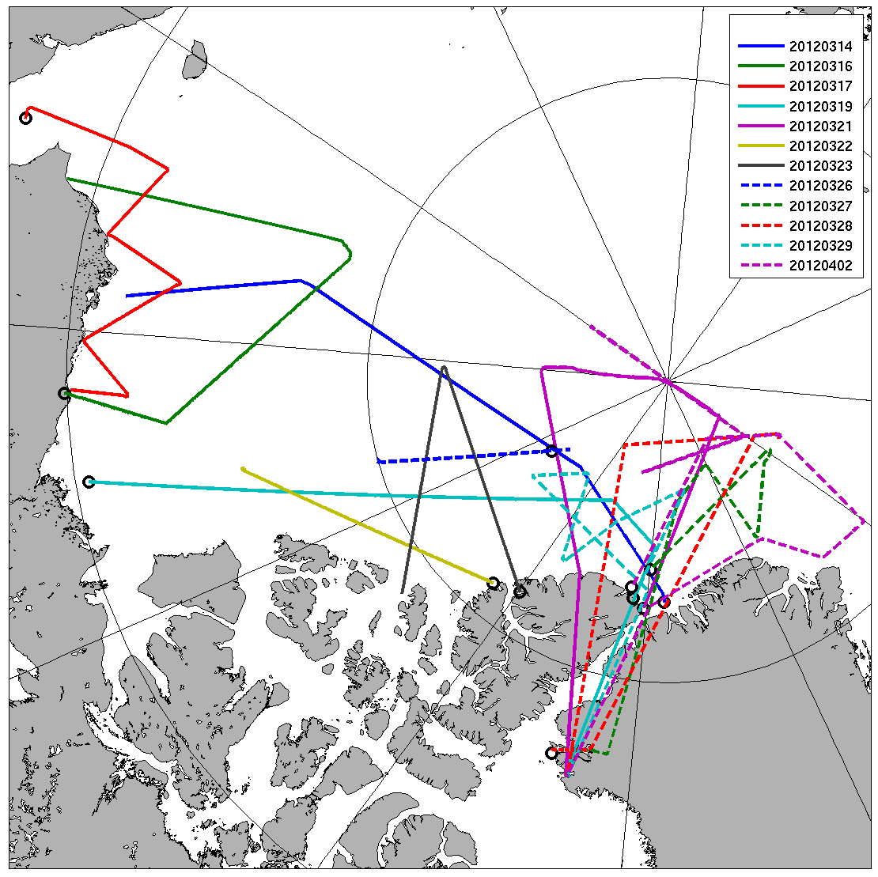
IceBridge Tracks Spring 2012
Sea Ice Thickness
Snow Thickness
Surface Temperature

Slide 5
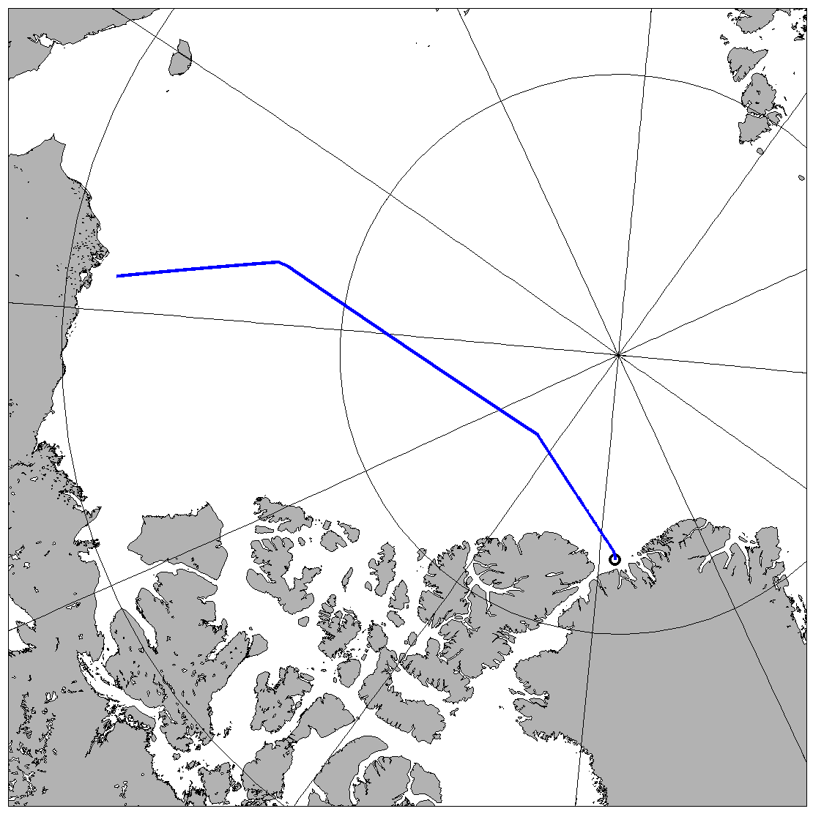
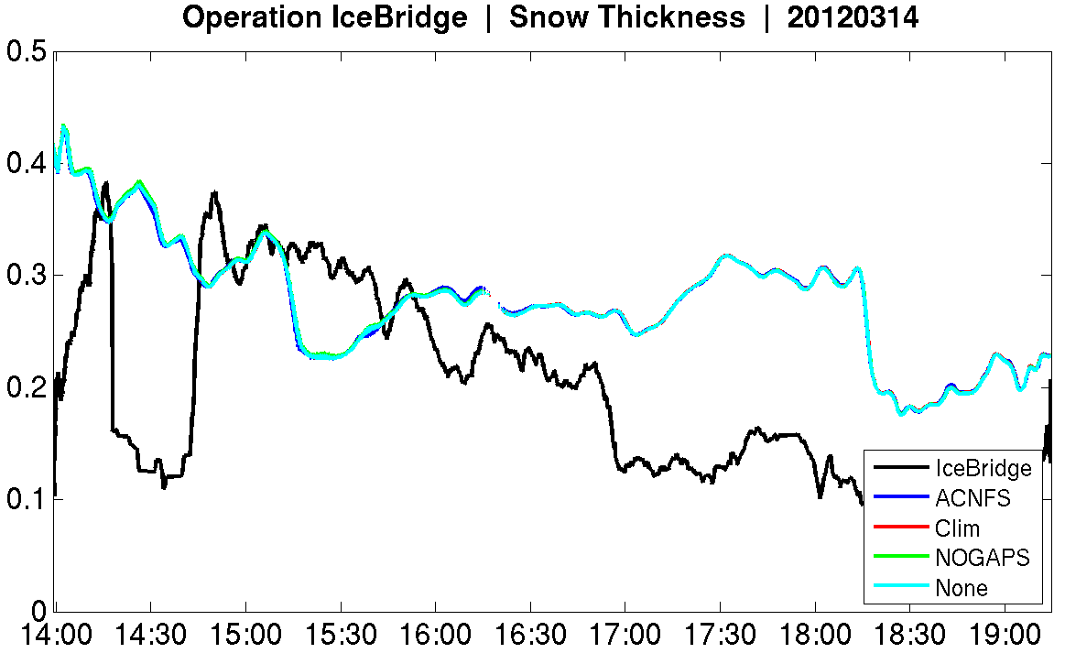
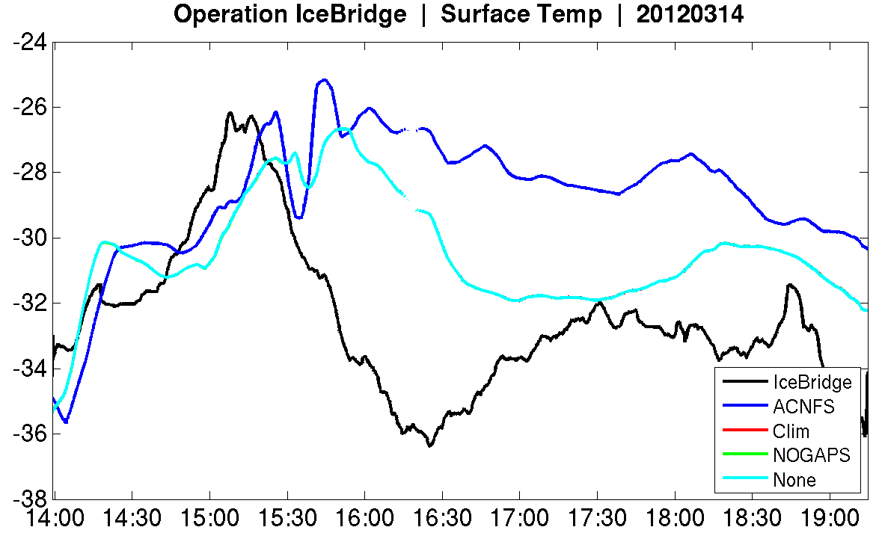
Results

Slide 6
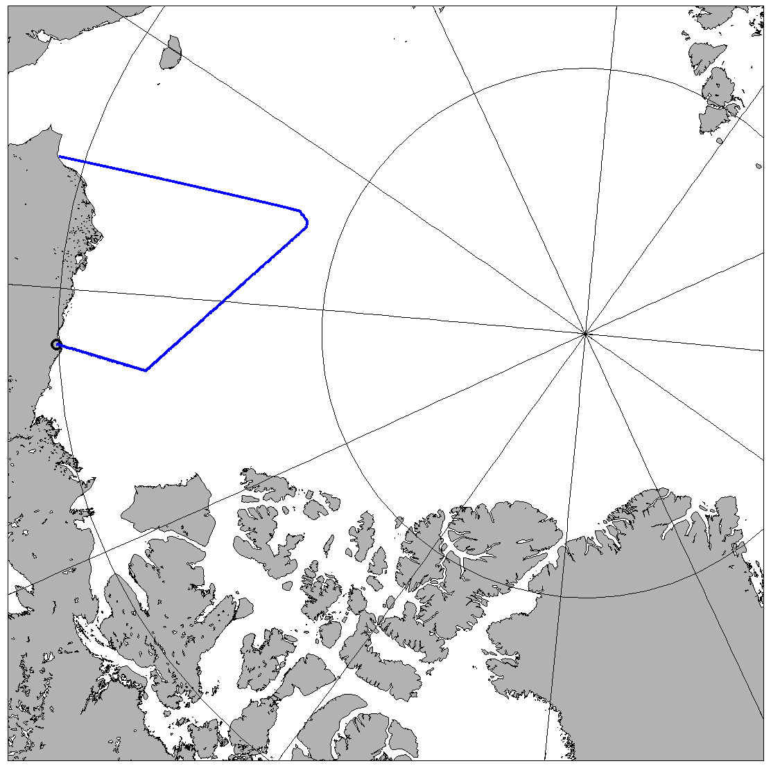
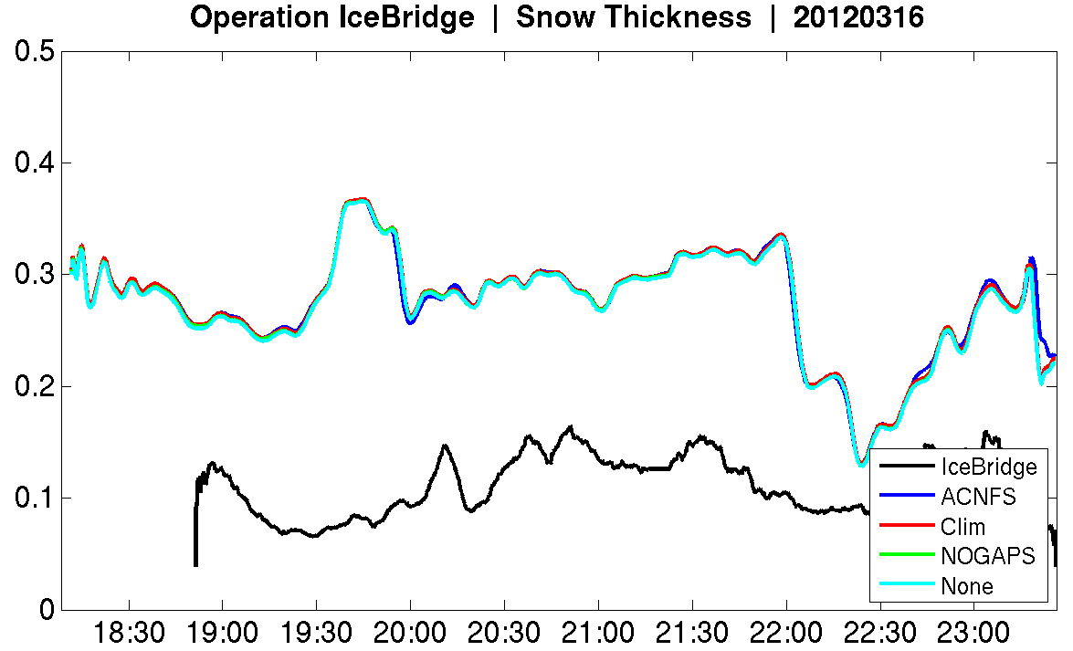
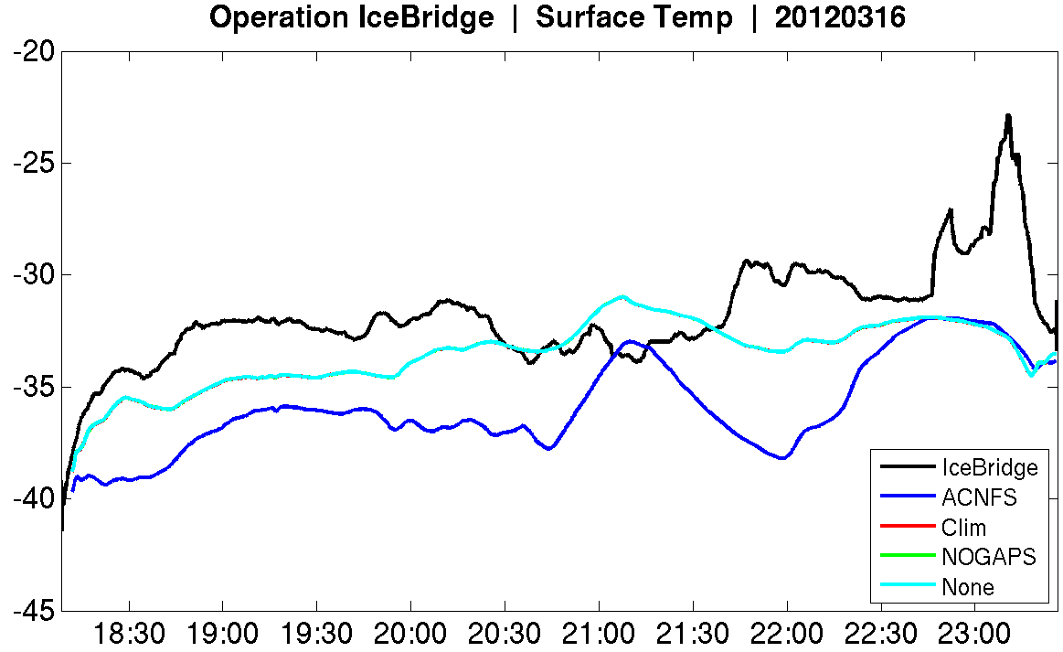
Results

Slide 7
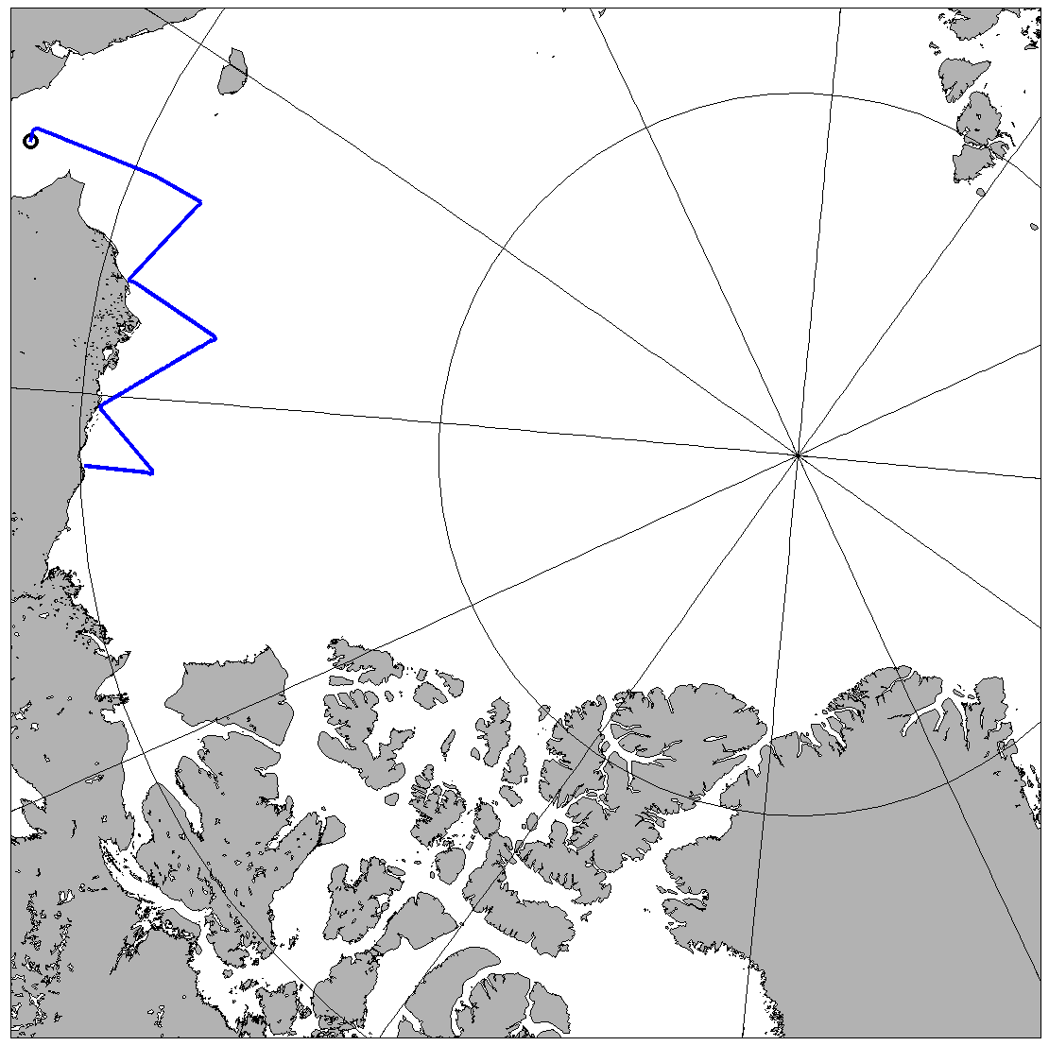
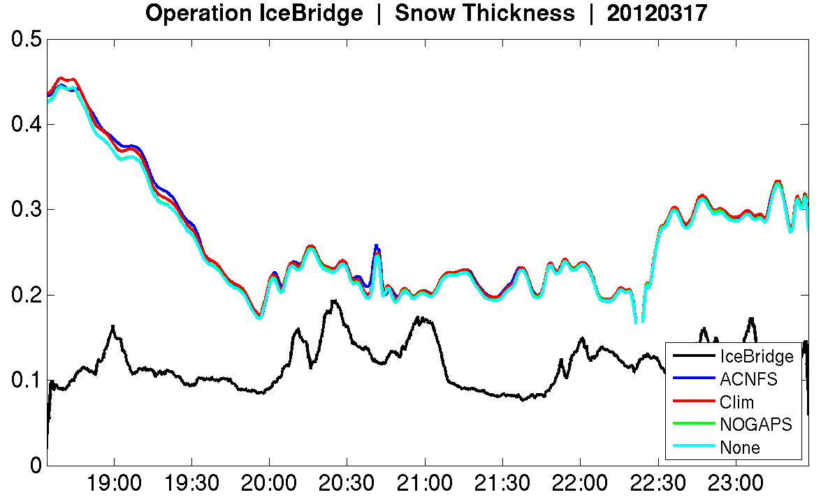
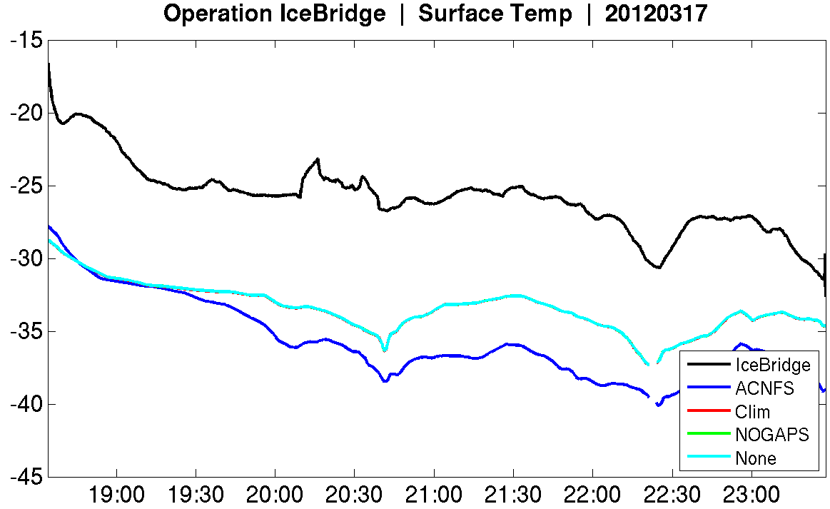
Results

Slide 8
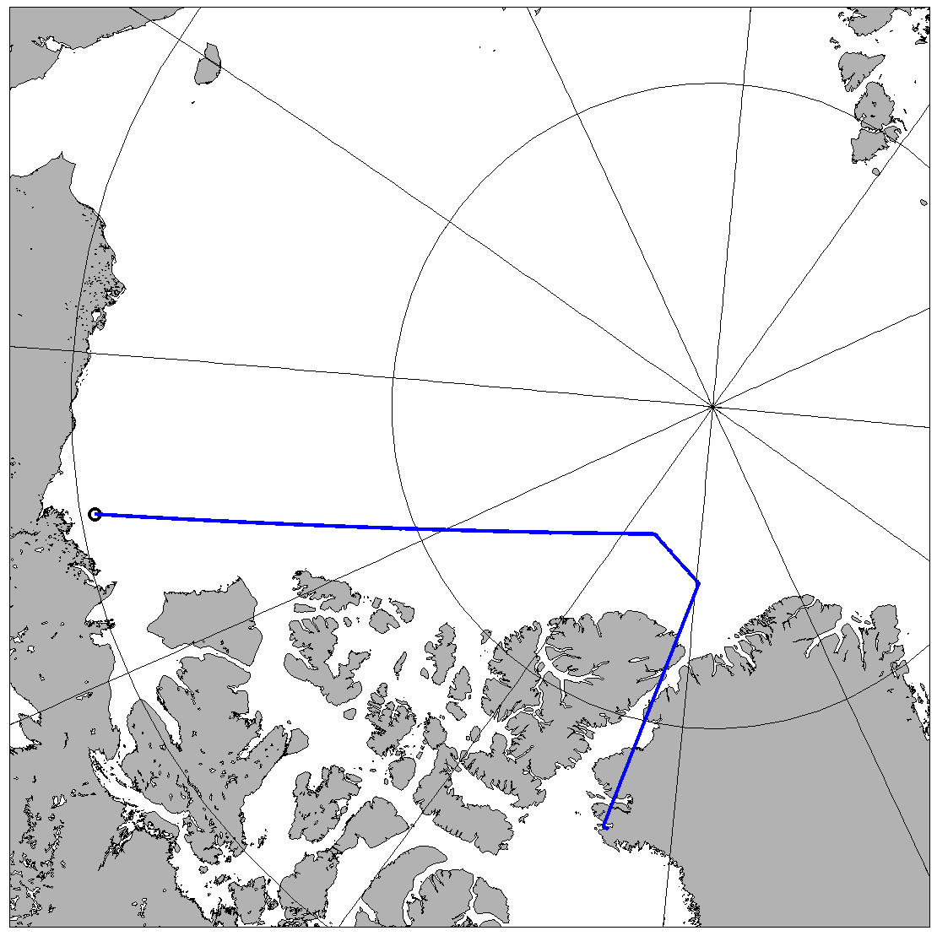
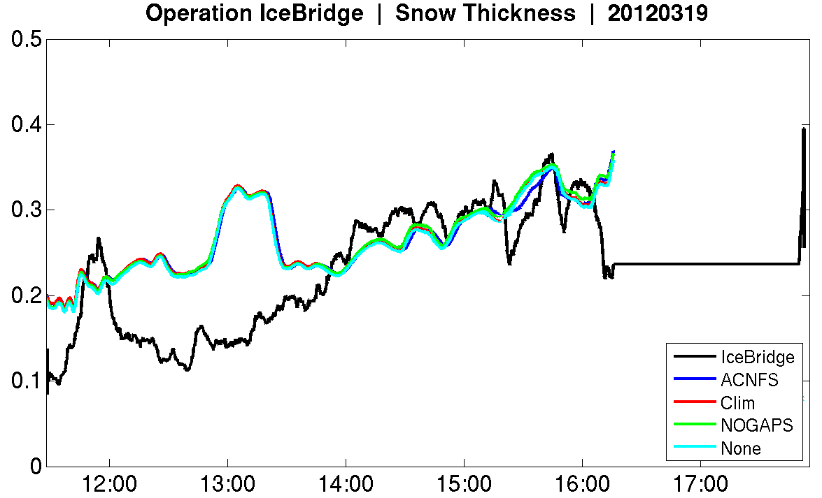
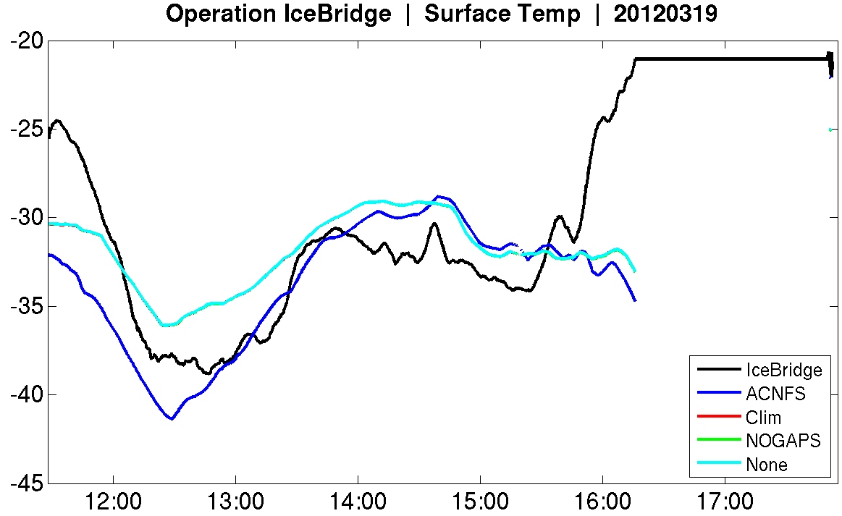
Results

Slide 9
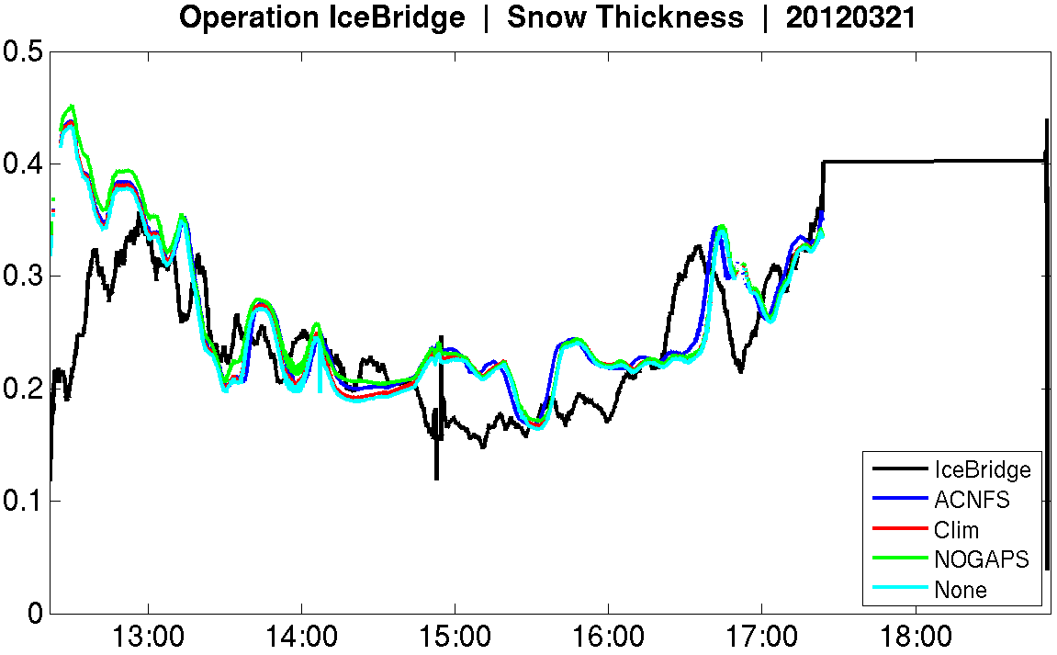
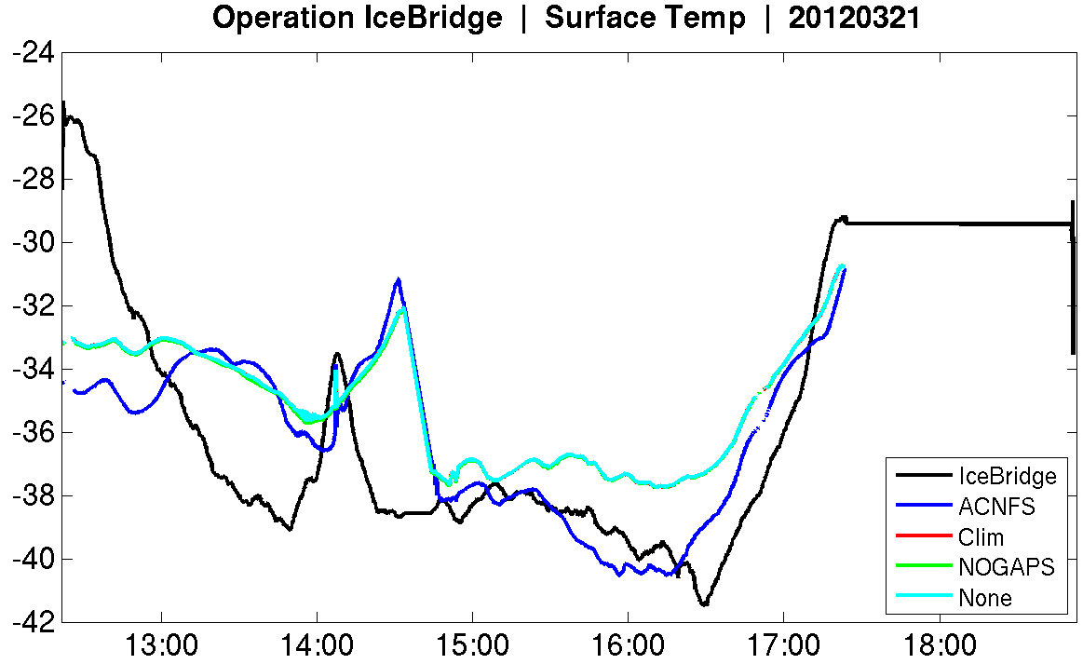
Results

Slide 10
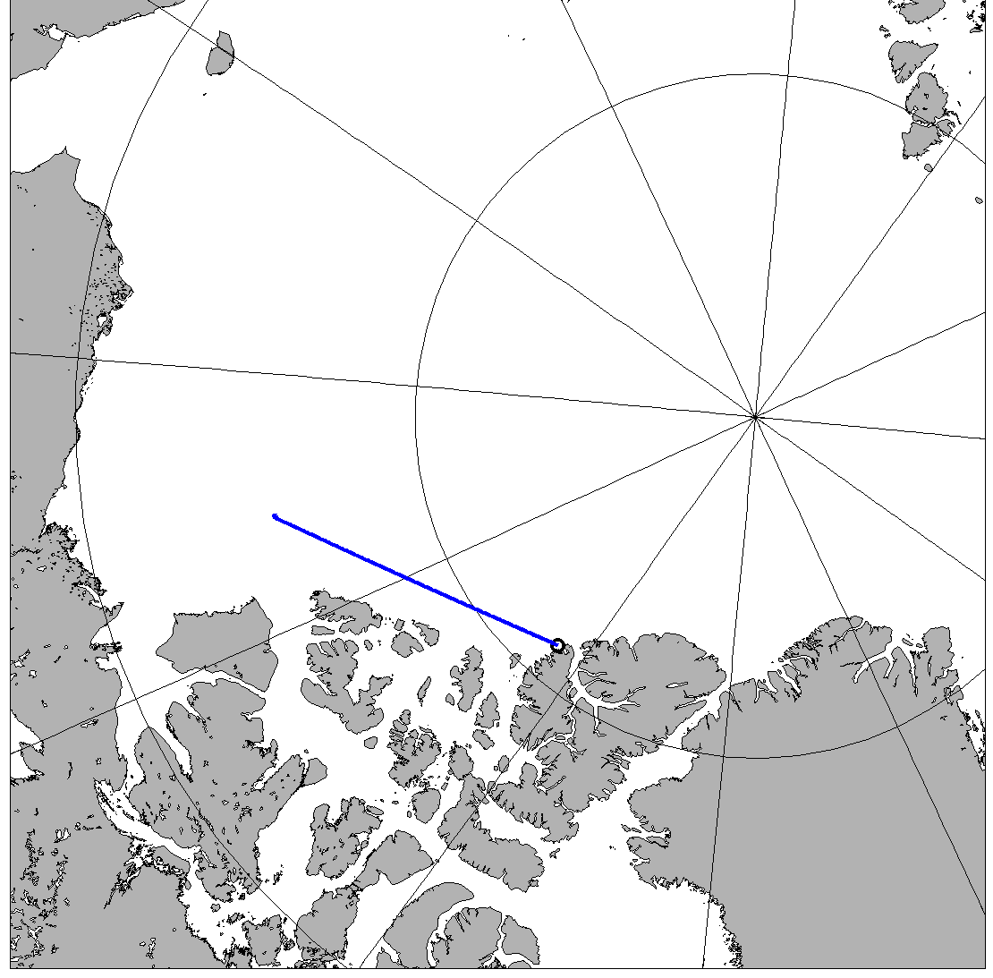
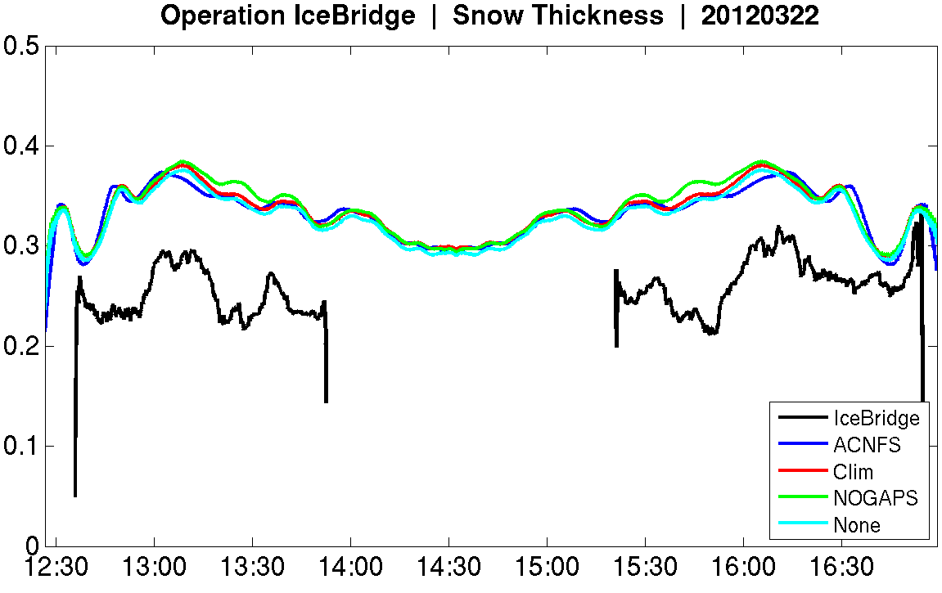
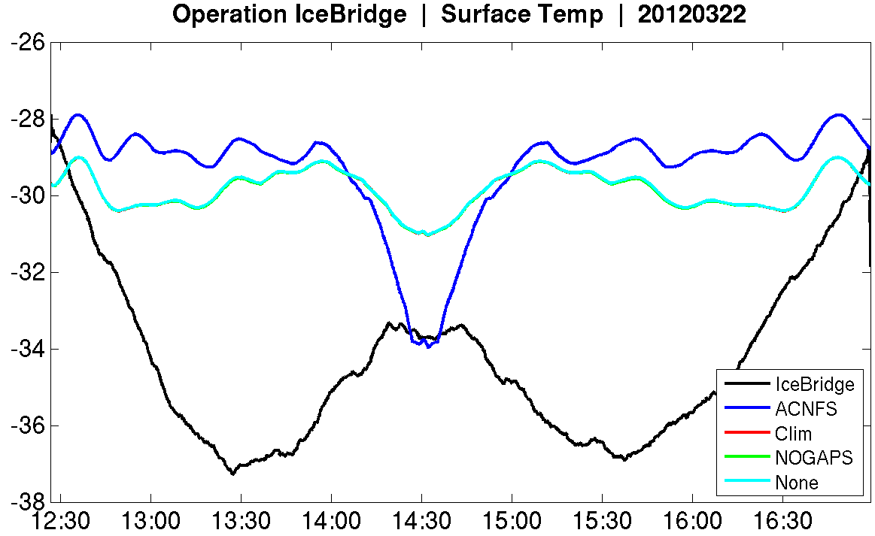
Results

Slide 11
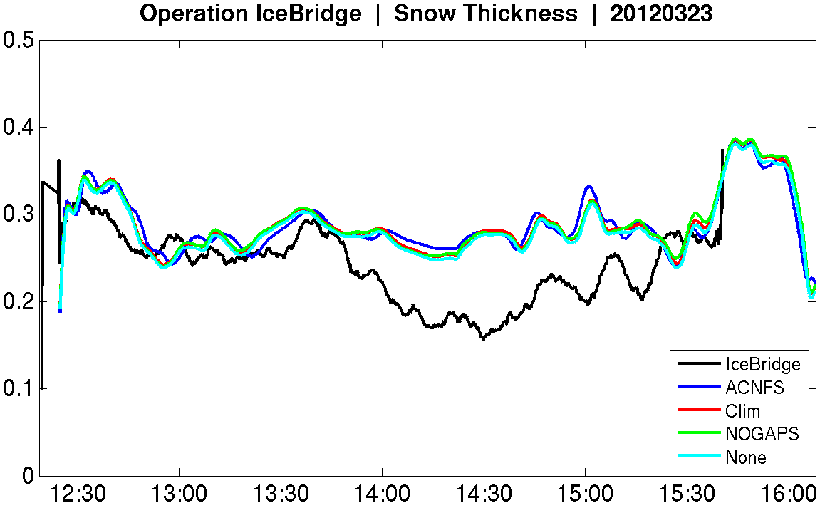
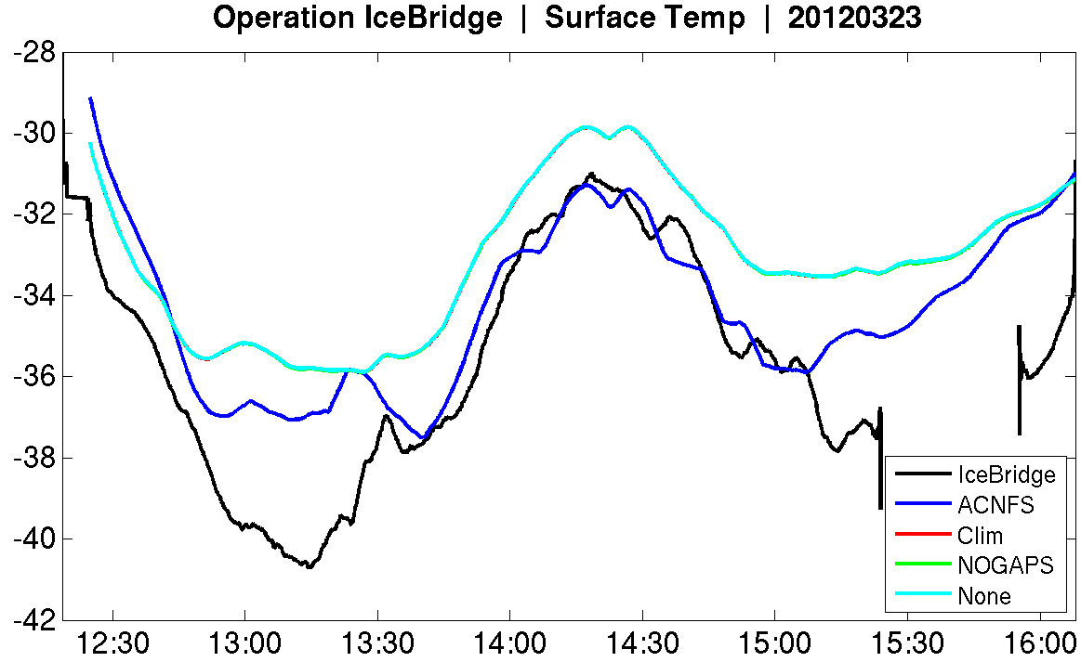
Results

Slide 12
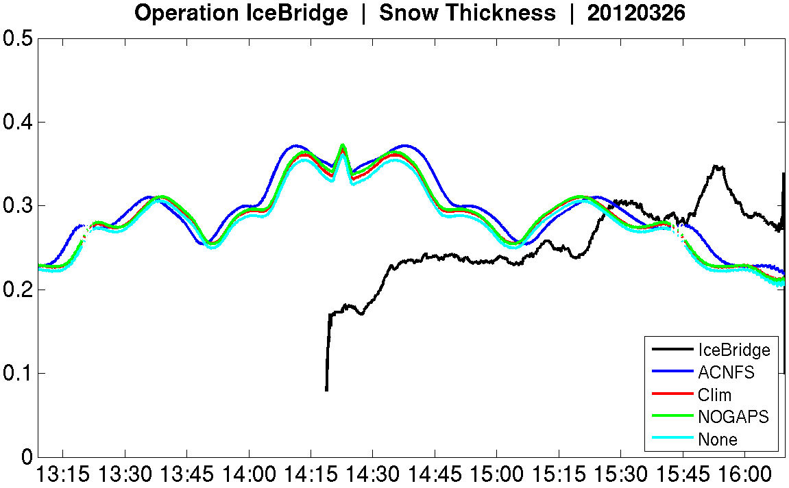
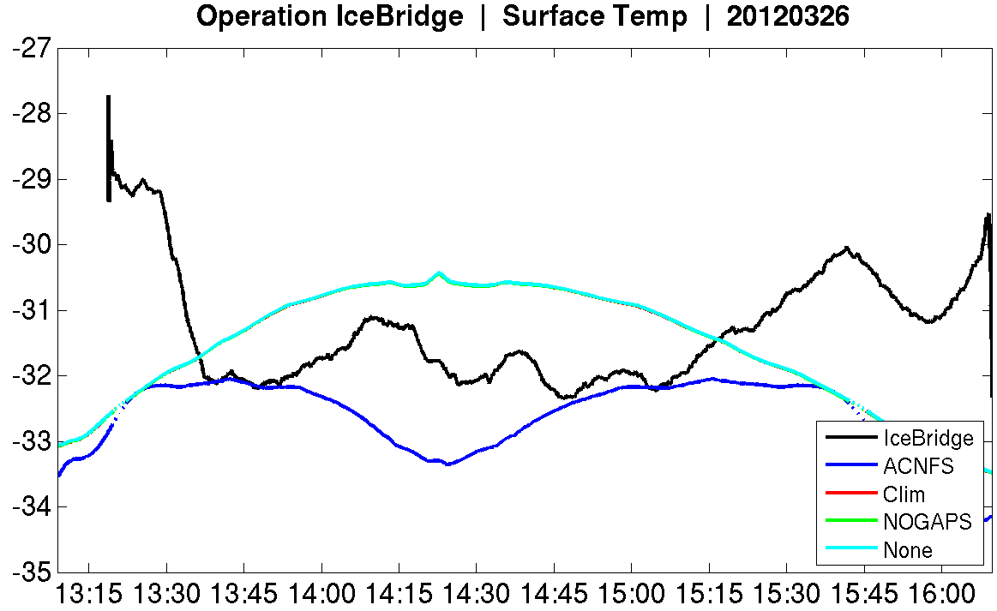
Results

Slide 13
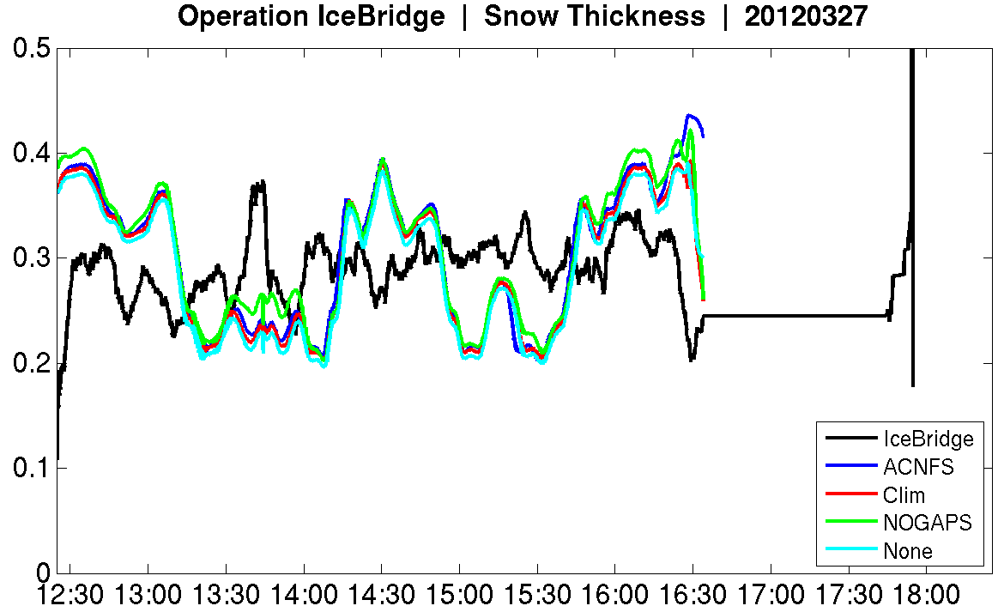
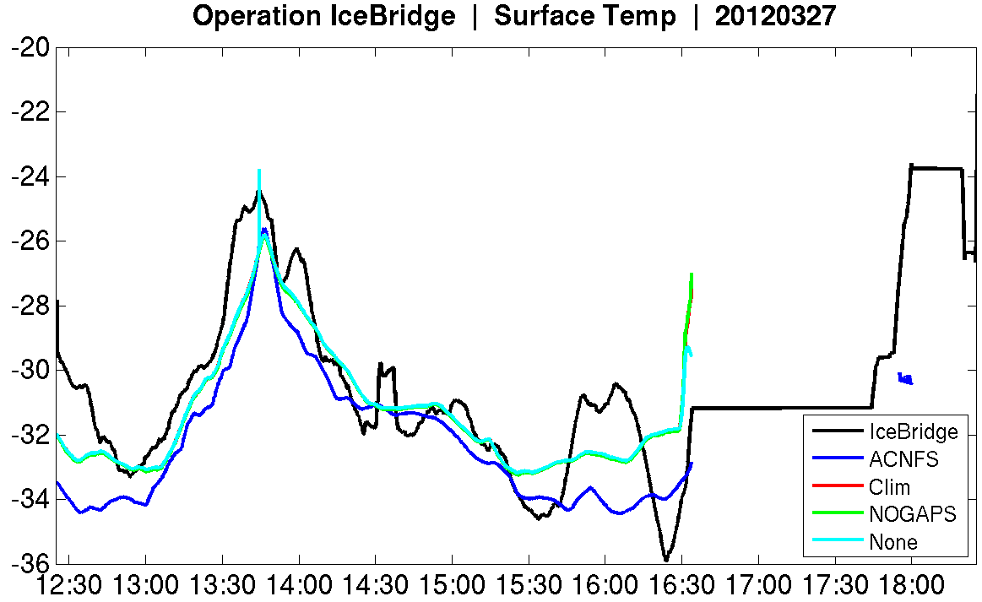
Results

Slide 14
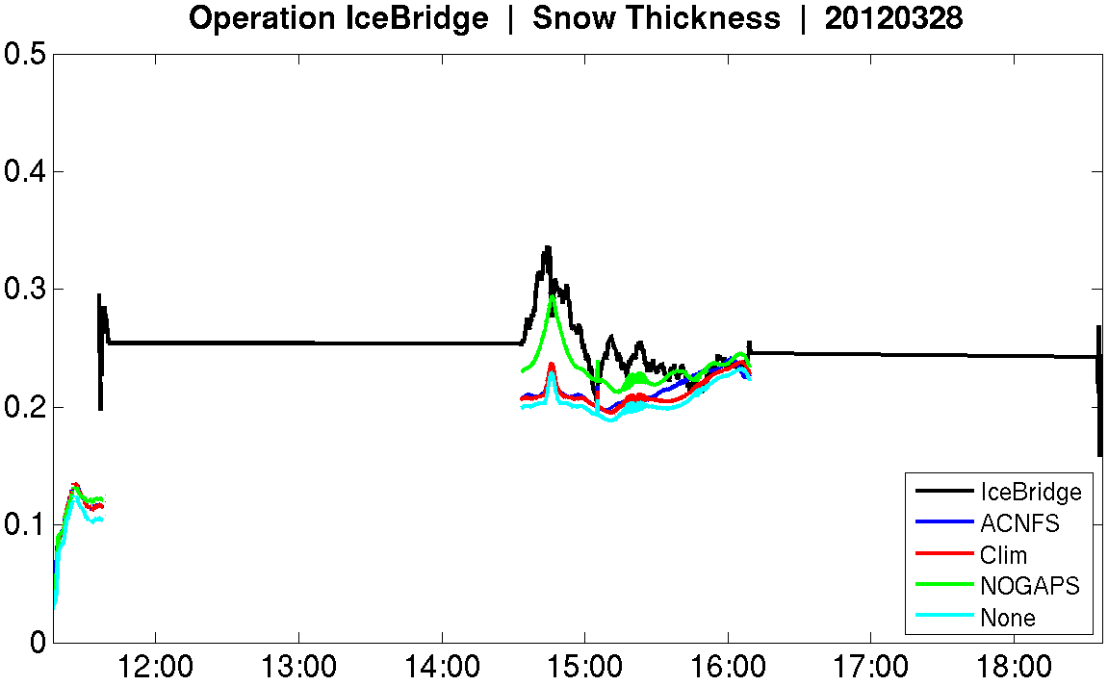
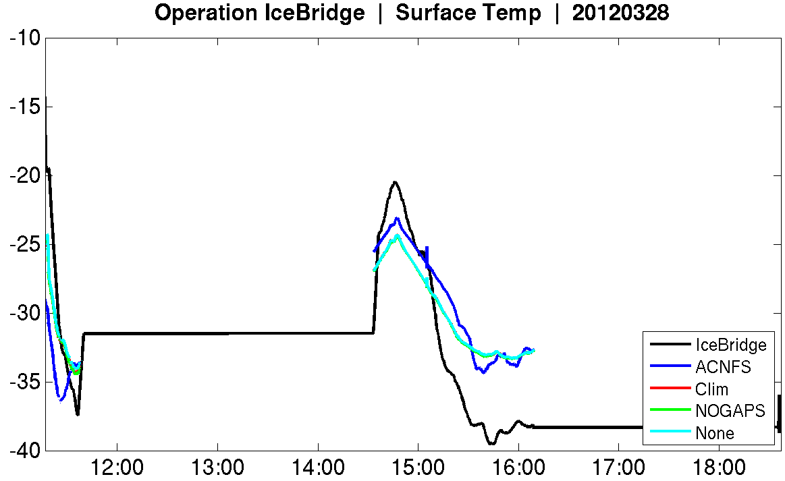
Results

Slide 15
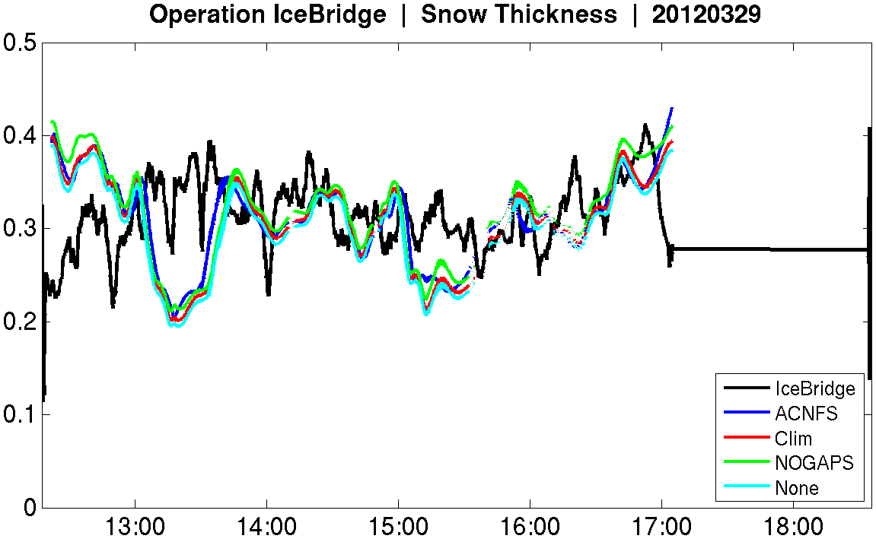
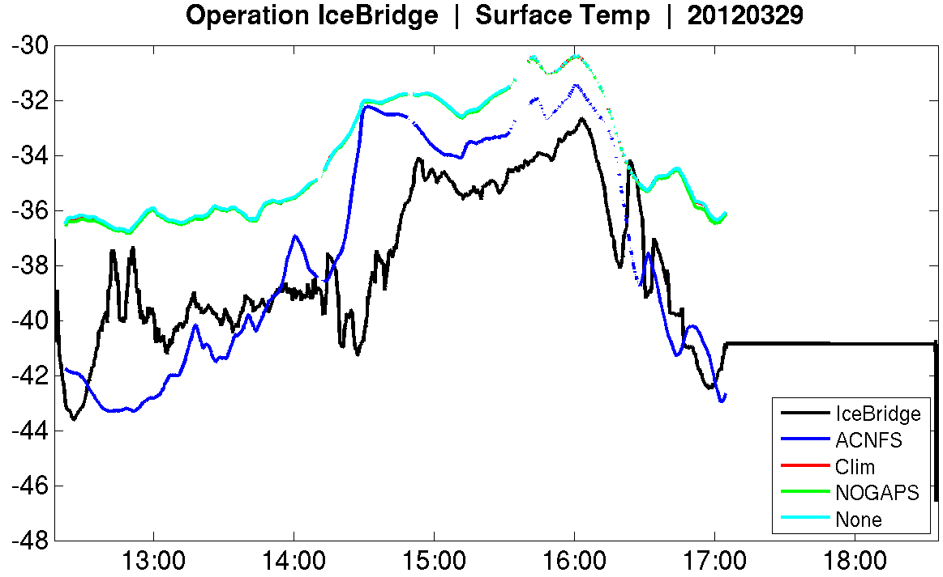
Results

Slide 16
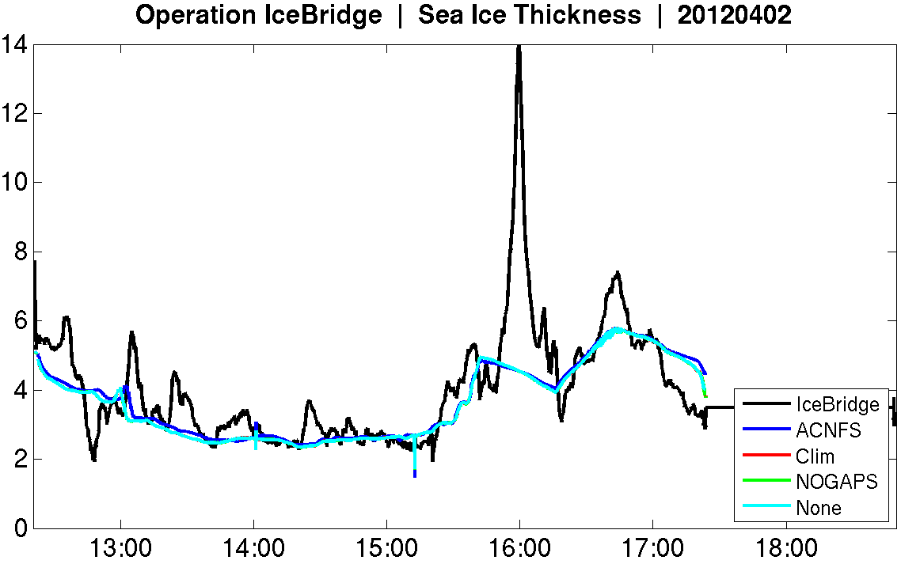
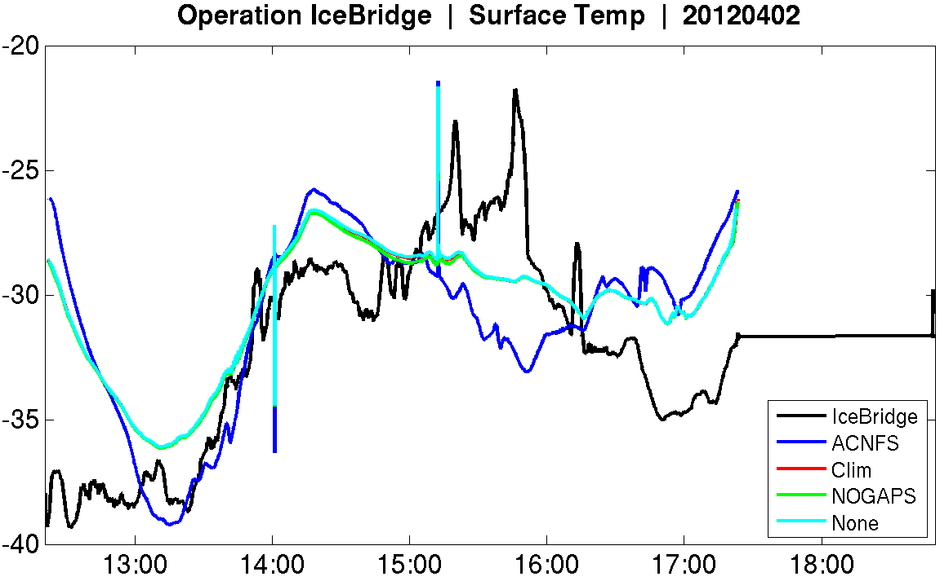
Results

Slide 17
Summary
ACNFS and CICE Stand Alone compared with Ice Bridge sea ice thickness, snow depth, surface temperature
Compared to Ice Bridge:
Modeled Ice Thickness generally 1-2 m too thick
Modeled Snow Depth generally 10-20 cm too deep
Surface Temp ± 5⁰C, follows Ice Bridge pattern
Longer runs needed to see differences due to precipitation

Slide 18
What’s next?
Precipitation comparisons
Climatology vs. NOGAPS
Different snow, different albedo (Melt ponds?)
Assimilation
Will change in observed snow depth help forecast?
Thermodynamics?
Surface temp impact on modeled ice thickness

