Slide 1
Evaluation of Arctic sea ice thickness from Six AOMIP models
Mark Johnson, Andrey Proshutinsky, Yevgeny Aksenov,
An Nguyen, Ron Lindsay, Christian Haas, Jinlun Zhang,
Nikolay Diansky, Ron Kwok, Wieslaw Maslowski,
Sirpa Hakkinen, Igor Ashik, Beverly de Cuevas

Slide 2
Question: Do the AOMIP model simulations of sea ice thickness agree with observations?
Motivation
a comparison has not been done previously for multiple models and multiple data
comparisons are essential for model improvement
validation is essential for science based policy and decision making (IPCC, etc.)

Slide 3
The Models
ECCO2 – An Nguyen
GSFC – Sirpa Hakkinen
INMOM – Nikolay Diansky
ORCA – Yevgeny Aksenov
NAME – Wieslaw Maslowski
UW – Jinlun Zhang

Slide 4
The Data
ICESat – Ron Kwok
Airborne Electromagnetic surveys – Christian Haas
Moorings – Melling, Fahrbach, Proshutinsky
Submarine – Rothrock (Lindsay’s CDR)
Coastal Stations – via Andrey Proshutinsky
Russian Landing Sites – Romanov atlas and digitized maps by Proshutinsky
All data converted to thickness

Slide 6
Russian landings, Romanov Atlas and digitized maps
WHOI Moorings (Beaufort Gyre Experiment -Proshutinsky)
IOS Moorings (Melling)
Russian coastal stations in fast ice
Alfred Wegener Institute Moorings (Fahrbach)

Slide 7
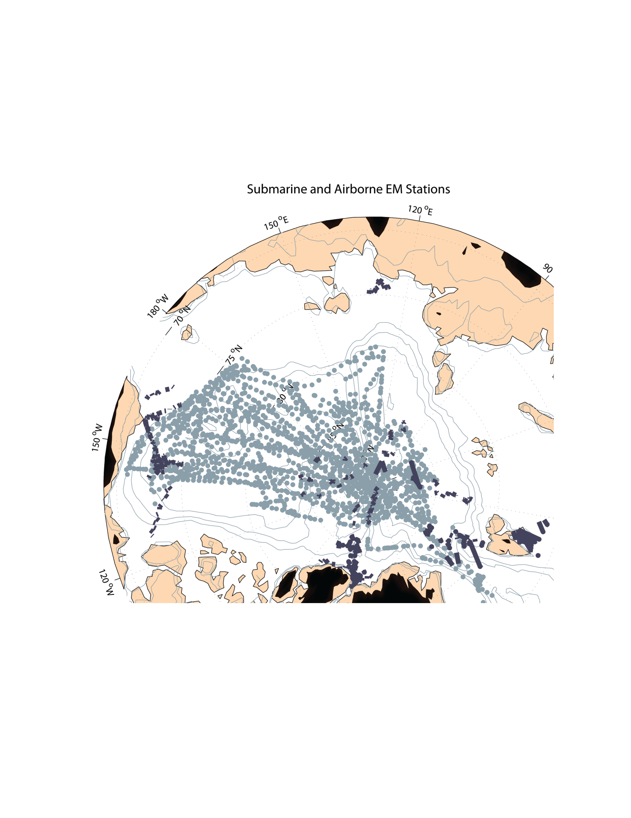
Submarine and Airborne EM Stations

Slide 8
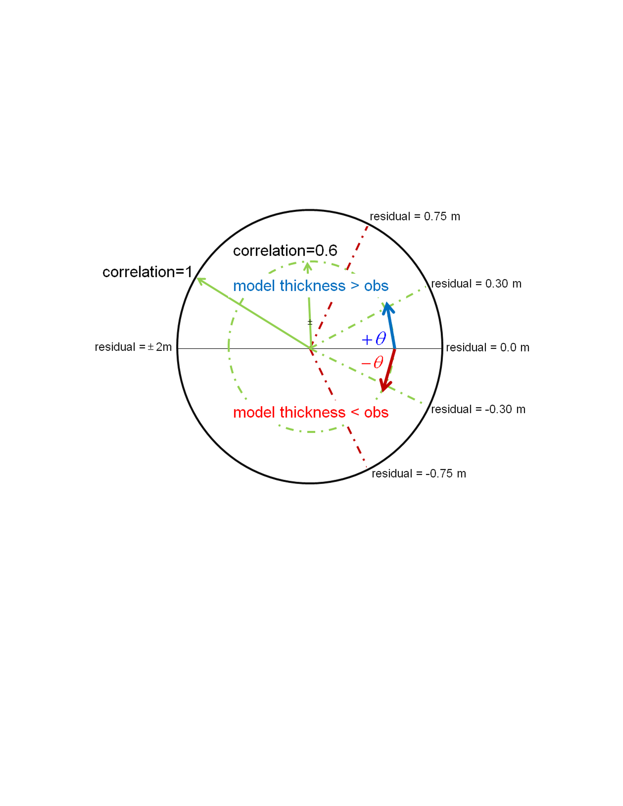
Modified Taylor Diagram
for residuals (model-obs) and correlations
“residuals” are model minus observation

Slide 9
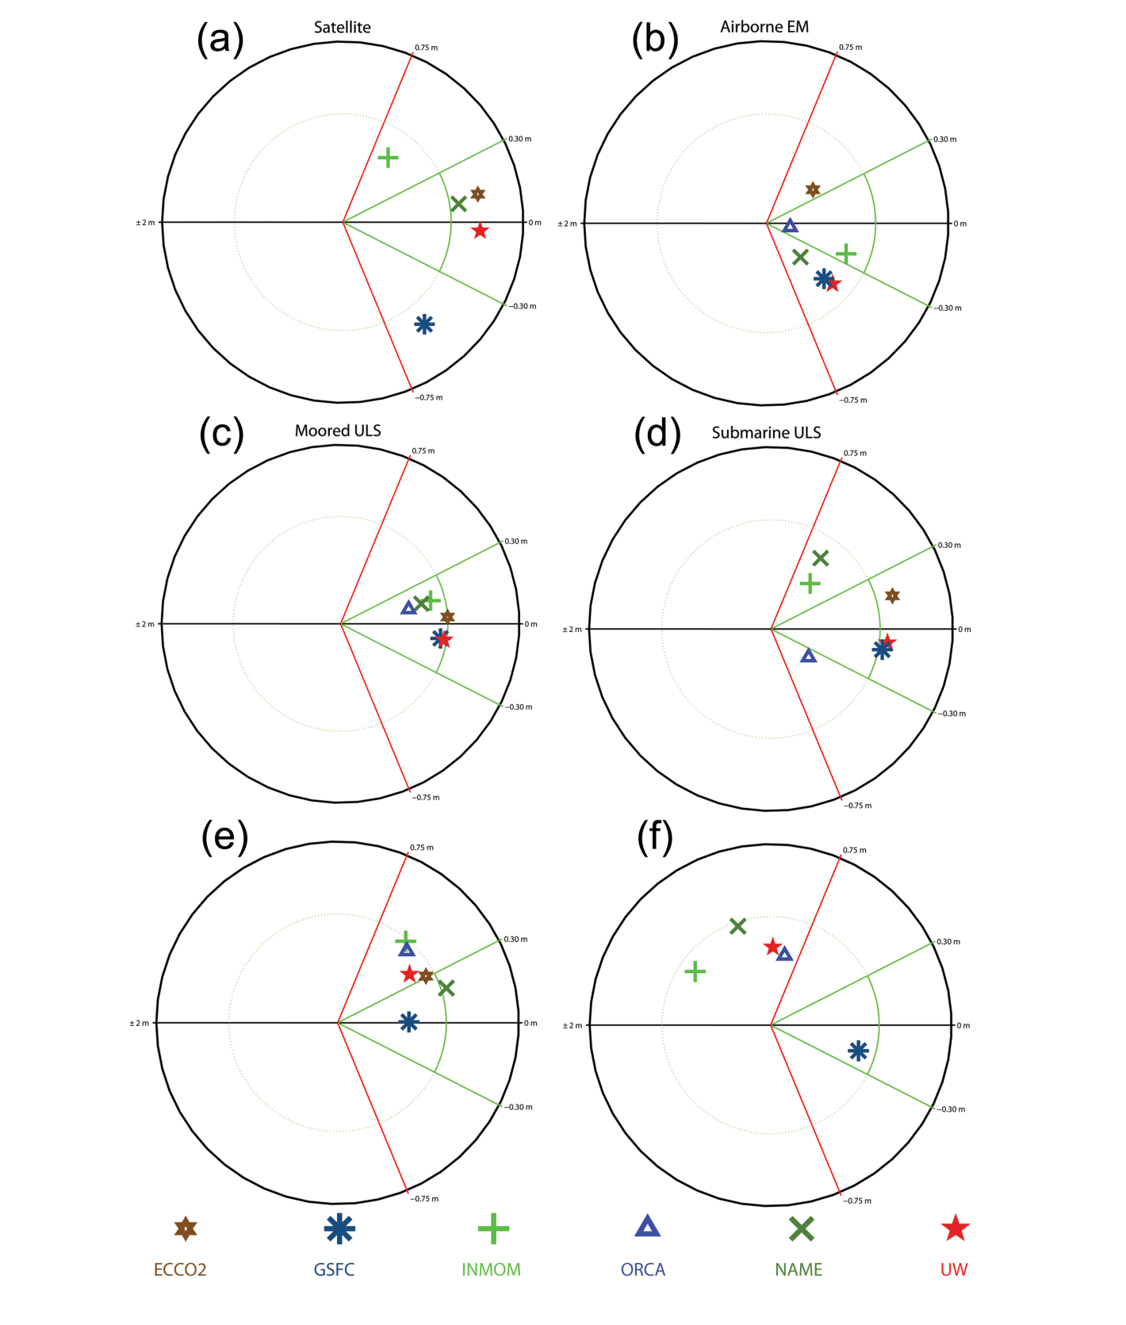
Coastal Stations
Landing Sites

Slide 10
Coastal Stations
Landing Sites
Ice thickness from models > observations at Landing Sites

Slide 11
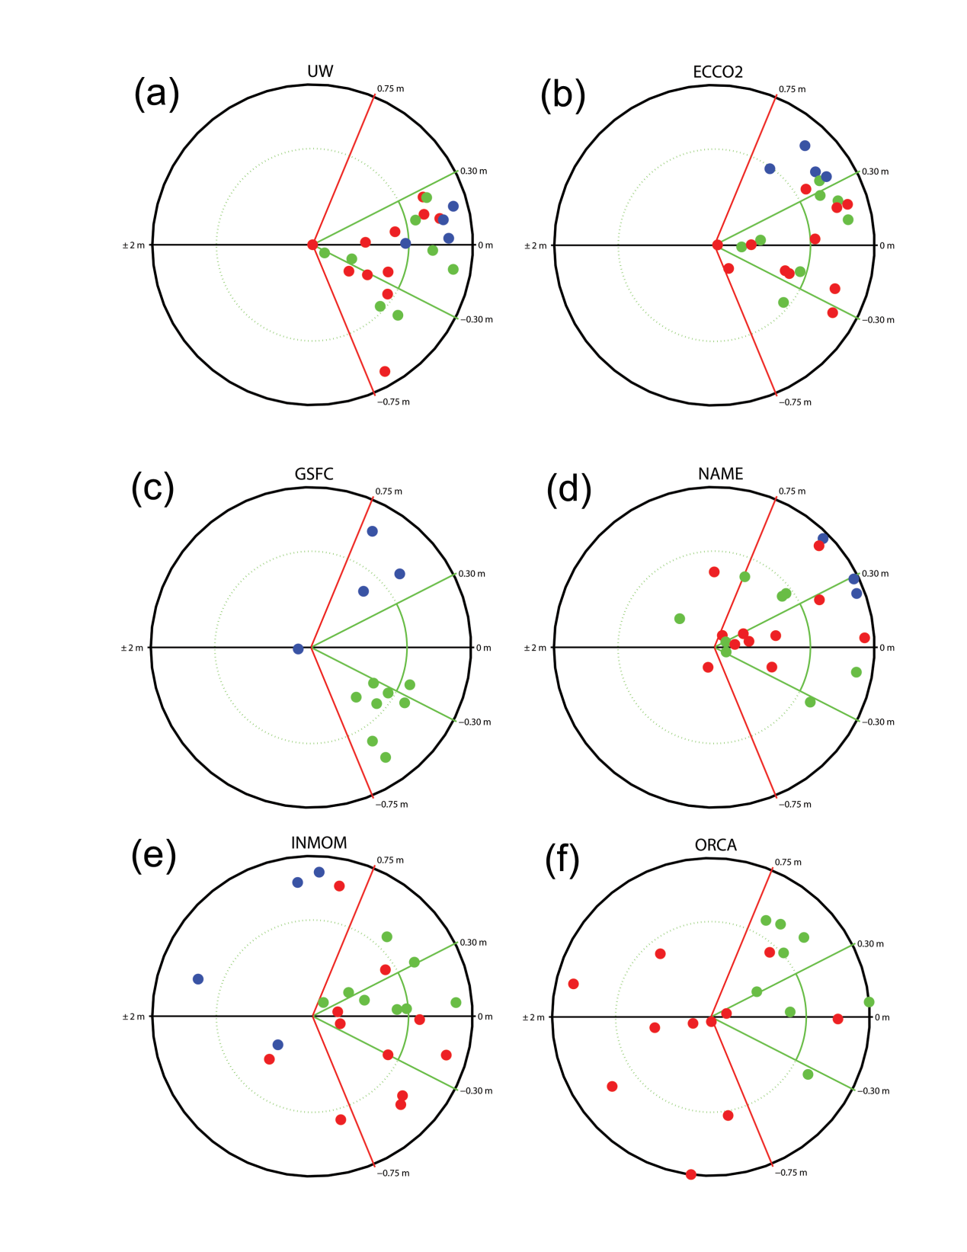
ULS Data
residual magnitude increases
AWI
IOS
BGEP

Slide 12
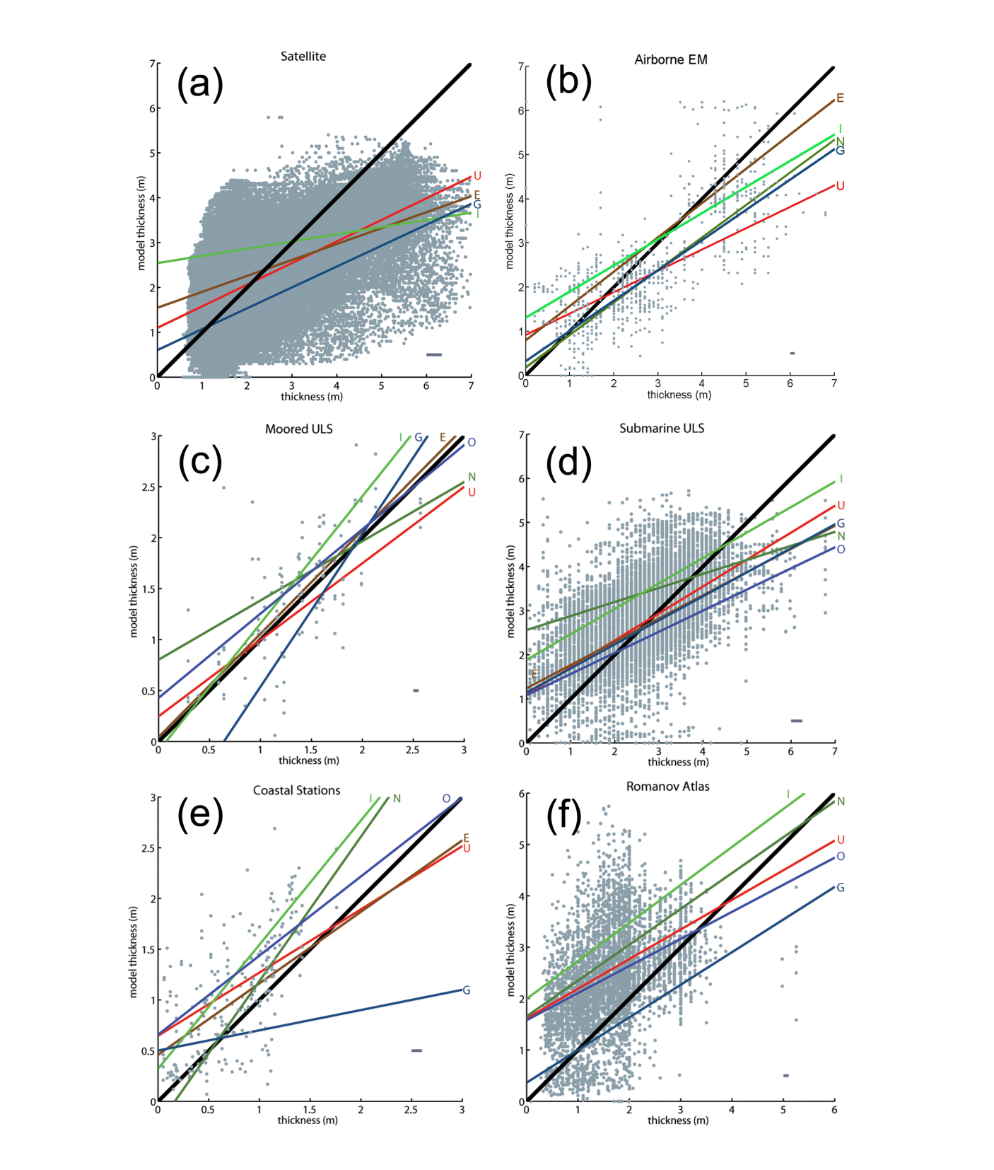
LINEAR REGRESSIONS
32 regressions total
28 have slopes <1
29 overestimate “thin” ice
27 underestimate “thick” ice
y=x crossing at ~2 m (mean)
“thin” < 2m
“thick” > 2 m

Slide 13
Why to the models generally overestimate thin ice?
separate “dynamics” from “thermodynamics” using the coastal stations in “fast ice”
use observed mean monthly air temperatures to compute thermodynamic ice thickness from Zubov’s 1943 formula:
there are 22 cases where observed ice thickness matches Zubov estimate for 3 consecutive months or more
22 cases are from 13 stations, 8 years, and 132 months
22 cases are compared to 6 models

Slide 14
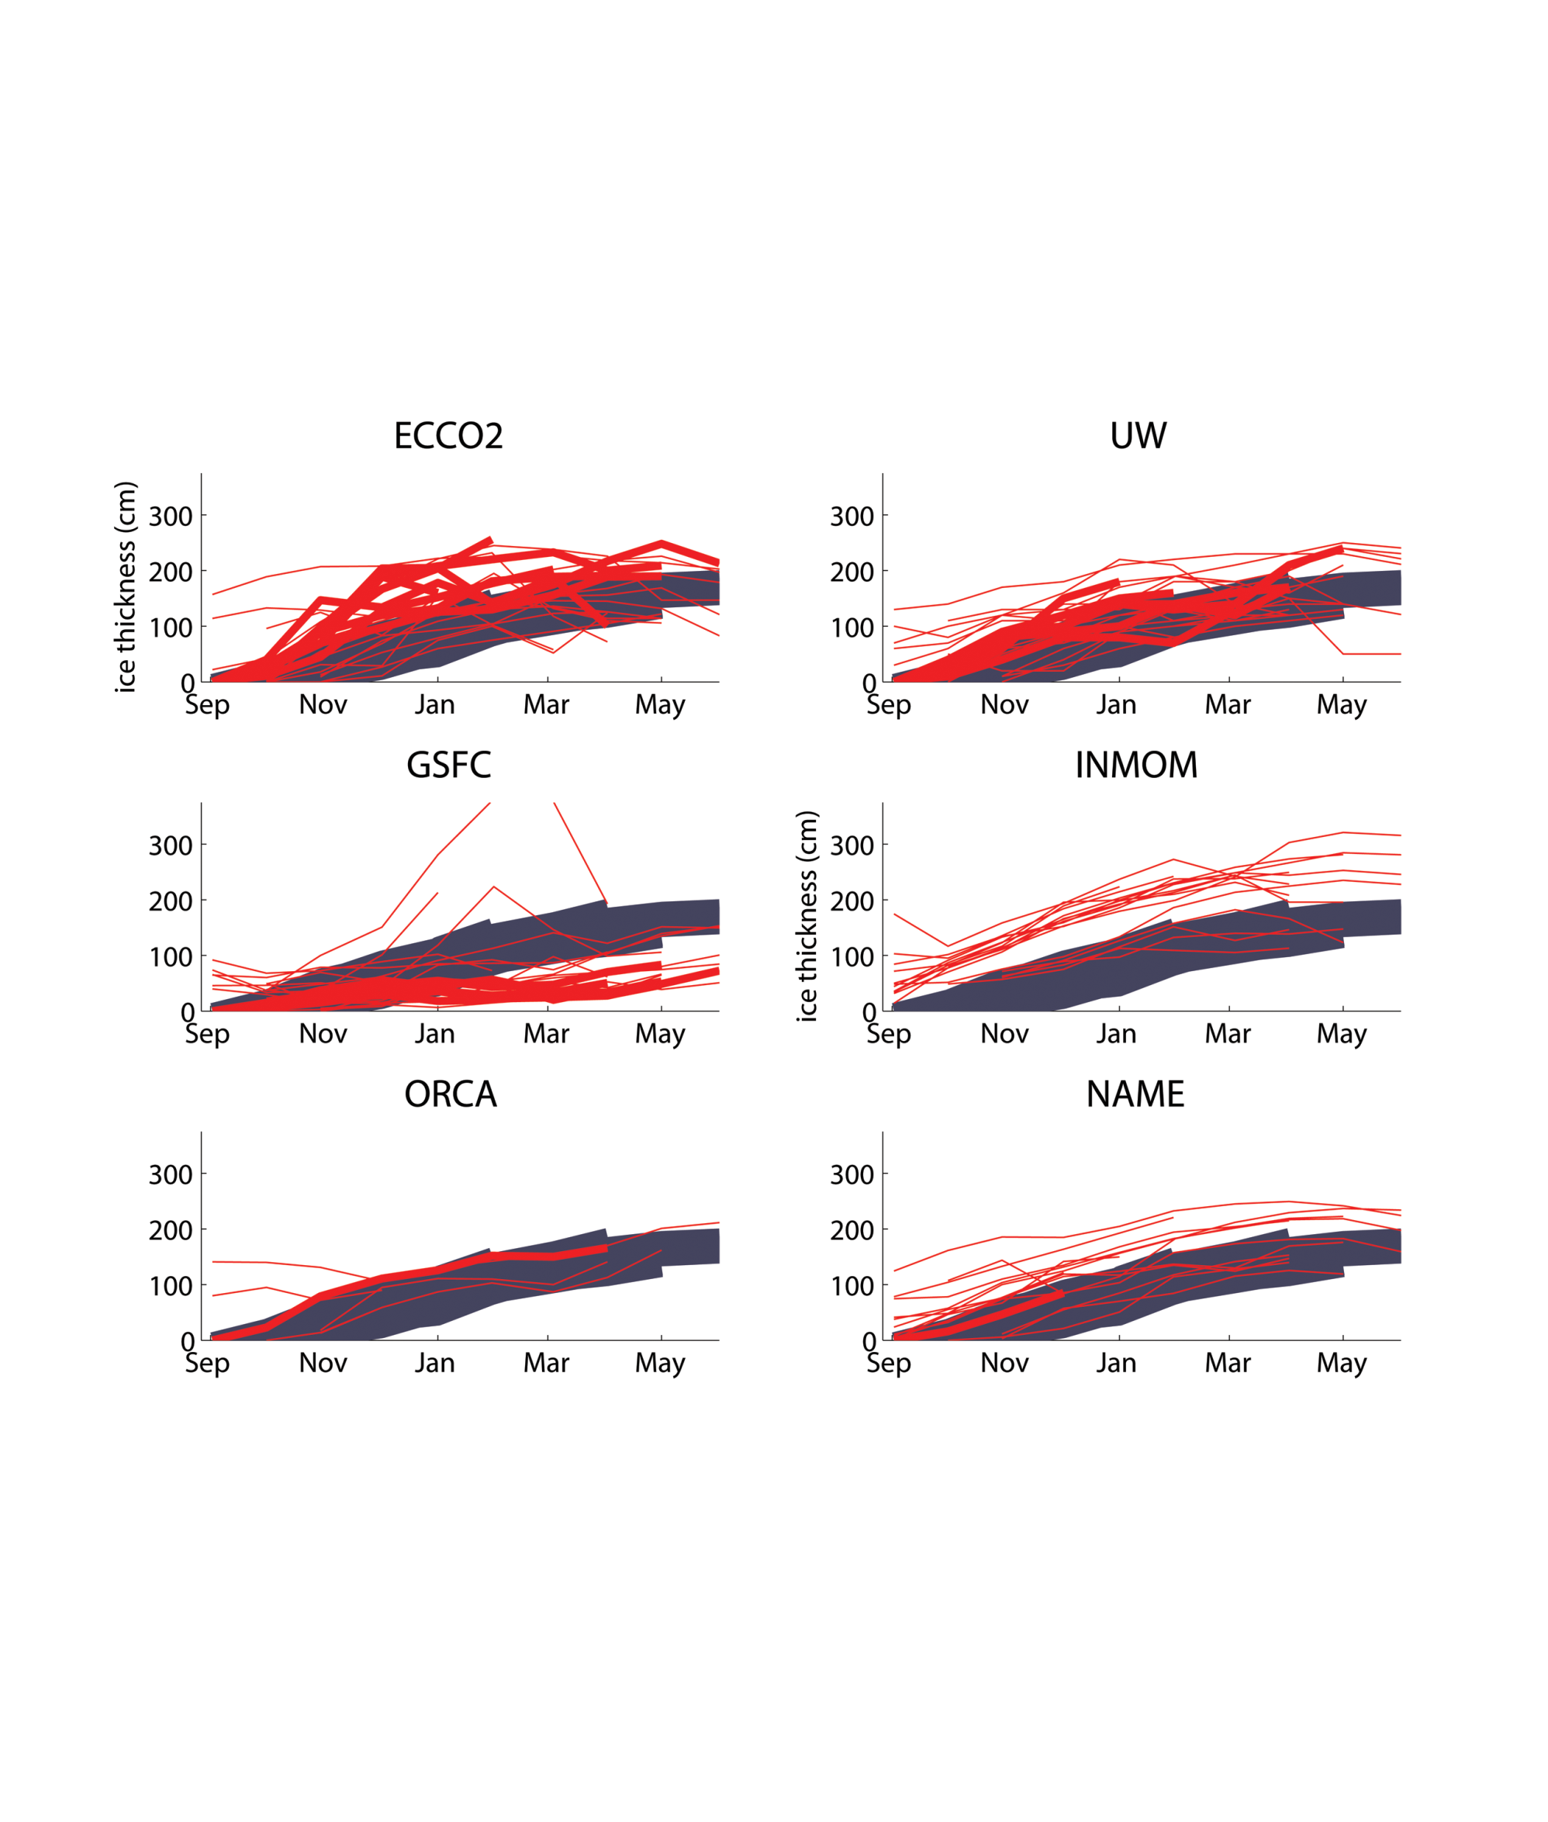
Grey from Zubov thermodynamics
Red from stations where “Zubov” equals observed
Red (thick) where thickness starts at in September

Slide 15
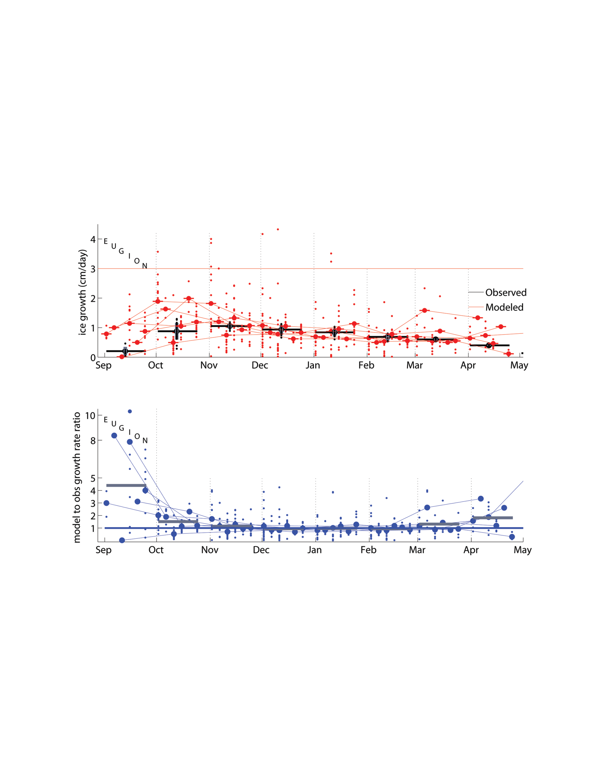
Growth (thickening) Rate
STD of observed (vertical)
Mean of observed
mean ratio from all models is ~4.5
Growth Rate Ratio (model/observed)
Modeled ice “growth” too fast in Sept. and Oct.

Slide 16
Growth (thickening) Rate
Growth Rate Ratio (model/observed)
extreme ratios exceed 8x over observed
Modeled ice “growth” too fast in Sept. and Oct.

Slide 17
Results from ORCA showing decrease of ice thickness after making “fast ice” immobile

Slide 18
Conclusions
Models underestimate ice thicker than ~2 m
Models overestimate ice thinner than ~2 m
overestimate occurs in September and October
thickening due to dynamics
ORCA model experiment making “fast ice” immobile reduces model ice thickness
Sea ice parameterization needs improvement in models
Causes of underestimate of thickness for ice > 2 m is future work

