Slide 1
A 50 year reconstruction of FWF from Greenland Jonathan Bamber, Michiel van den Broeke, Janneke Ettema, Eric Rignot

Slide 2
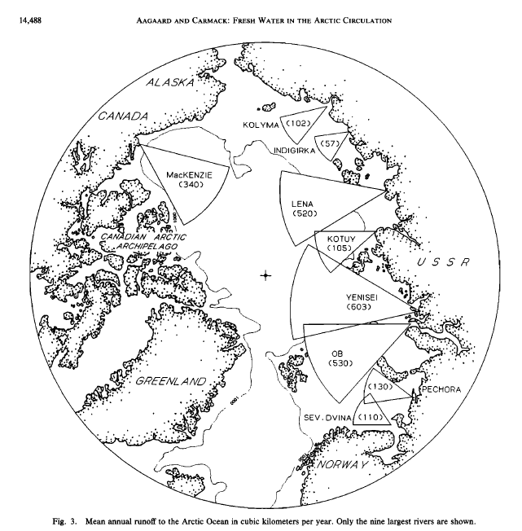
State of the art circa 1990:

Slide 3
What we did:
Two components: runoff (SMB) and discharge (calving, D).
SMB reconstructed using RCM and ERA-40
D reconstructed from observations & extrapolation

Slide 4
Total Fluxes (annual):

Slide 5
Total fluxes (seasonal):

Slide 6
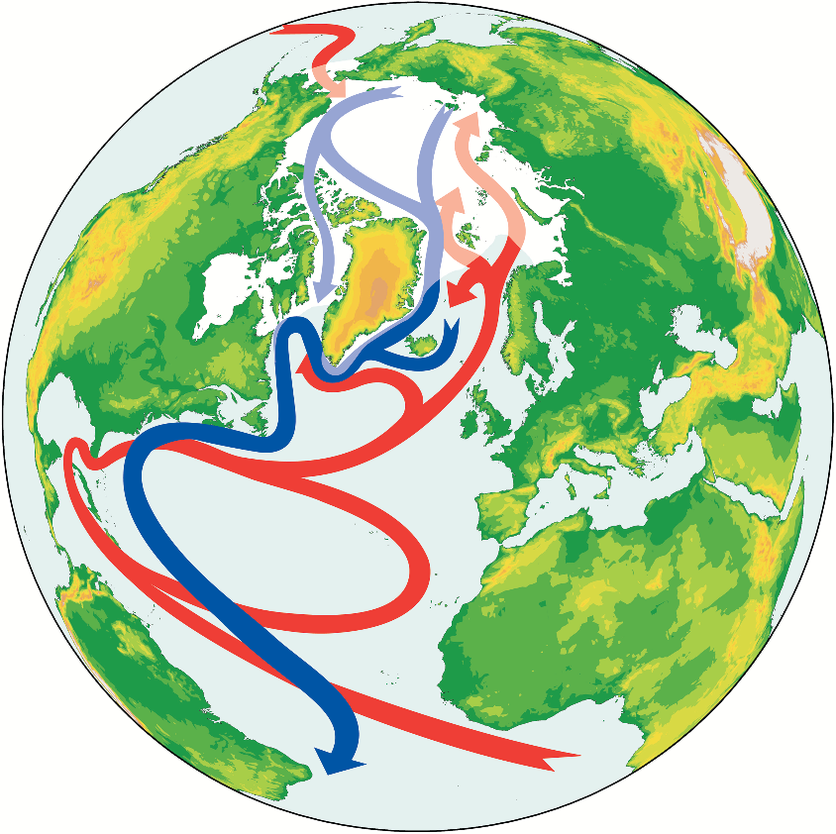

Slide 7
Aargaard & Carmack 1989:

Slide 8
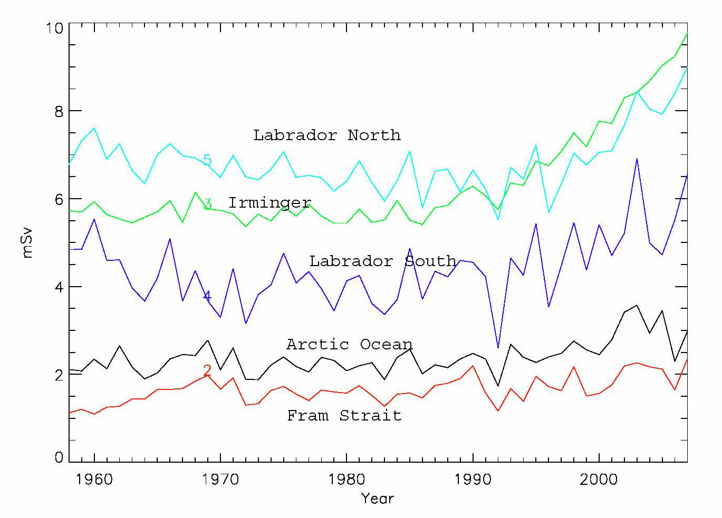
Regional fluxes:

Slide 9
Conclusions
Mean FWF for 1960-1990 22 mSv with no trend
Since ~1996 quadratic increase from equal contribution of D and runoff
Present day flux 30% above climatological mean (~30 mSv)
Rate of increase much higher than river delta
Summer peak around 80 mSv

Slide 10
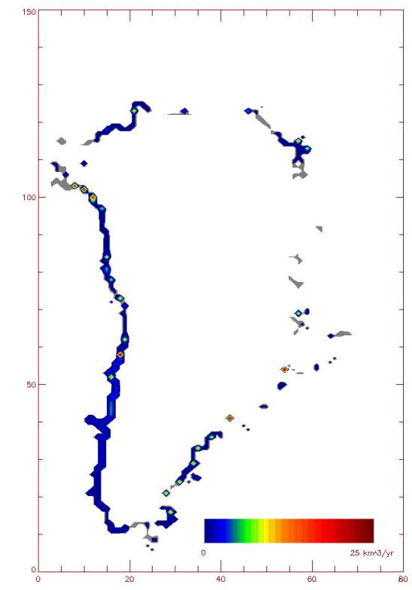
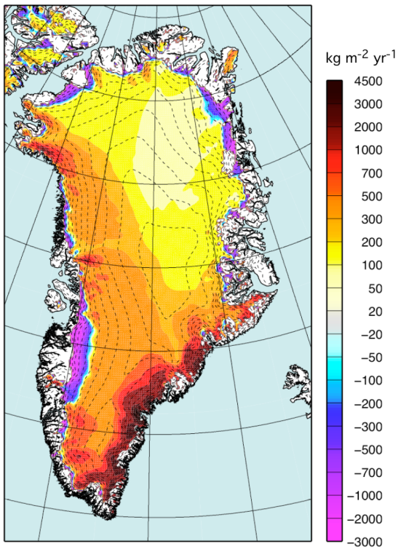
RACMO RCM:
Ettema, J., et al 2009. Higher surface mass balance of the Greenland ice sheet
revealed by high-resolution climate modeling. Geophys. Res. Lett. 36.

Slide 11
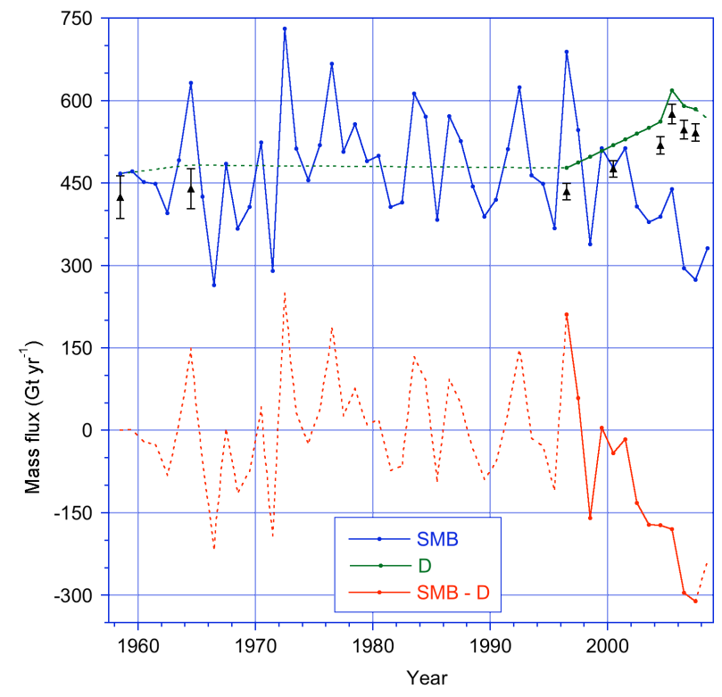
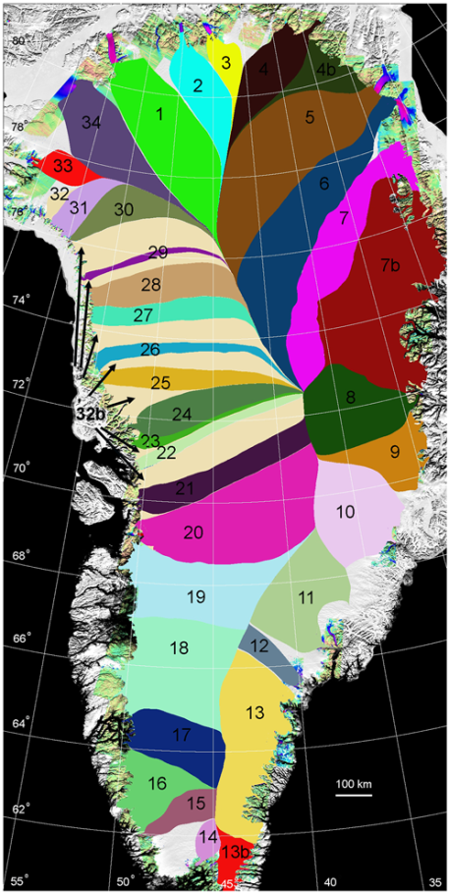
Solid ice fluxes:
Rignot, E., et al. (2008), Mass balance of the Greenland ice sheet from 1958 to 2007, Geophys. Res. Lett., 35(20).

