Slide 1
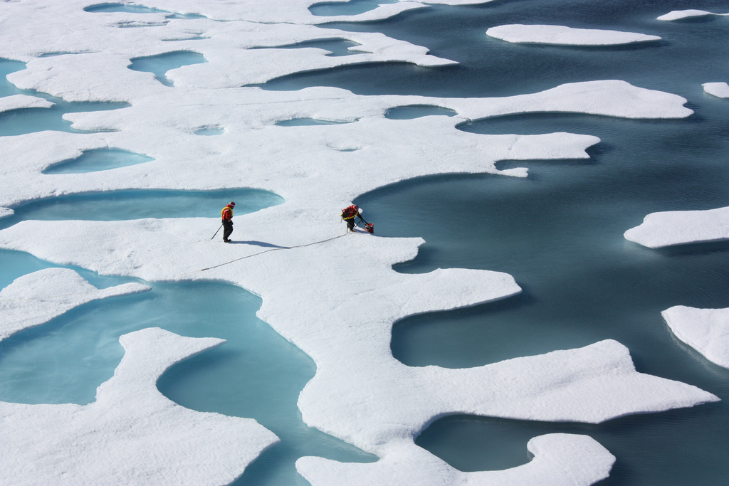


Spatial and temporal evolution
of melt pond area and depth based on Arctic sea ice simulations from 1990 to 2012
David Schroeder Daniel Feltham Daniela Flocco
Department of Earth Sciences
University College London
Centre for Polar Observation and Modelling
(NASA image acquired July 12, 2011)
Notes:
Snow and ice melts; melt water accumulates to ponds; impact on albedo; not represented in any GCM

Slide 2
GCM-compatible melt pond model
g₁
Ice thickness distribution
g₂
Fractional
Area
g₃
g₅
g₄
Sea ice topography
Thickness
Height and depth distribution functions
h_{sl}
α
Reference height
β
Flocco and Feltham, JGR, 2007
Flocco et al., JGR, 2010, 2012
Notes:
Developed pond model for climate simulations; Basic idea: melt water accumulates on ice of lowest height. ITD based on Rothrock, Lipscomp
We assume each thickness class is in hydrostatic equilibrium and measure alpha and beta with respect to a fixed reference height.

Slide 3
Melt pond parameterization features
Melt water collects on ice of lowest height.
Hydrostatic balance is maintained throughout.
Vertical drainage calculated by Darcy’s law with a variable permeability.
Melt water is transported as a tracer on each thickness class.
Melt water is lost during ridging.
Melt water is lost if ice area decreases due to melting.
During refreezing, a pond lid forms that grows/melts at each time step.
ice lid growing downwards
“trapped” melt pond

Slide 4
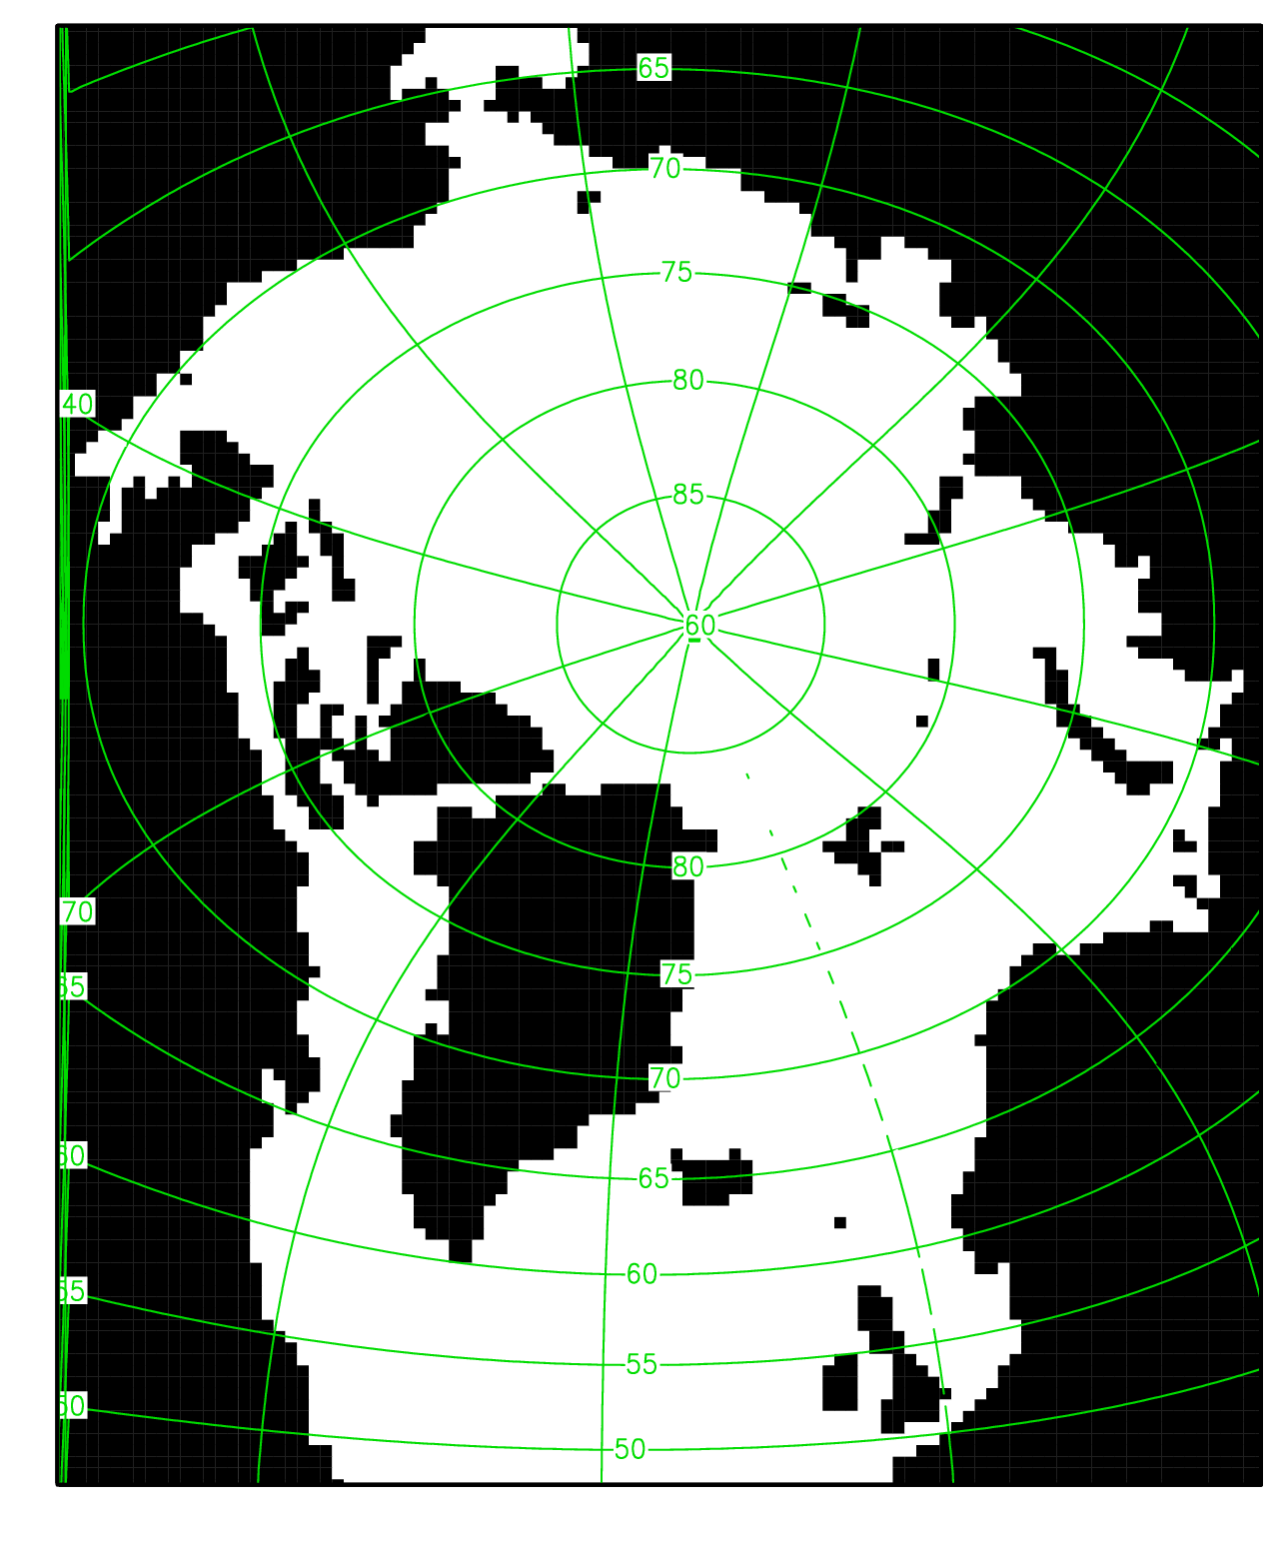
CICE simulation with our pond scheme
Stand-alone
Arctic domain (40 km)
          Spun up from 1980-1989
          Analysed from 1990-2012
Atmosphere:
  T2m, q2m (6-hourly)
  u10m, v10m (6-hourly)
  QLW, QSW (daily)
  PRECIP, SNOW (monthly)
  (ERA-Interim with T2m (-1.5K) , q2m corrections following Dussin and Barnier, 2012 (DRAKKAR DFS5)

Slide 5
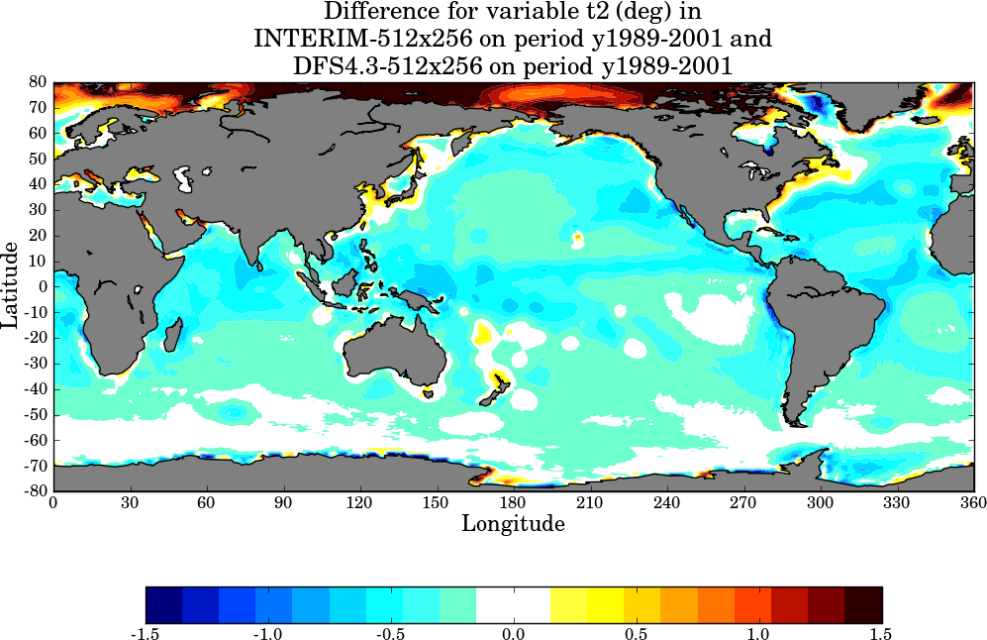
Dussin and Barnier, 2012, DFS5 report
corrections are based on the POLES monthly climatology for air temp.

Slide 6
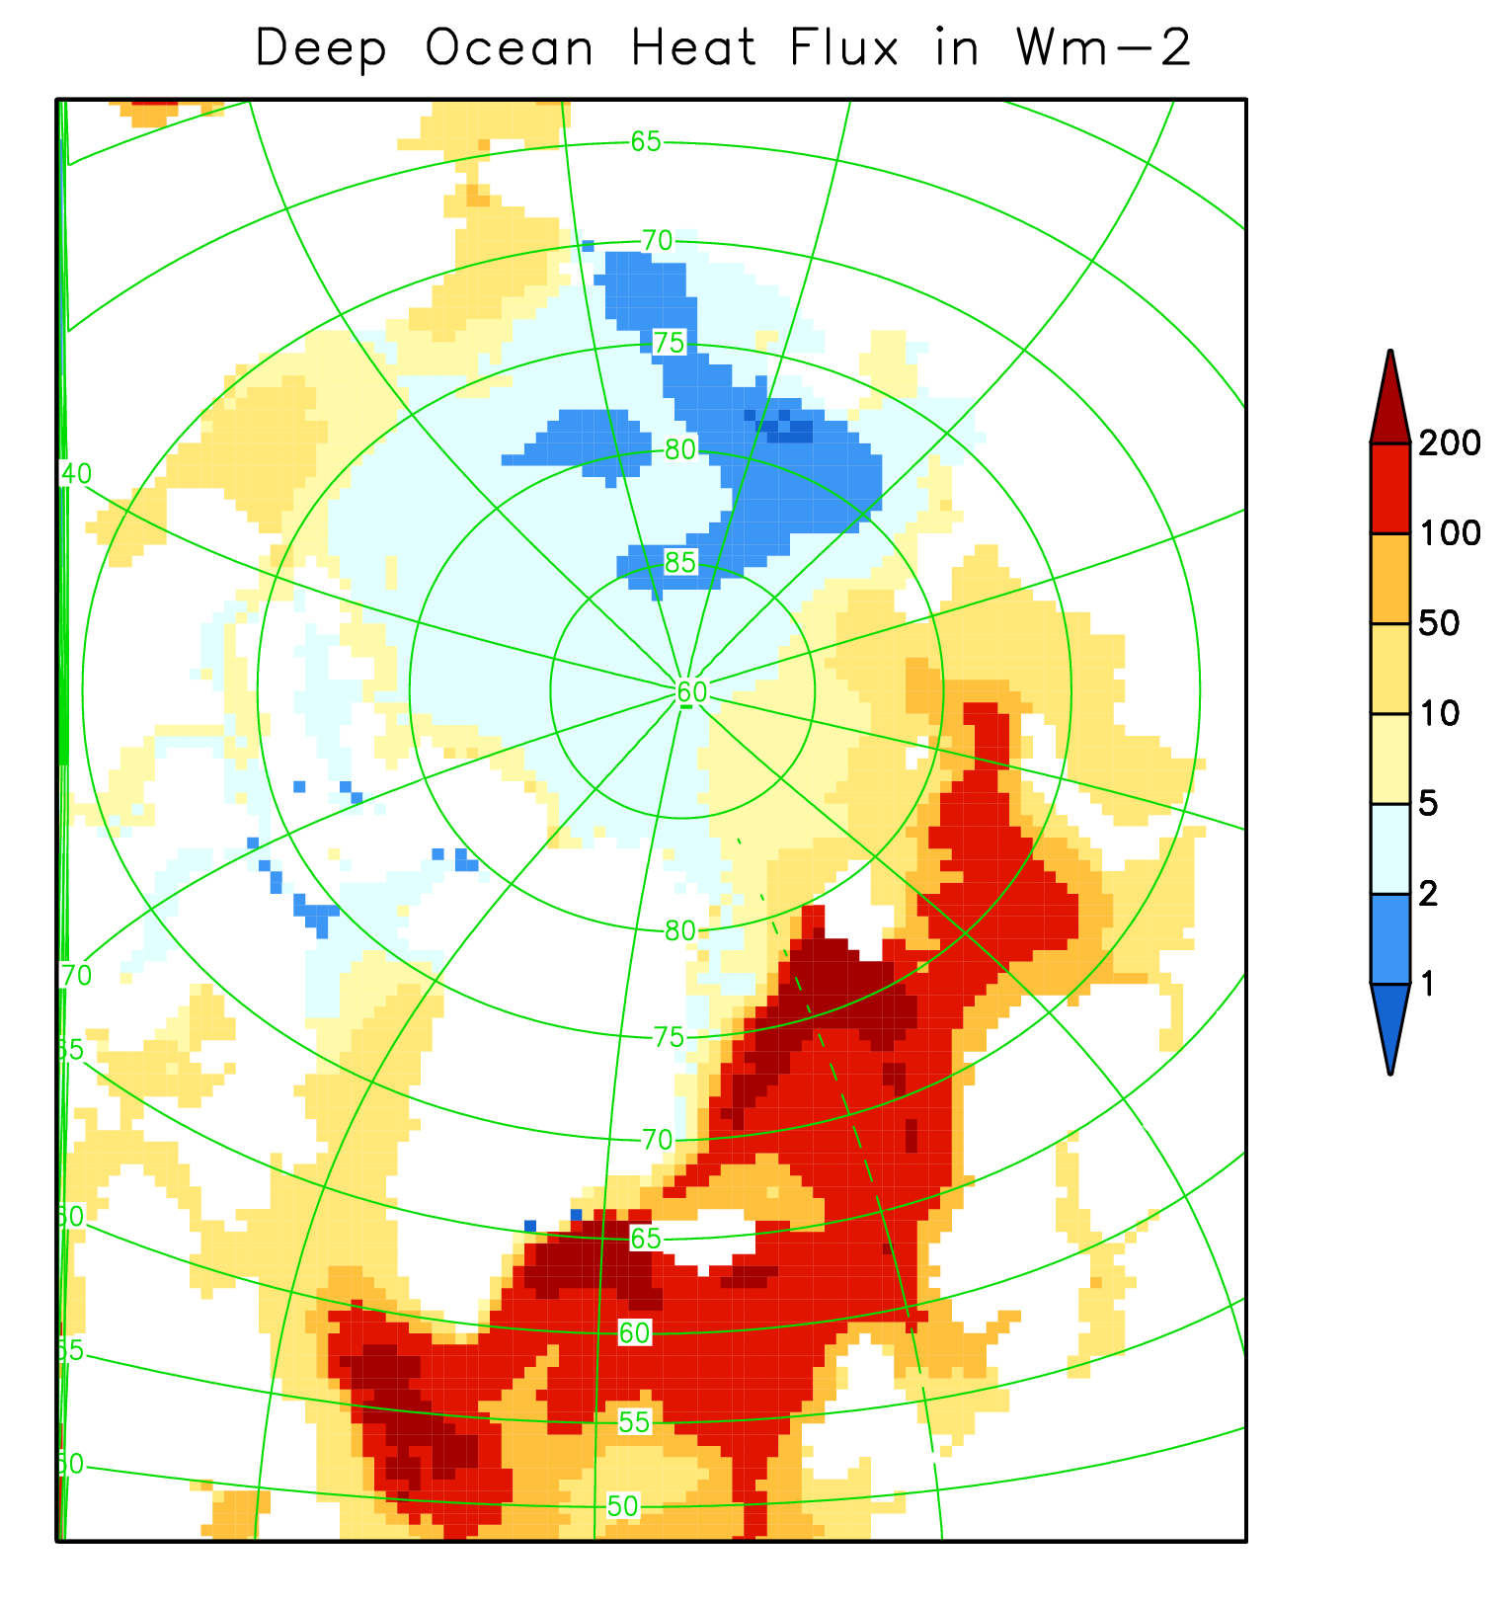
CICE simulation with our pond scheme
Mixed-layer ocean
(depth = 20 m)
SSS prescribed (monthly
clim. means – ReAn,
Ferry et al., 2011)
Deep Ocean Heat Flux
prescribed (monthly clim.
means – CCSM3,
Collins et al., 2006)
Ocean currents
  prescribed (monthly clim.
  means – ReAn,
  Ferry et al., 2011)

Slide 7
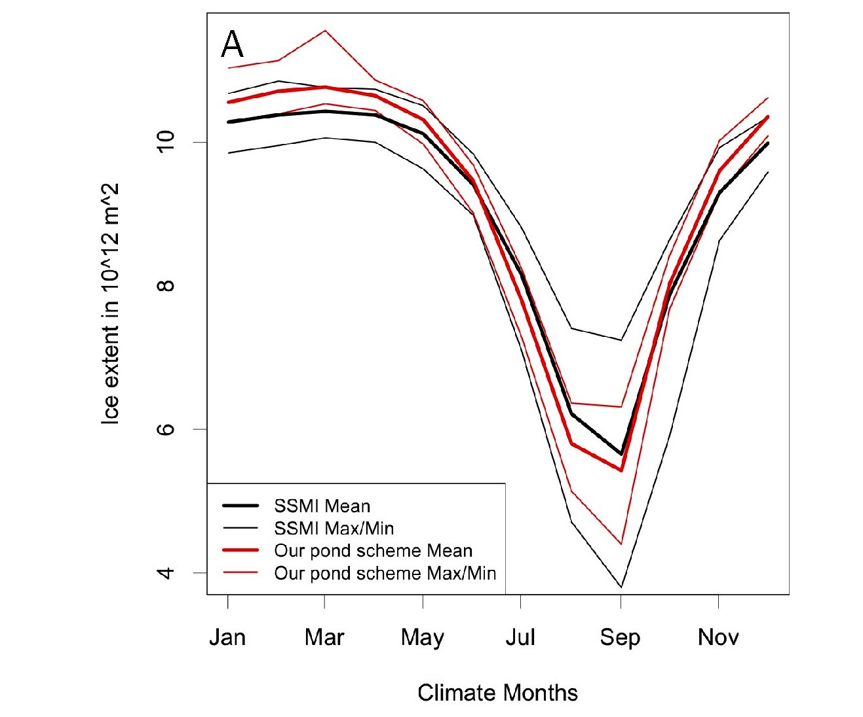
Flocco, Schroeder, Feltham,
Hunke,
JGR 2012
Mean annual cycle of sea ice extent realistically simulated

Slide 8
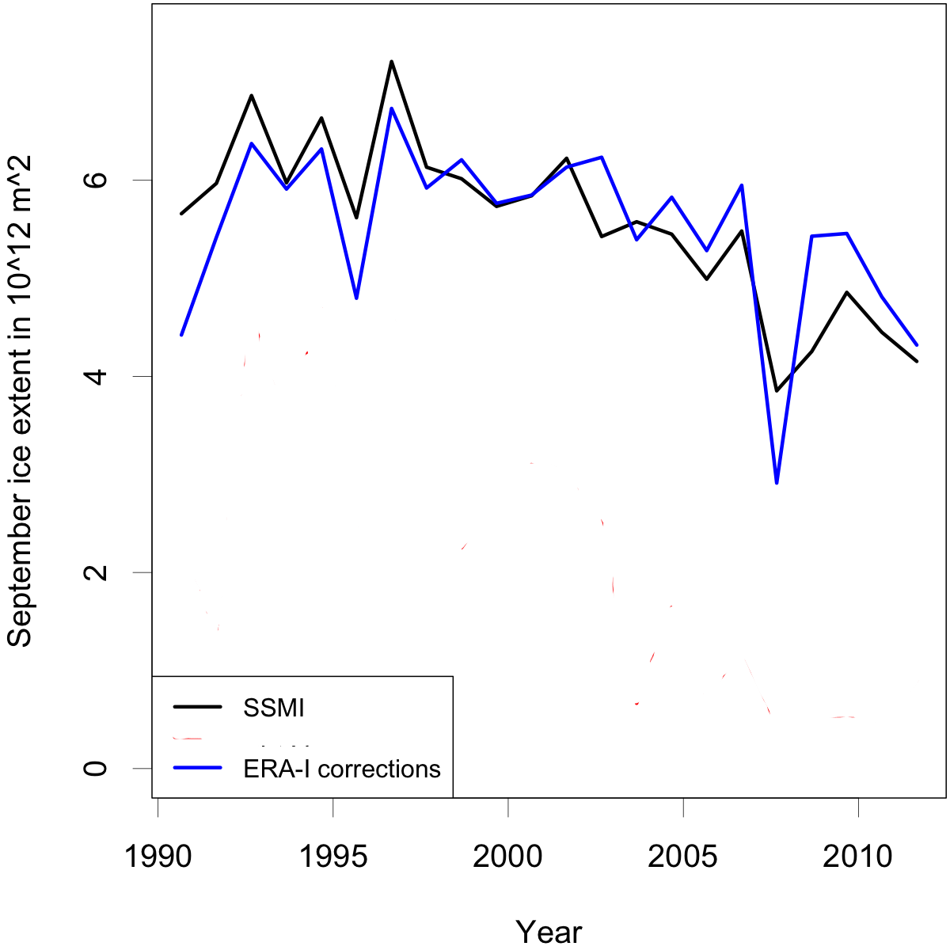
Variability and trend of September ice extent realistic

Slide 9
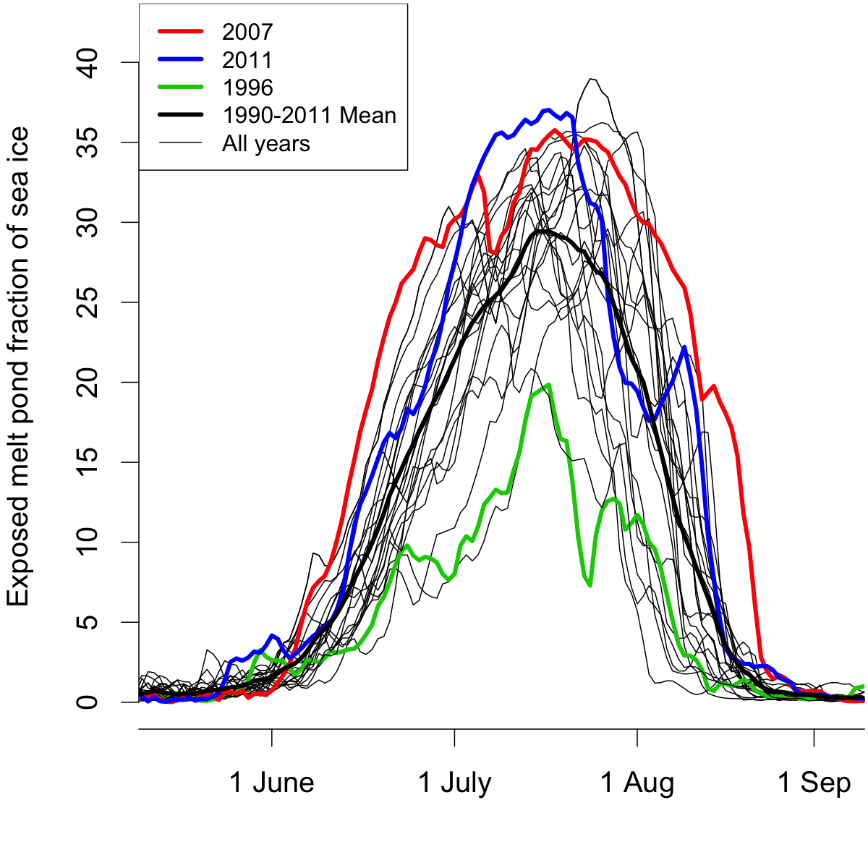
Low summer ice extent (2007,2011):
Large pond area
Large summer ice extent (1996):
Small pond area

Slide 10
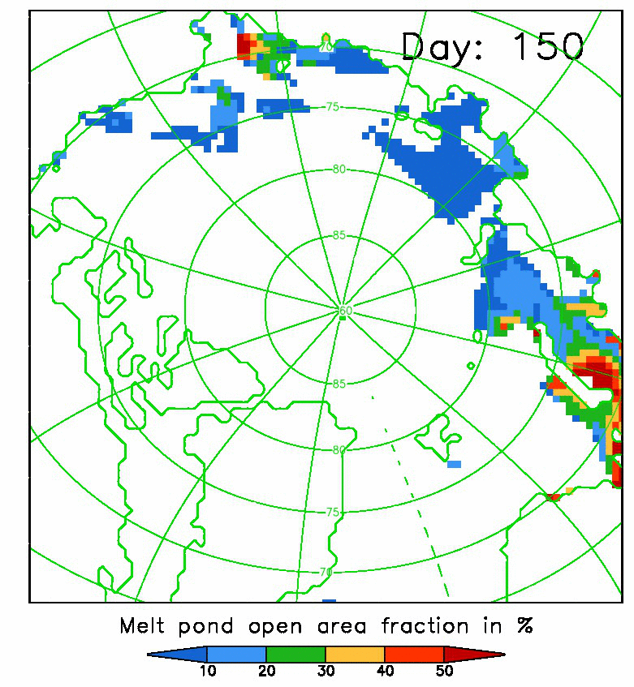
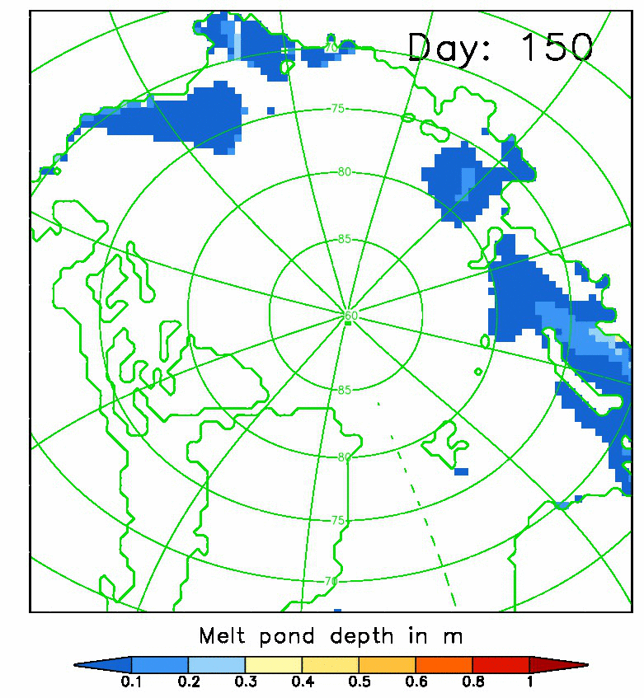
Melt pond area and depth
30th May (Day 150) – 18th August (Day 230) 2011
Notes:
MAX pond area in Eastern Arctic, narrow band in Canadian Arctic, MAX pond depth over thicker ice with small area fraction, white areas (<1%, covered with ice lid)

Slide 11
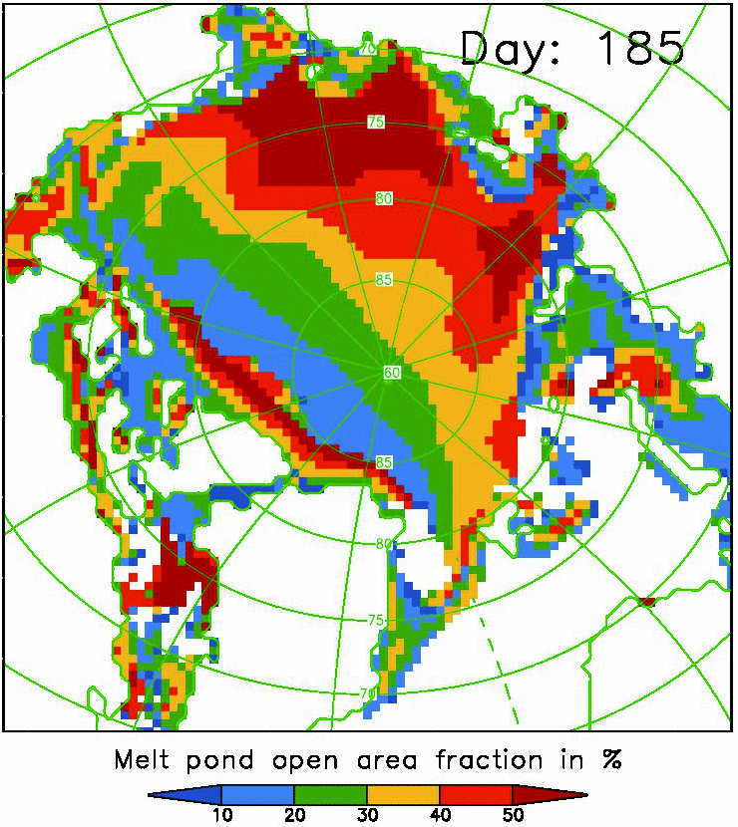
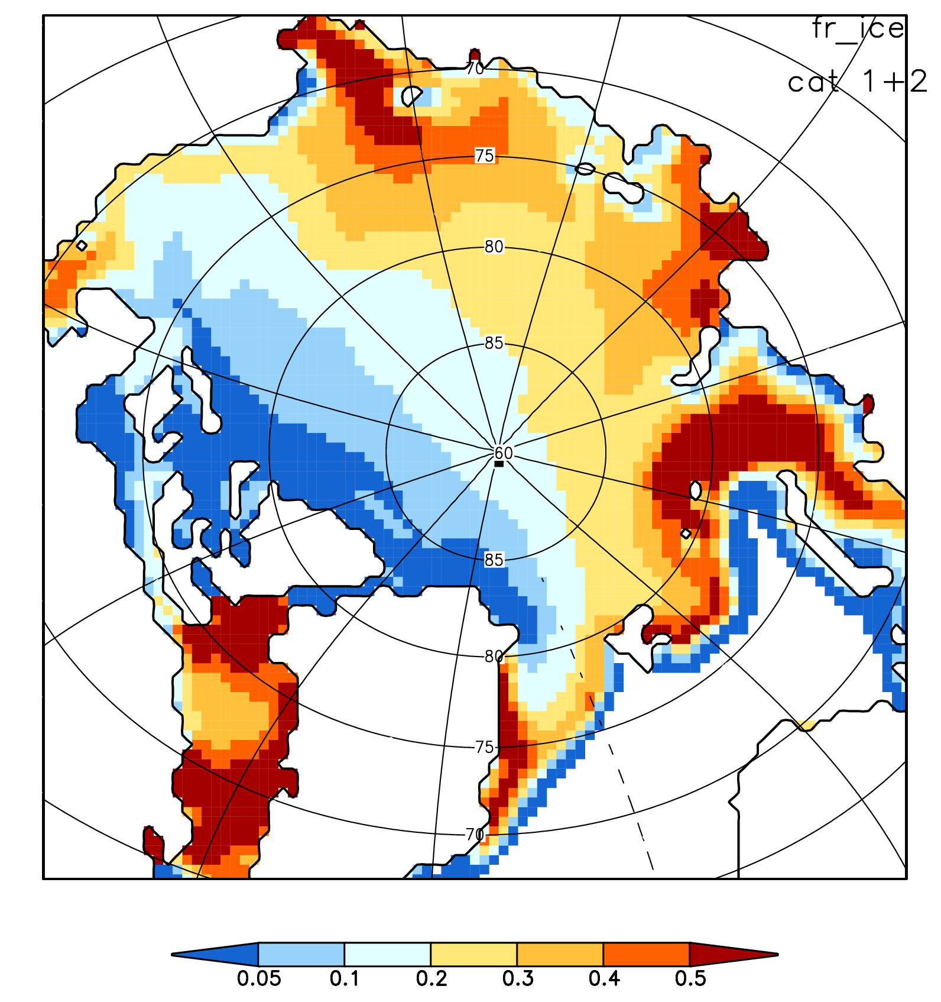
Melt pond area 3rd July 2011
Ice area (h< 1.4m) June 2011
Ice thickness distribution has strongest impact on pond distribution

Slide 12
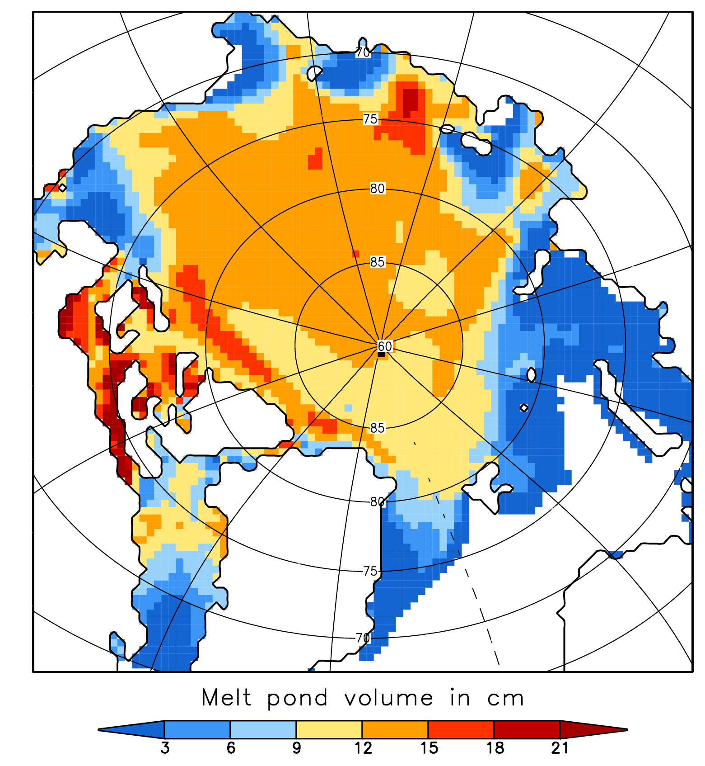
Melt pond area 3rd July 2011
Melt pond volume July 2011
Available amount of meltwater not responsible for spatial variability

Slide 13
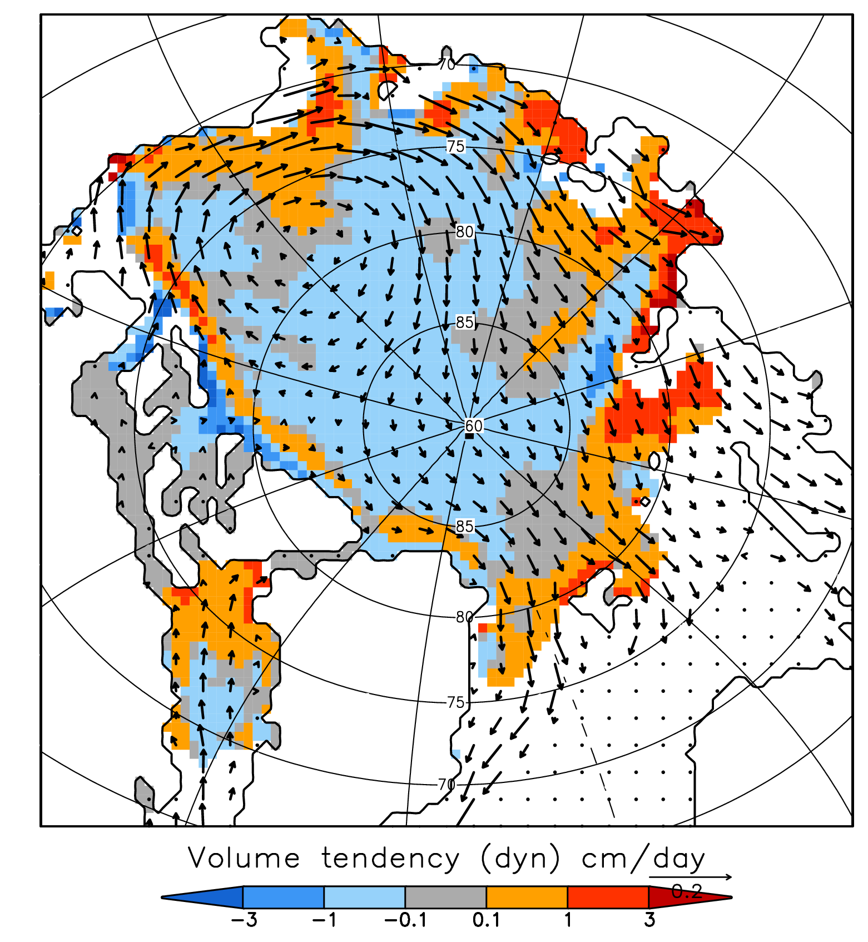
Melt pond area 3rd July 2011
Ice transport June 2011
Ice transport causes narrow band of high pond area

Slide 14
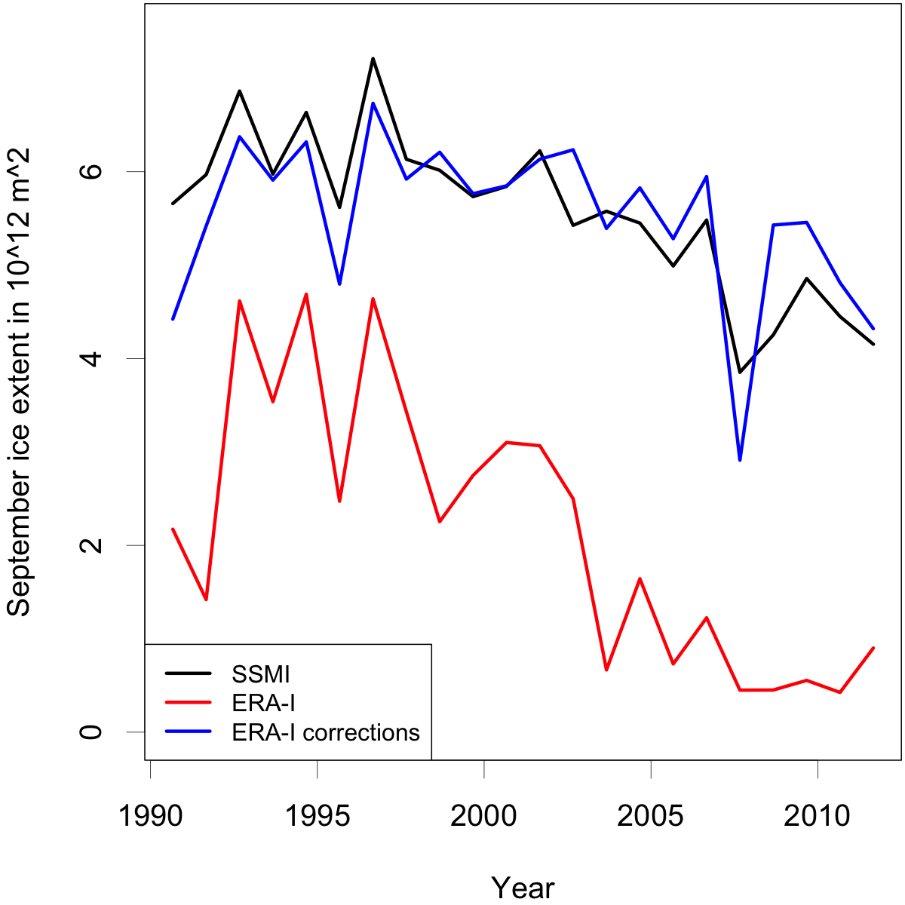
Increase of Tair by + 1.5 K removes up to 90% of September ice extent
Notes:
Increase of Tair of 1.5K removes up to 90% of summer ice extent
All following figures from the ERA-I corrections run

Slide 15
Conclusions
CICE with our melt pond scheme is able to simulate Arctic sea ice evolution realistically (stand-alone)
Low September Arctic ice extent coincides with large summer melt pond fraction and vice versa (in agreement with findings from Roesel and Kaleschke based on MODIS satellite data)
Ice thickness distribution determines the distinct spatial pond distribution (only our pond scheme accounts for this)
Our melt pond scheme is implemented in main CICE branch

Slide 17
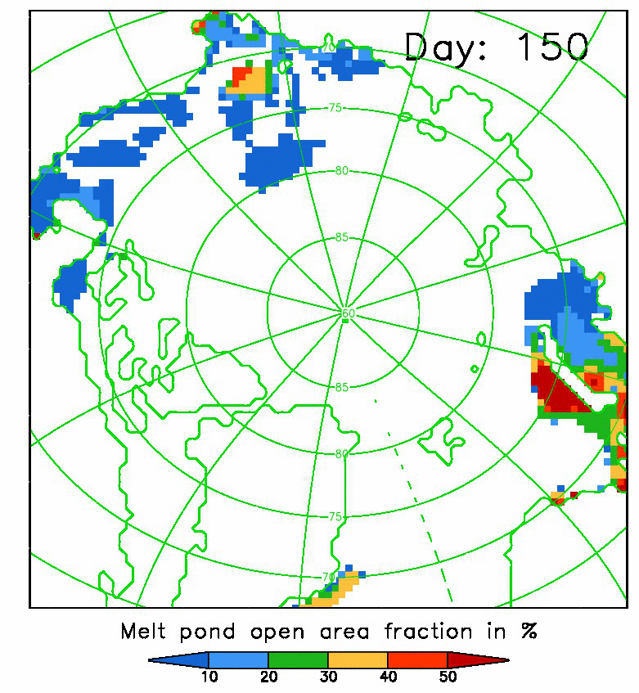
Melt pond area
30th May (Day 150) – 18th August (Day 230)
2011
1996
Notes:
1996: hardly any open pond area in inner Arctic: low meltrate, frequently covered by lid

Slide 18
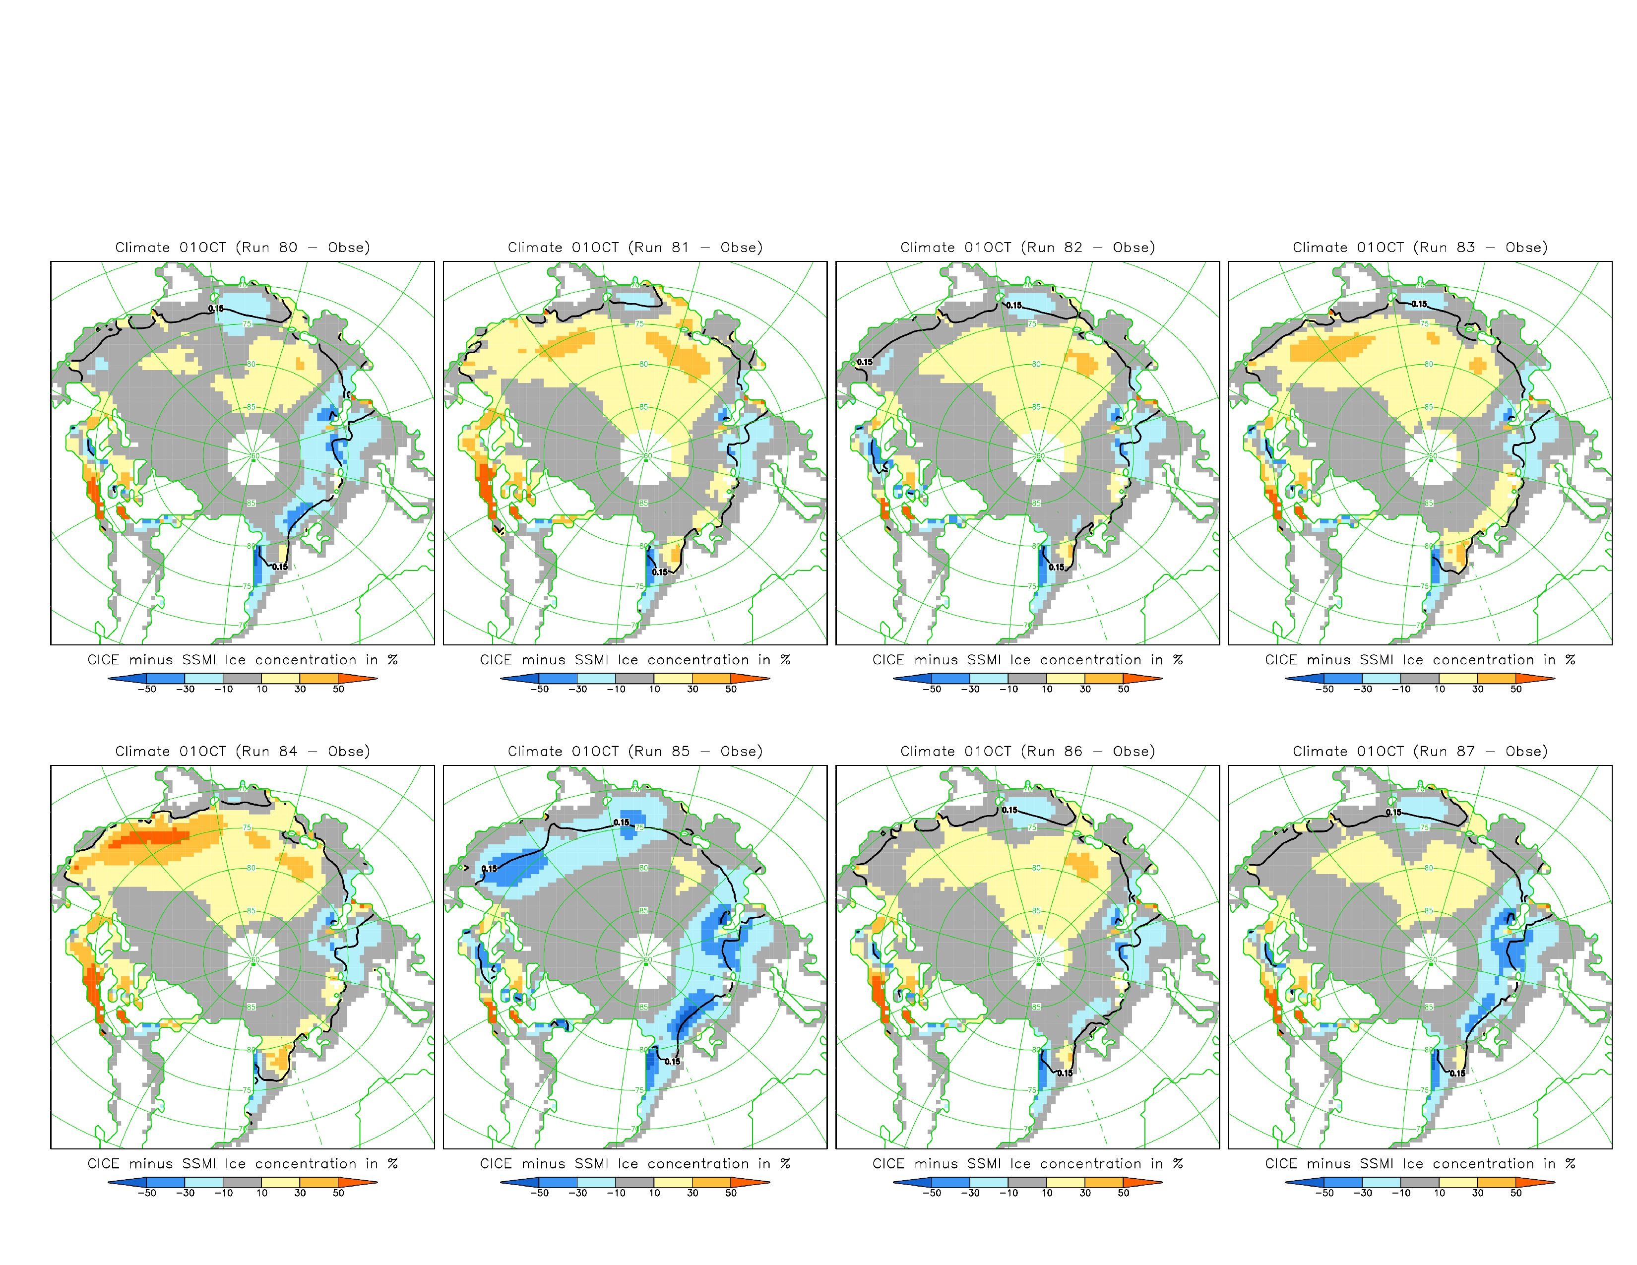
Climatological September ice concentration: CICE minus SSM/I
Our pond scheme
No ponds
Including ponds improves
model match with SSM/I.
Our pond scheme which
Is not tuned does a similar job to empirically-tuned melt pond schemes (Bailey, CCSM).
An advantage of our
model is that it can account for future changes in ice cover type (e.g. more FYI).
Bailey
CCSM
Bailey

Slide 19
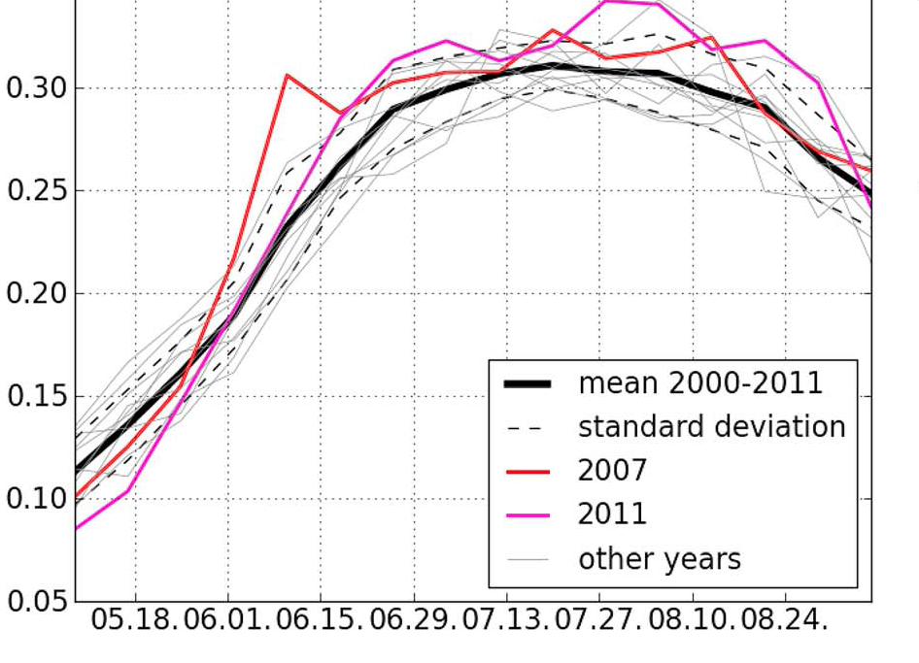
CICE
based on MODIS satellite data
Agreement with
respect to mean Arctic maximum pond area of 30 %
Roesel and Kaleschke, JGR 2012

Slide 20
