Slide 1
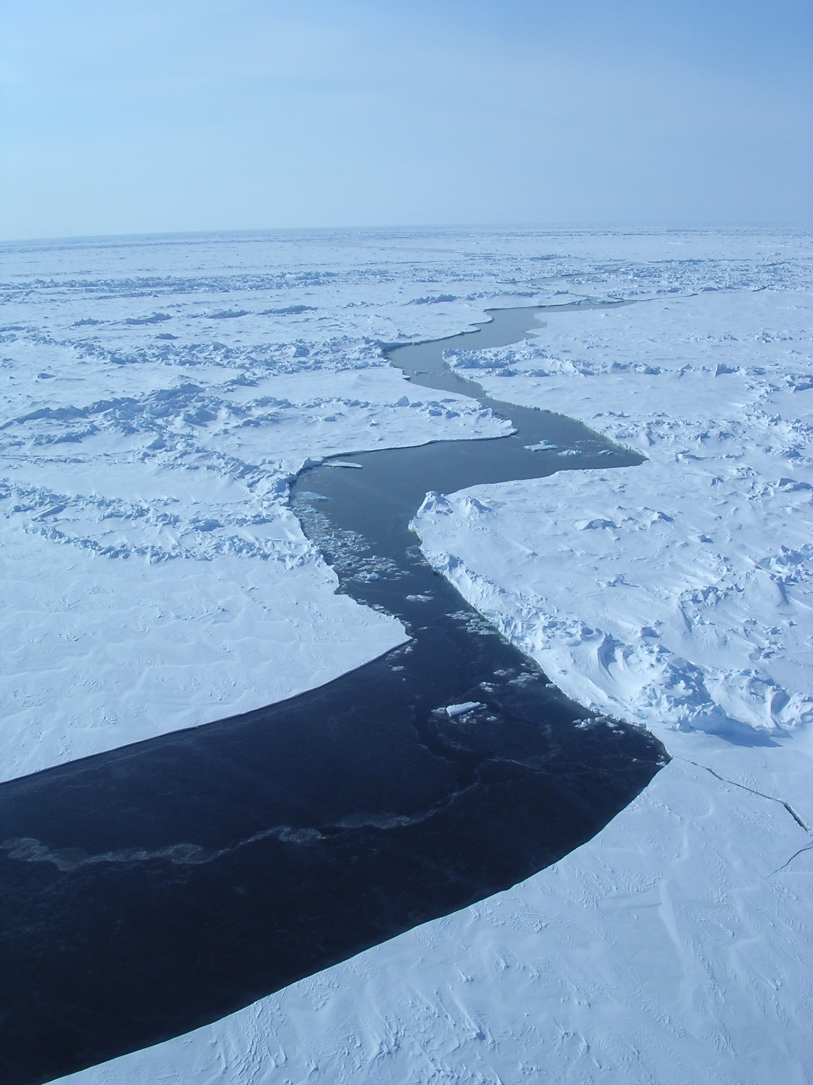
Mixed Layer Depth
in the Arctic Seas
Michael Steele
Wendy Ermold
Jinlun Zhang
Polar Science Center
Applied Physics Laboratory
University of Washington

Slide 2

What controls
Primary Productivity? i.e., growth of phytoplankton
Michael Steele
Polar Science Center / APL
University of Washington
Light
Nutrients
Heat?
...not as much
(“cold adapted”)

Slide 3
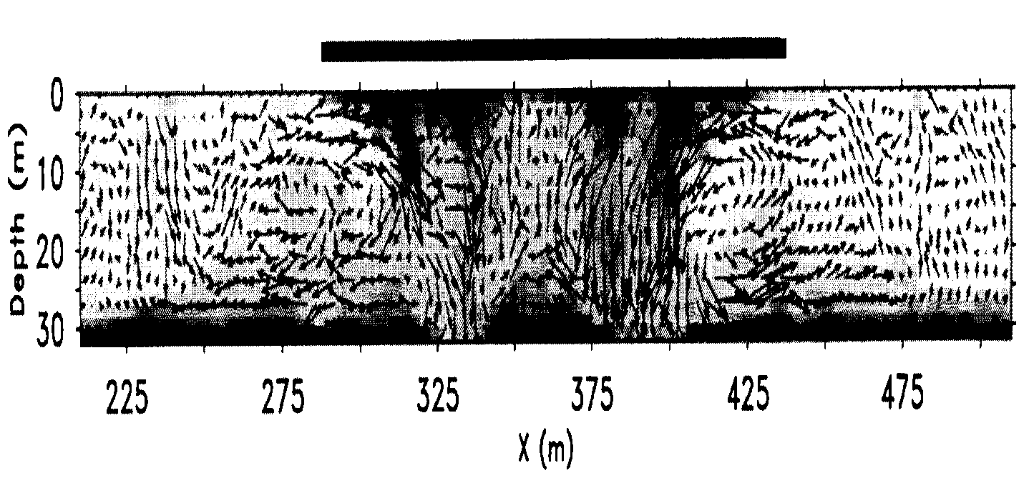


Phytoplankton & the Upper Ocean
Michael Steele
Polar Science Center / APL
University of Washington
light
lead
deep MLD:
light deficit?
shallow MLD:
nutrient deficit?
nutrients
nutrients
Skyllingstad & Denbo, 1998
Upper ocean stratification!
…MLD…
Dylan the Arctic Diatom

Slide 4
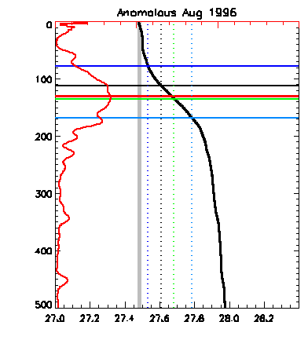
Def’n: Mixed Layer Depth
Michael Steele
Polar Science Center / APL
University of Washington
MLD ≡
Max
“gradient method”
…less common:
  requires smoothing
  more complicated
  etc
∂σ_{θ}
∂z
Δσ_{θ} = 0.05
0.125
0.2
0.3
∂σ_{θ}
∂z
σ_{θ}
Depth (m)
⟨σ_{θ}⟩_{0-10m}
2) ⟨σ_{θ}⟩_{0-10m} + Δσ_{θ}
“increment method”
…more common:
  easier!
Sigma-theta (kg/m³)

Slide 5
Data Sets
Michael Steele
Polar Science Center / APL
University of Washington
WOD’05
  Original profile data
    (averaged into monthly ave.
    50 km bins, vertically smoothed)
      → poor winter, central Arctic Ocean coverage
PHC 3.0
  Monthly gridded, smoothed climatology
    (inputs: “Levitus”, “EWG”, BIO data)
      better Arctic Ocean coverage
PIOMAS
  Jinlun Zhang’s ice-ocean model
    (2000-2007 output)
      excellent coverage everywhere!

Slide 6

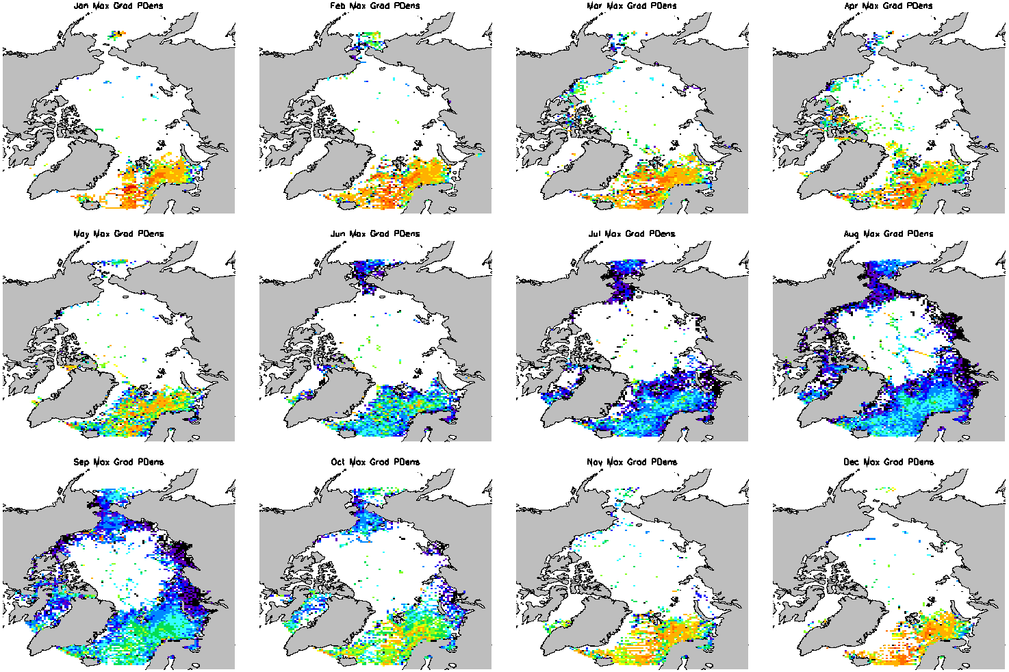
WOD Gradient Method MLD
10 15 20 30 40 60 80 100 250 500 750
(m)
jan
feb
mar
apr
deep!
may
jun
jul
aug
sparse!
shallow!
transition
sep
oct
nov
dec
transition

Slide 7
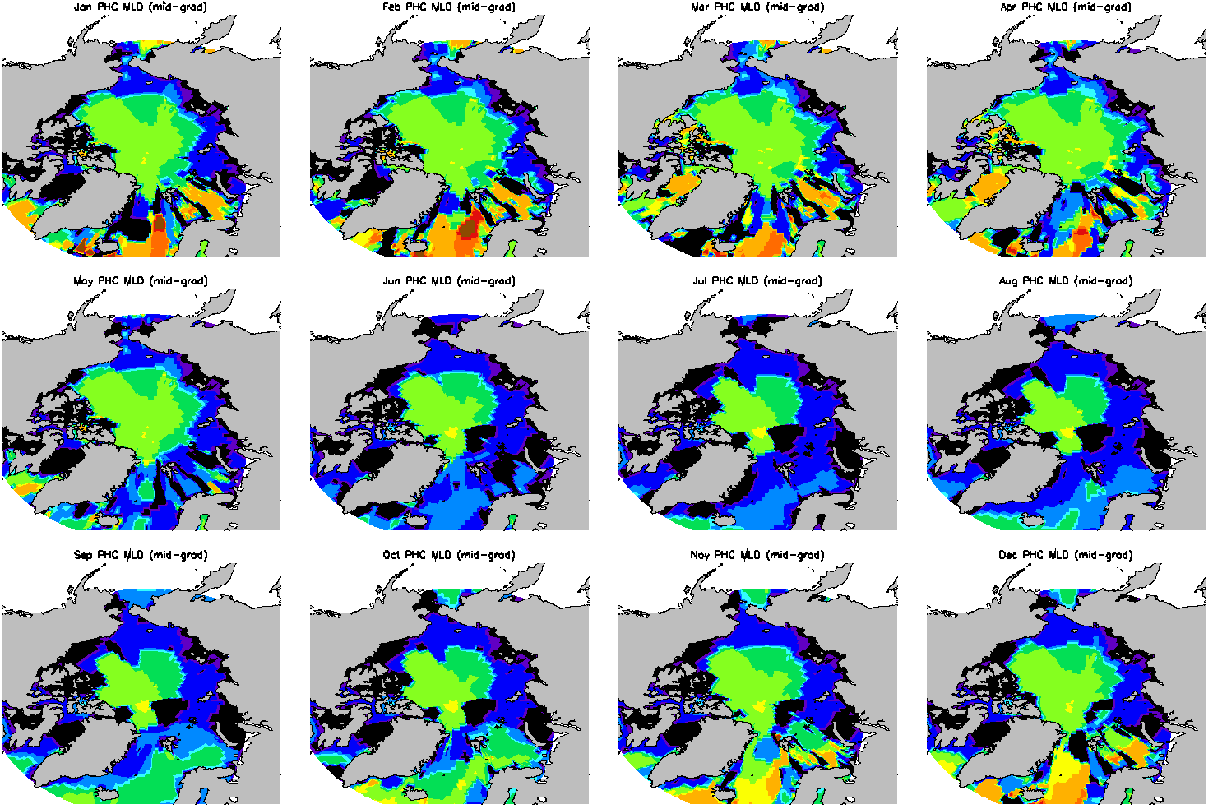
PHC Gradient Method MLD
EWG version
10 15 20 30 40 60 80 100 250 500 750
(m)
PHC ≅
EWG (Arctic Ocean)
BIO data (winter E. Canada)
Levitus “WOA” (elsewhere)
EWG
“The moth”
“Barents Badness”
Levitus

Slide 8
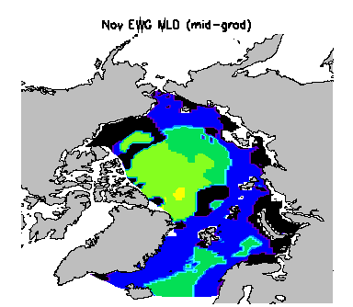
EWG Gradient Method MLD
Too shallow throughout winter…

Slide 9
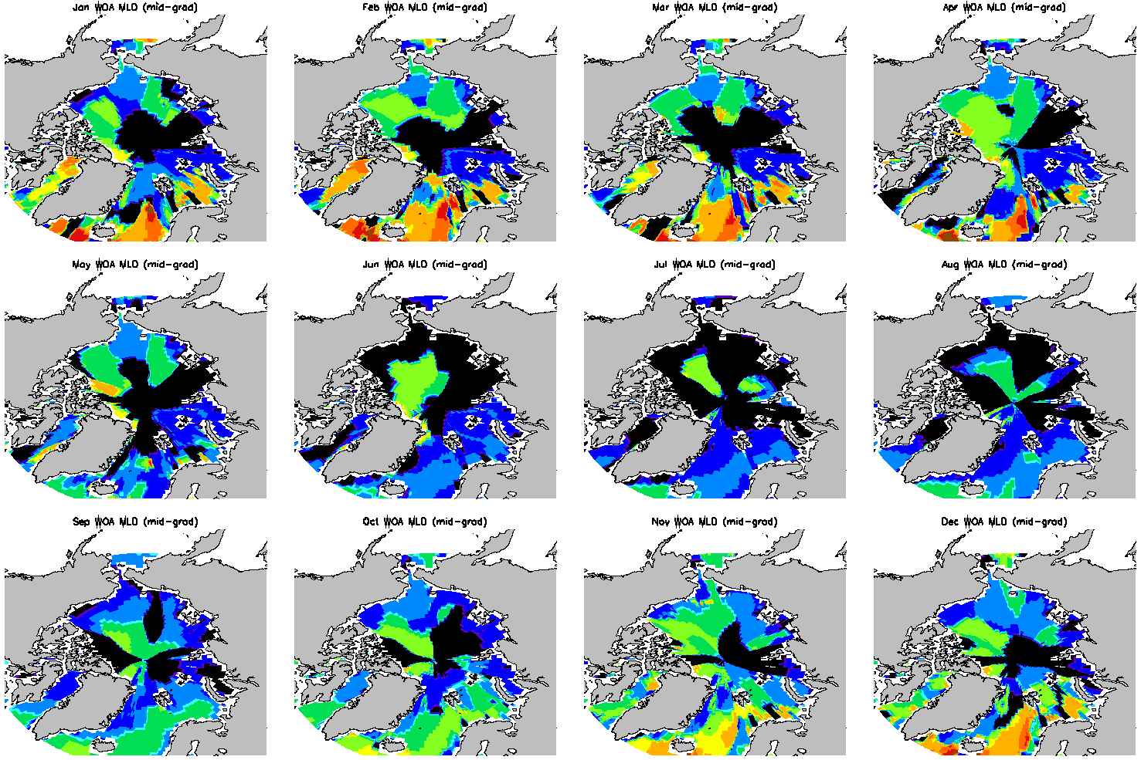
“Levitus” WOA05 Gradient Method MLD
North Pole madness

Slide 10
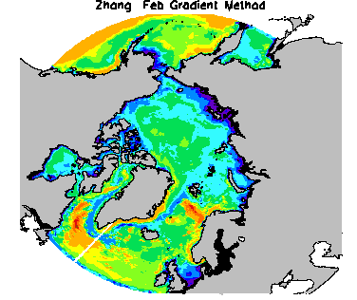
PIOMAS Gradient Method MLD
10 15 20 30 40 60 80 100 250 500 750
(m)
feb
Deep central Greenland Sea MLDs only in March & April
Late GIN Sea transitions
  “spring”: June
  “fall”: December
EGC
MIZ?
WSC?

Slide 11
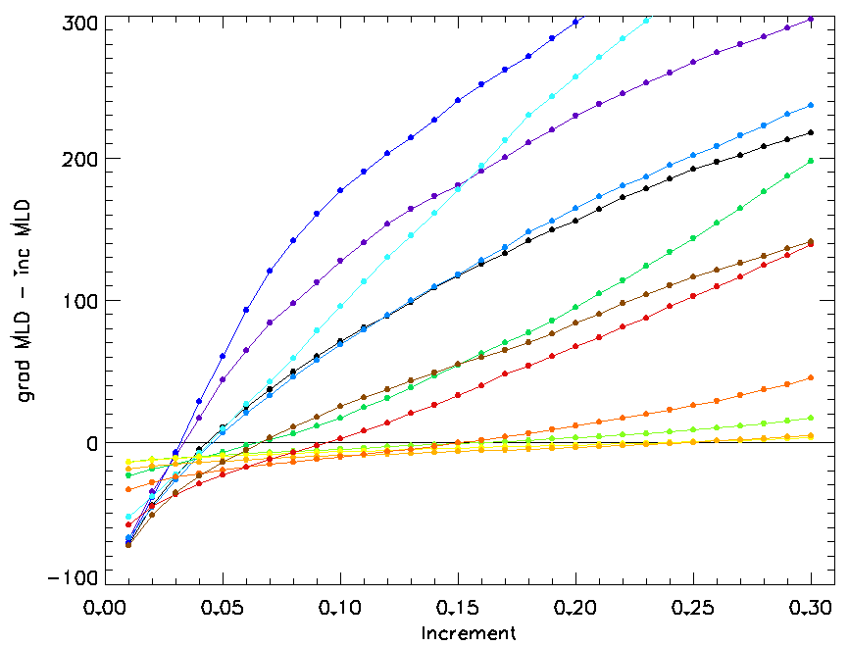
Finding the “Optimal Δσ_{θ}”
for the Increment Method
…assuming gradient method
is correct but undesirable
Mar
May
Feb
Apr
Jan
Total Domain:
MLD gradient - MLD increment (m)
Dec
Jun
Nov
Oct
Jul
Aug, Sep
fall,
winter,
spring
summer
(kg/m³)

Slide 12
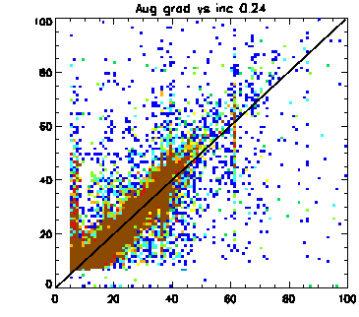
# of WOD obs
Gradient method:
quantized!?
bottle data
Increment Method MLD (m)
MLD
Gradient Method MLD (m)
…same for climatologies &
model output…

Slide 13
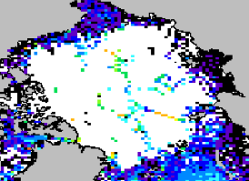
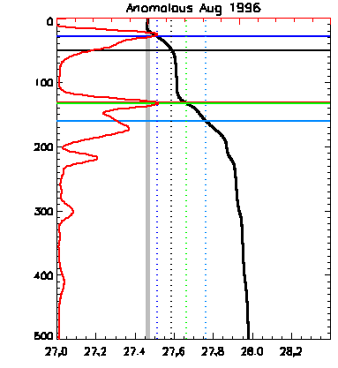
Gradient Method Pathologies
WOD:
Deep MLD in August
∂σ_{θ}
∂z
σ_{θ}
Gradient method finds winter MLD!
…but it’s not so bad…

Slide 14
Next Steps
Can we blend WOD + PHC/model to get an “optimal MLD” over the entire region?
Model MLD intercomparison:
  Climatological monthly mean 3D T & S output
Interannual variability/trends?
Time for a movie?!

