Slide 1
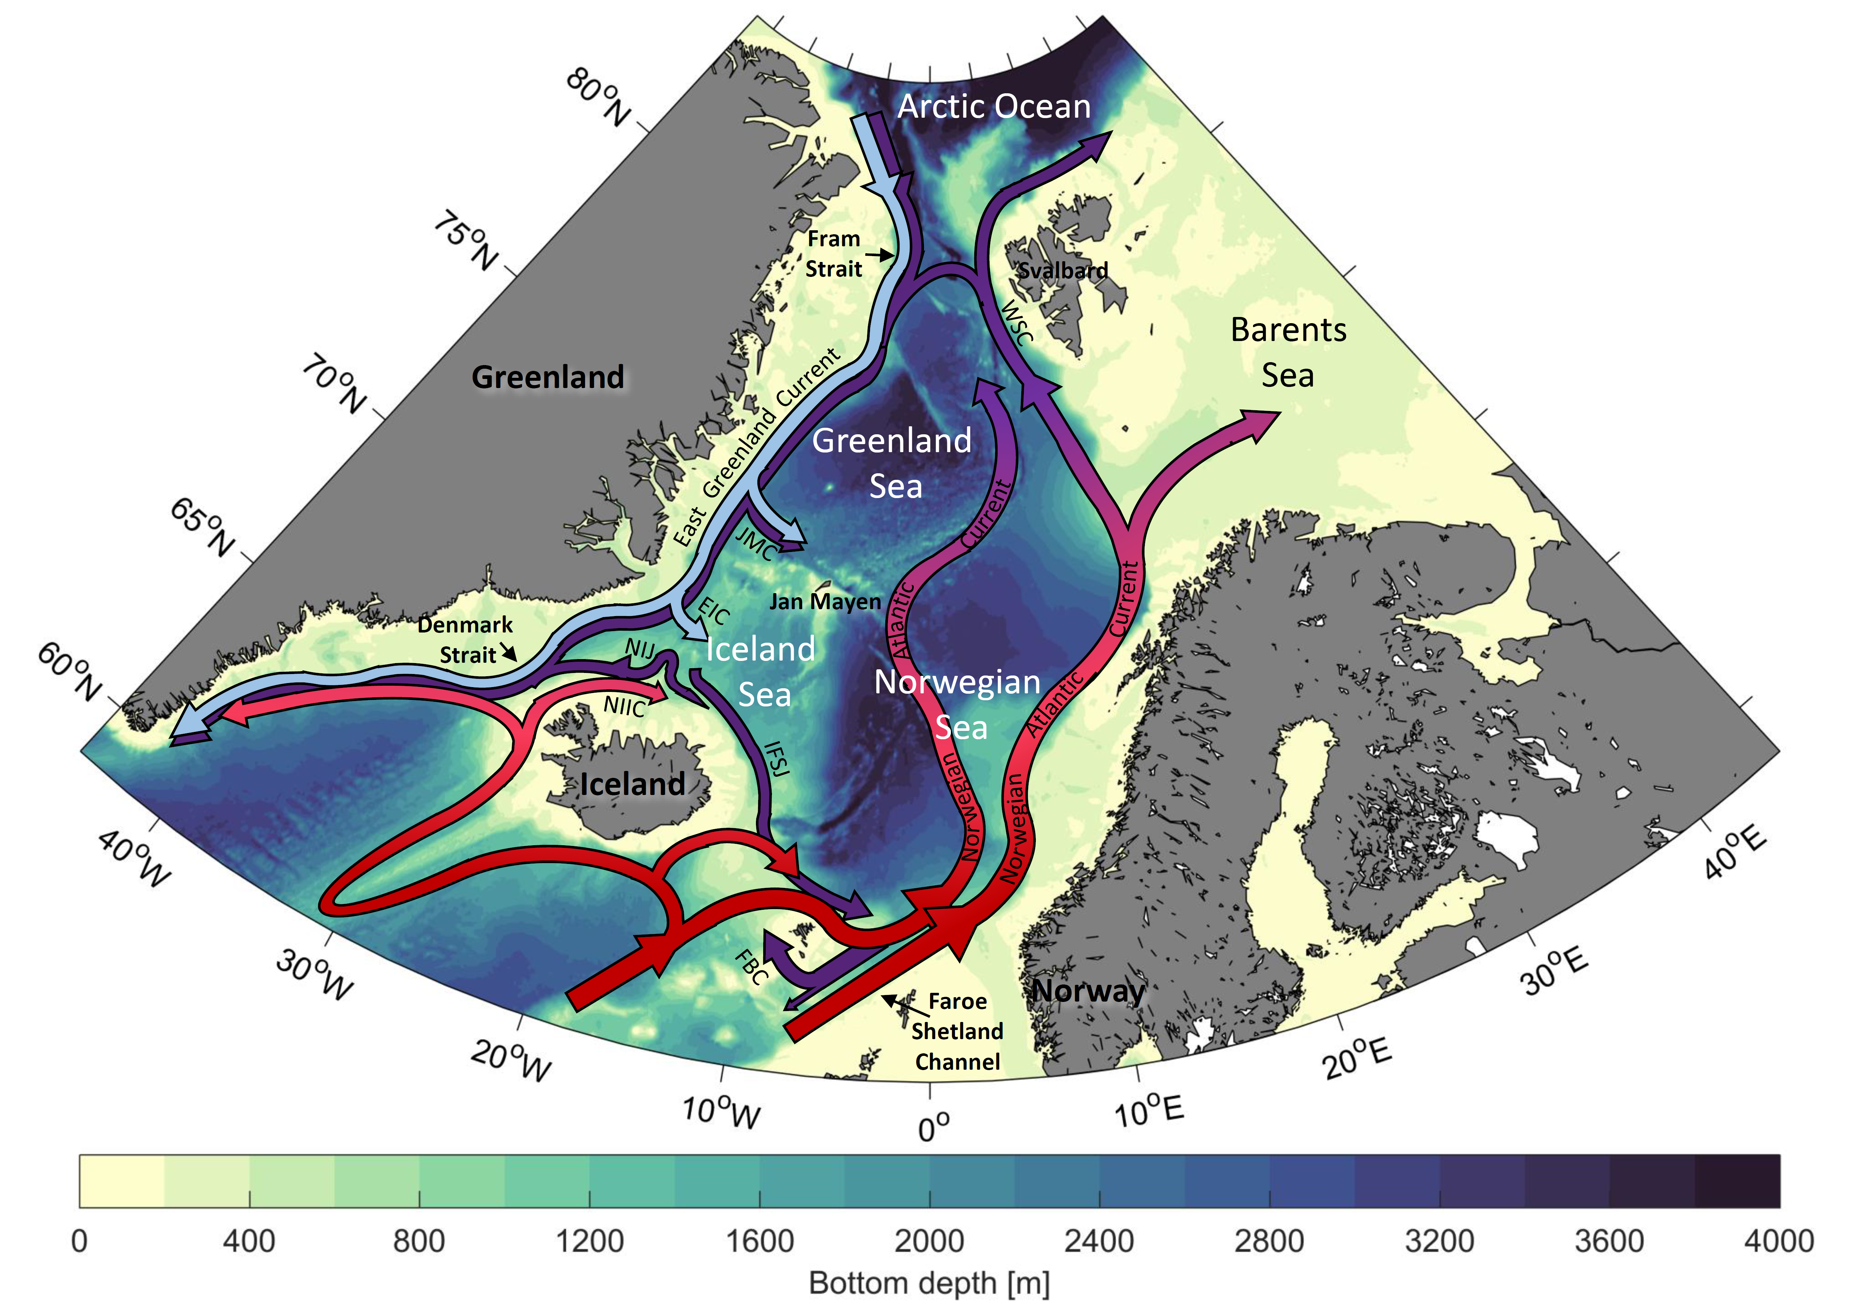
Formation and pathways of dense water in the Nordic Seas from a steady-state inversion
Ailin Brakstad
Geoffrey (Jake) Gebbie
Kjetil Våge
Emil Jeansson
Sólveig Ólafsdóttir

Slide 2
Formation and pathways of dense water in the Nordic Seas from a steady-state inversion
Changes in water mass structure and volume in the Nordic Seas between 1950 and 2019
Ailin Brakstad
Geoffrey (Jake) Gebbie
Kjetil Våge
Emil Jeansson
Sólveig Ólafsdóttir

Slide 3
Distribution of hydrographic observations
Number of profiles per 0.5˚ longitude X 0.25˚ latitude bin
Number of profiles per year (*10^3)
1950-1979
1980-1999
2000-2019

Slide 4
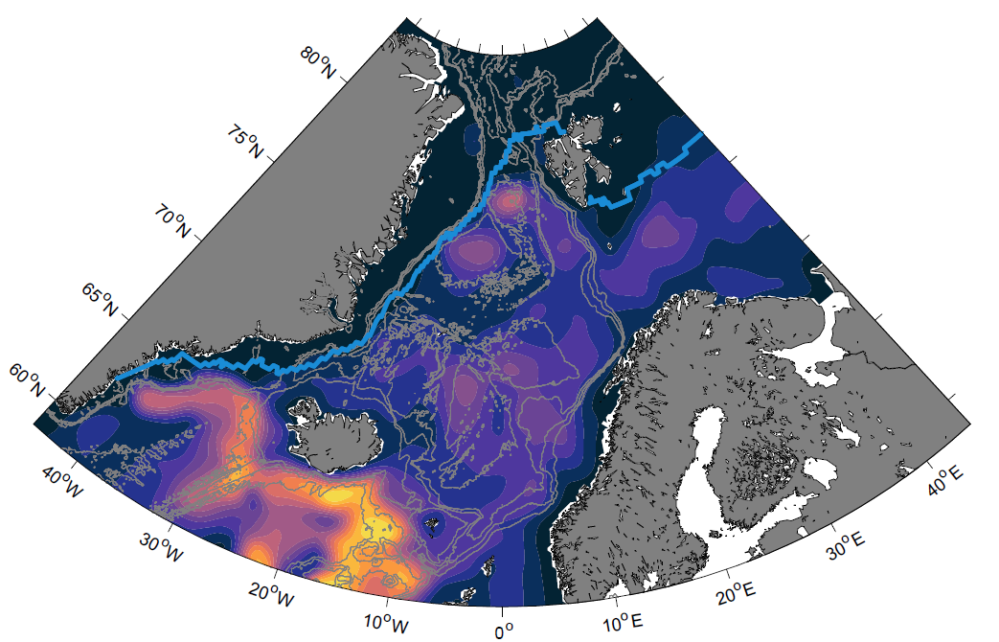
Mixed-layer depth (Feb-Apr)
1950-1979
1980-1999
2000-2019

Slide 5
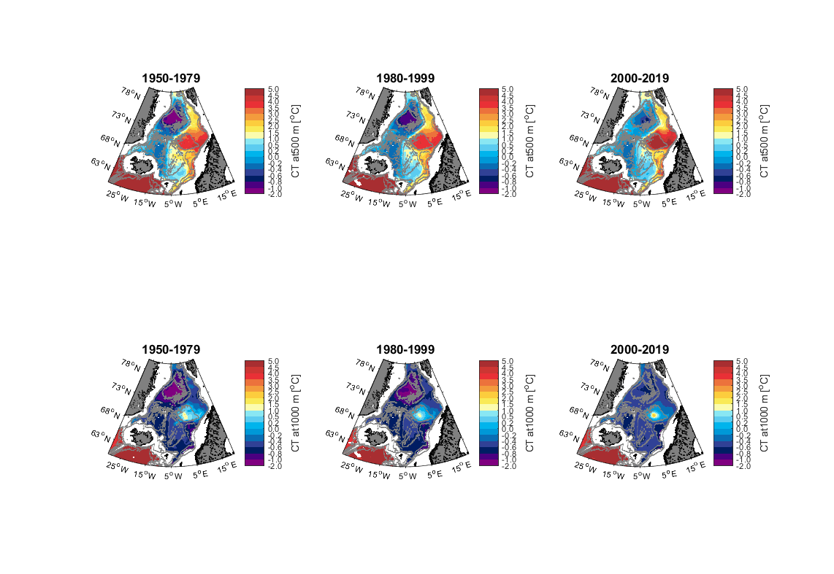
Temperature at 500m depth

Slide 6
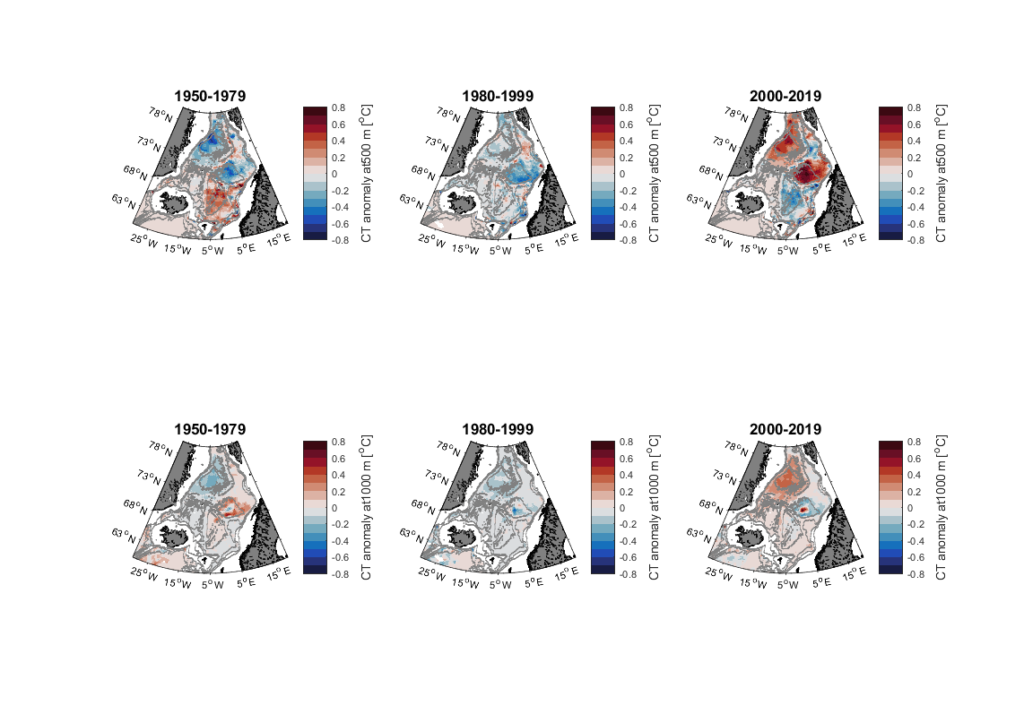
Temperature anomaly at 500m depth relative to the 1950-2019 mean

Slide 7
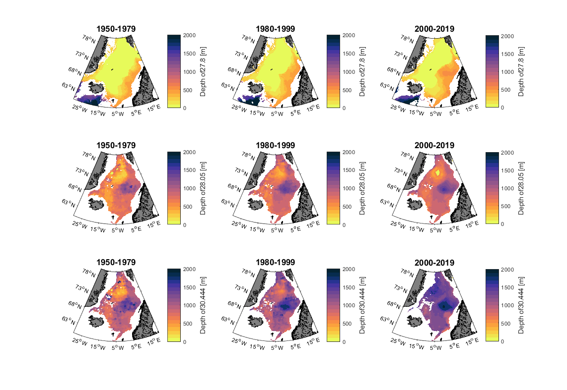
Depth of $σ_{θ}=27.8 kg m^{−3}$ (lower density limit of overflow water)

Slide 8
Depth of $σ_{θ}=28.05 kg m^{−3}$ (NIJ mode water)

Slide 9
Depth of $σ_{0.5}=30.444kg m^{−3}$ (isopycnal separating IW and DW)

Slide 10
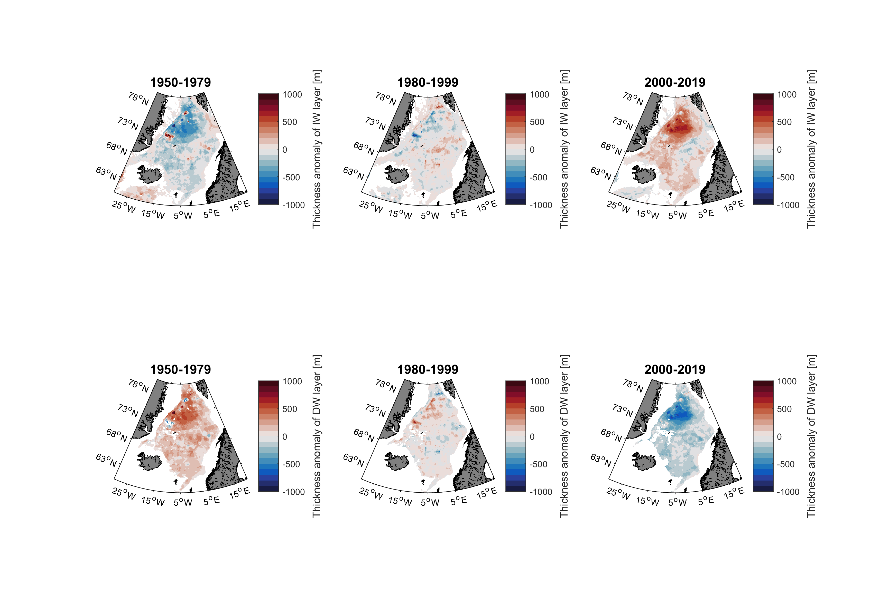
Thickness anomaly of IW layer relative to the 1950-2019 mean

Slide 11
Thickness anomaly of IW layer relative to the 1950-2019 mean
Thickness anomaly of DW layer relative to the 1950-2019 mean

Slide 12
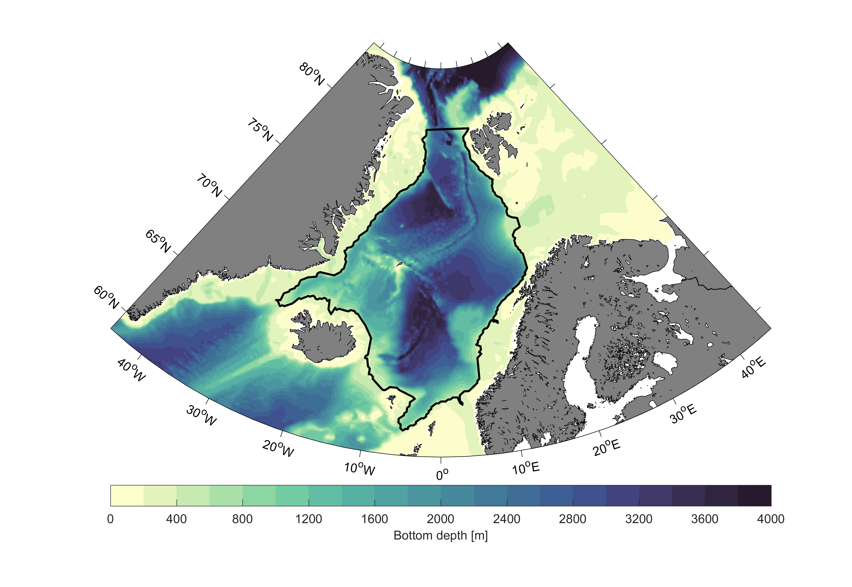
Definition of the total Nordic Seas volume

Slide 13
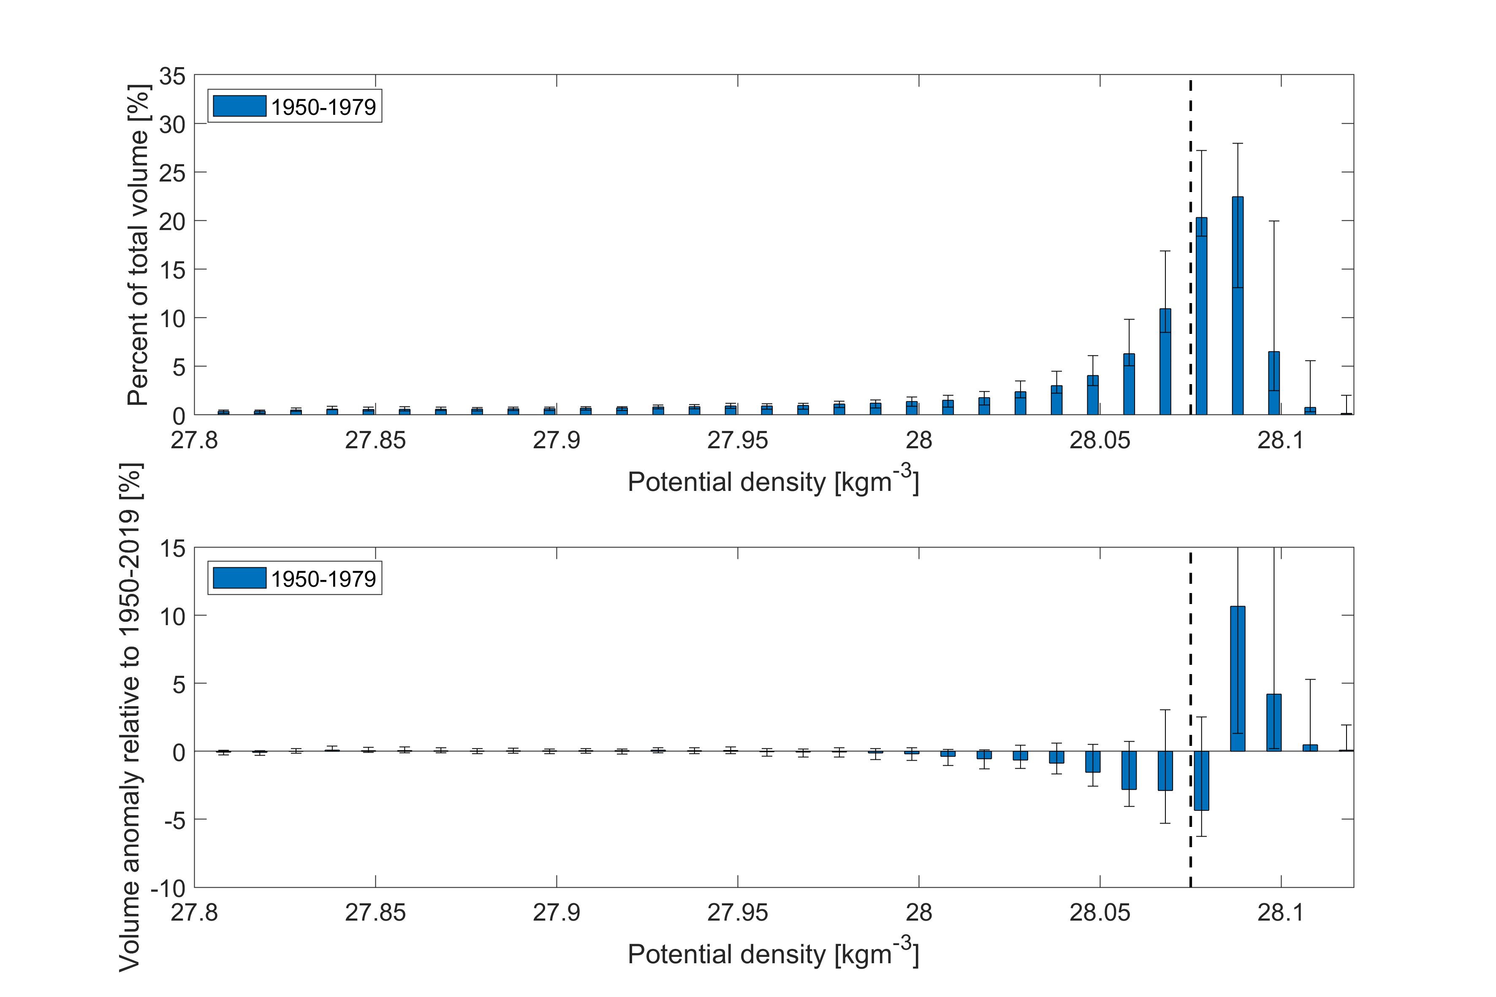
Partitioning the Nordic Seas volume into density classes

Slide 14
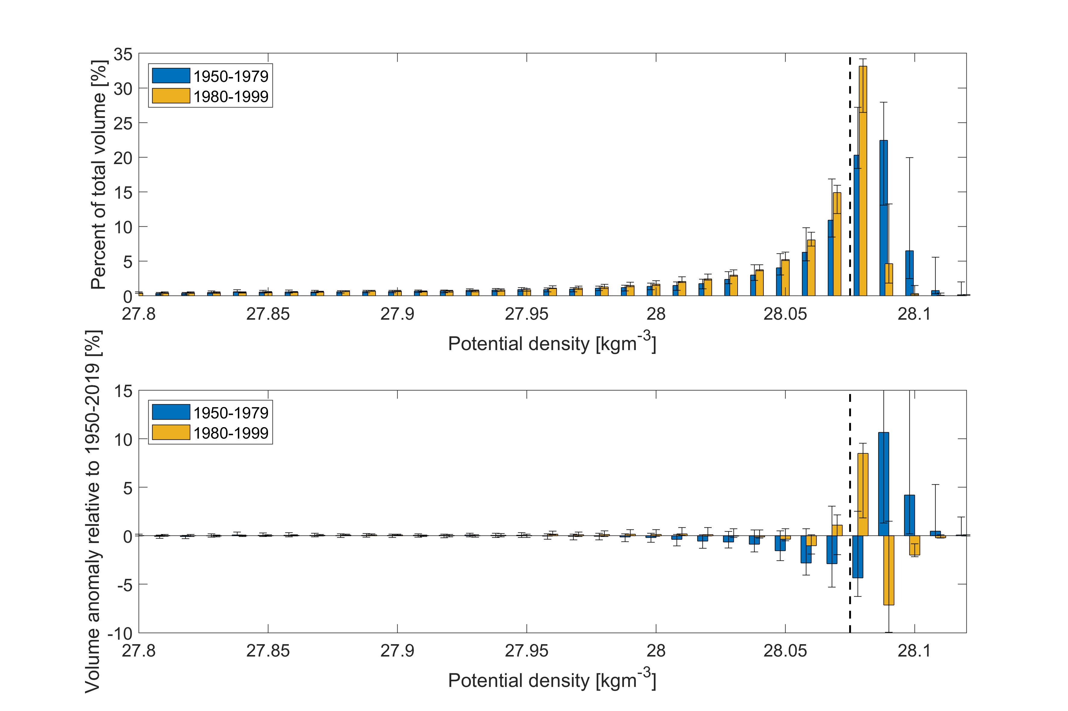
Partitioning the Nordic Seas volume into density classes

Slide 15
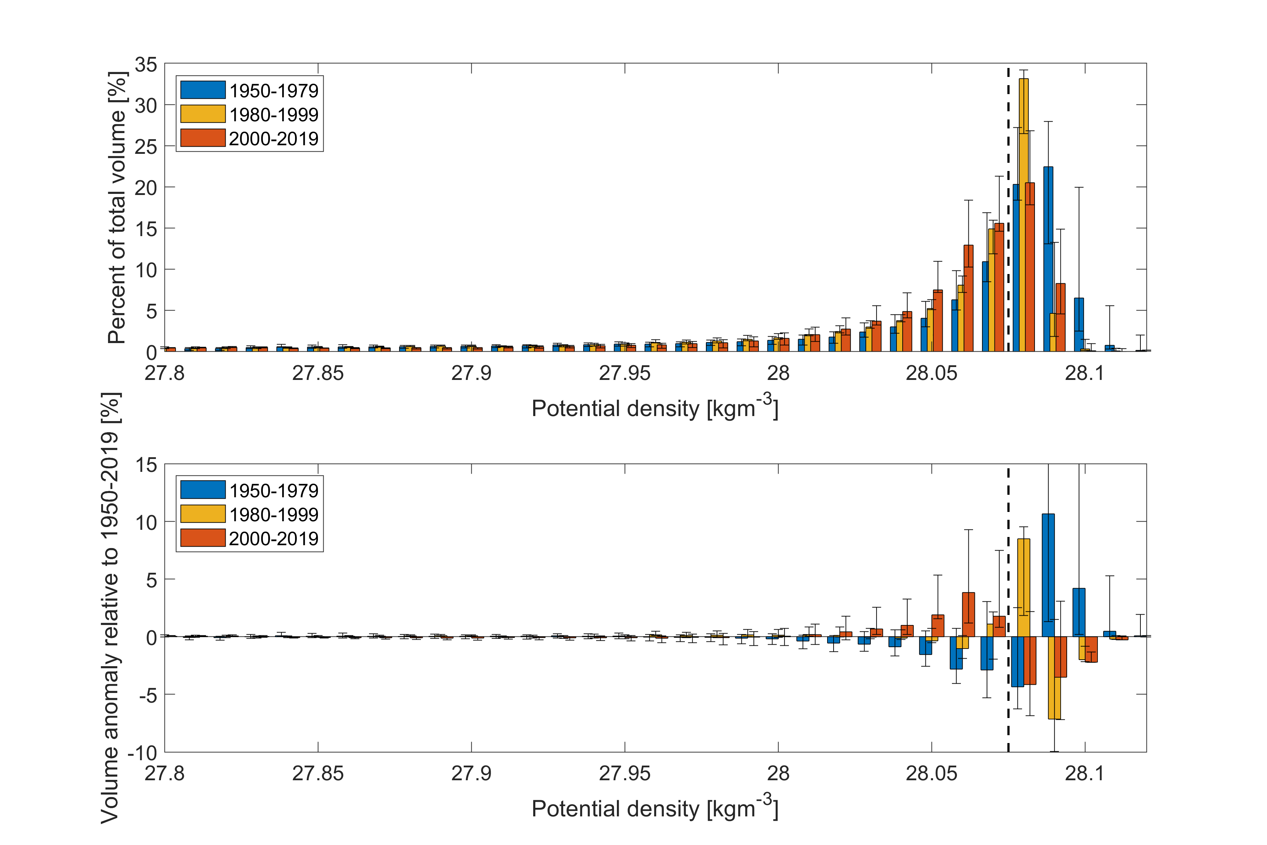
Partitioning the Nordic Seas volume into density classes

Slide 16
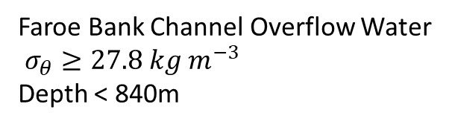
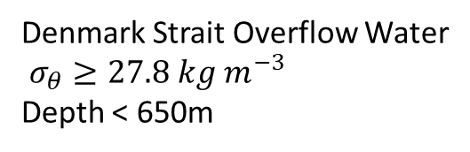
Definition of the overflow water
Denmark Strait Overflow Water
$σ_{θ}≥27.8 kg m^{−3}$
Depth < 650m
Faroe Bank Channel Overflow Water
$σ_{θ}≥27.8 kg m^{−3}$
Depth < 840m

Slide 17
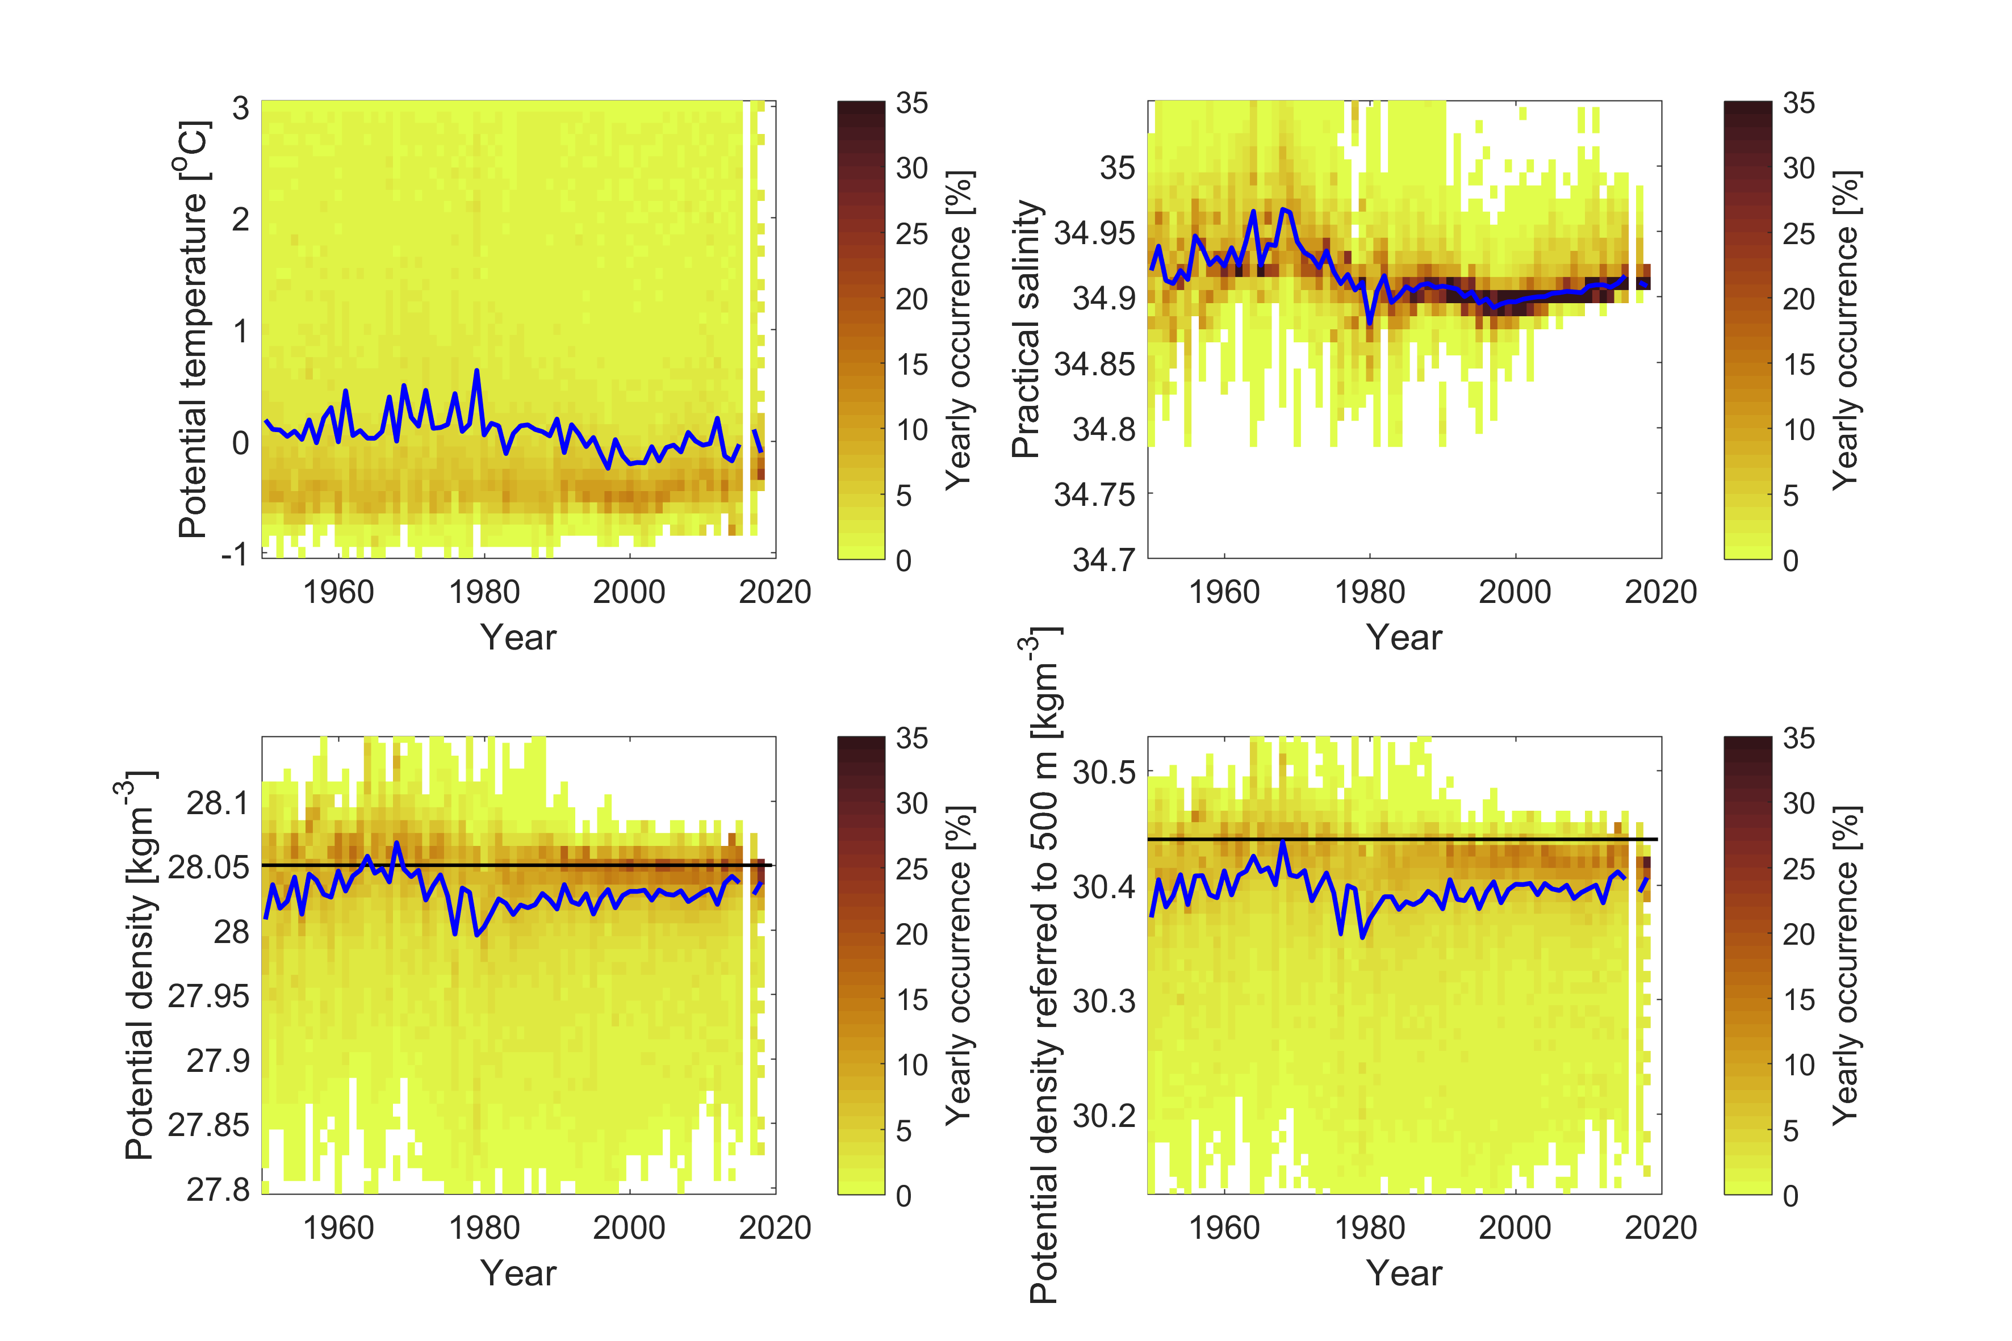
Faroe Bank Channel Overflow Water

Slide 18
Faroe Bank Channel Overflow Water

Slide 19
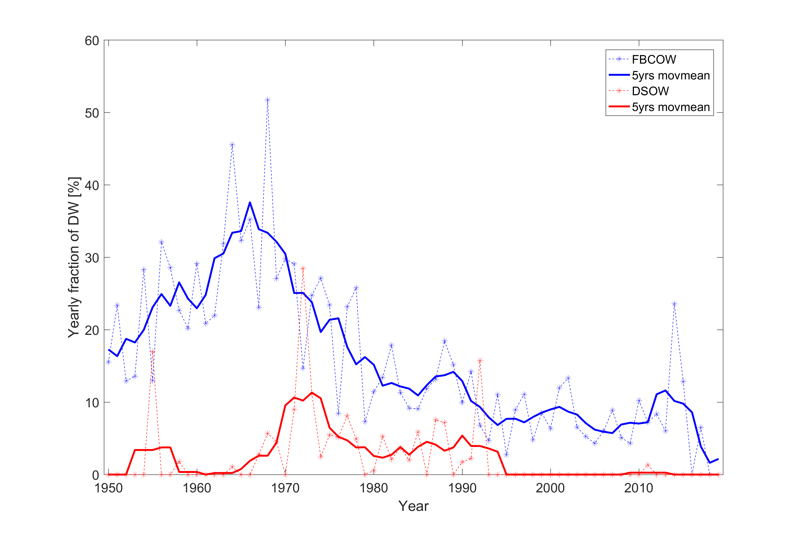
Percentage of overflow water classified as DW

Slide 20
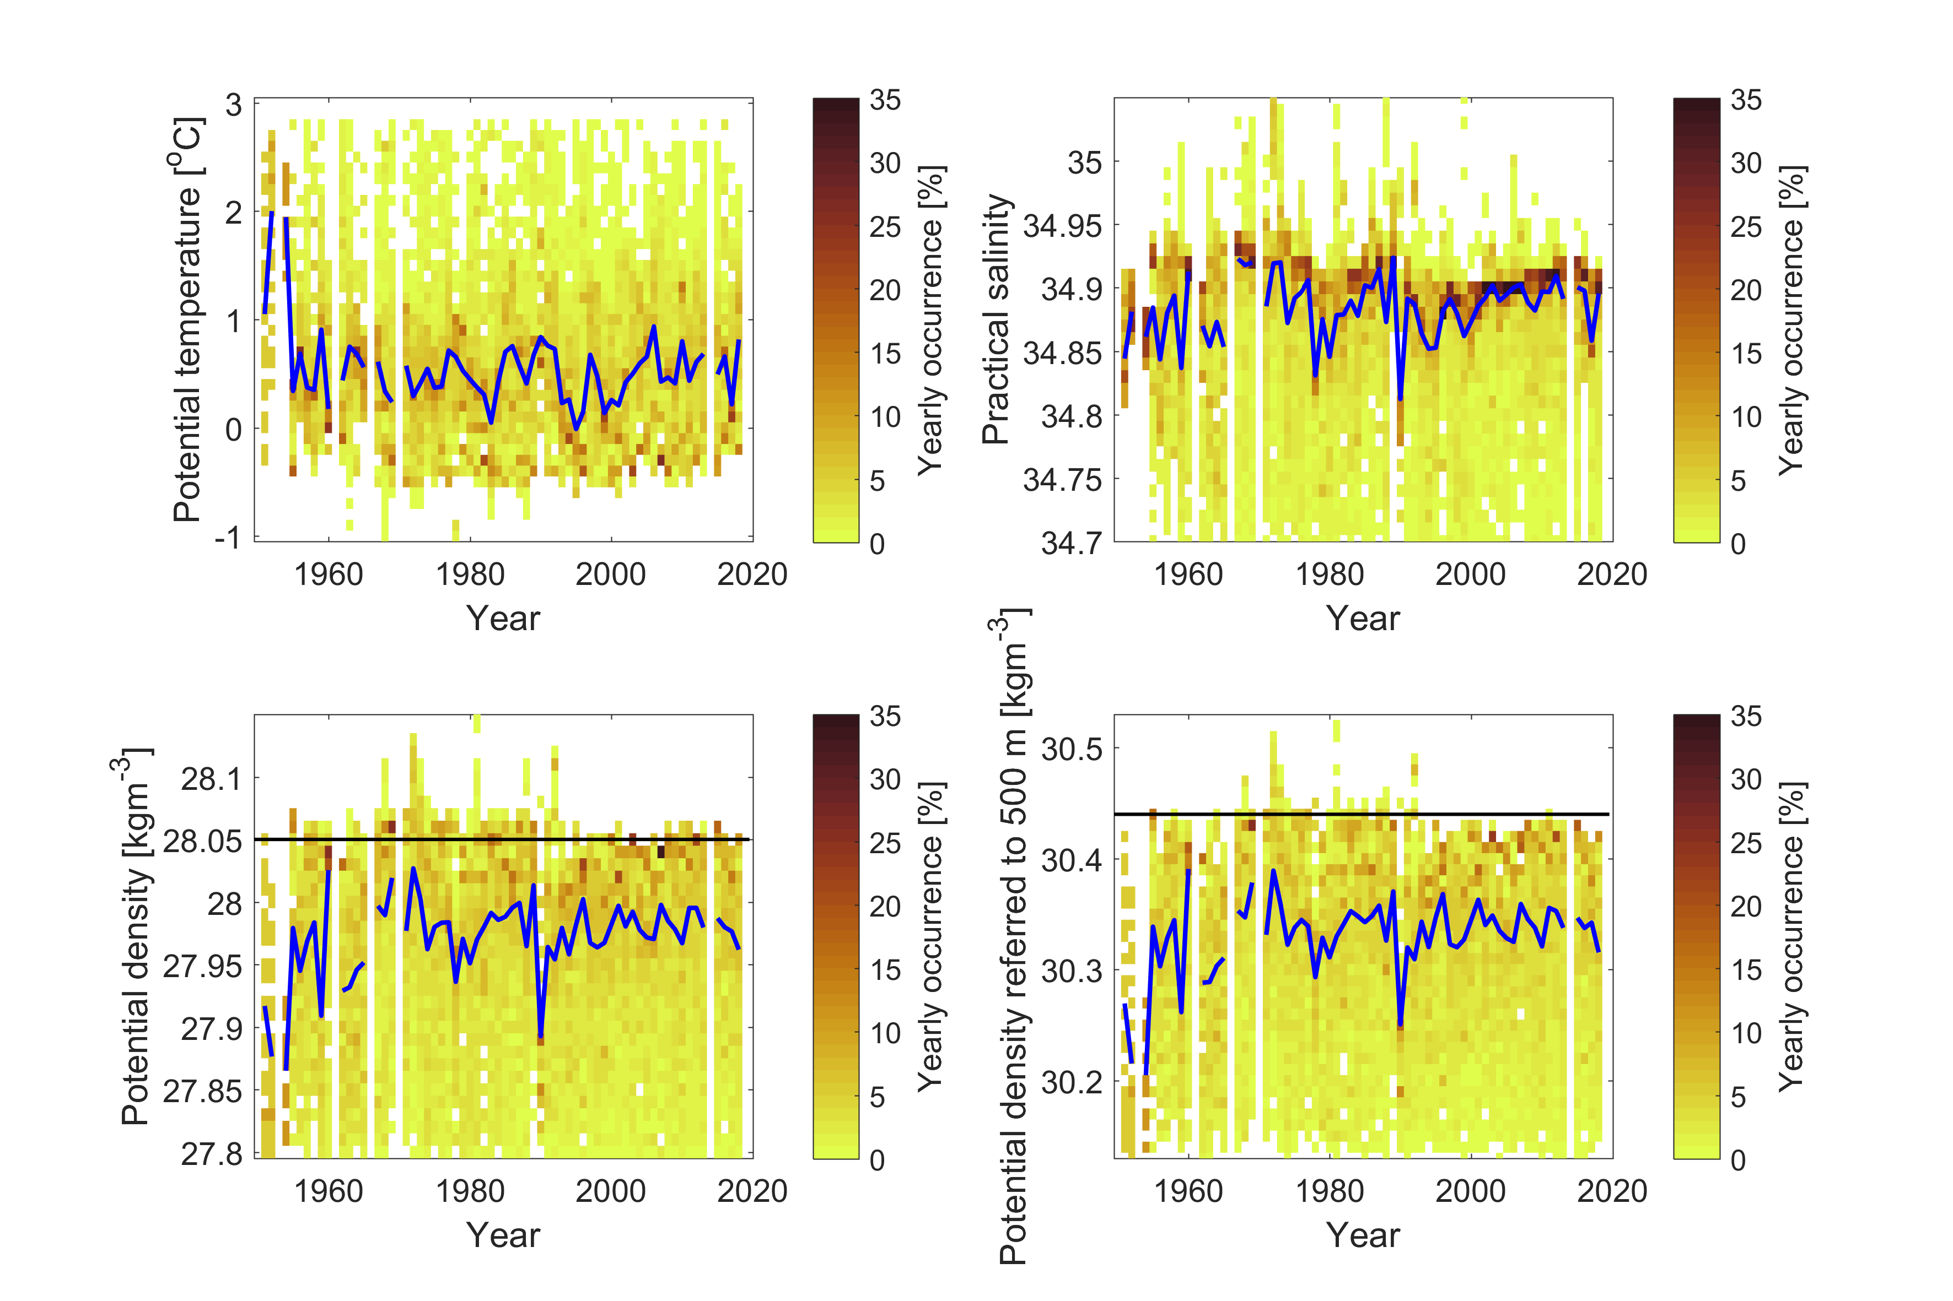
Denmark Strait Overflow Water

Slide 21
Inverse method: Total Matrix Intercomparison
Based on observations (temperature, salinity, oxygen, nitrate, phosphate)
Pre-defined source waters are not required.
Instead, every ocean surface/boundary locations is considered a potential source of overflow water.
Solves for the water mass pathways that best fit the observations
=> Can be used to identify the origin, pathways, and final composition of the overflow water

Slide 22
Origin of overflow water (2000-2019)
Denmark Strait
Fraction of overflow water originating from the surface (log10 scale)
Notes:
0.1% from Iceland shelf (<400m)
1.2% from east of Jan Mayen (Norwegian Sea, <72degN)

Slide 23
Origin of overflow water (2000-2019)
Denmark Strait
Faroe Bank Channel
Fraction of overflow water originating from the surface (log10 scale)
Notes:
0.1% from Iceland shelf (<400m)
1.2% from east of Jan Mayen (Norwegian Sea, <72degN)

Slide 24
Origin of overflow water
Denmark Strait

Slide 25
Origin of overflow water
Denmark Strait
Faroe Bank Channel

Slide 26
Summary
Large changes in water mass structure and volume in the Nordic Seas between 1950-2019
Decrease in DW volume and increase in IW volume (connected to changes in Greenland Sea convection)

Slide 27
Summary
Large changes in water mass structure and volume in the Nordic Seas between 1950-2019
Decrease in DW volume and increase in IW volume (connected to changes in Greenland Sea convection)
DW fraction in FBCOW has decreased
Large variability in DSOW properties, but no long-term trend

Slide 28
Summary
Large changes in water mass structure and volume in the Nordic Seas between 1950-2019
Decrease in DW volume and increase in IW volume (connected to changes in Greenland Sea convection)
DW fraction in FBCOW has decreased
Large variability in DSOW properties, but no long-term trend
Greenland Sea contribute with 37.5% of the DSOW.
We expect this to be smaller in 1950-1979.
FBCOW mainly originates in the Greenland Sea (39.8%) and Arctic Ocean (29.6%).
We expect that the Greenland Sea was even more important in 1950-1979.

