Slide 1
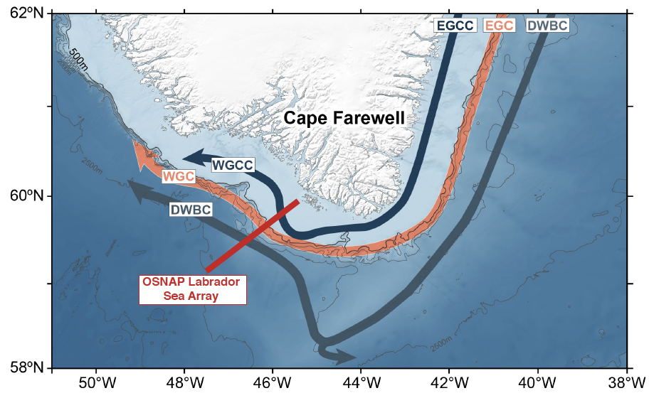
Moored observations of the West Greenland Coastal Current along the Southwest Greenland Shelf
Nicholas P. Foukal and Robert S. Pickart
Pacini et al. (2020) and Lin et al. (2018)

Slide 2
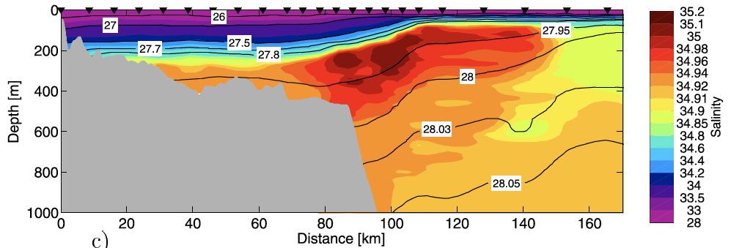
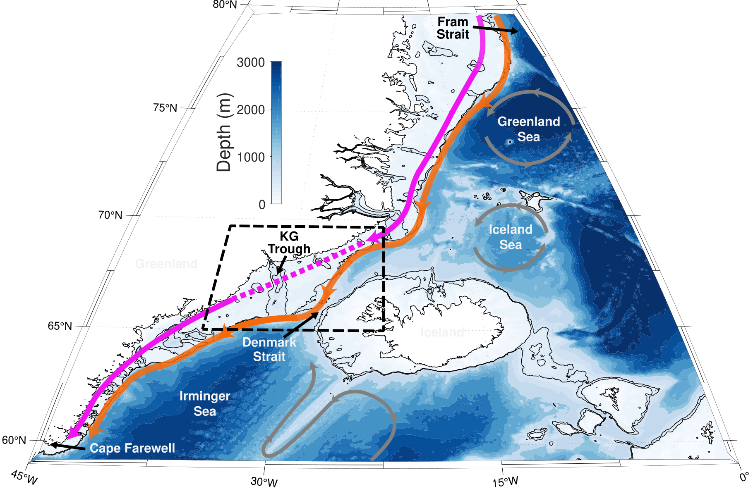
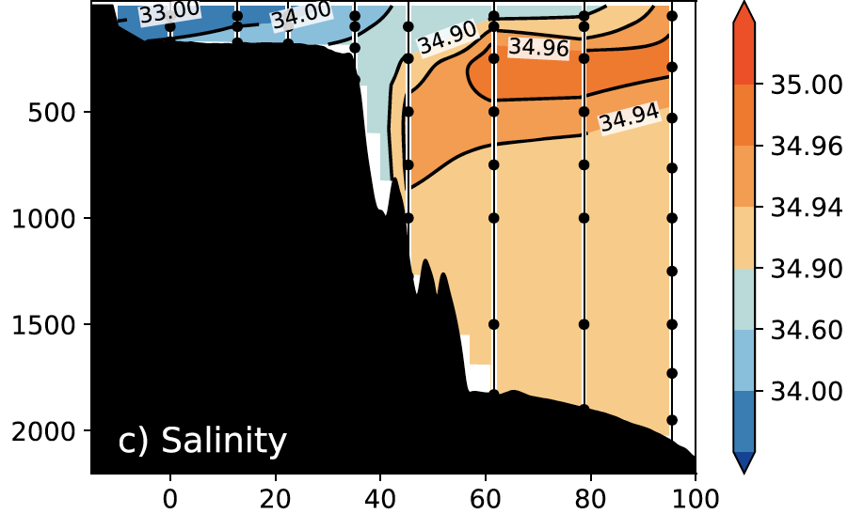
Coastal Current Salinity
“Freshwater wedge”
Håvik et al., 2017
“Freshwater wedge”
Foukal et al., 2020
“Freshwater wedge”
Foukal et al., 2020
Le Bras et al., 2018

Slide 3
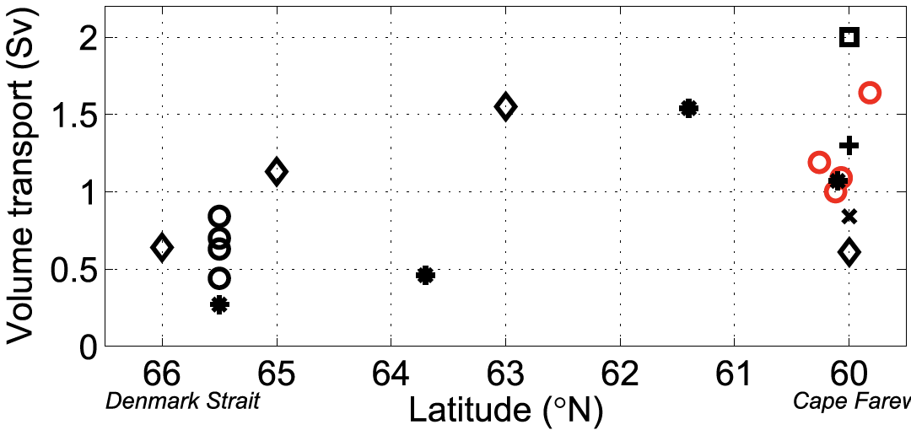
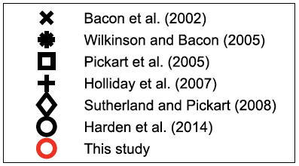
Coastal Current Volume Transport
Lin et al., 2018
Lin et al., 2018

Slide 4
Coastal Current Volume Transport
68
Lin et al., 2018
Lin et al., 2018
Foukal et al., 2020
Le Bras et al., 2018
This study

Slide 5
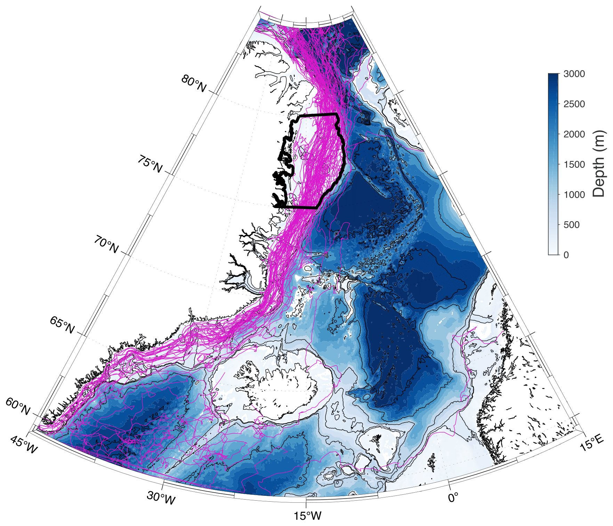
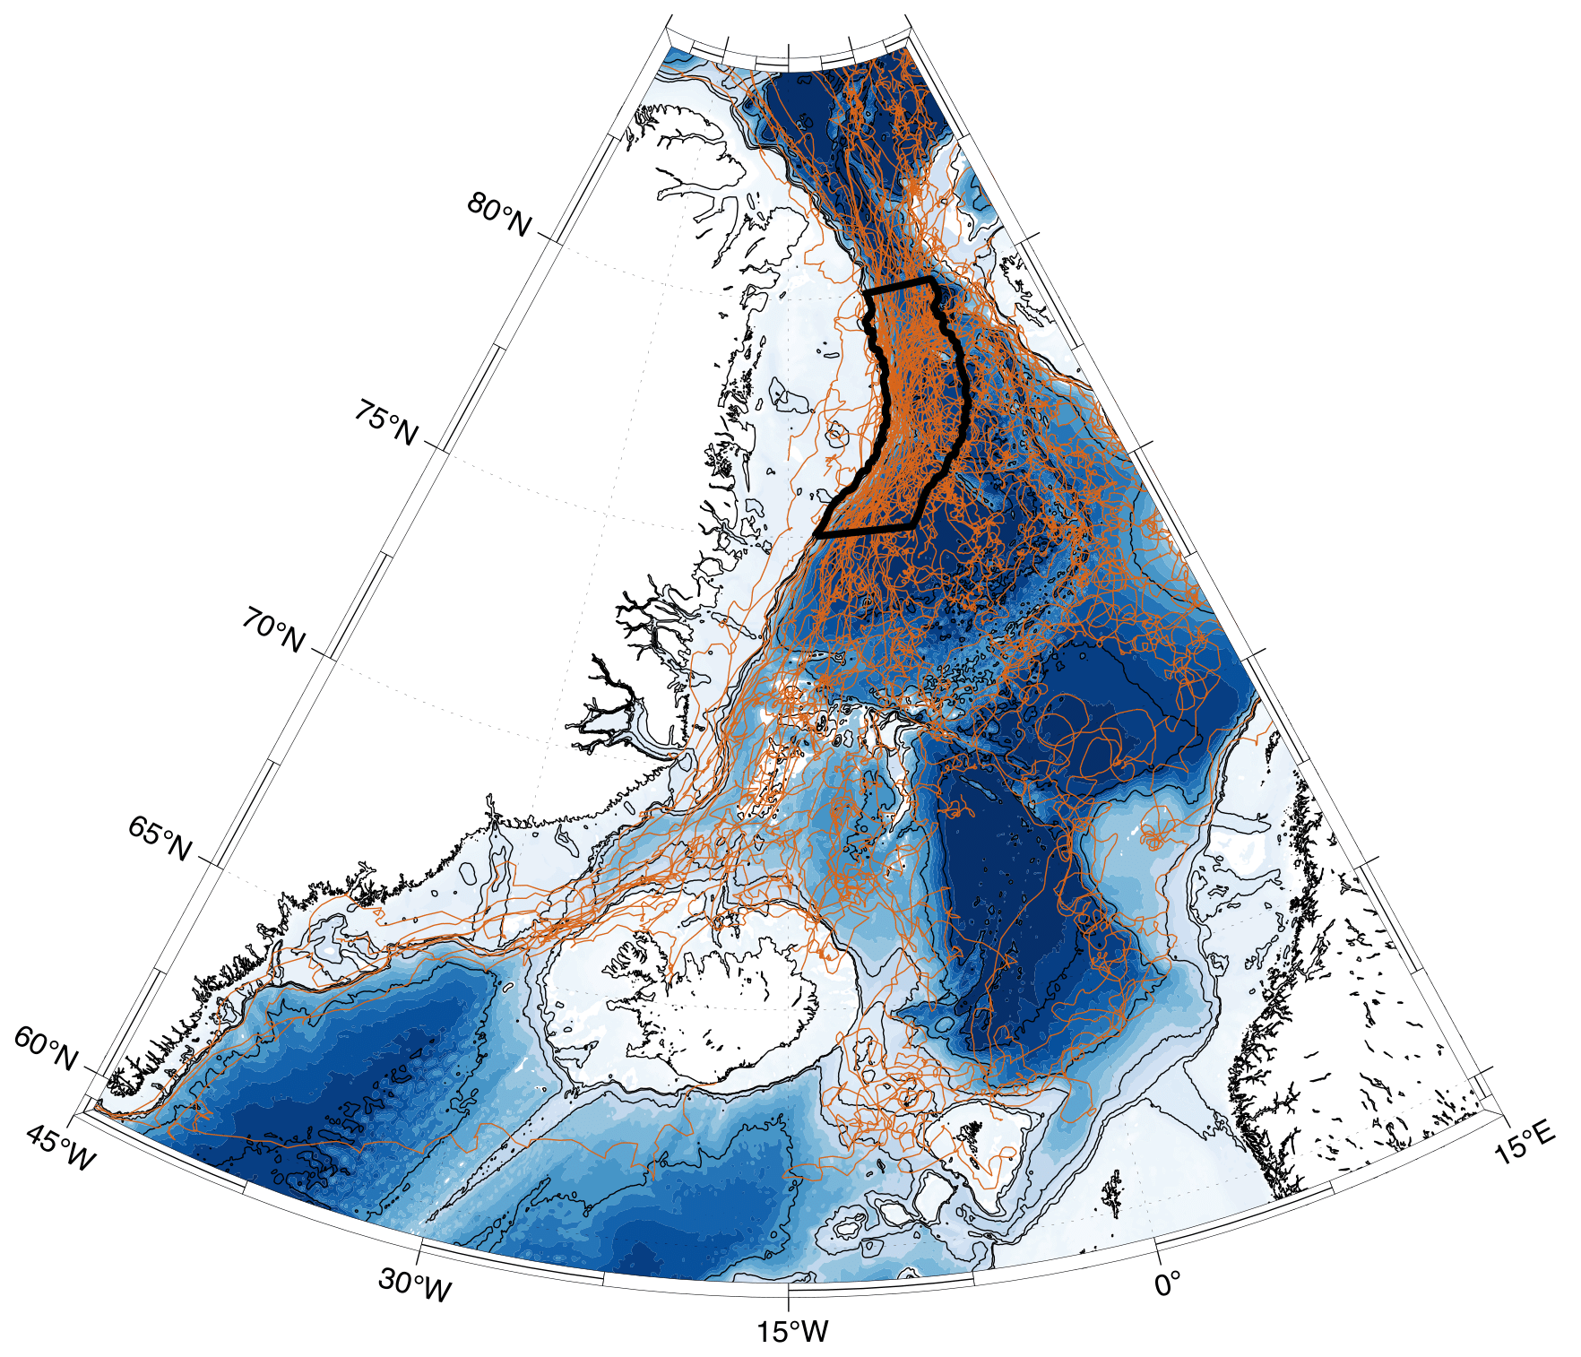
North-South Connectivity of the East Greenland Coastal Current
IABP trajectories inshore of 500 m isobath between 75-80°N (n=92)
IABP trajectories offshore of 500 m isobath between 75-80°N (n=59)
Foukal et al., 2020
Foukal et al., 2020

Slide 6
Connectivity of the coastal current at Cape Farewell
Meltwater.whoi.edu

Slide 7
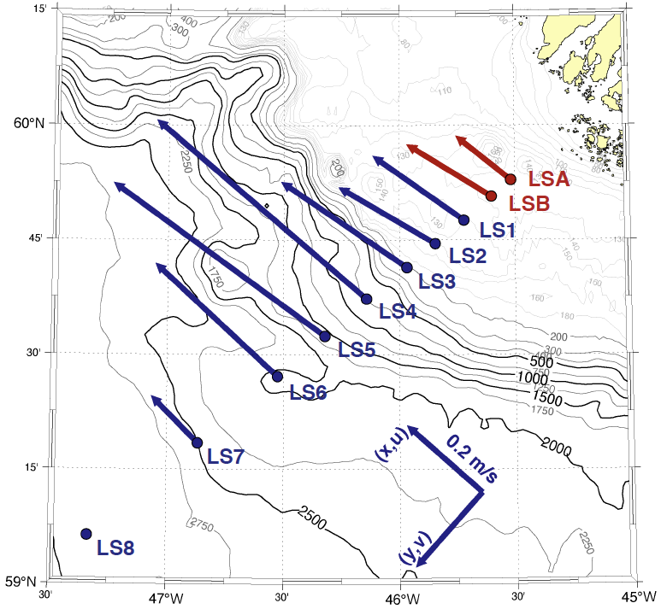
OSNAP Labrador Sea Mooring Array
Time-mean velocity vectors (upper 100 m)
2014-2020
2018-2020

Slide 8
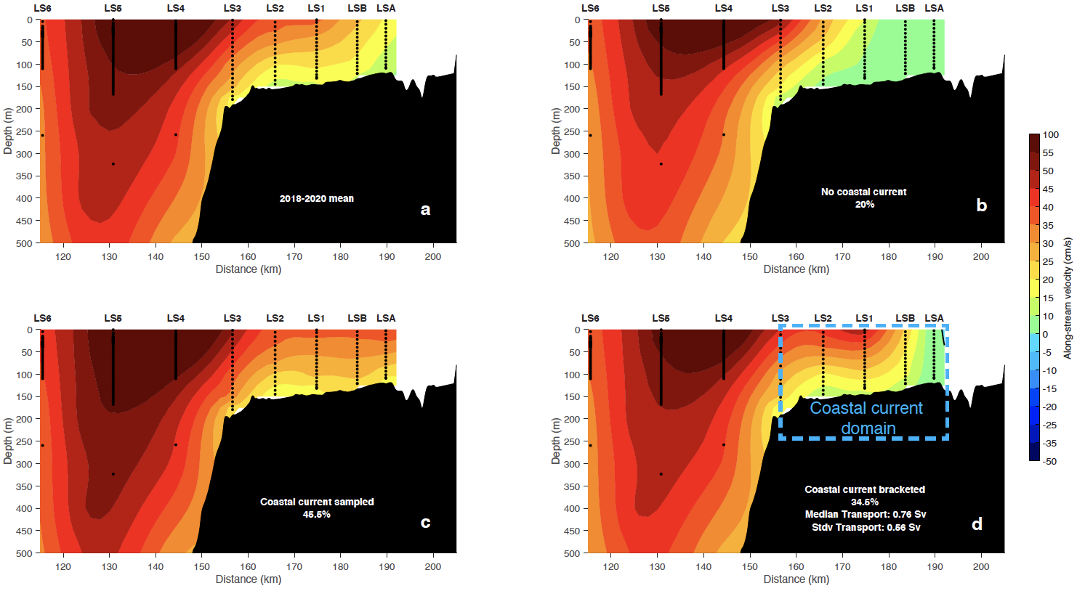
OSNAP Labrador Sea Mooring Array
Time-mean velocity vectors (upper 100 m)
2014-2020
2018-2020
Hourly, 2 km horizontal x 25 m vertical resolution
Coast
New in 2018
Aquadops
ADCP

Slide 9
Coastal Current velocity regimes

Slide 10
Salinity
“Freshwater wedge”
Front
Front

Slide 11
Time-varying coastal current

Slide 12
Hydrography
5 summer occupations during deployment/turnaround cruises
Data loss from 2018-2020 mooring deployments
LSA dangler dropped from 50 m to 90 m in July 2019 (iceberg)
LSB microcat on tripod biofouled in June 2019
No data from LS3 microcat on tripod
LSB
LSA
LS2
LS1
LS3
What about salinity in the upper water column?

Slide 13
Hydrography
How good is linear interpolation?
Salinity
Salinity

Slide 14
Hydrography
LSA
LSB
LS1
LS2
LS3

Slide 15
Hydrography

Slide 16
Next Steps
Methods questions:
How should I interpolate the salinity data to the surface?
Can we fill in LSA and LSB for 2014-2018 to bracket the WGCC for 6 years?
Science questions:
What drives variability in the WGCC?
How much of the fresh water in the EGCC makes it to the WGCC?
What is the downstream fate of the WGCC?

