Slide 1
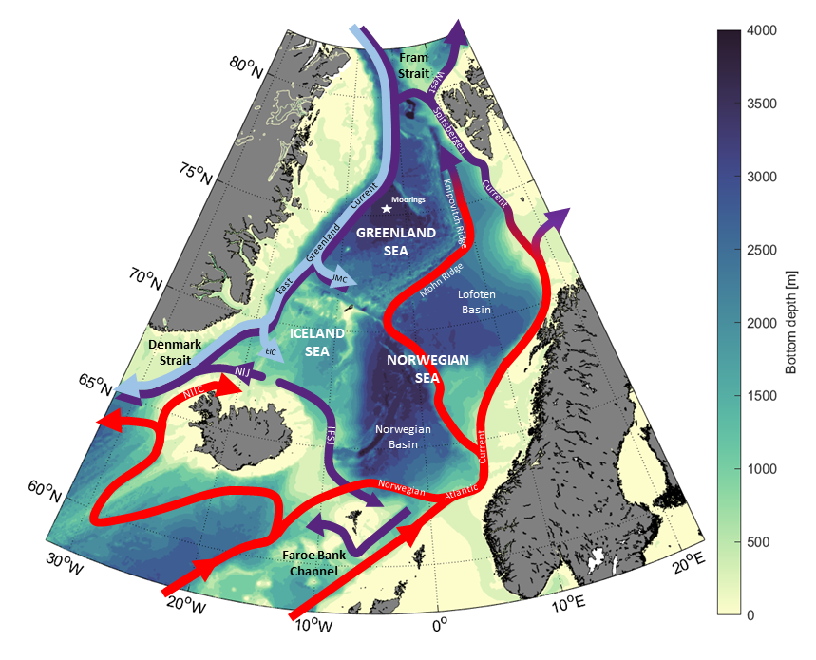
The impact of cold air outbreaks and lateral heat fluxes on dense water formation in the Greenland Sea from a ten-year moored record (1999-2009)
Kristin Svingen
Ailin Brakstad
Kjetil Våge
Wilken-Jon von Appen
Lukas Papritz

Slide 2
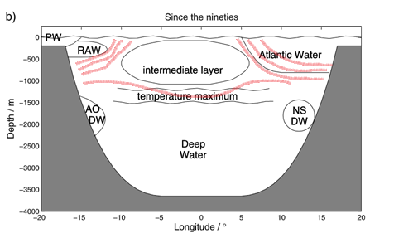
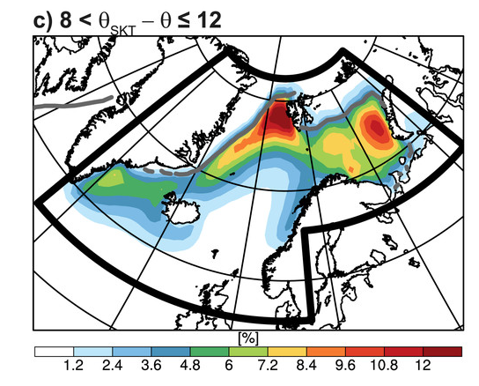
The Greenland Sea is an ideal place for open-ocean convection
50% sea ice concentration
(Ronski and Budéus, 2005)
Mean frequency of strong cold air outbreaks
(Papritz and Spengler, 2017)
Cyclonic gyre circulation
Weak stratification
Located near the sea ice edge
Large winter heat loss due to cold air outbreaks

Slide 3
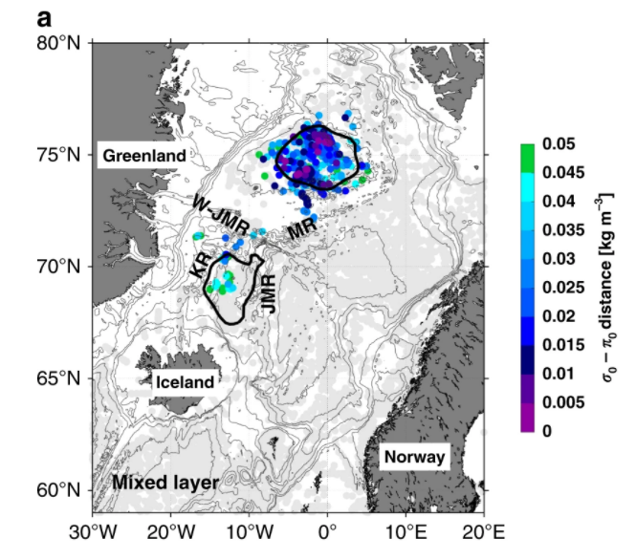
The Greenland Sea is origin to a significant portion of the overflow water
Denmark Strait (37.5%)
Faroe-Shetland Channel (39.8%)
Fraction of water originating in the Greenland Sea
(Huang et al., 2020)
(Brakstad et al., in prep)

Slide 4
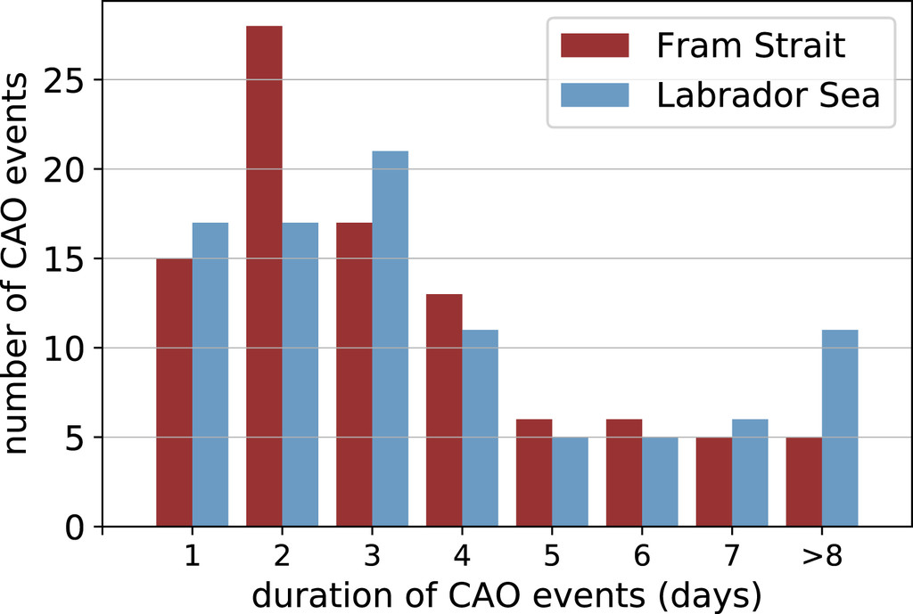
Winter-time evolution of the Greenland Sea mixed layer depends on:
Heat loss to the atmosphere
Lateral fluxes of heat and salt
(Moore et al., 2015; Latarius and Quadfasel, 2016; Lauvset et al., 2018; Brakstad et al., 2019)
60-80% of the heat lost during winter is due to
Cold Air Outbreaks (CAOs, Papritz and Spengler, 2017)
CAOs only last for a few days (Terpstra et al., 2021)
Due to sparse temporal data coverage it has not been possible to examine the direct impact of CAOs on the mixed layer
Questions remain regarding the vertical distribution and origin of the lateral heat and salt fluxes

Slide 5
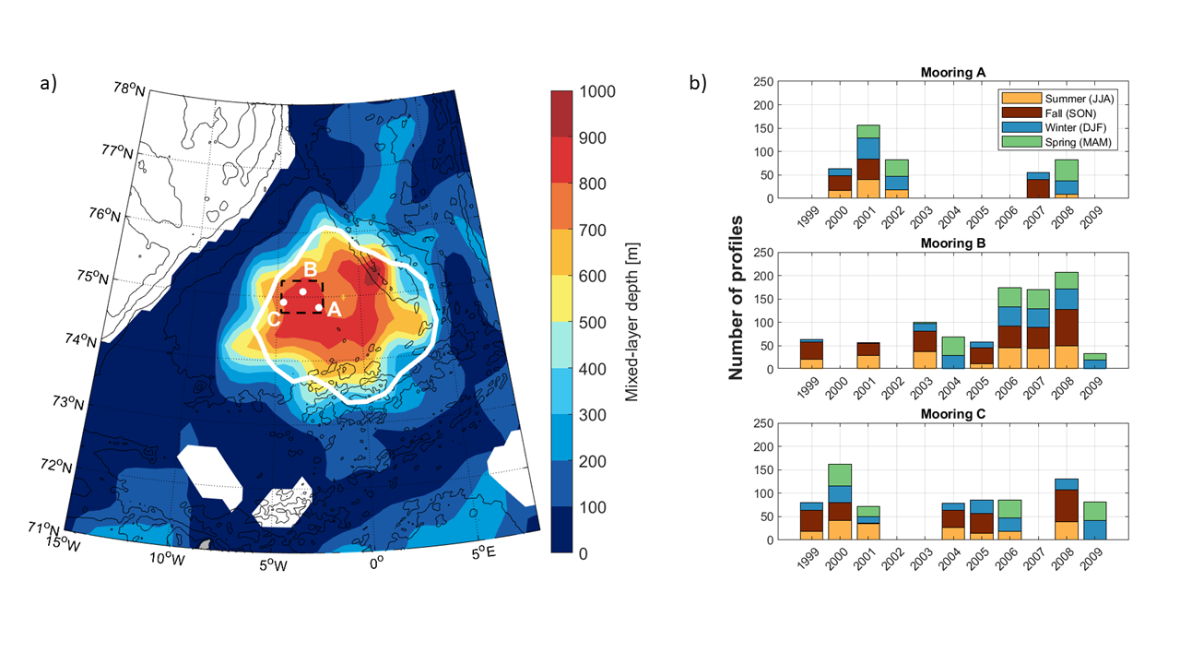
10 years (1999-2009) of profiling mooring data from the central Greenland Sea

Slide 6
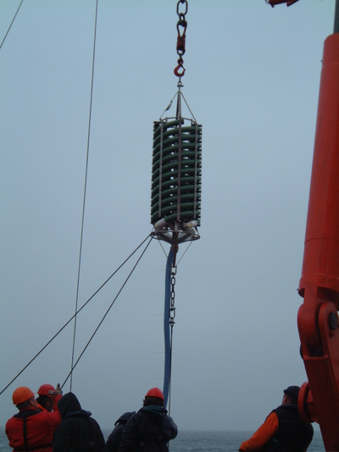
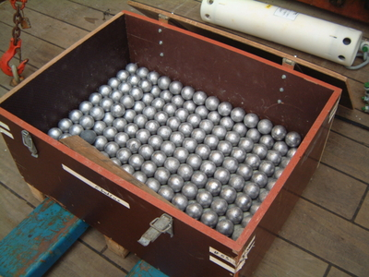
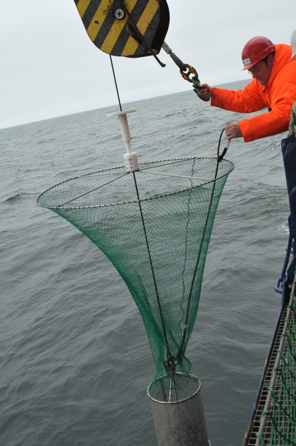
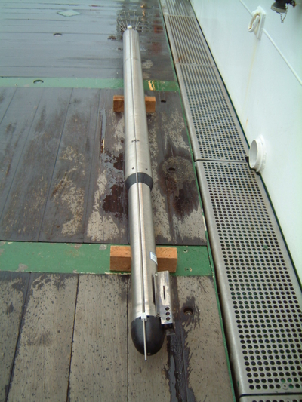
Mooring setup (photos by Gereon Budéus)
The ‘treasure chest’: Energy for 400 times of 4000m profiling
Budéus et al., 2005. DSR
Budéus, 2009. SeaTechnology
Notes:
https://www.awi.de/en/science/climate-sciences/physical-oceanography/instruments/tiefsee-yoyo/bildserie-zum-aussetzen-der-jojo-verankerung.html

Slide 7
10 years (1999-2009) of profiling mooring data from the central Greenland Sea

Slide 8
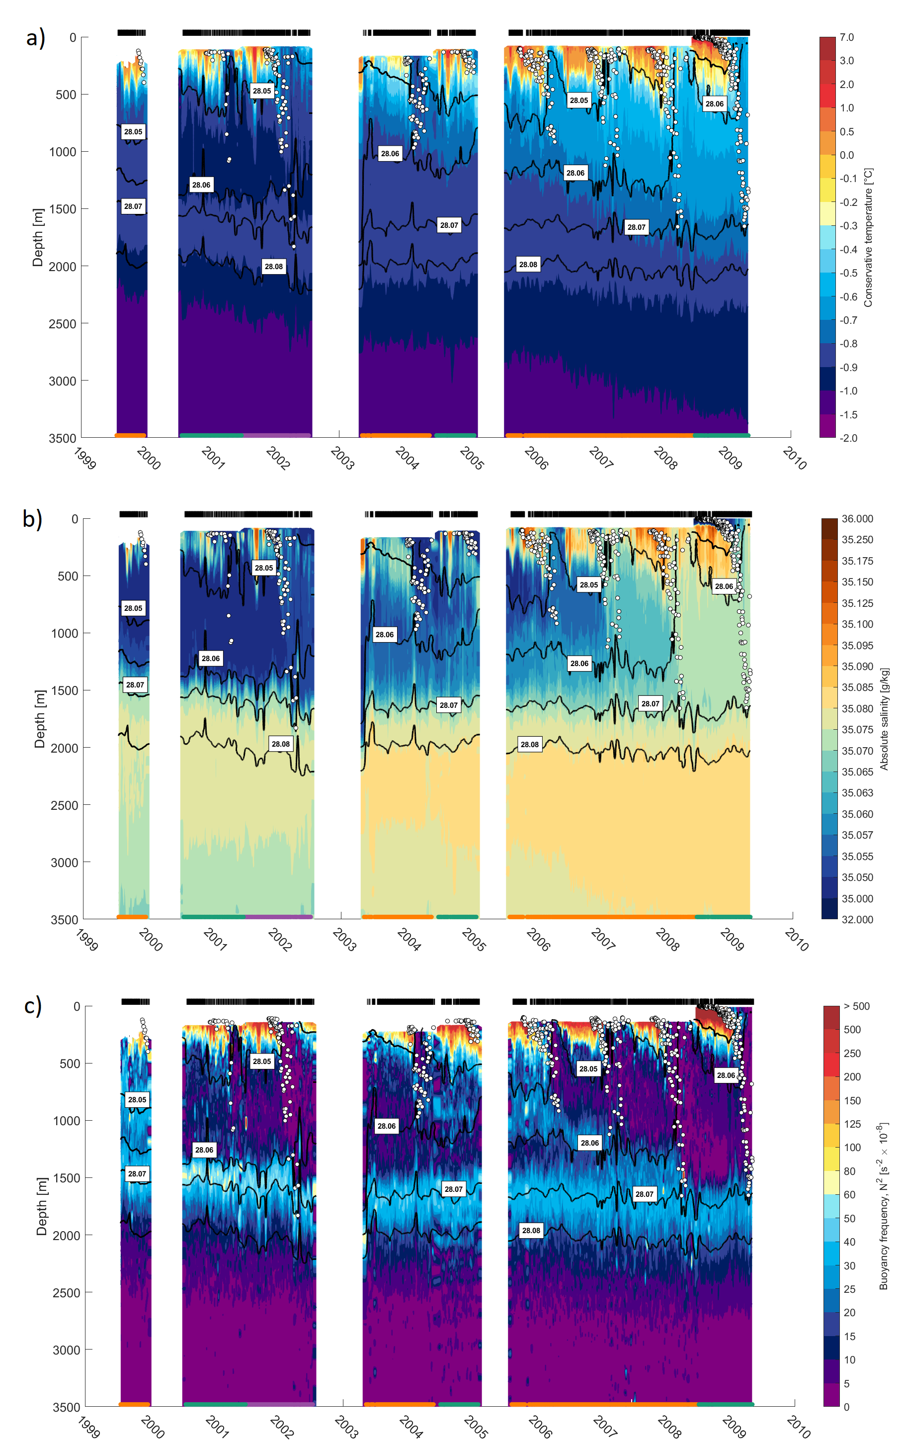
Long-term evolution of the hydrographic properties in the Greenland Sea Gyre
C
B
A
C
B
C
B
moorings

Slide 9
Long-term evolution of the hydrographic properties in the Greenland Sea Gyre
C
B
A
C
B
C
B
moorings

Slide 10
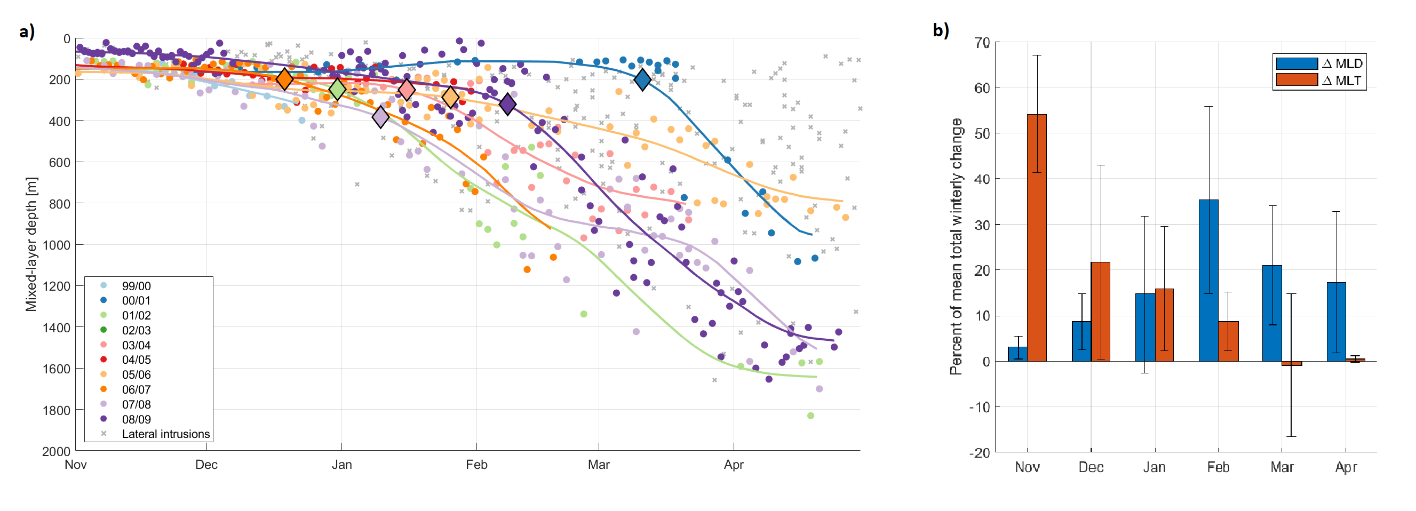
Mixed-layer evolution through winter

Slide 11
Mixed-layer evolution through winter
Mean total change in mixed-layer:
Temperature: -2.55˚C
Depth: 1554m

Slide 12
Mixed-layer evolution through winter
Cooling phase
Deepening phase
Notes:
Inflection point – minimum in second derivative of 30-day running means.

Slide 13
Cold Air Outbreaks (CAOs)
CAO index = surface skin temperature – potential temperature at 900 hPa

Slide 14
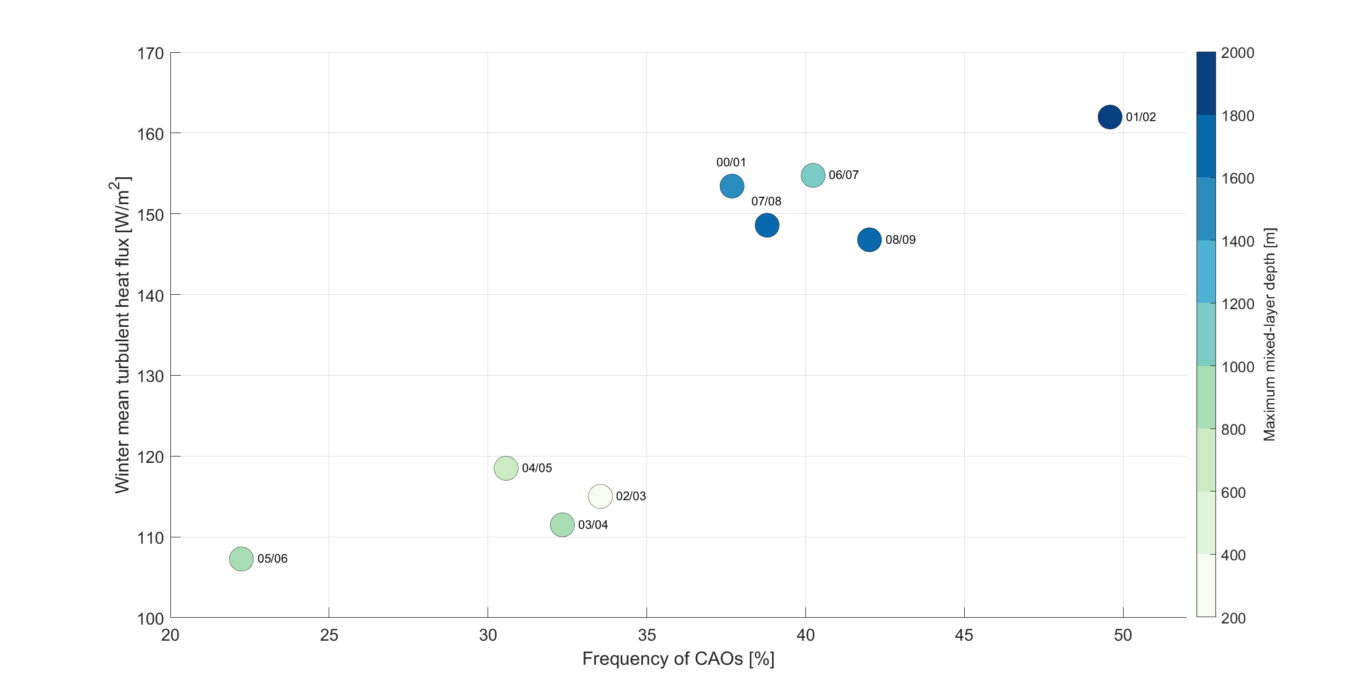
The effect of cold air outbreaks on the mixed layer

Slide 15
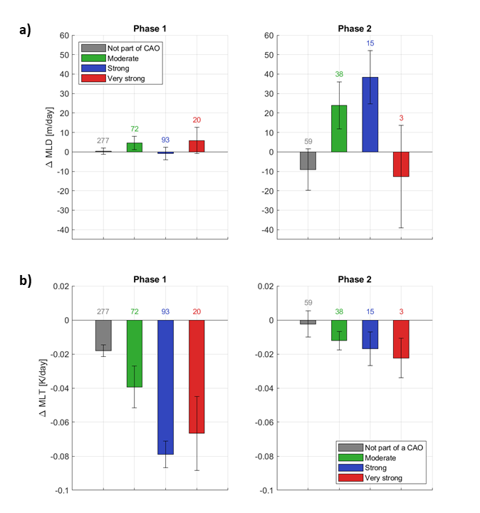
The effect of cold air outbreaks on the mixed layer
Cooling phase (median CAO index)
Deepening phase (median CAO index)
Change in mixed-layer depth

Slide 16
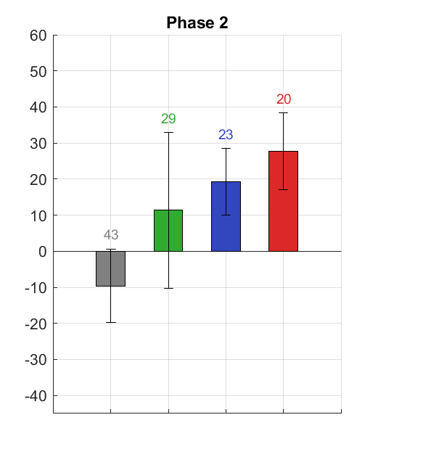
The effect of cold air outbreaks on the mixed layer
Cooling phase (median CAO index)
Deepening phase (median CAO index)
Deepening phase (90 percentile CAO index)
Change in mixed-layer depth

Slide 17
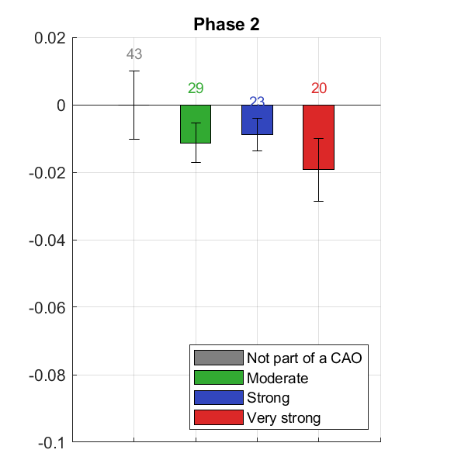
The effect of cold air outbreaks on the mixed layer
Cooling phase (median CAO index)
Deepening phase (median CAO index)
Deepening phase (90 percentile CAO index)
Change in mixed-layer depth
Change in mixed-layer temp.

Slide 18
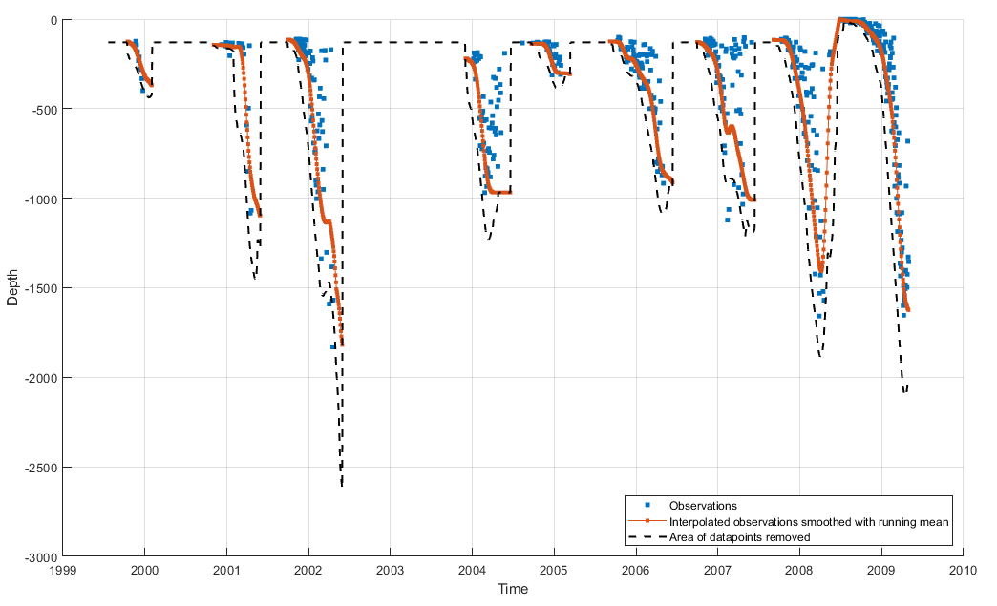
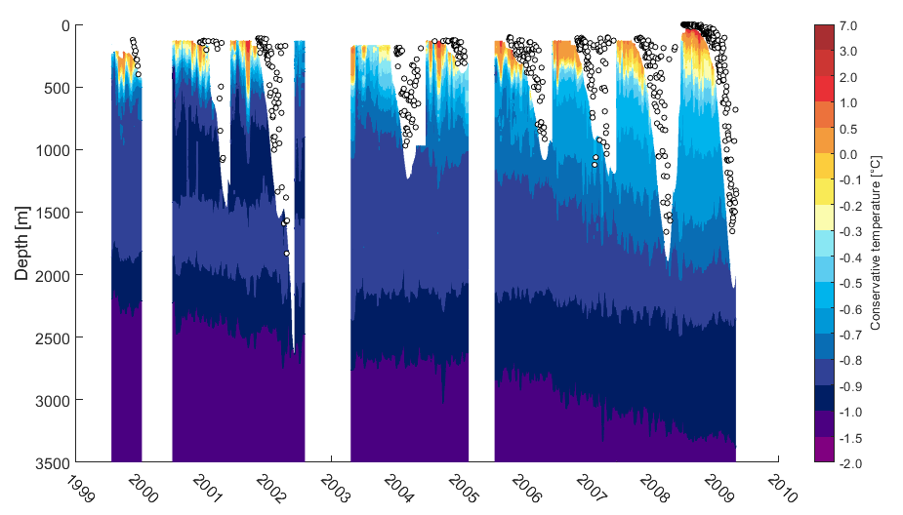
Excluding measurements in the mixed layer to estimate lateral fluxes

Slide 19
Annual change in temperature and salinity as a result of lateral fluxes

Slide 20
Impact of lateral heat and salt fluxes on the Greenland Sea mixed layer
PWP mixed-layer model
2 runs each winter: one including and one excluding lateral heat and salt fluxes
Initial conditions: First November hydrographic profile where the mixed layer was detected by the moorings
ERA5 atmospheric forcing
No lateral advection
Including our updated estimates of lateral heat and salt fluxes

Slide 21
Origin of lateral heat and salt fluxes into the Greenland Sea Gyre???

Slide 22
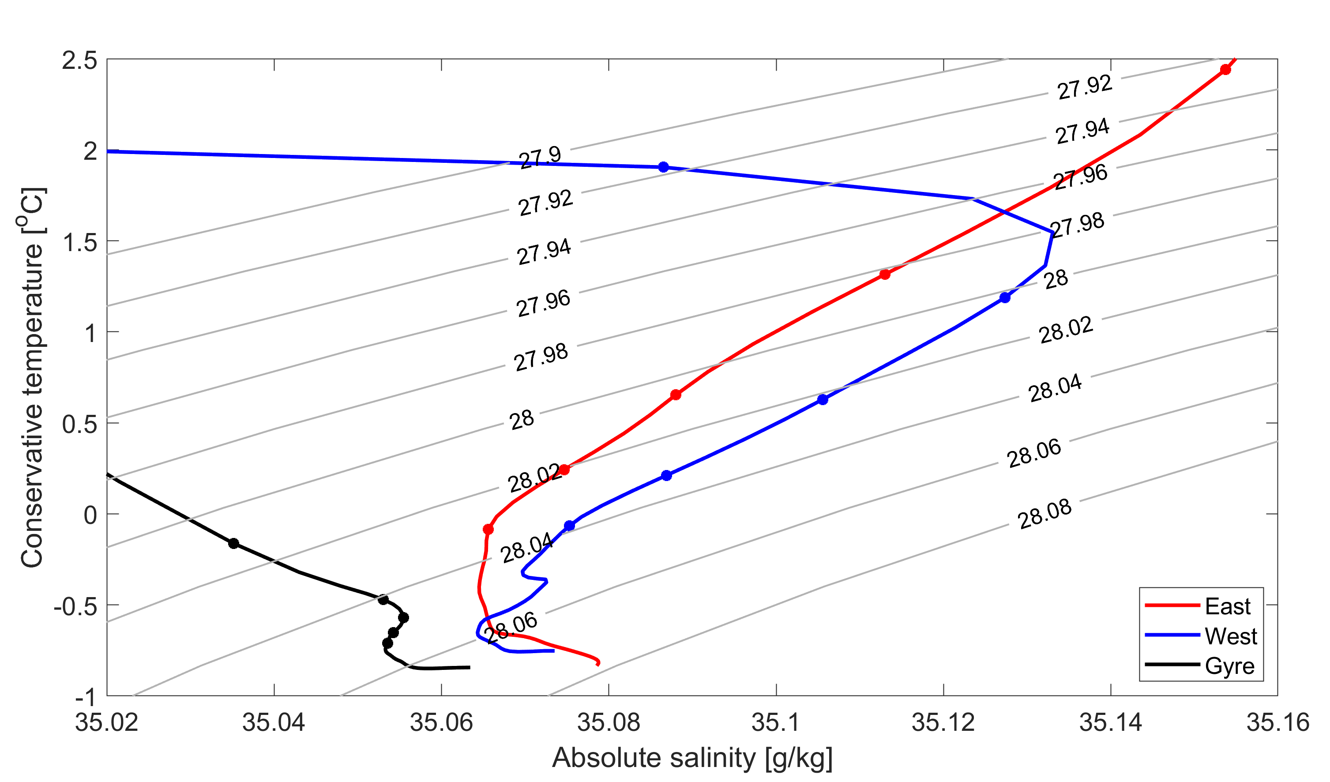
Origin of lateral heat and salt fluxes into the Greenland Sea Gyre???

Slide 23
Summary
Mixed-layer development through winter can be divided into two phases:
During the cooling phase (Nov-Jan): strong CAOs cool the mixed layer by ~0.08K/day
During the deepening phase (Feb-Apr): strong CAOs deepen the mixed layer by ~40m/day

Slide 24
Summary
Mixed-layer development through winter can be divided into two phases:
During the cooling phase (Nov-Jan): strong CAOs cool the mixed layer by ~0.08K/day
During the deepening phase (Feb-Apr): strong CAOs deepen the mixed layer by ~40m/day
Lateral heat and salt fluxes are important for the mixed-layer development:
Exchange with the East Greenland Current (west) more important than the Norwegian Atlantic Frontal Current (east)???

