Slide 1
Overturning in the Nordic Seas from 2002 to 2017 in the Arctic Subpolar gyre sTate Estimate (ASTE)
Birgit Rinde
Supervisors: Kjetil Våge & Ailin Brakstad

Slide 2
Scope of thesis
1. Validate ASTE in the Nordic Seas: how well is it reproducing the features of the Nordic Seas?
2. Use ASTE to gain insight into overturning: how much dense water is formed, where is it formed, and through what pathways does it travel?

Slide 3
ASTE
“a data-constrained ocean-sea ice model-data synthesis”
Based on ECCO
State estimate constrained by (a billion) satellite - and in situ observations
Strictly obedient to physical laws (thus free of any artificial and un-physical sources and sinks)
Nominal resolution of 1/3º (about 16 km in the Nordic Seas)
50 unevenly spaced vertical levels
Time span from 2002 to 2017.
Generally good performance in the Arctic and in the Barents Sea

Slide 4
Validation: how well does ASTE reproduce the main features of the Nordic Seas?

Slide 5
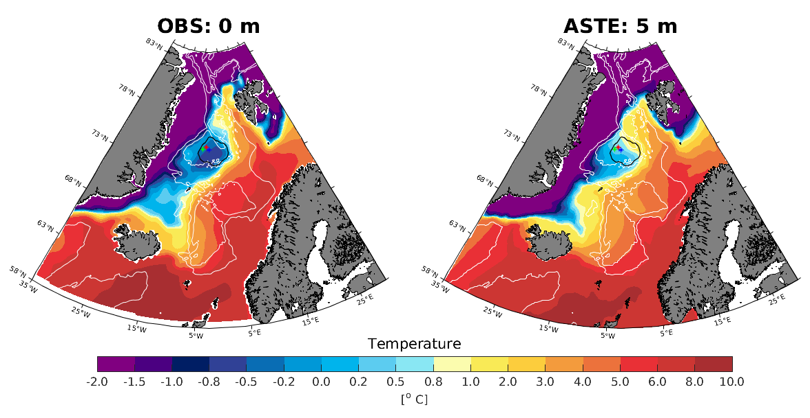
Surface potential temperature

Slide 6
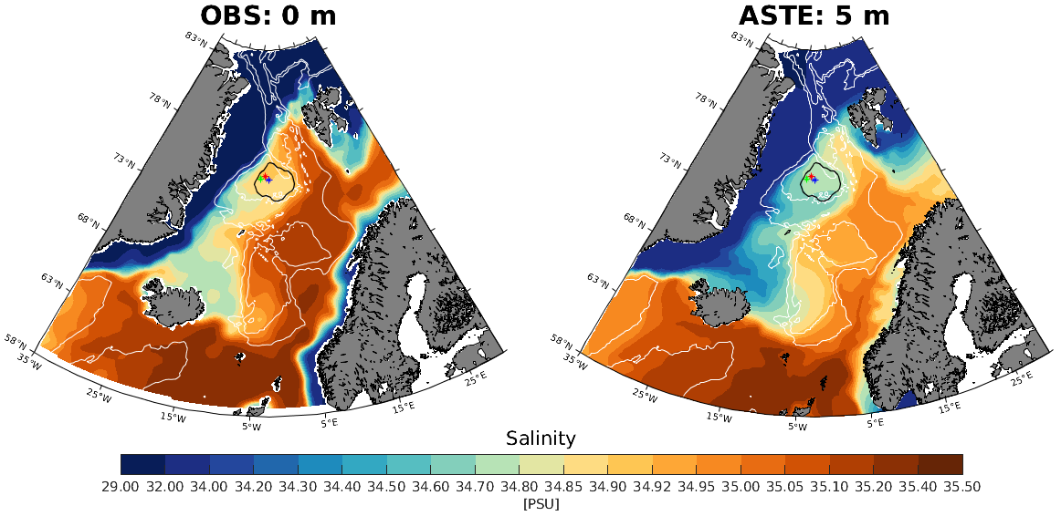
Surface salinity

Slide 7
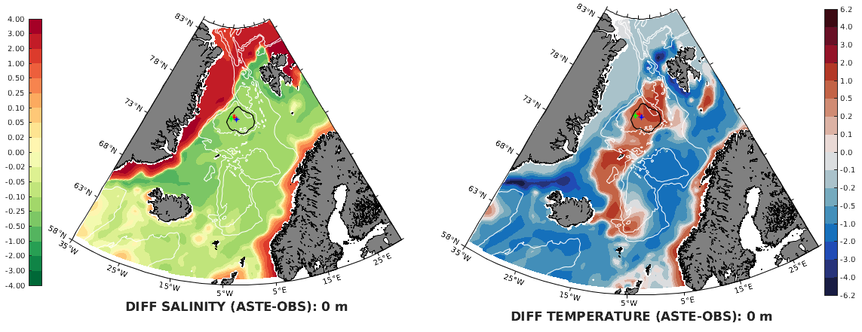
Surface differences between ASTE and observations

Slide 8
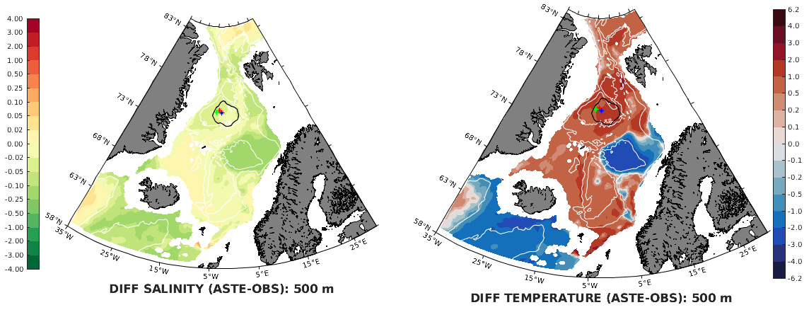
500 m

Slide 9
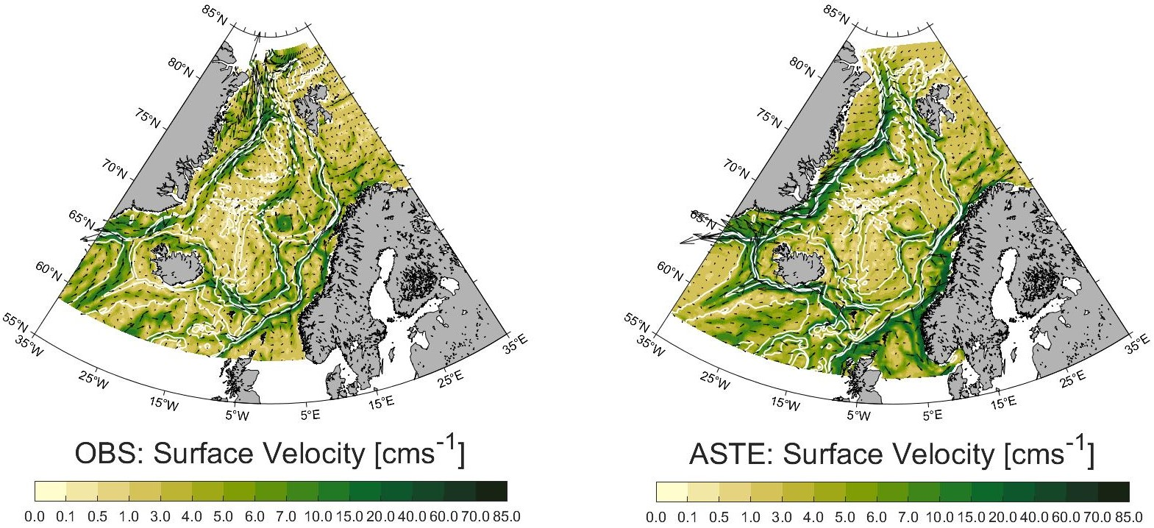

Slide 10
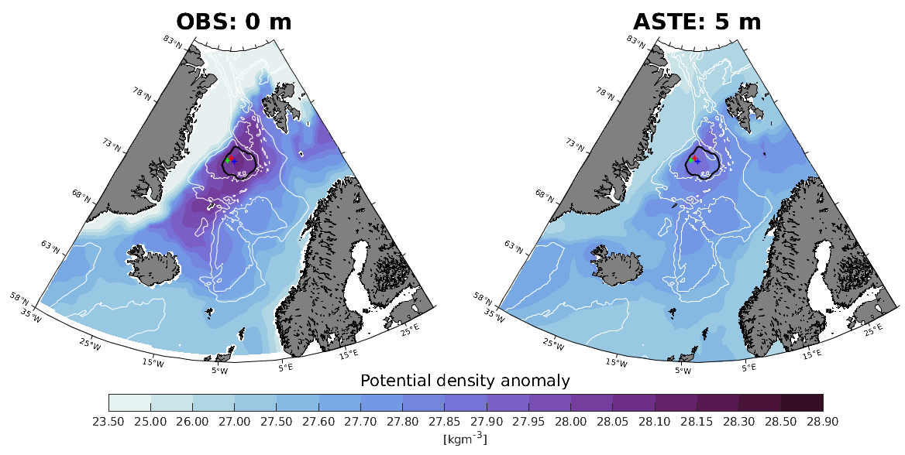

Slide 11
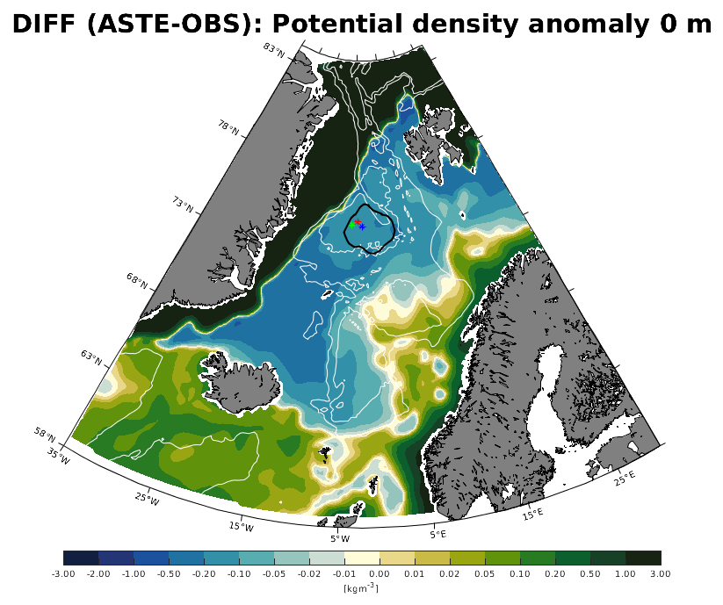
Greenland Sea: Too light by 0.2 kg/m3
Iceland Sea:
Too light by 0.5 kg/m3

Slide 12
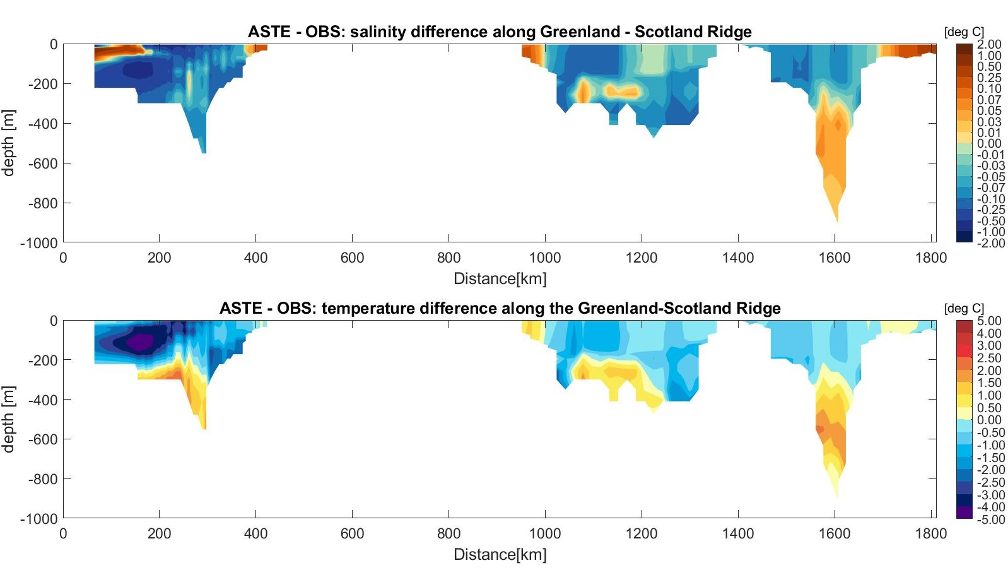
DS
IFR
FSC
DS
IFR
FSC

Slide 13
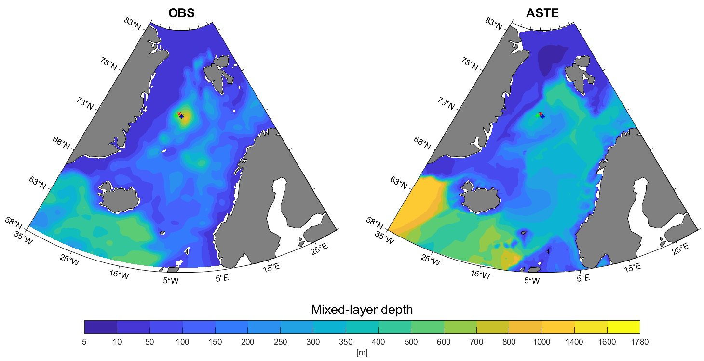
Mixed-layer depth

Slide 14
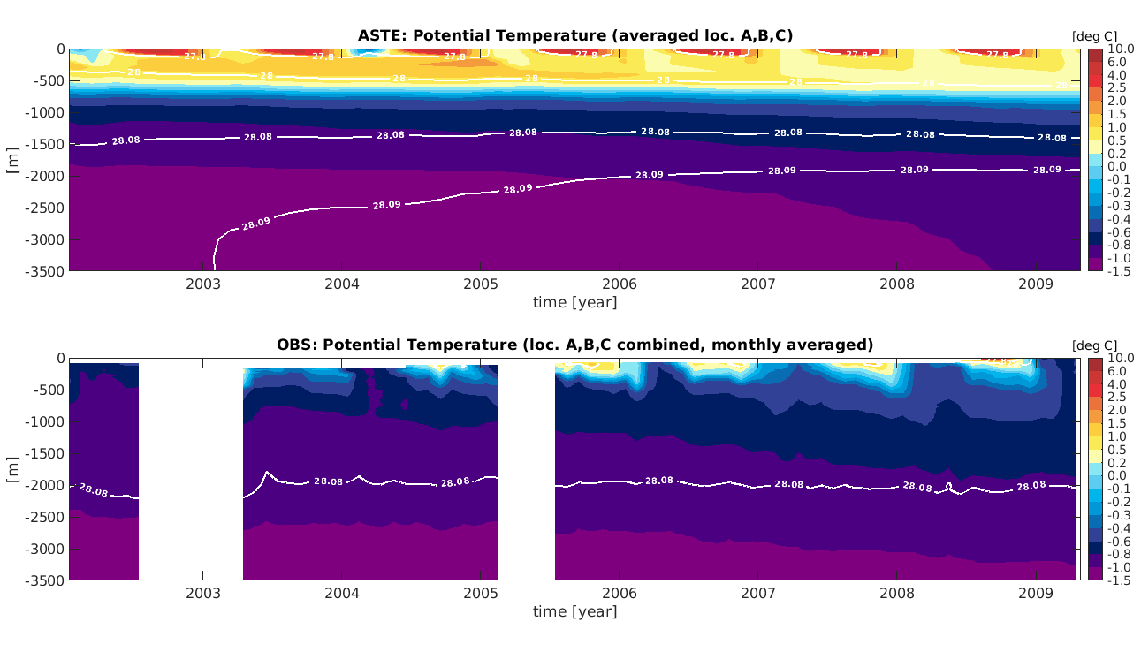

Slide 15
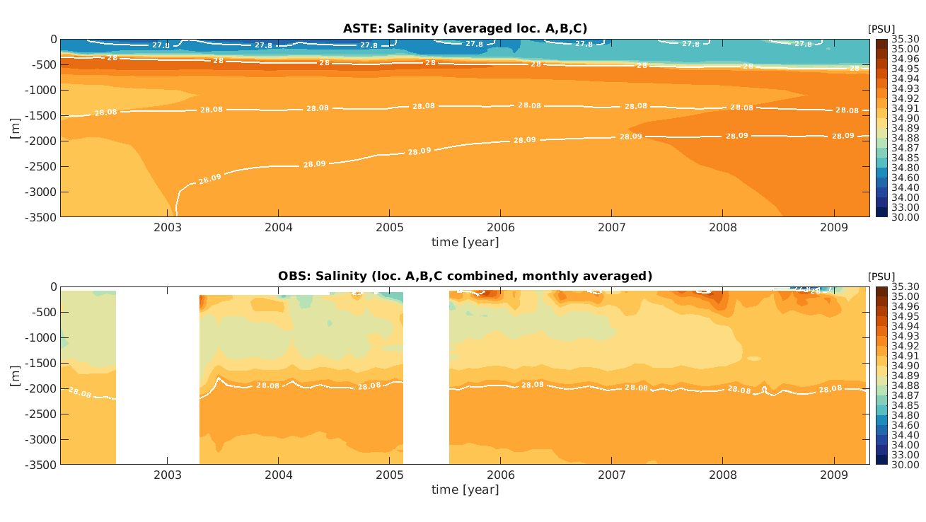

Slide 16
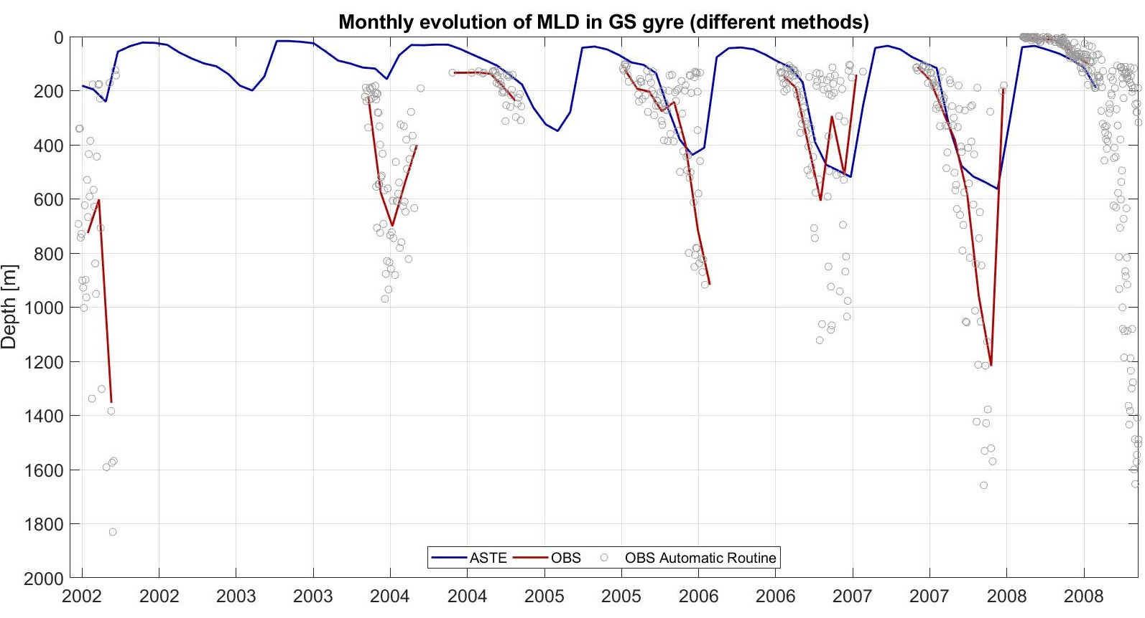

Slide 17
Conclusion:
ASTE is biased warm and fresh down to 1000 m, especially in the Greenland and Iceland Seas
Thus, ASTE is biased low in density (around 0.1 – 0.5 kg/m3 in the upper western Nordic Seas)
Mixed-layer depths are generally too deep over too large an area, but too shallow in the Greenland Sea and in the Lofoten Basin Eddy
Overflow waters are biased low in density, and the volume they constitute is small compared to observations
Representative for a future warmer climate

Slide 18
Water mass transformation in the four main basins of the Nordic Seas

Slide 19
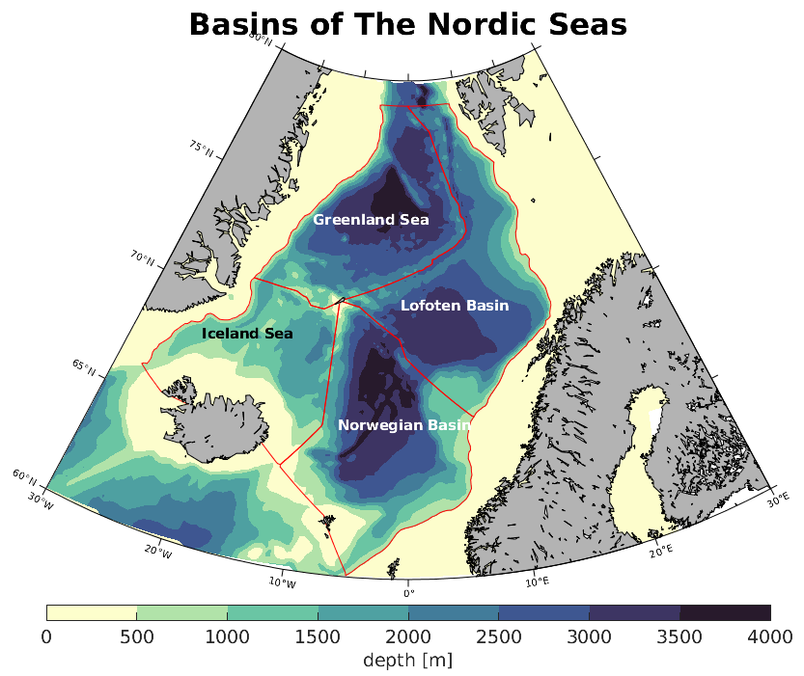
Greenland
Sea
Lofoten
Basin
Iceland
Sea
Norwegian
Basin

Slide 20
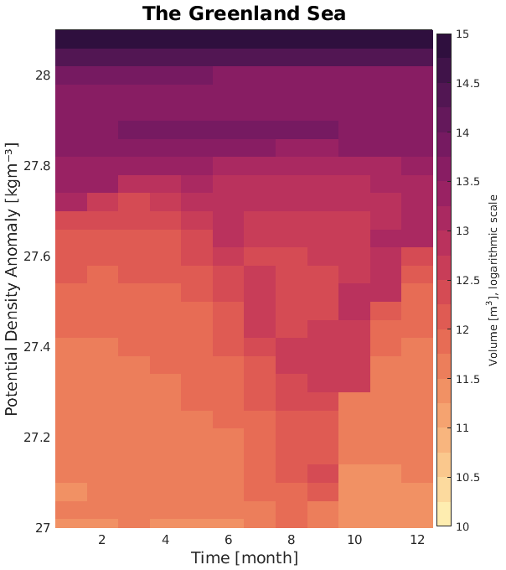
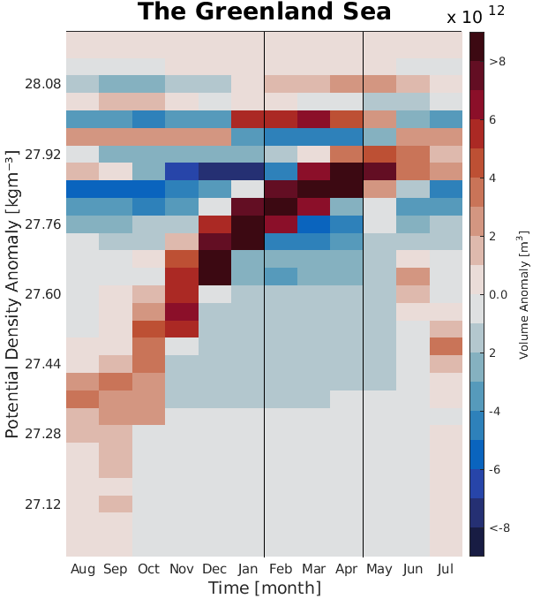

Slide 21
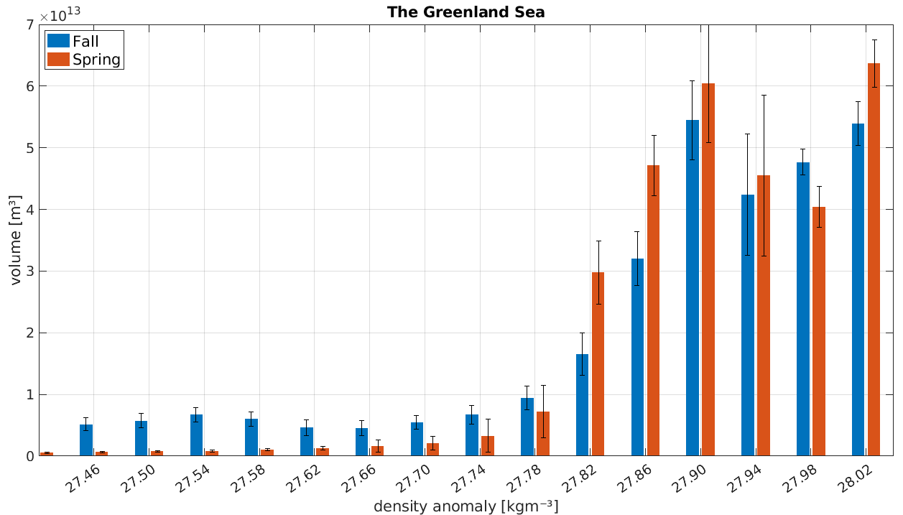
?
Main product: 27.80 – 27.92 kg/m3
Notes:
Interannual variability? Large domains? Advection?

Slide 22
Next steps:
Investigate exchange between basins
What are the main dense water pathways in and out of the basins?
Closed volume, heat and freshwater budgets?
Suggestions?

Slide 23
Supplementary Figures

Slide 24
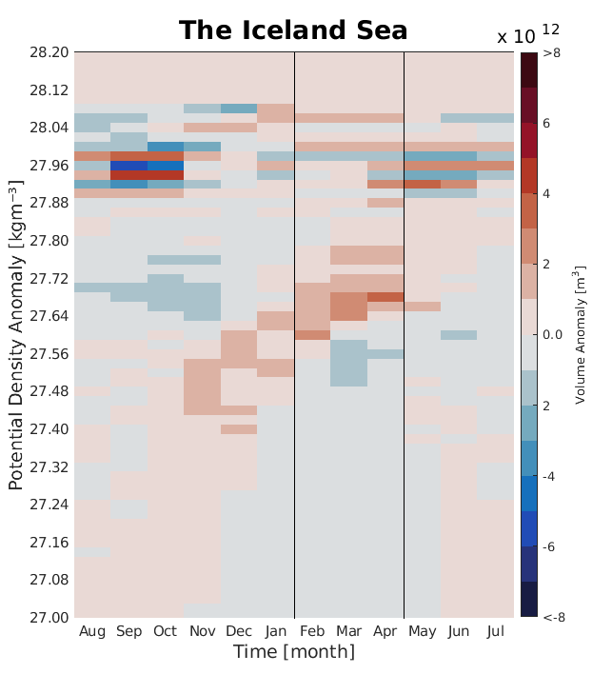

Slide 25
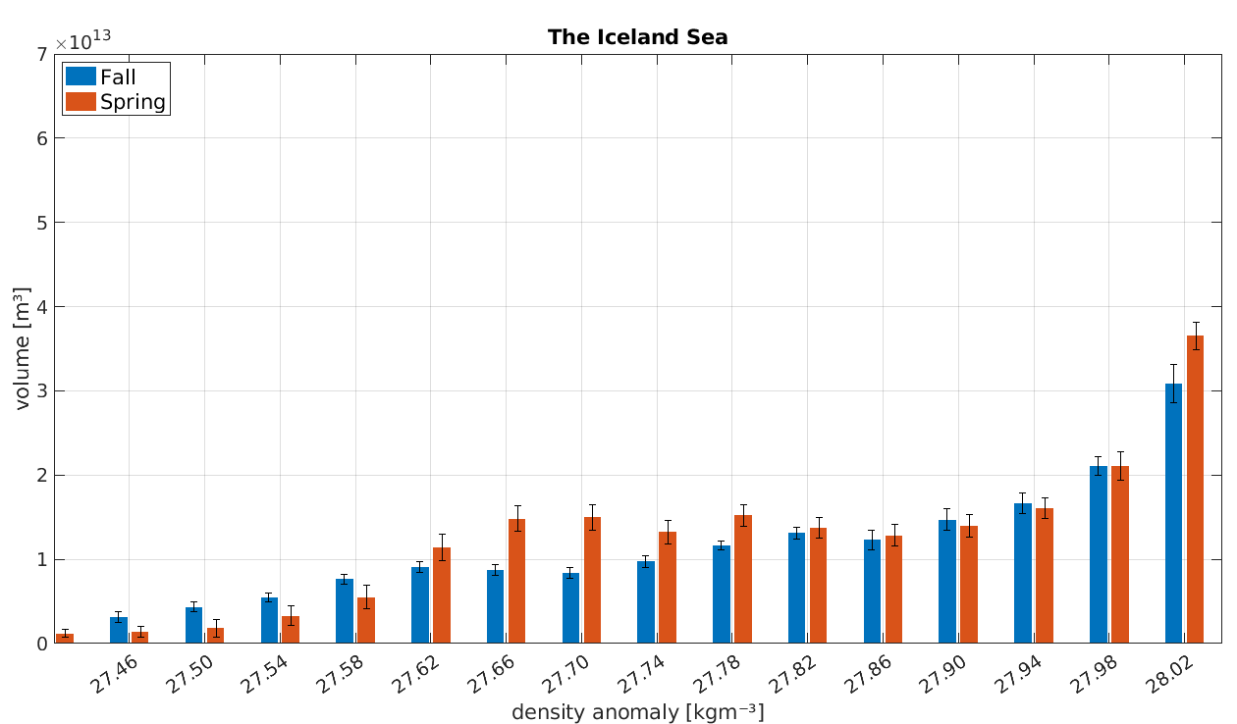
Main product: 27.62 – 27.78 kg/m3
?

Slide 26
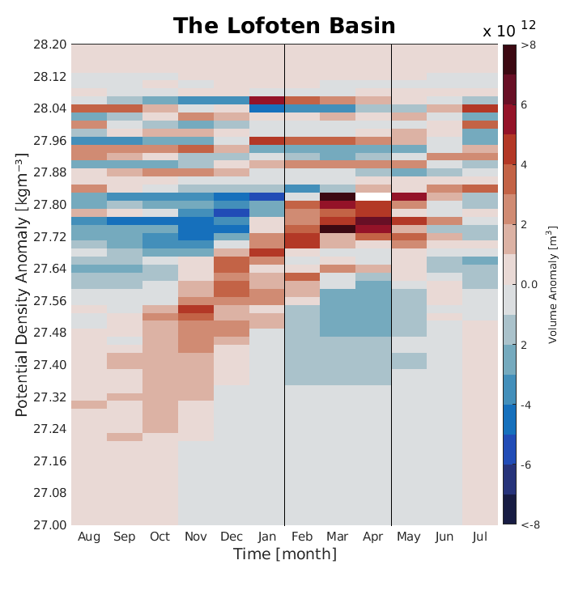

Slide 27
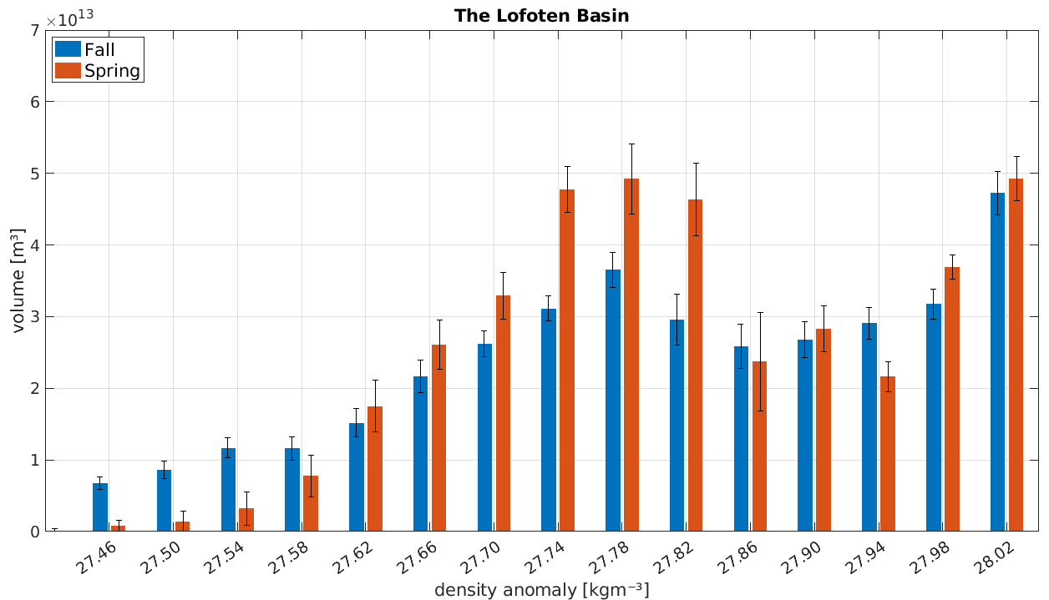
Main product: 27.66 – 27.82 kg/m3

Slide 28
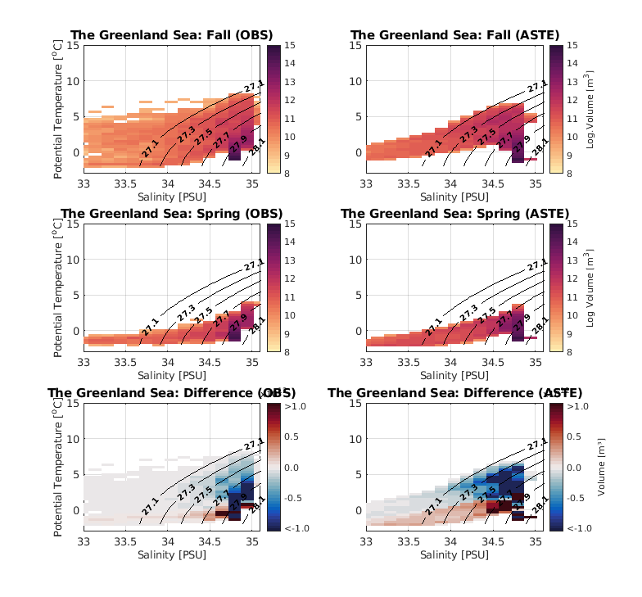
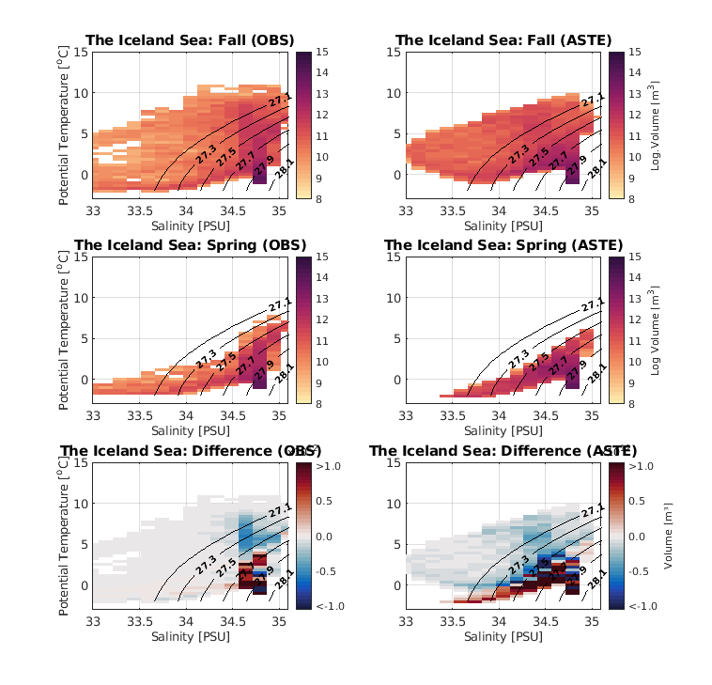
The Greenland Sea
The Iceland Sea

Slide 29
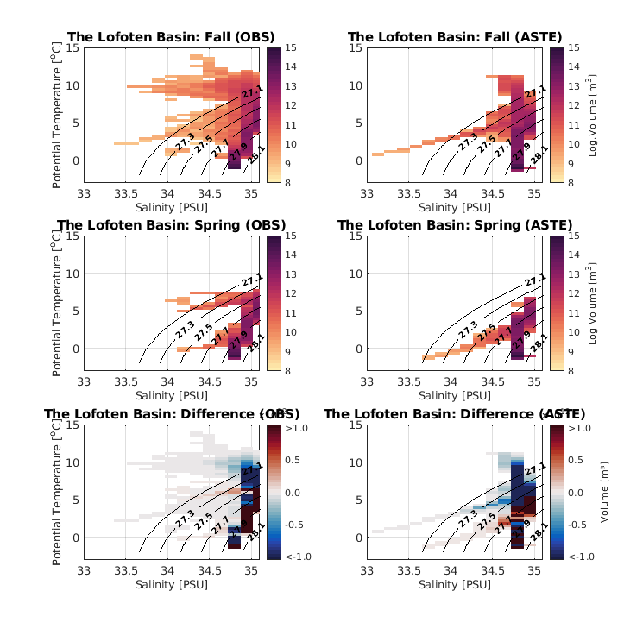
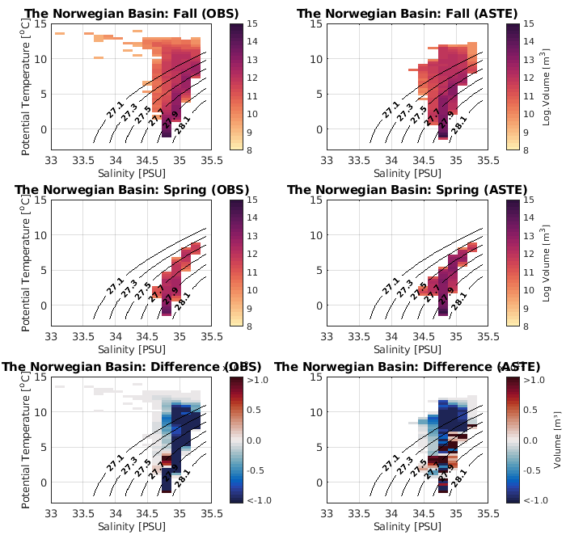
The Lofoten Basin
The Norwegian Basin

Slide 30
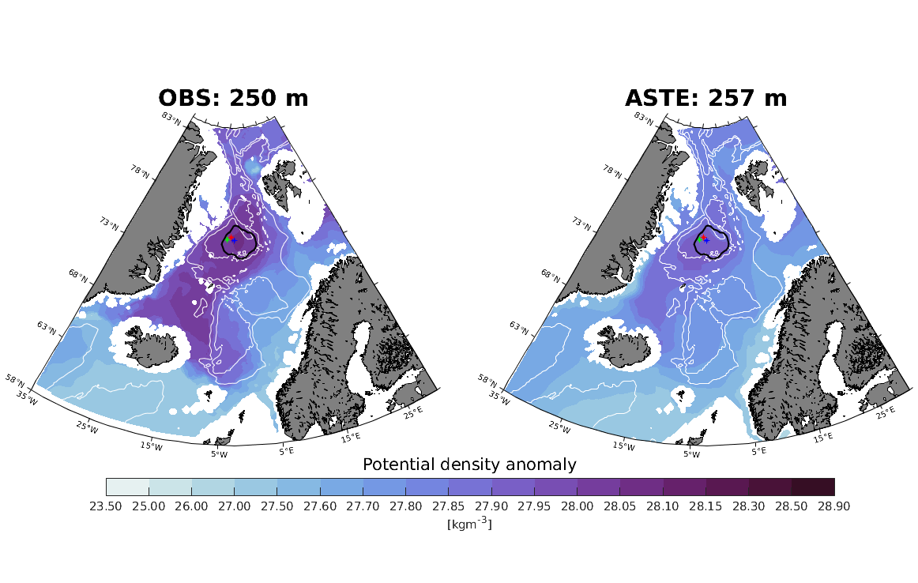

Slide 31
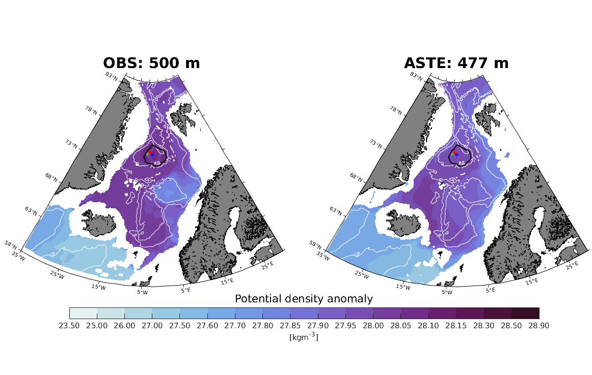

Slide 32
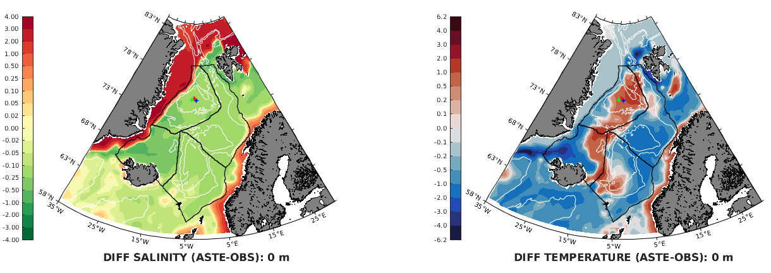

Slide 33
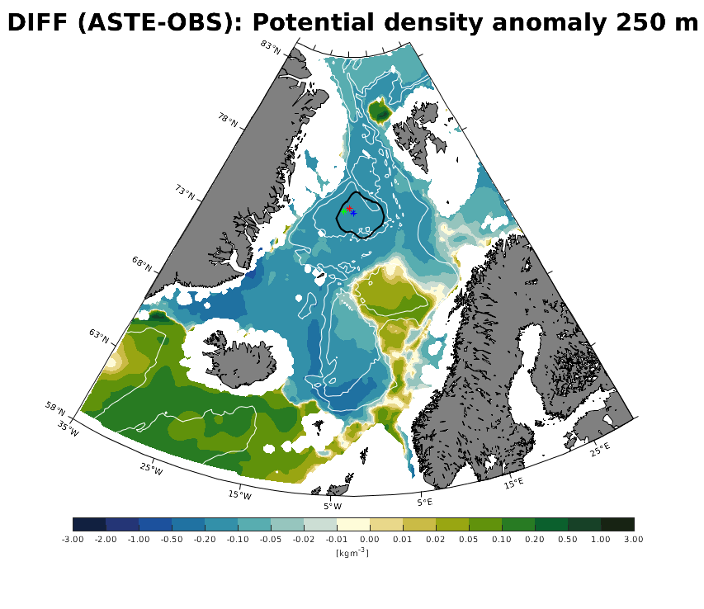

Slide 34
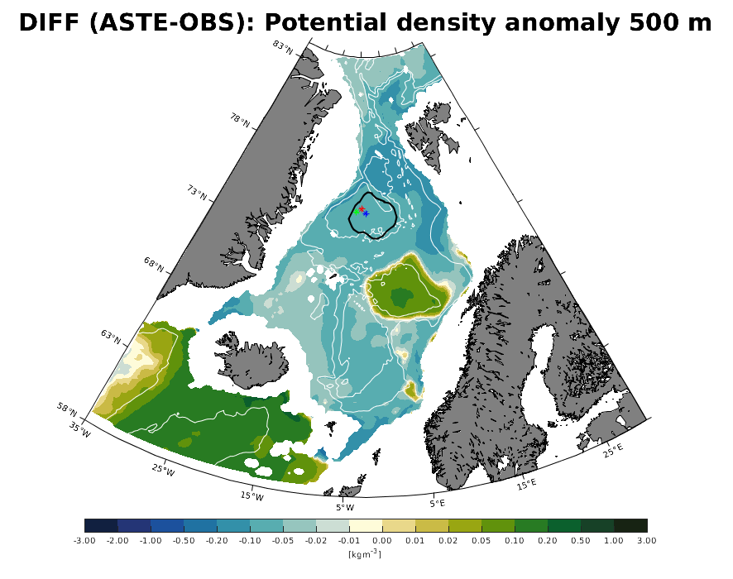

Slide 35
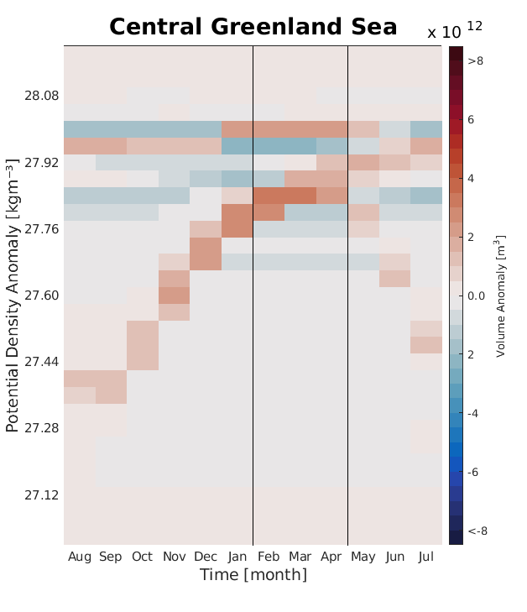

Slide 36
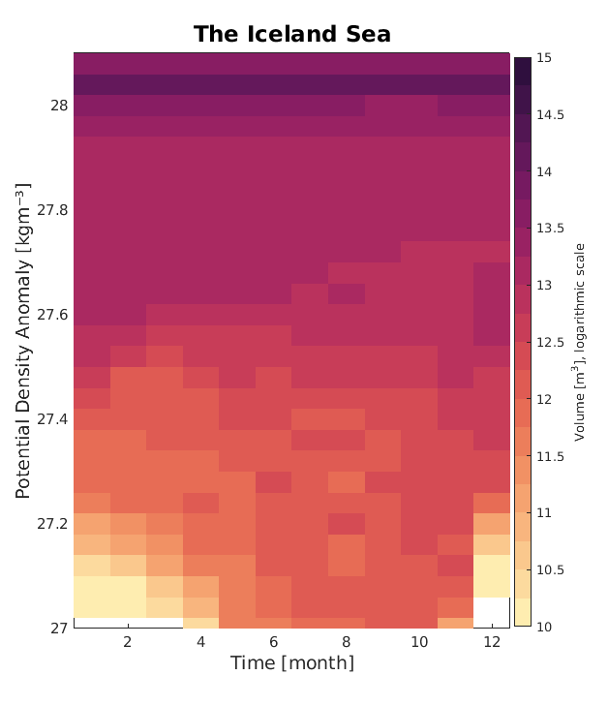

Slide 37
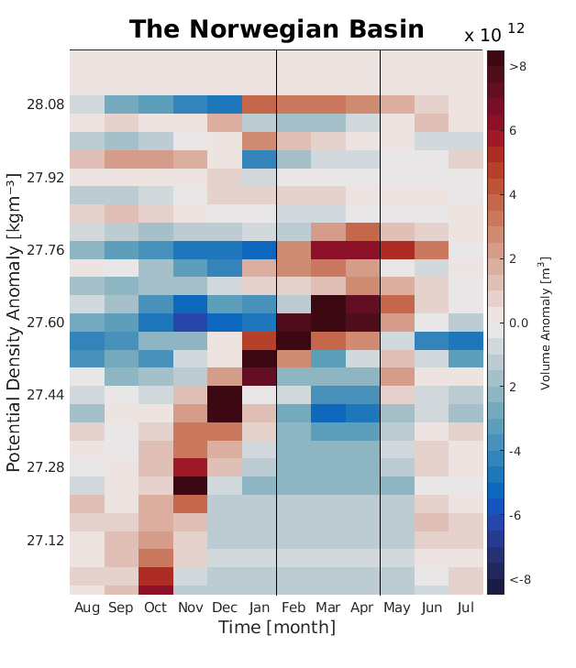

Slide 38
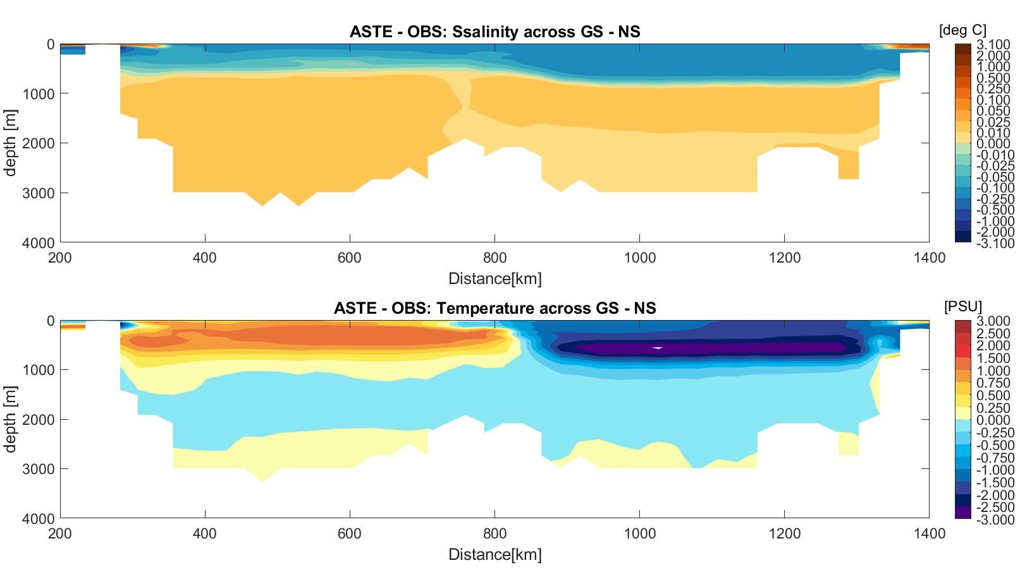

Slide 39
Comments:
Put error bars on bar charts, and be specific of partitioning
After your validation, explain more about the motivation for future work
Check resolution of velocity observations
Stagger!
Tell them about what values we expect

