Slide 1

Deep weakly-stratified layers in the
Greenland Sea
Joan Mateu Horrach Pou
24th March 2022
Supervised by Kjetil Våge and Ailin Brakstad
UNIVERSITY OF BERGEN
GEOPHYSICAL INSTITUTE

Slide 2
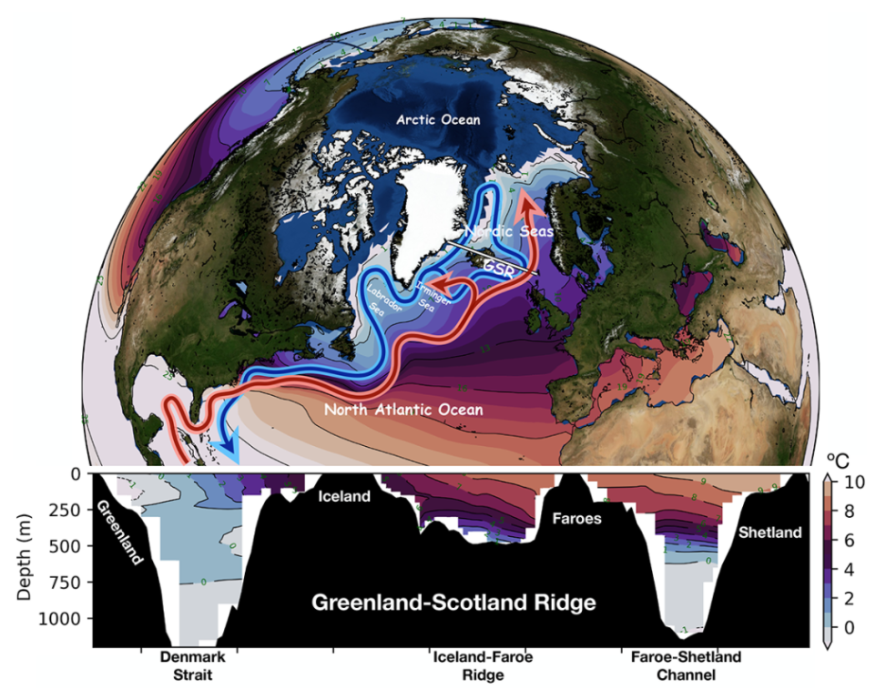
Background and motivation – Data and methods – Results – Conclussions – Future work
The AMOC
Chafik et al., (2021)
Notes:
THE AMOC PLAYS A KEY ROLE ON SUSTAINING THE GLOBAL CLIMATE
UPPER BRANCH TRANSP OF HEAT FROM THE EQUATOR TOWARD HIGH LATITUDES
LOWER BRANCH RETURNS AS COLD DENSE INTERMEDIATE AND DENSE WATER.
WHERE DO THE UPPER AND LOWER BRANCH CONECT?
E OF GREENLAND, SPECIFICALLY IN THE NORDIC SEAS

Slide 3
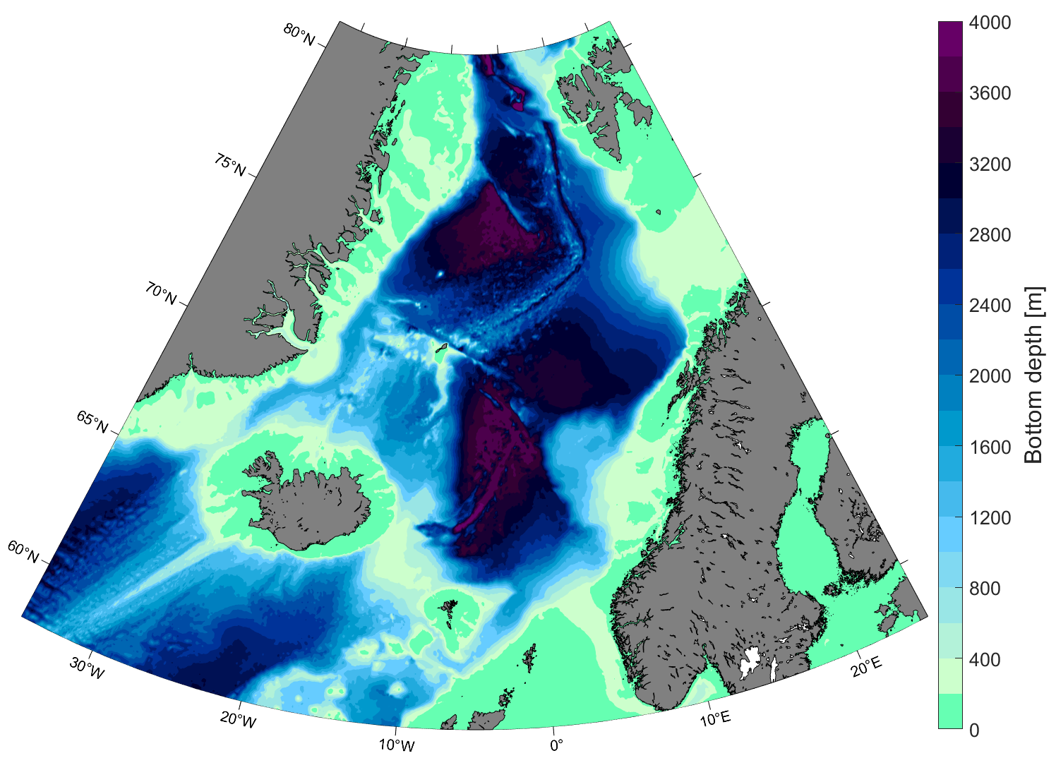
Background and motivation – Data and methods – Results – Conclussions – Future work
The Nordic Seas
Arctic Ocean
Overturning
Fram Strait
Svalbard
Boreas
Basin
Barents
Sea
Greenland
Knipovich Ridge
Greenland
Sea
Mohn Ridge
WJMR
Lofoten
Basin
Denmark
Strait
Iceland
Sea
Norwegian
Sea
Jan Mayen Ridge
Norwegian
Basin
Iceland
Reykjanes Ridge
Norway
Notes:
THE NORDIC SEAS IS WHERE

Slide 4
Background and motivation – Data and methods – Results – Conclussions – Future work
The Nordic Seas
Arctic Ocean
Overturning
Boundary current system (Mauritzen 1996)
Fram Strait
Svalbard
Boreas
Basin
WSC
Barents
Sea
Greenland
Knipovich Ridge
Greenland
Sea
Mohn Ridge
WJMR
Lofoten
Basin
Denmark
Strait
Iceland
Sea
Norwegian
Sea
NIIC
Jan Mayen Ridge
Norwegian
Basin
Iceland
NwAC
NwAC
Reykjanes Ridge
Norway
Notes:
MOST OF THE DENSE WATER IS FORMED THROUGH GRADUAL DENSIFICATION OF AW IN THE BOUNDARY CURRENT SYSTEM

Slide 5
Background and motivation – Data and methods – Results – Conclussions – Future work
The Nordic Seas
Arctic Ocean
Overturning
Boundary current system (Mauritzen 1996)
Fram Strait
Svalbard
Boreas
Basin
WSC
Barents
Sea
Greenland
Knipovich Ridge
Greenland
Sea
East Greenland Current
Mohn Ridge
NIJ
JMC
WJMR
Lofoten
Basin
Denmark
Strait
Iceland
Sea
EIC
Norwegian
Sea
NIIC
Jan Mayen Ridge
Norwegian
Basin
Iceland
NwAC
NwAC
Reykjanes Ridge
Norway
Notes:
THESE WATERS LEAVE THE NS VIA THE EGC IN THE DENMAKR STRAIT

Slide 6
Background and motivation – Data and methods – Results – Conclussions – Future work
The Nordic Seas
Arctic Ocean
Overturning
Boundary current system (Mauritzen 1996)
Open-ocean convection (Huang et al., 2020)
Fram Strait
Svalbard
Boreas
Basin
WSC
Barents
Sea
Greenland
Knipovich Ridge
Greenland
Sea
East Greenland Current
Mohn Ridge
NIJ
JMC
WJMR
Lofoten
Basin
Denmark
Strait
Iceland
Sea
NIJ
EIC
Norwegian
Sea
NIIC
Jan Mayen Ridge
Norwegian
Basin
Iceland
IFSJ
NwAC
NwAC
Reykjanes Ridge
Norway
Notes:
HOWEVER THE DENSEST PORTION OF THE OVERFLOWS ON BOTH SIDES OF ICELAND IS PRODUCED THROUGH OPEN OCEAN CONVECTION
MAINLY IN THE GREENLAND SEA

Slide 7
Background and motivation – Data and methods – Results – Conclussions – Future work
Convection in the Greenland Sea
Density
1000
2000
Depth (m)
3000
Previous to 1980

Slide 8
Background and motivation – Data and methods – Results – Conclussions – Future work
Convection in the Greenland Sea
Density
1000
After 1980
2000
Depth (m)
3000
Previous to 1980

Slide 9
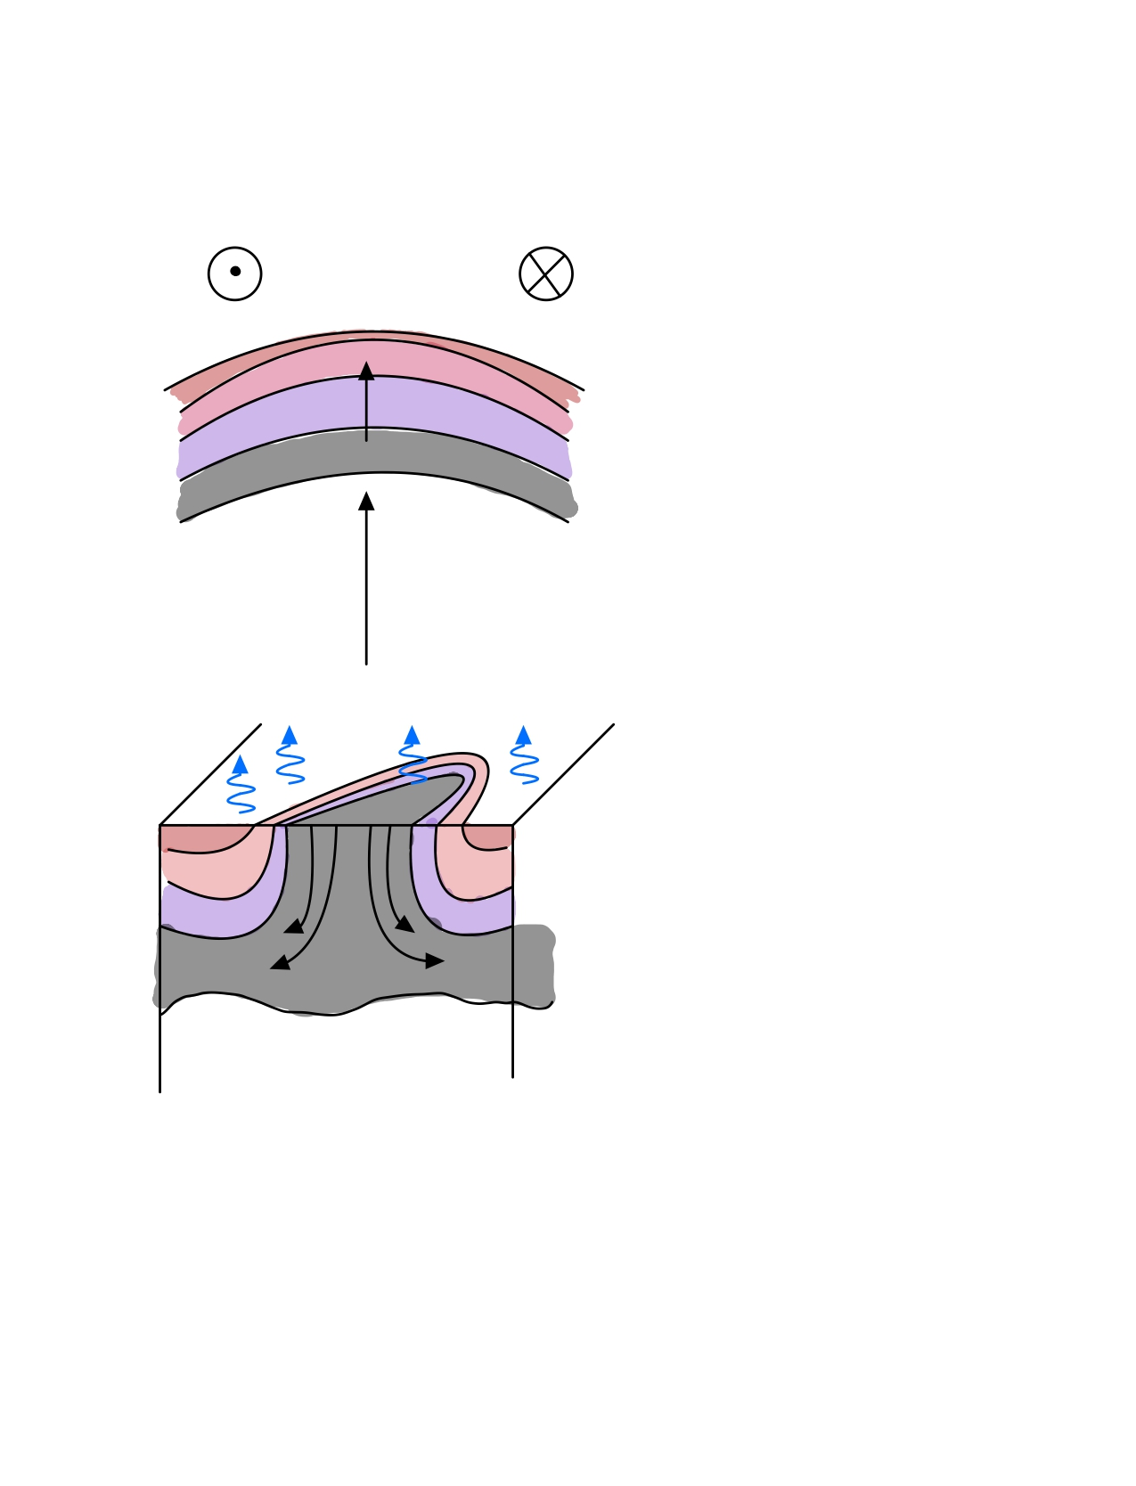
Background and motivation – Data and methods – Results – Conclussions – Future work
Convection in the Greenland Sea
Convection takes place in 3 phases:
1)Preconditioning
Cylonic gyre circulation
Previous convective events

Slide 10
Background and motivation – Data and methods – Results – Conclussions – Future work
Convection in the Greenland Sea
Convection takes place in 3 phases:
1)Preconditioning
2)Convection
Cylonic gyre circulation
Previous convective events

Slide 11
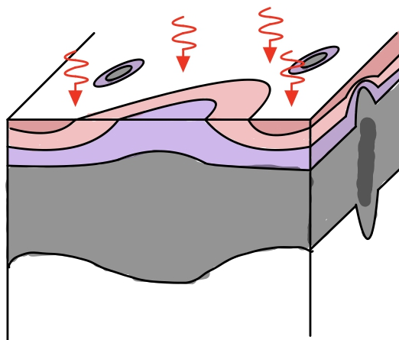
Background and motivation – Data and methods – Results – Conclussions – Future work
Convection in the Greenland Sea
Convection takes place in 3 phases:
1)Preconditioning
2)Convection
3)Restratification
Cylonic gyre circulation
Previous convective events

Slide 12
Background and motivation – Data and methods – Results – Conclussions – Future work
Convection in the Greenland Sea
Convection takes place in 3 phases:
1)Preconditioning
2)Convection
3)Restratification
Cylonic gyre circulation
Previous convective events
Different scales involved
  50-100km convective patch

Slide 13
Background and motivation – Data and methods – Results – Conclussions – Future work
Convection in the Greenland Sea
Convection takes place in 3 phases:
1)Preconditioning
2)Convection
3)Restratification
Cylonic gyre circulation
Previous convective events
Different scales involved
  50-100km convective patch
  <1 km convective plumes

Slide 14
Background and motivation – Data and methods – Results – Conclussions – Future work
Convection in the Greenland Sea
Convection takes place in 3 phases:
1)Preconditioning
2)Convection
3)Restratification
Cylonic gyre circulation
Previous convective events
Different scales involved
  50-100km convective patch
  Sub-mesoscale coherent vortices (15-20km)
  <1 km convective plumes

Slide 15
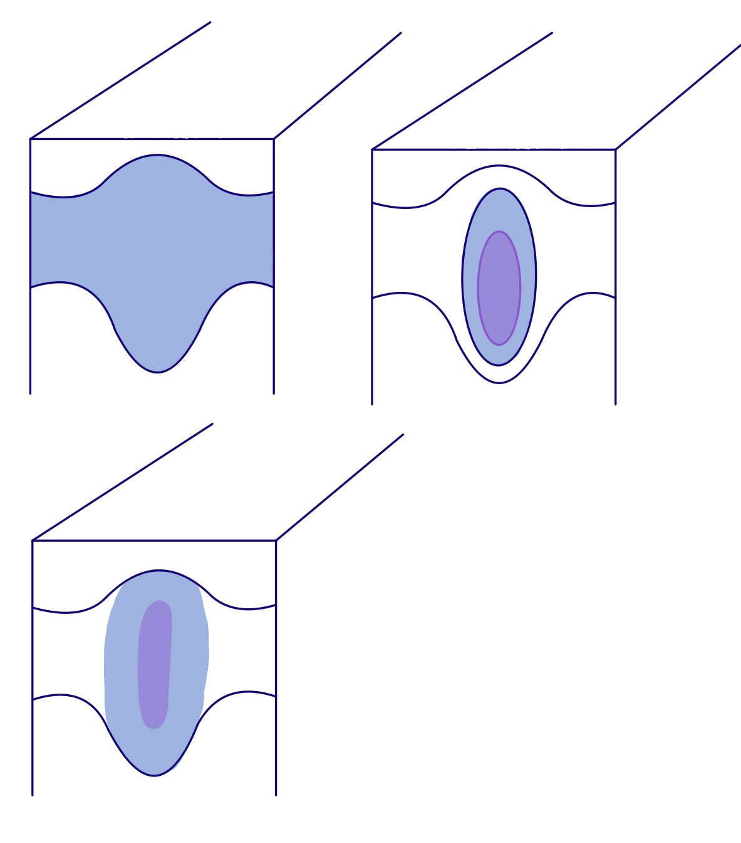
Background and motivation – Data and methods – Results – Conclussions – Future work
Sub-mesoscale cohertent vortices (SCVs)
  Sub-mesoscale (r≤10 km)
r

Slide 16
Background and motivation – Data and methods – Results – Conclussions – Future work
Sub-mesoscale cohertent vortices (SCVs)
  Sub-mesoscale (r≤10 km)
  Colder/Fresher than the environment
Skirt
Core
r

Slide 17
Background and motivation – Data and methods – Results – Conclussions – Future work
Sub-mesoscale cohertent vortices (SCVs)
  Sub-mesoscale (r≤10 km)
  Colder/Fresher than the environment
  Thickness ~ 2000 m
Skirt
Core
r

Slide 18
Background and motivation – Data and methods – Results – Conclussions – Future work
Sub-mesoscale cohertent vortices (SCVs)
  Sub-mesoscale (r≤10 km)
  Colder/Fresher than the environment
  Thickness ~ 2000 m
  Anticyclonic
Skirt
Core
r

Slide 19
Background and motivation – Data and methods – Results – Conclussions – Future work
Sub-mesoscale cohertent vortices (SCVs)
  Sub-mesoscale (r≤10 km)
  Colder/Fresher than the environment
  Thickness ~ 2000 m
  Anticyclonic
  Long lived
Skirt
Core
r

Slide 20
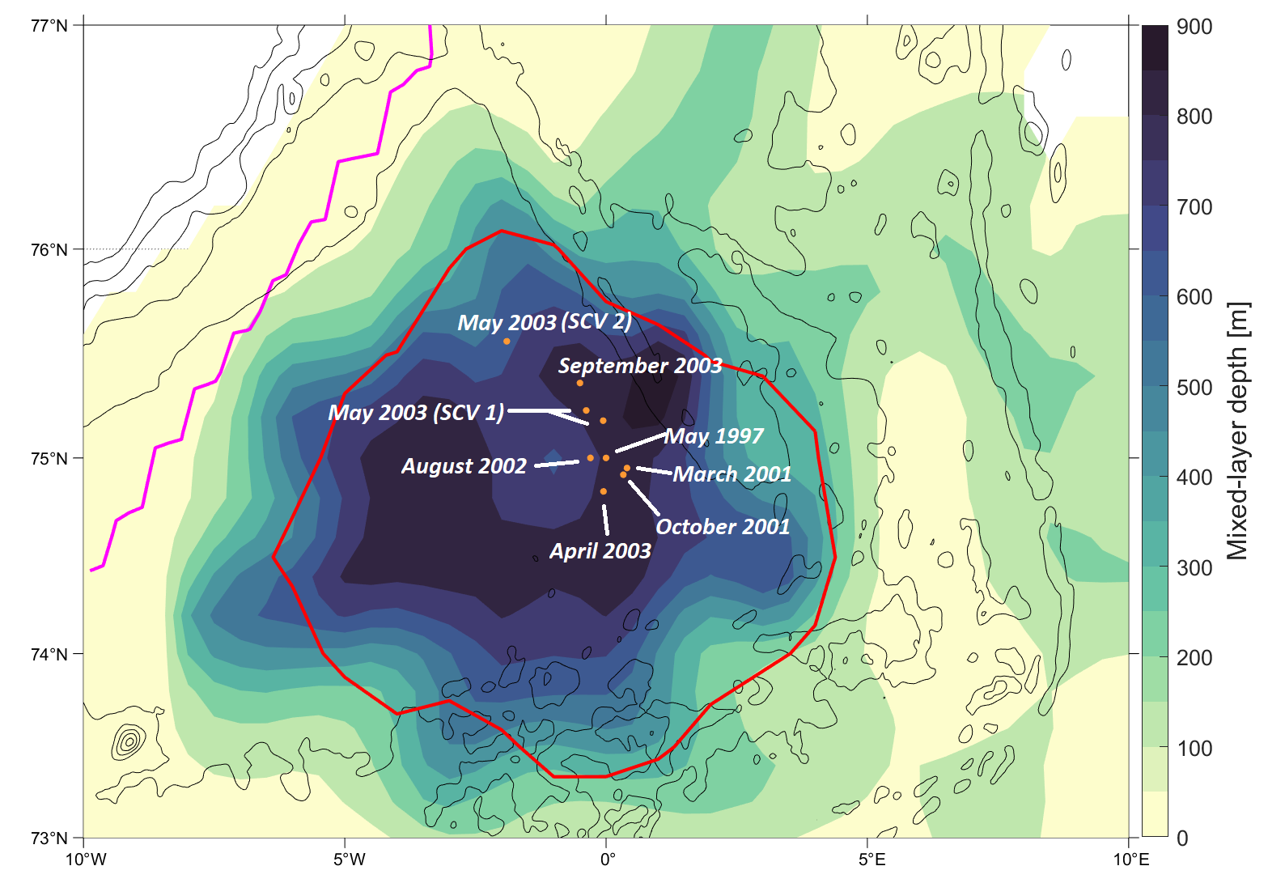
Background and motivation – Data and methods – Results – Conclussions – Future work
Historical observations of SCVs in the Greenland Sea

Slide 21
Background and motivation – Data and methods – Results – Conclussions – Future work
Historical observations of SCVs in the Greenland Sea
  All detected between 1997 and 2003

Slide 22
Background and motivation – Data and methods – Results – Conclussions – Future work
Historical observations of SCVs in the Greenland Sea
  All detected between 1997 and 2003
  Central Greenland Sea

Slide 23
Background and motivation – Data and methods – Results – Conclussions – Future work
Historical observations of SCVs in the Greenland Sea
  All detected between 1997 and 2003
  Central Greenland Sea
  Greenland Fracture Zone

Slide 24
Background and motivation – Data and methods – Results – Conclussions – Future work
Research questions

Slide 25
Background and motivation – Data and methods – Results – Conclussions – Future work
Research questions
When/where are SCVs formed?

Slide 26
Background and motivation – Data and methods – Results – Conclussions – Future work
Research questions
When/where are SCVs formed?
How persistent are SCVs in the Greenland Sea?

Slide 27
Background and motivation – Data and methods – Results – Conclussions – Future work
Research questions
When/where are SCVs formed?
How persistent are SCVs in the Greenland Sea?
What is their role in dense water formation?

Slide 28
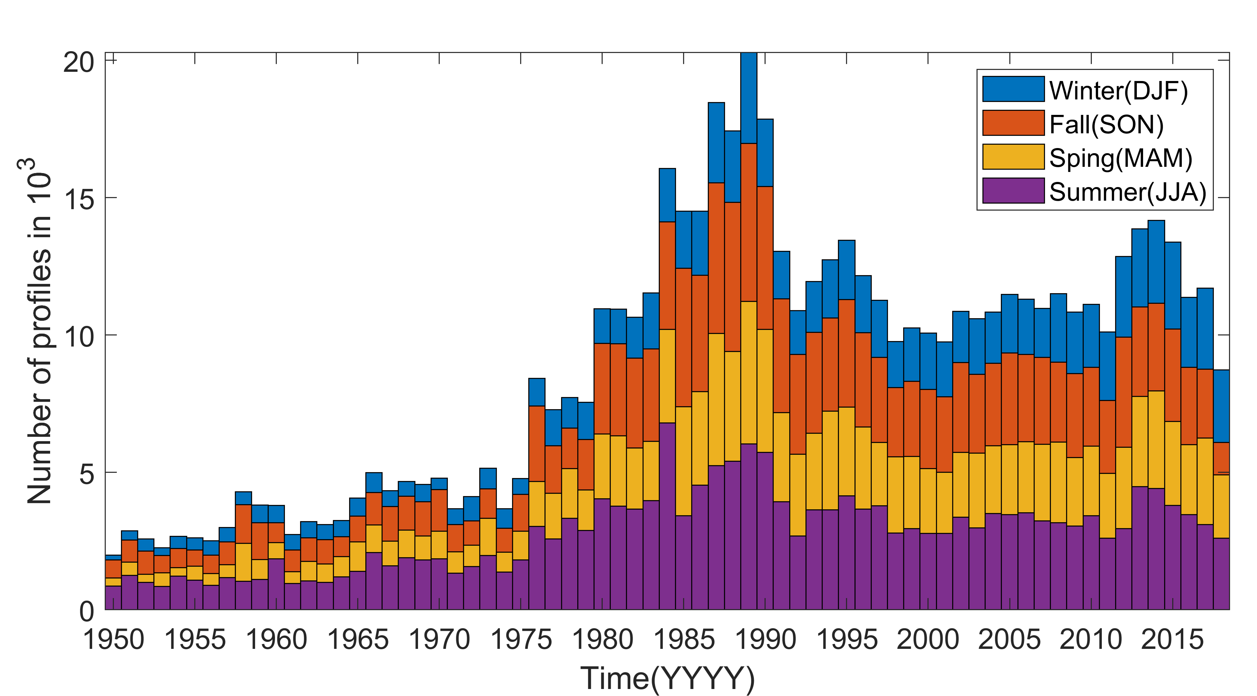
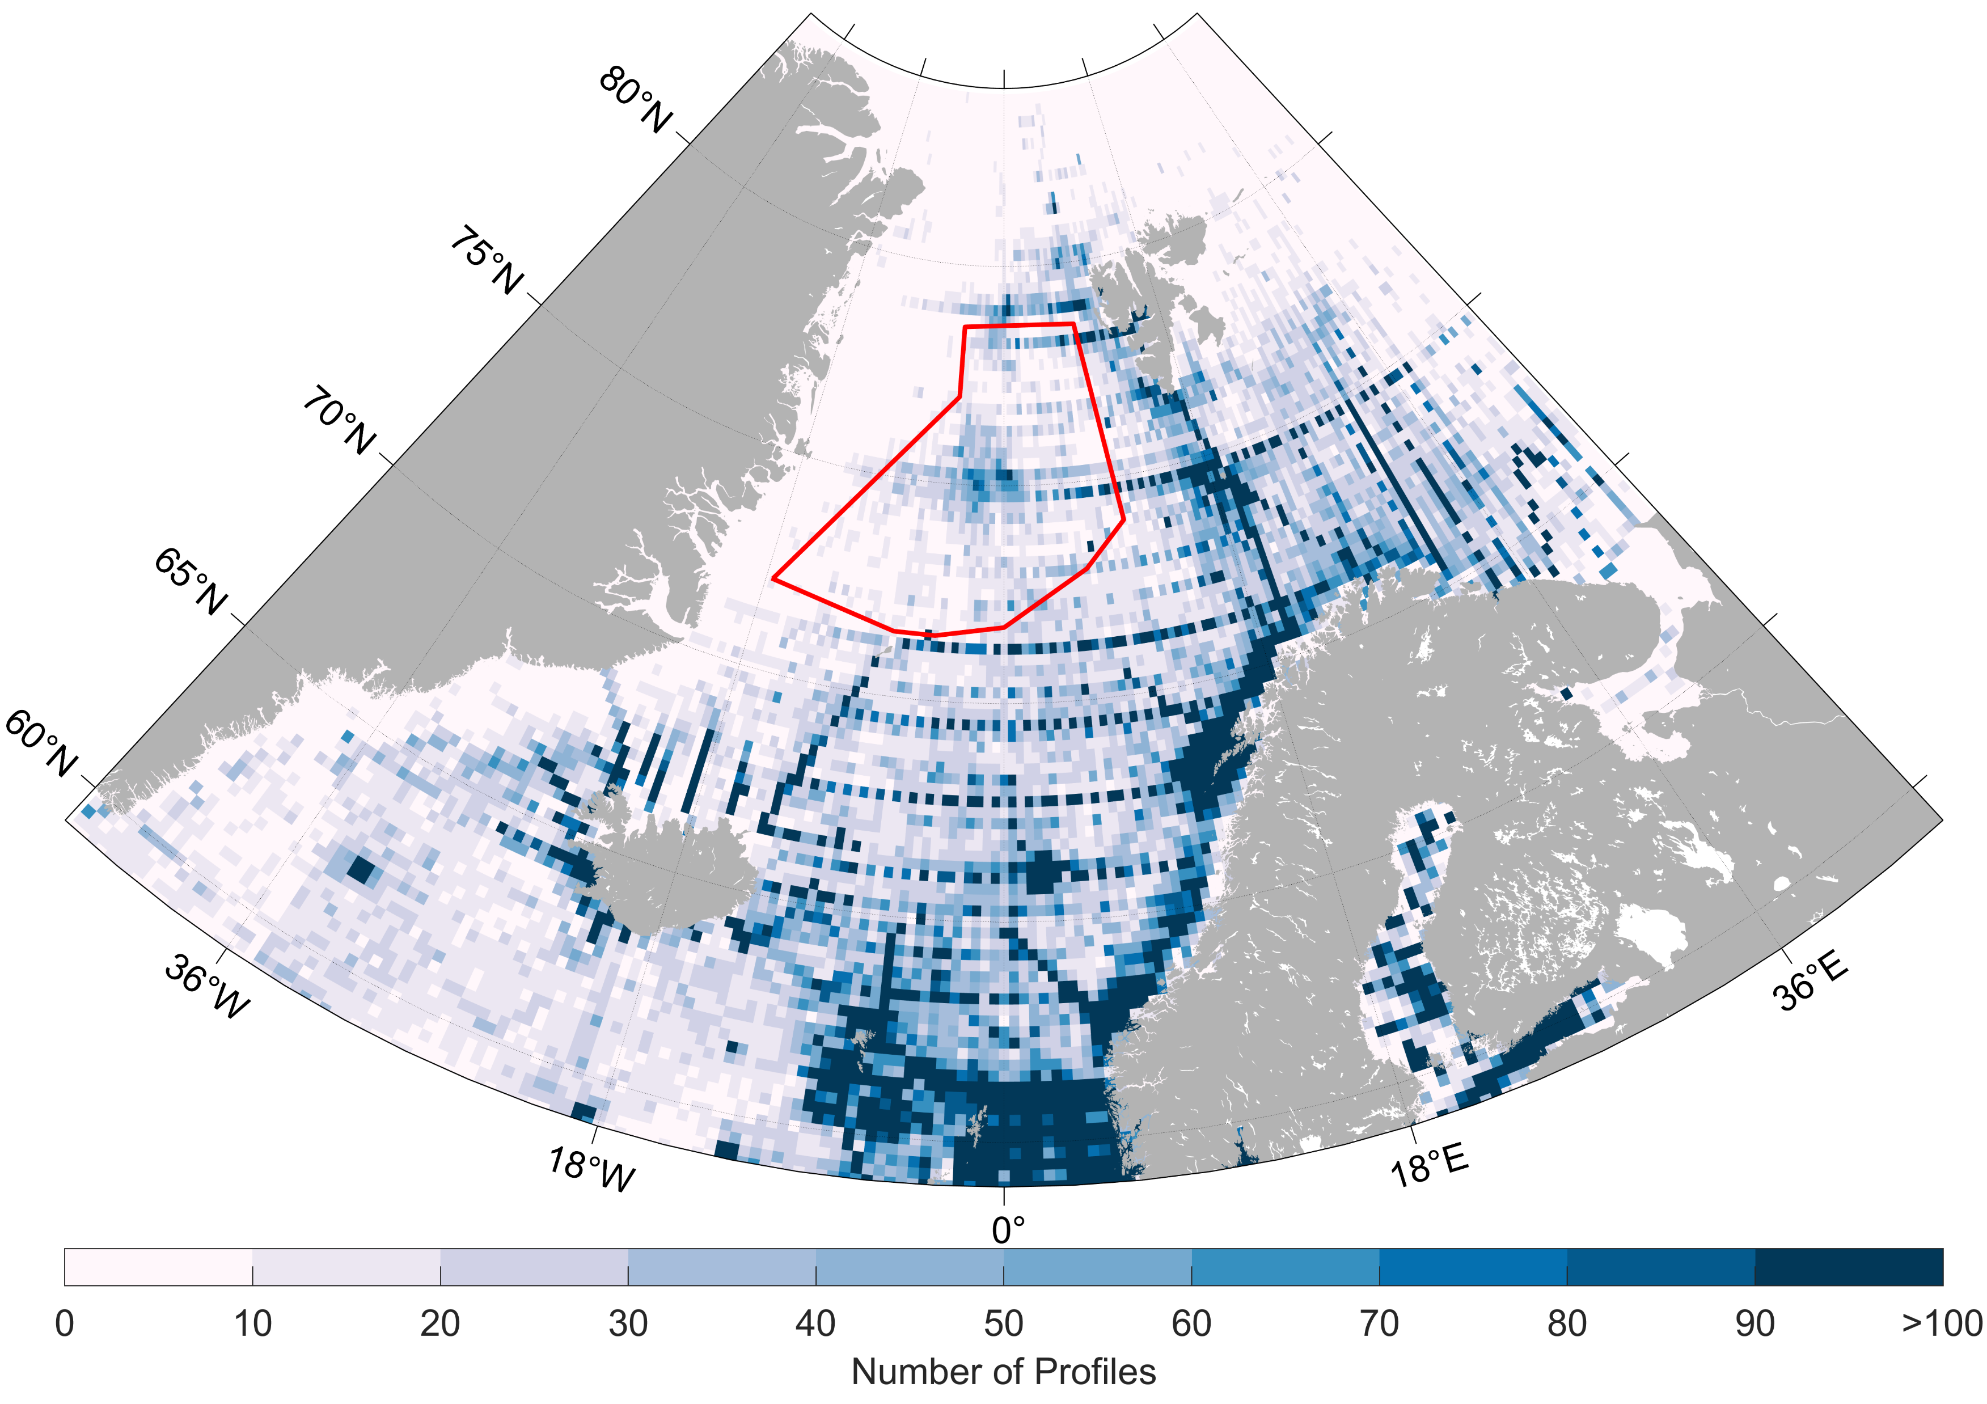
Background and motivation – Data and methods – Results – Conclussions – Future work
Historical hydrographic data set
>500k T, S, and P profiles.

Slide 29
Background and motivation – Data and methods – Results – Conclussions – Future work
Historical hydrographic data set
>500k T, S, and P profiles.
High temporal and spatial resolution.
High vertical resolution.

Slide 30
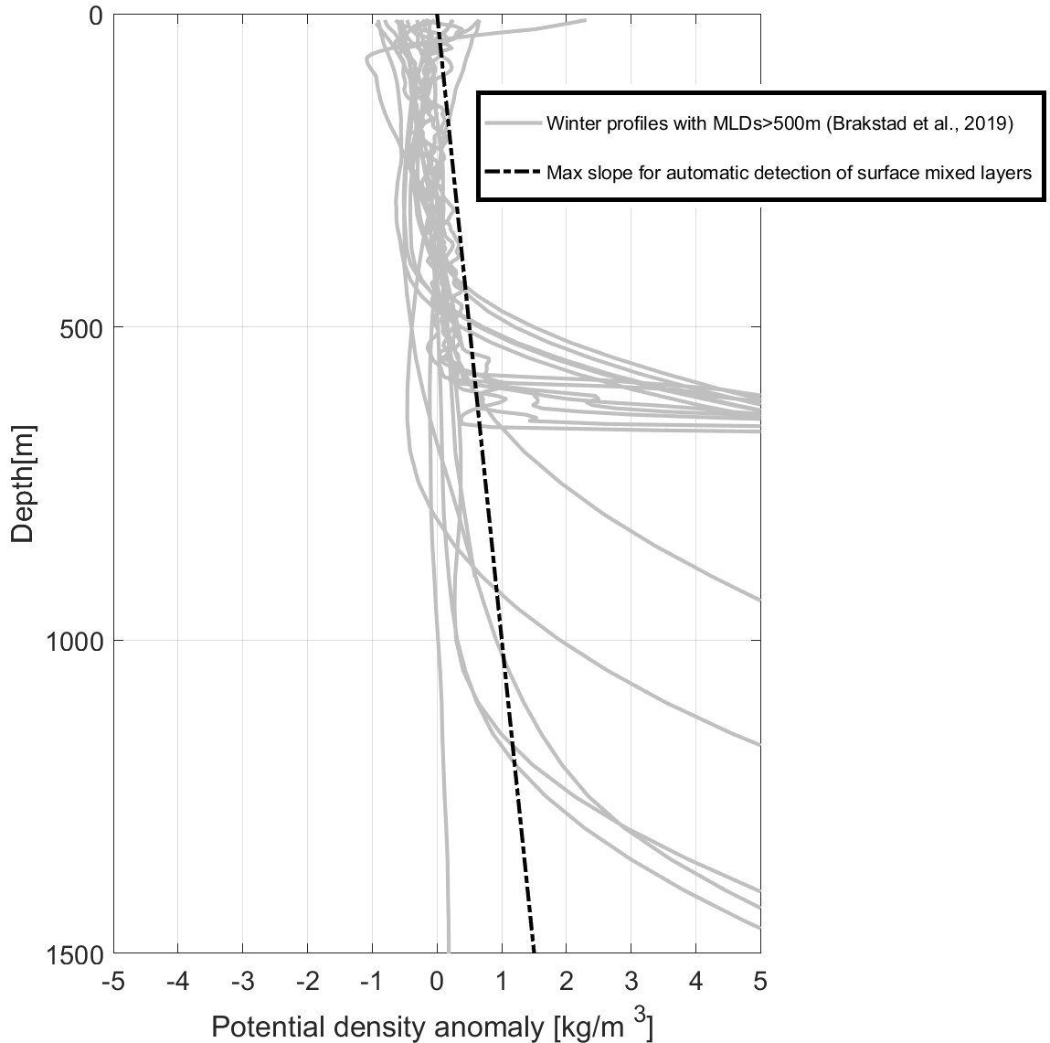
Background and motivation – Data and methods – Results – Conclussions – Future work
What type of layers am I looking for?
Deep surface mixed layers
x 10⁻³
Notes:
IN OUR DATA SET WE WANT TO IDENTIFY THOSE LAYERS THAT COULD BE FORMING SCVs
THIS PANEL SHOWS THE PDENS ANOMALY OF THE PROFILES WITH MLD>500M
THE SHADED LINE REPRESENTS THE CHARACTERISTIC SLOPE OF THESE LAYERS

Slide 31
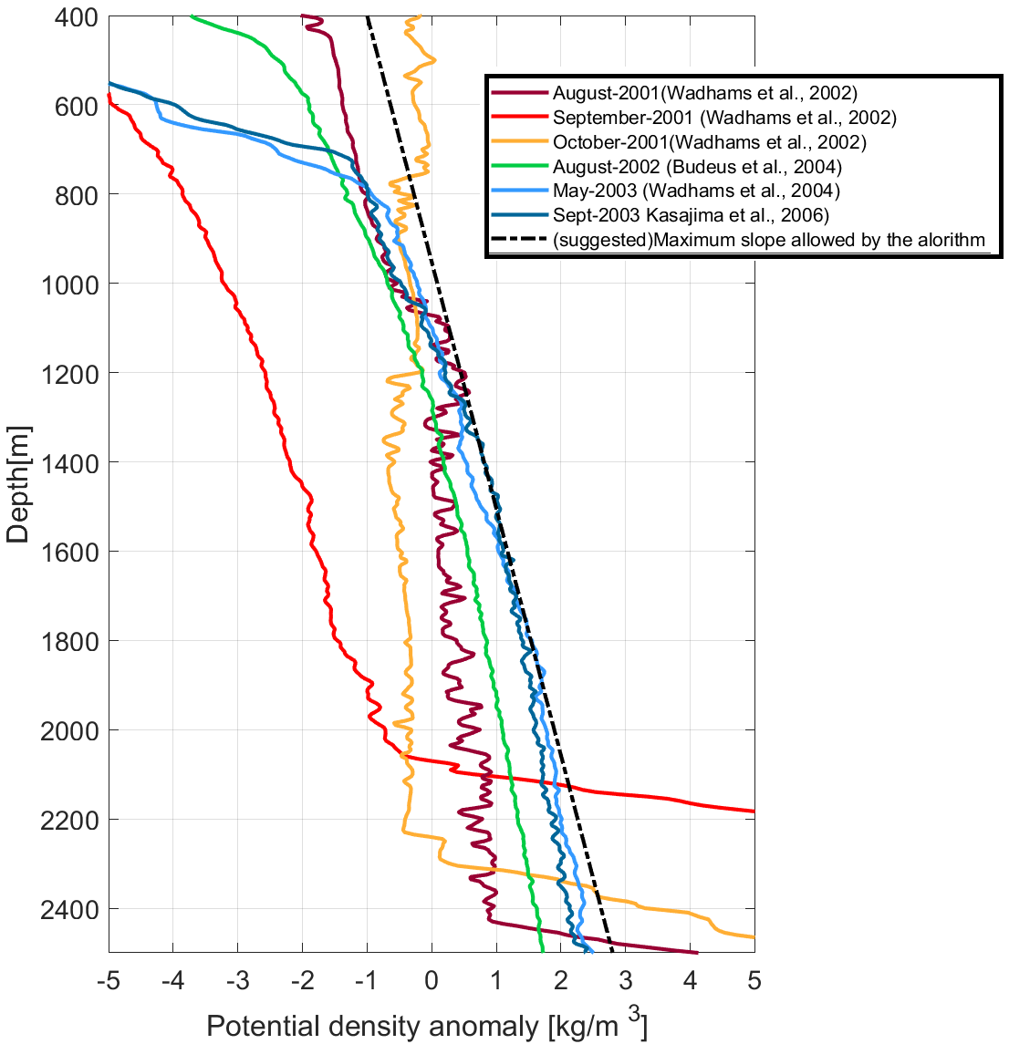
Background and motivation – Data and methods – Results – Conclussions – Future work
What type of layers am I looking for?
Deep surface mixed layers
Thick interior weakly-stratified layers
x 10⁻³
x 10⁻³
Notes:
THE RIGHT PANEL REPRESENTS PROFILES TAKEN AT THE CORE OF PREVIOUSLY DOCUMENTED SCVs
THE SADED LINE ALSO REPRESENTS THE CHARACTERISTIC SLOPE
WE WANT TO IDENTIFY LAYERS THAT COULD CONSITUTE THE ORIGIN OR THE CORE OF SCVs AND WE WILL DO IT BASED ON THEIR
CHARACTERISTIC SLOPE

Slide 32
Background and motivation – Data and methods – Results – Conclussions – Future work
Previous routines
  Based on ΔT, ΔS, Δ σ_{ϴ} (Nilsen and Falck, 2006) or curvature (Lorbacher et al., 2006) criteria.
Notes:
Previous routines…

Slide 33
Background and motivation – Data and methods – Results – Conclussions – Future work
Previous routines
  Based on ΔT, ΔS, Δ σ_{ϴ} (Nilsen and Falck, 2006) or curvature (Lorbacher et al., 2006) criteria.
No interior layers

Slide 34
Background and motivation – Data and methods – Results – Conclussions – Future work
Previous routines
  Based on ΔT, ΔS, Δ σ_{ϴ} (Nilsen and Falck, 2006) or curvature (Lorbacher et al., 2006) criteria.
No interior layers
  Semi-manual procedure (Pickart et al., 2002)

Slide 35
Background and motivation – Data and methods – Results – Conclussions – Future work
Previous routines
  Based on ΔT, ΔS, Δ σ_{ϴ} (Nilsen and Falck, 2006) or curvature (Lorbacher et al., 2006) criteria.
No interior layers
  Semi-manual procedure (Pickart et al., 2002)
Not automatic

Slide 36
Background and motivation – Data and methods – Results – Conclussions – Future work
Previous routines
  Based on ΔT, ΔS, Δ σ_{ϴ} (Nilsen and Falck, 2006) or curvature (Lorbacher et al., 2006) criteria.
No interior layers
  Semi-manual procedure (Pickart et al., 2002)
Not automatic
My routine:
AUTOMATIC
DETECT LAYERS ISOLATED FORM THE SURFACE

Slide 37
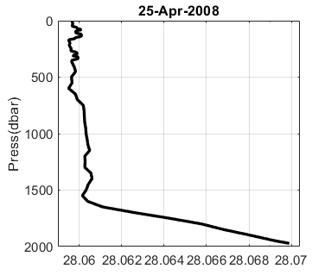
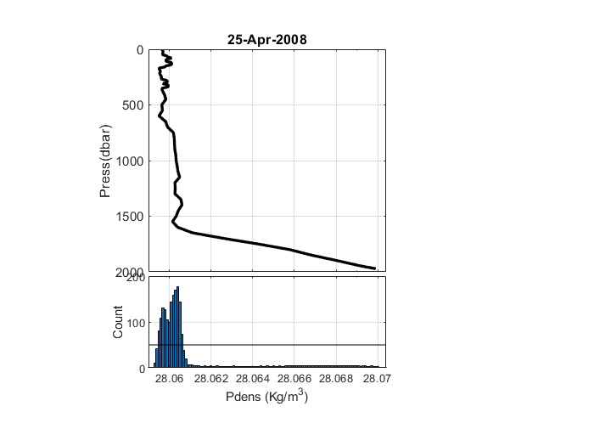
Background and motivation – Data and methods – Results – Conclussions – Future work
Novel weakly-stratified layer routine
Notes:
My routine first calculates the potential density of the profile

Slide 38
Background and motivation – Data and methods – Results – Conclussions – Future work
Novel weakly-stratified layer routine
Weakly-stratified layers = nearly homogeneous

Slide 39
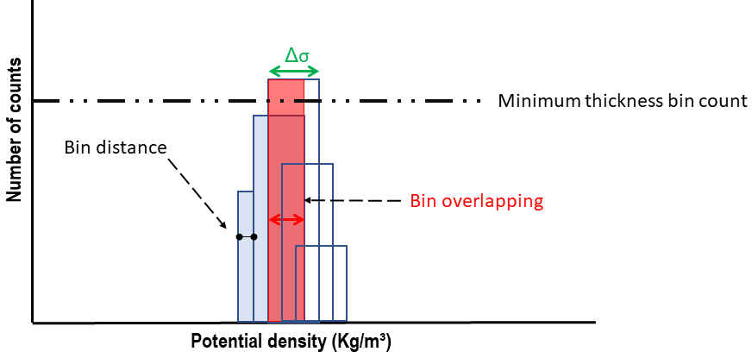
Background and motivation – Data and methods – Results – Conclussions – Future work
Novel weakly-stratified layer routine
Weakly-stratified layers = nearly homogeneous
σ_{ϴ} HISTOGRAM
Bin width

Slide 40
Background and motivation – Data and methods – Results – Conclussions – Future work
Novel weakly-stratified layer routine
Weakly-stratified layers = nearly homogeneous
σ_{ϴ} HISTOGRAM
Controlling parameters = stablish slope criterion
Bin width

Slide 41
Background and motivation – Data and methods – Results – Conclussions – Future work
Novel weakly-stratified layer routine
Weakly-stratified layers = nearly homogeneous
σ_{ϴ} HISTOGRAM
Local maximum
Controlling parameters = stablish slope criterion
Bin width

Slide 42
Background and motivation – Data and methods – Results – Conclussions – Future work
Novel weakly-stratified layer routine
Weakly-stratified layers = nearly homogeneous
σ_{ϴ} HISTOGRAM
Local maximum
Controlling parameters = stablish slope criterion
New pref
Bin width

Slide 43
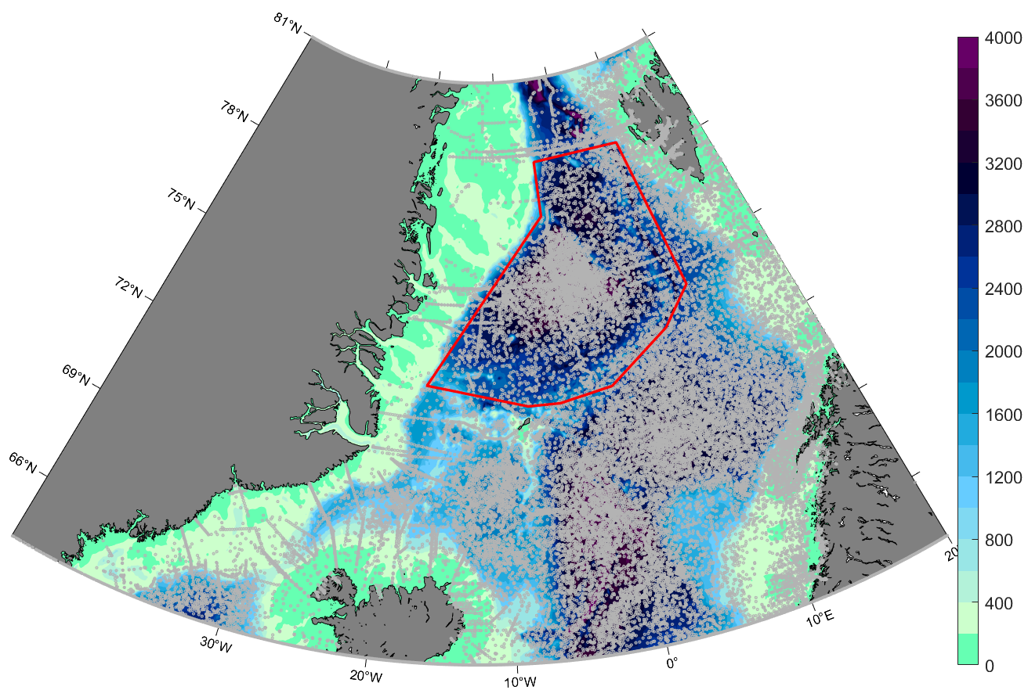
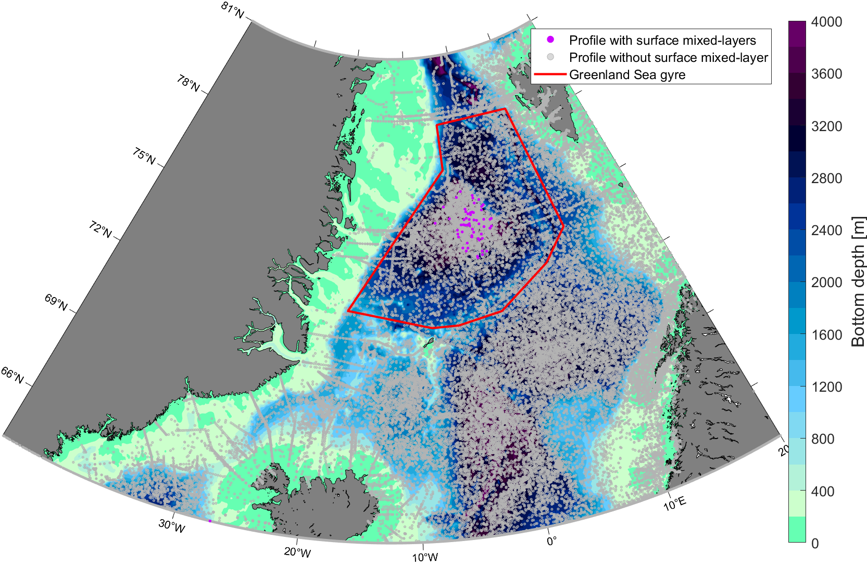
Background and motivation – Data and methods – Results – Conclussions – Future work
Location of interior weakly-stratified layers and surface mixed layers

Slide 44
Background and motivation – Data and methods – Results – Conclussions – Future work
Location of interior weakly-stratified layers and surface mixed layers
52 surface mixed layers>500 m

Slide 45
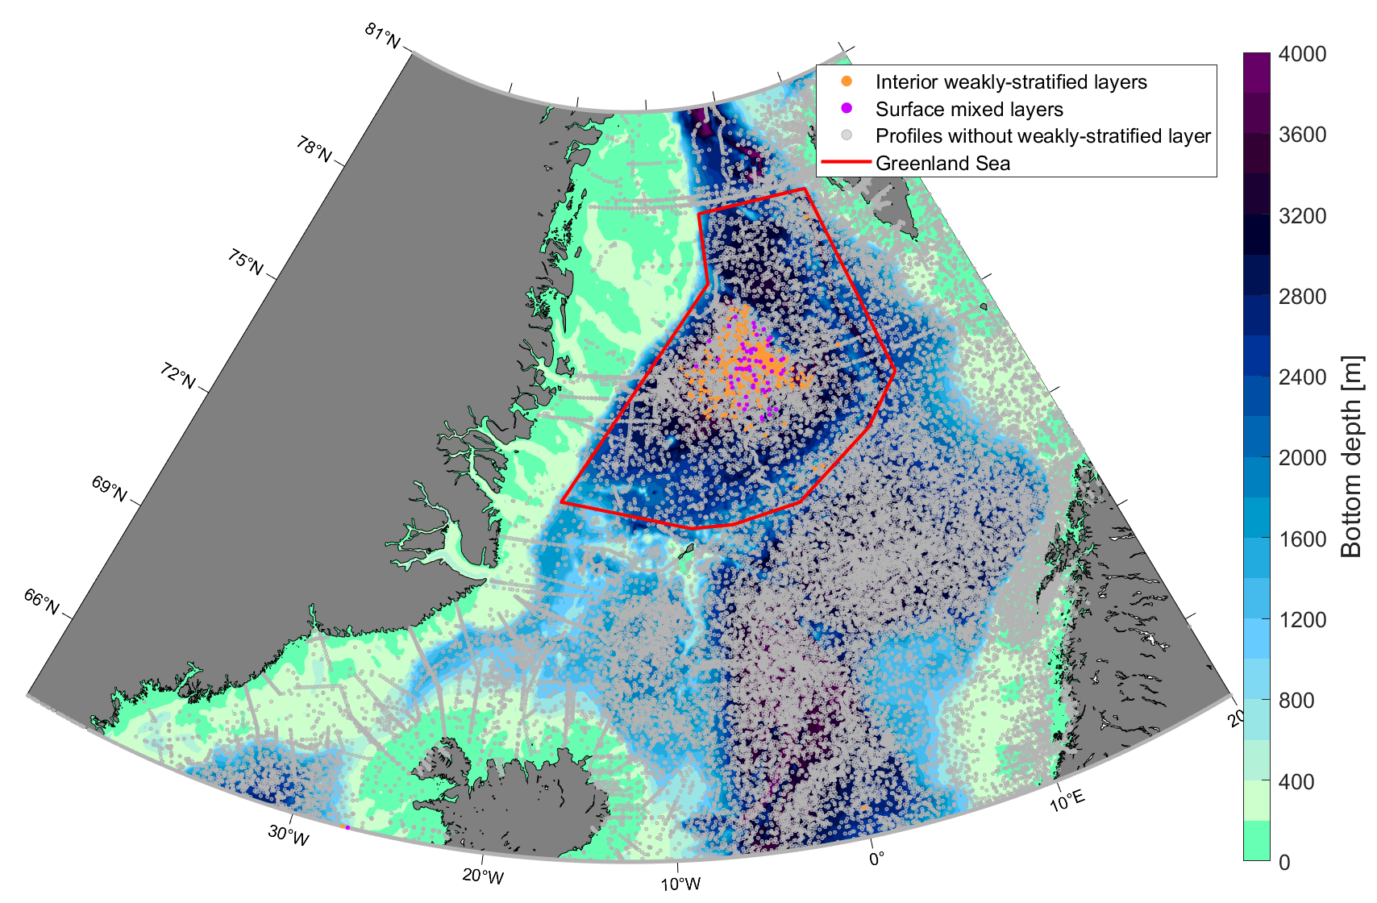
Background and motivation – Data and methods – Results – Conclussions – Future work
Location of interior weakly-stratified layers and surface mixed layers
52 surface mixed layers>500 m
>250 interior weakly-stratified
layers

Slide 46
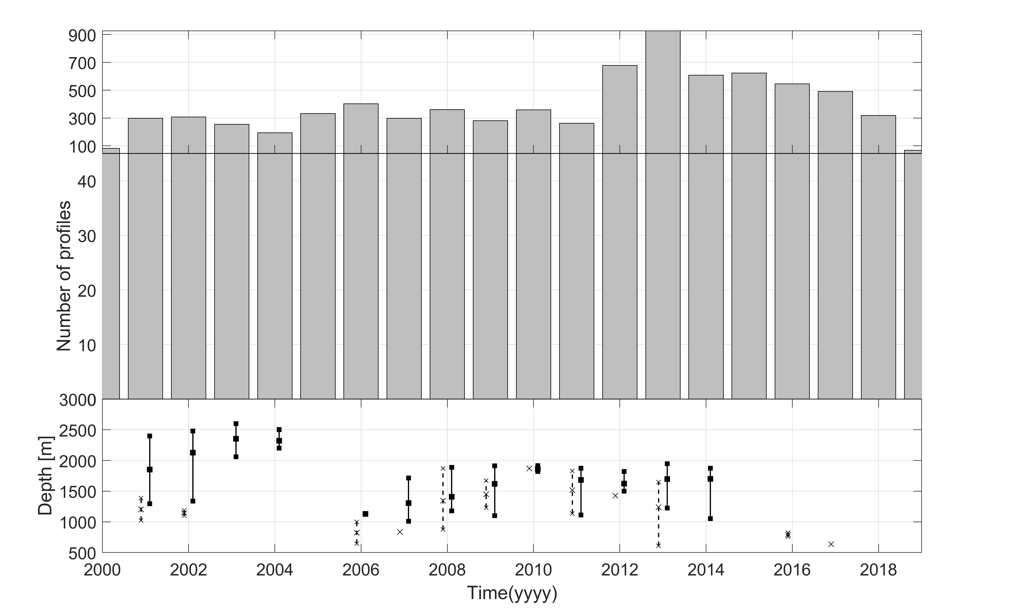
Background and motivation – Data and methods – Results – Conclussions – Future work
Interannual variability

Slide 47
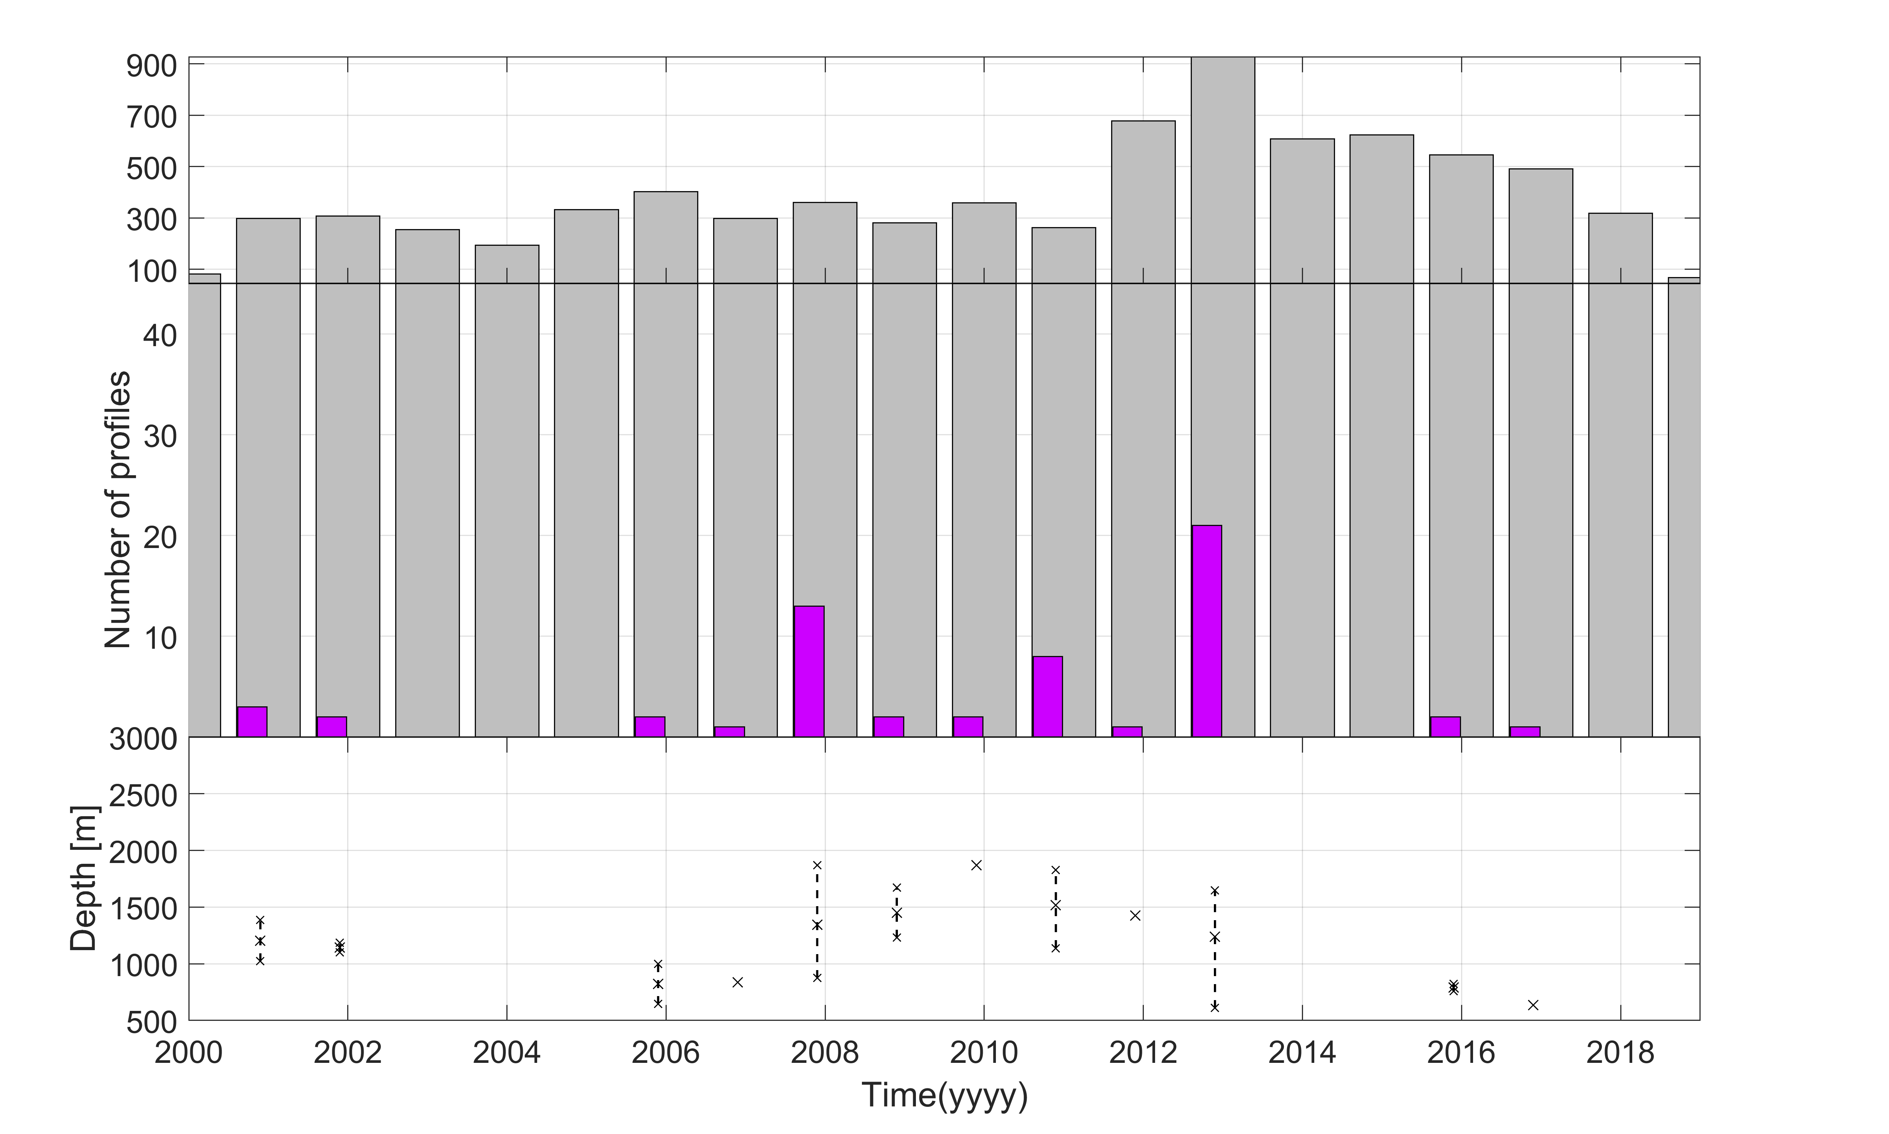
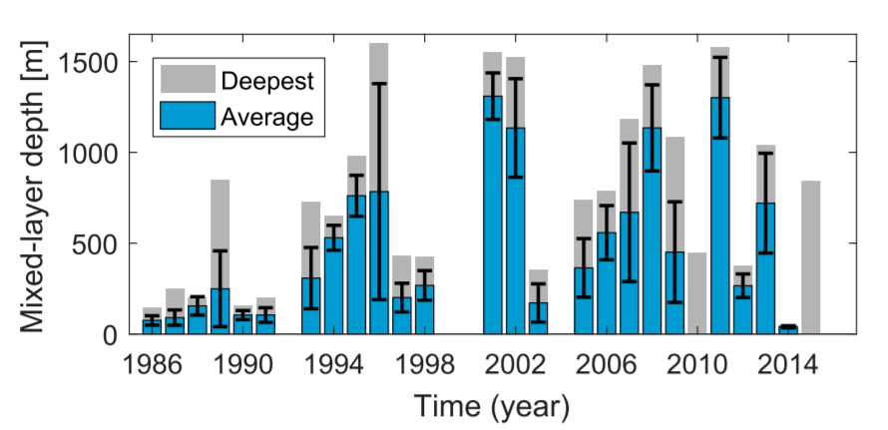
Background and motivation – Data and methods – Results – Conclussions – Future work
Interannual variability
Brackstad et al., (2019)

Slide 48
Background and motivation – Data and methods – Results – Conclussions – Future work
Interannual variability
Weak convection
Brackstad et al., (2019)

Slide 49
Background and motivation – Data and methods – Results – Conclussions – Future work
Interannual variability
Weak convection
Strong convection
Brakstad et al., (2019)

Slide 50
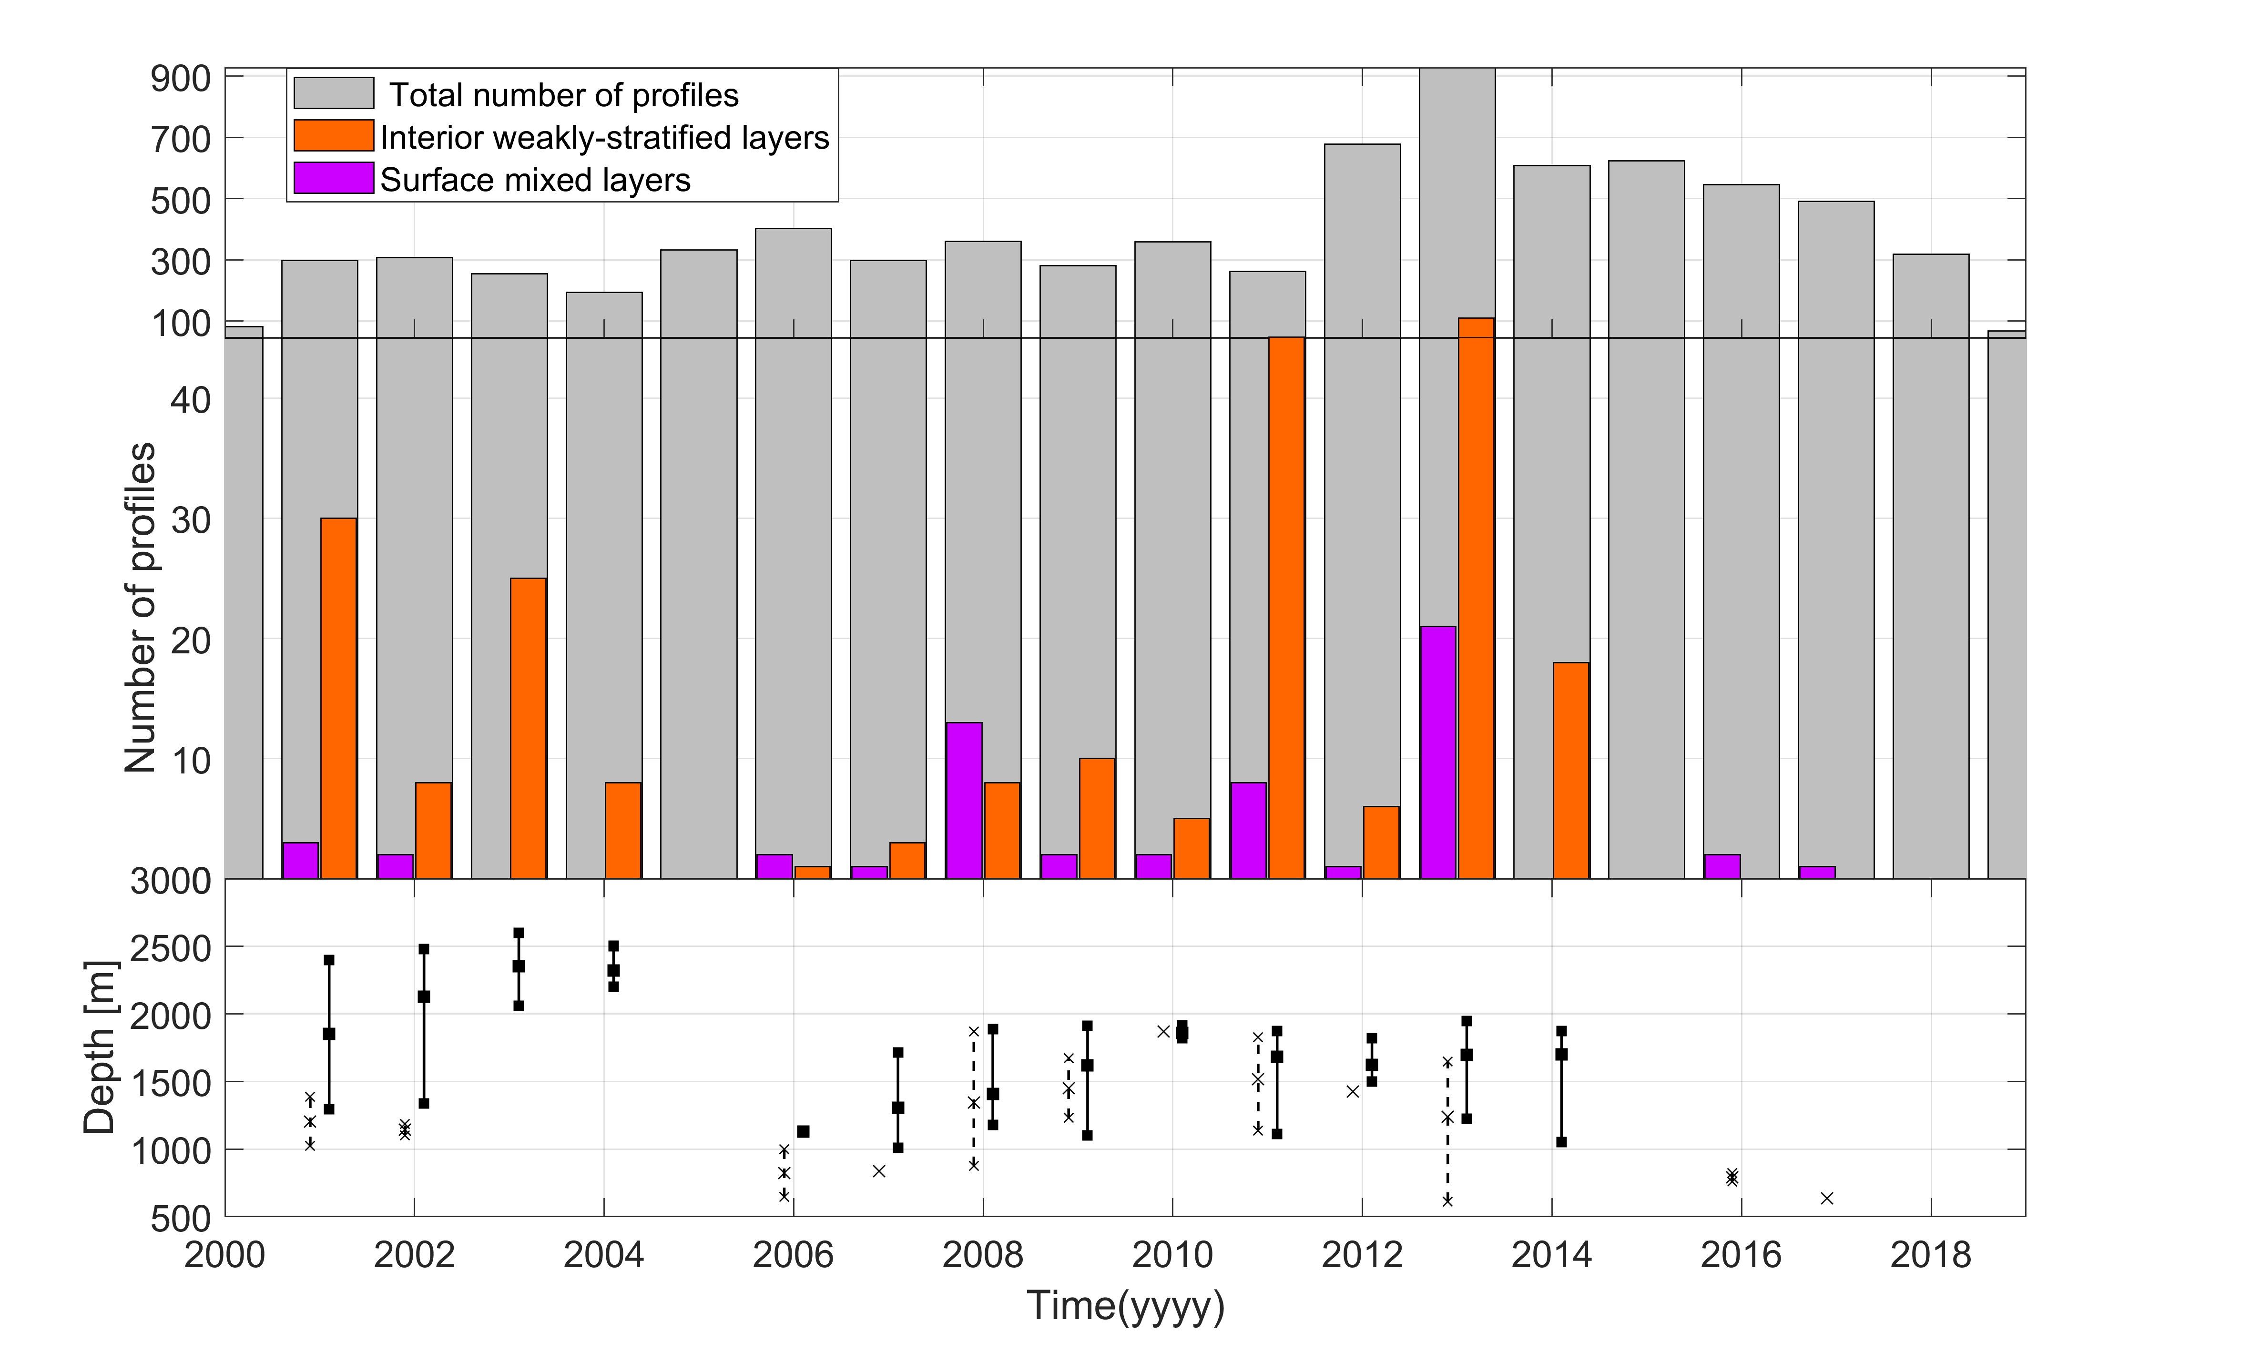
Background and motivation – Data and methods – Results – Conclussions – Future work
Interannual variability
Weak convection
Strong convection
Persistence

Slide 51
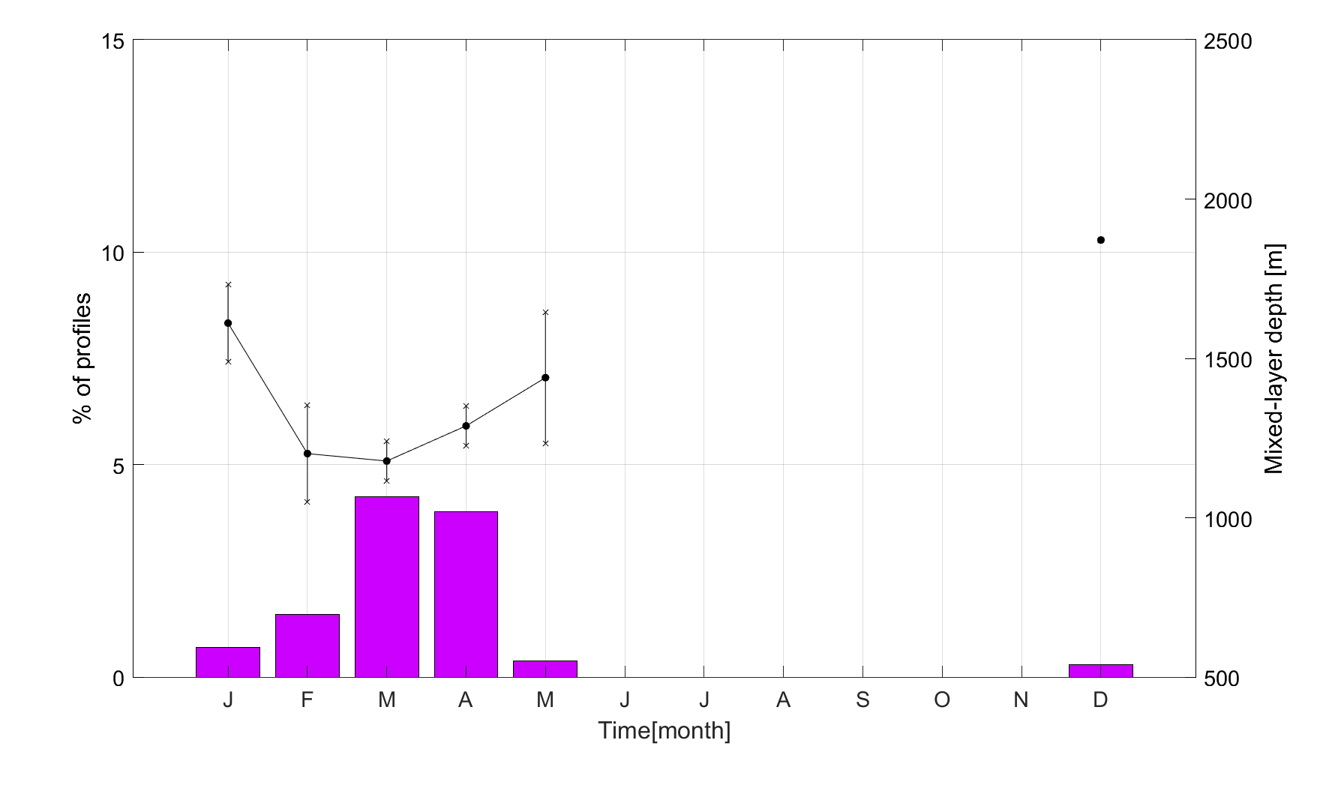
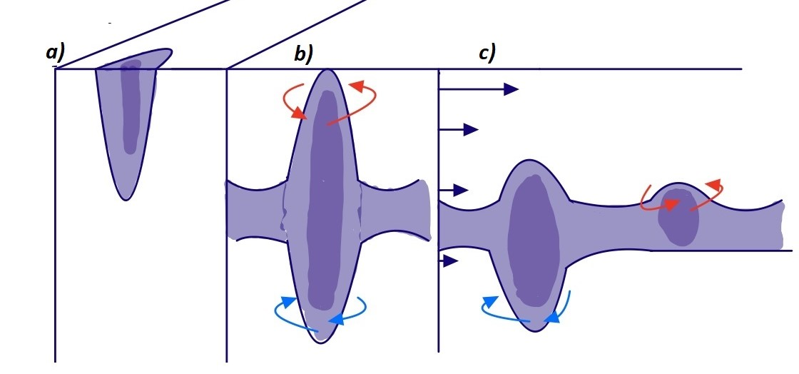
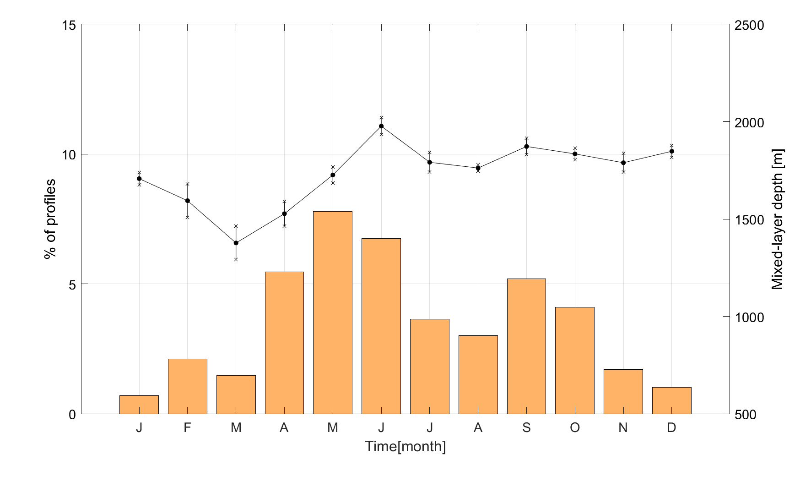
Background and motivation – Data and methods – Results – Conclussions – Future work
Seasonal occurrence
Convective season

Slide 52
Background and motivation – Data and methods – Results – Conclussions – Future work
Seasonal occurrence
Convective season
After restratification
?

Slide 53
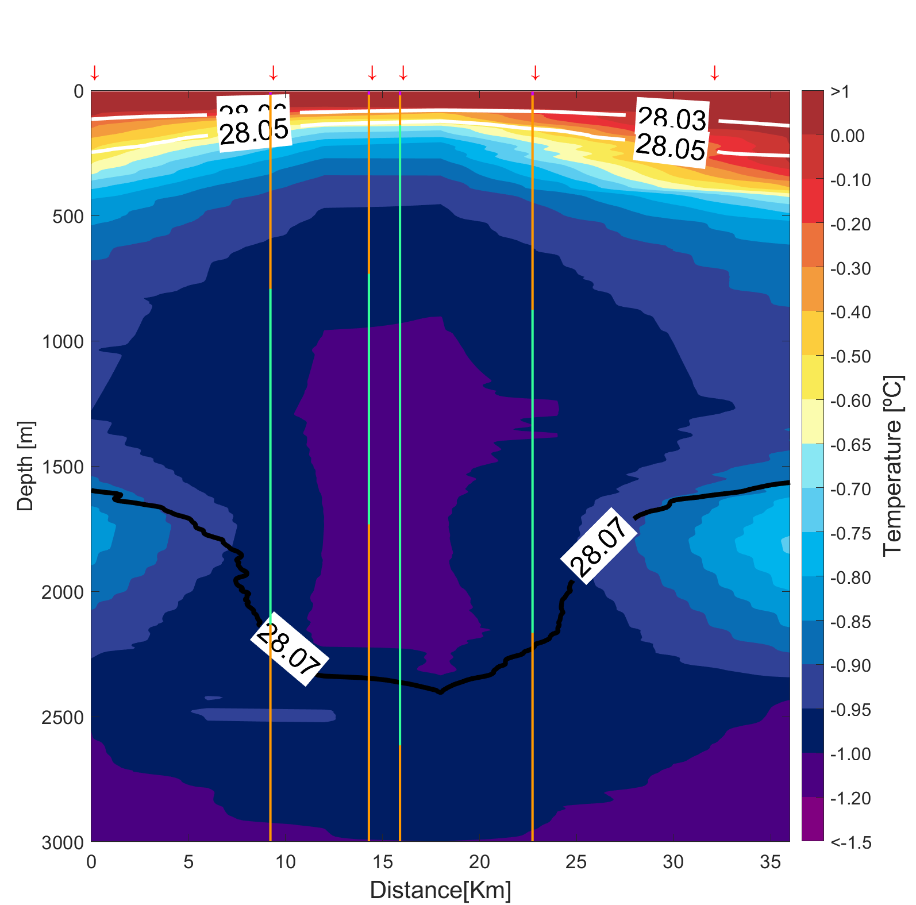
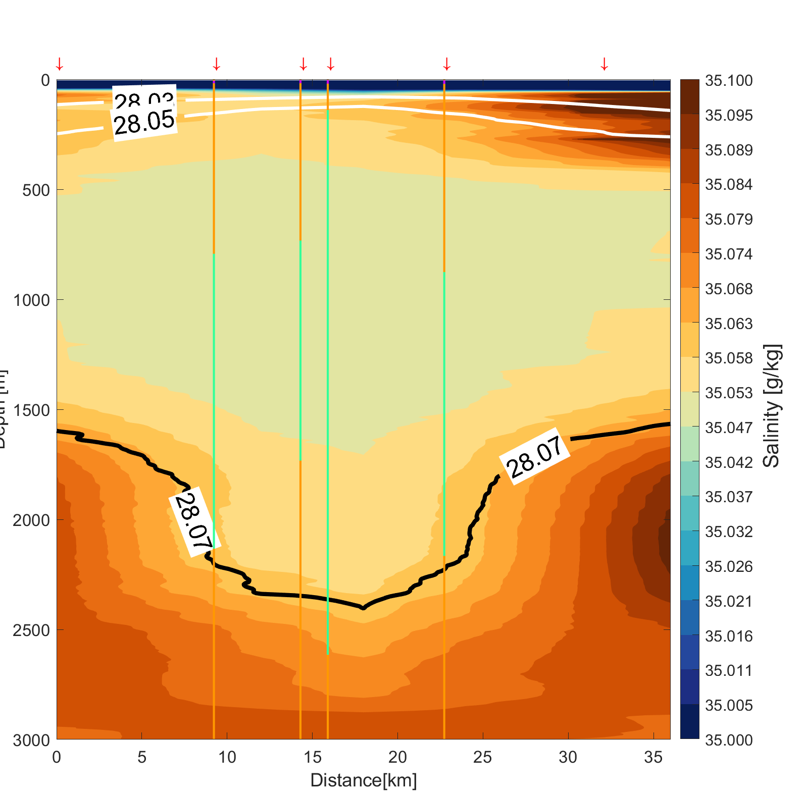
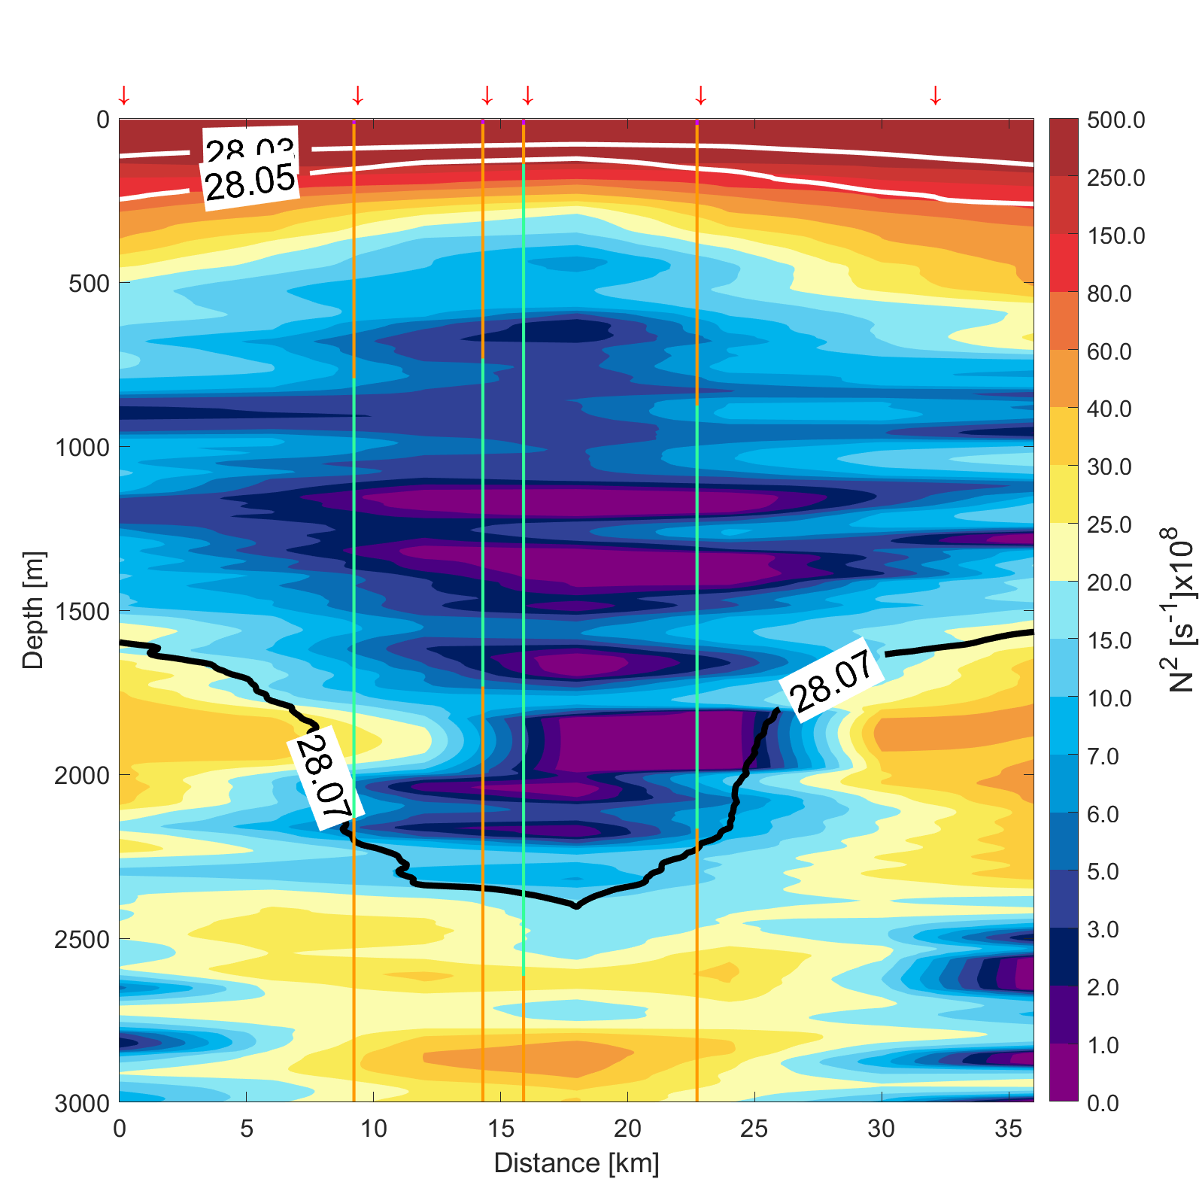
Background and motivation – Data and methods – Results – Conclussions – Future work
General structure of SCVs detected in the Greenland Sea
0

Slide 54
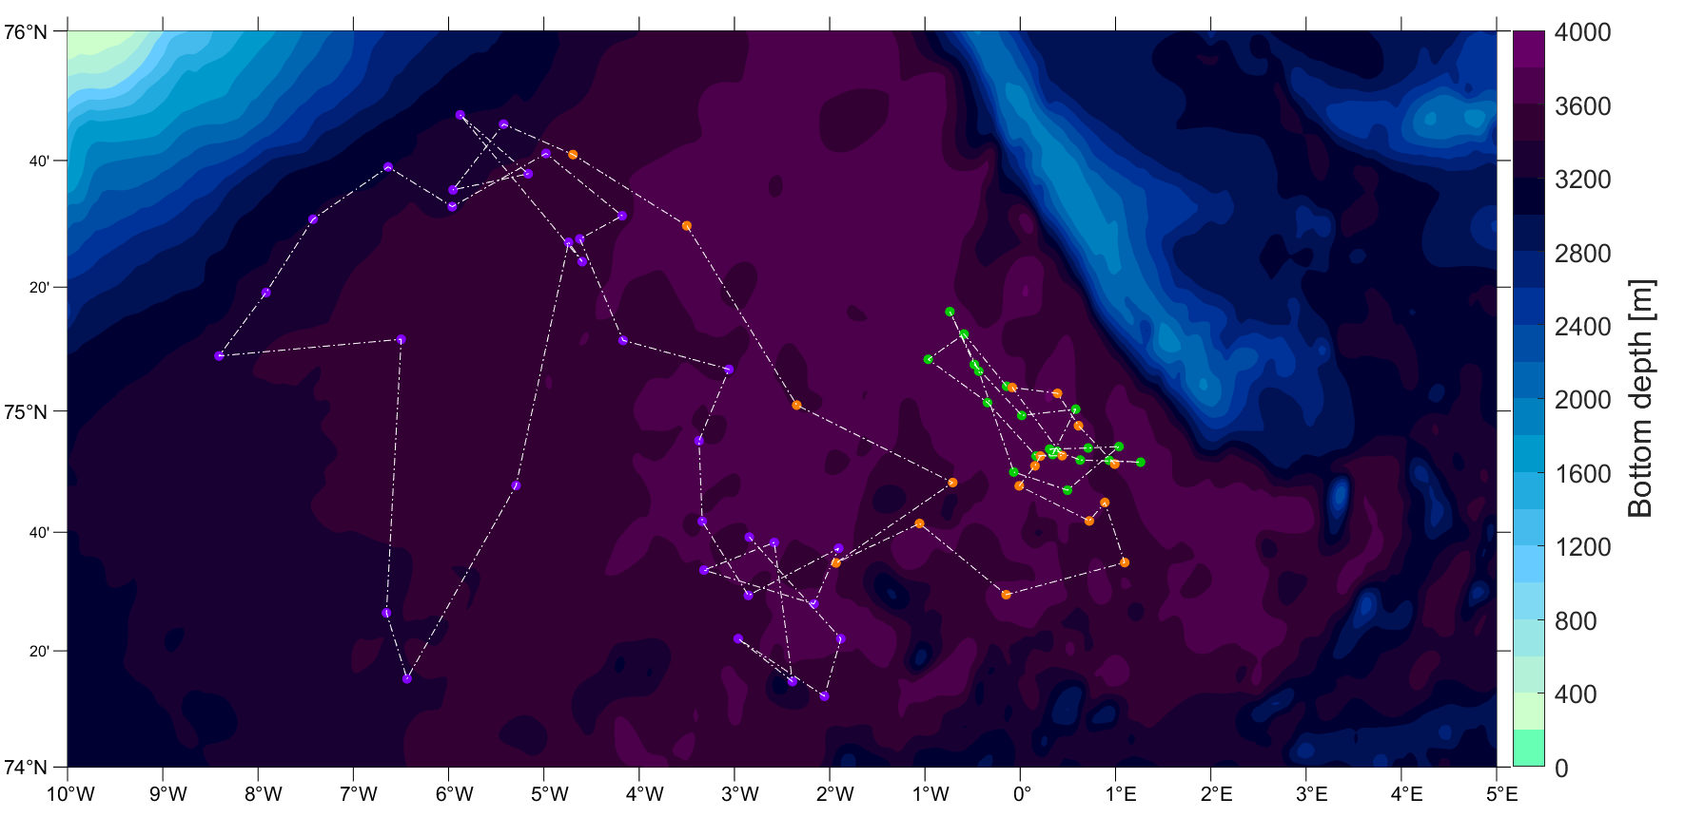
Background and motivation – Data and methods – Results – Conclussions – Future work
2001/2002 SCV

Slide 55
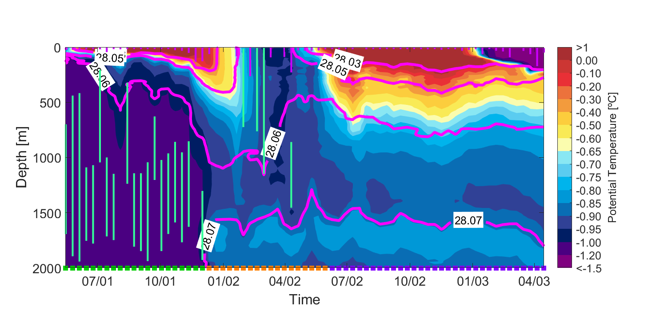
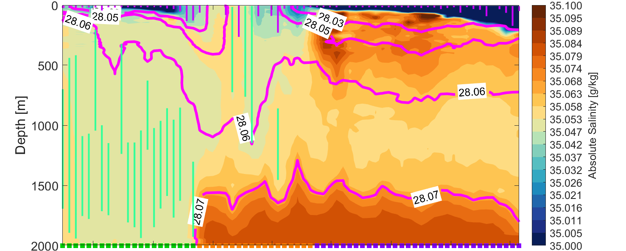
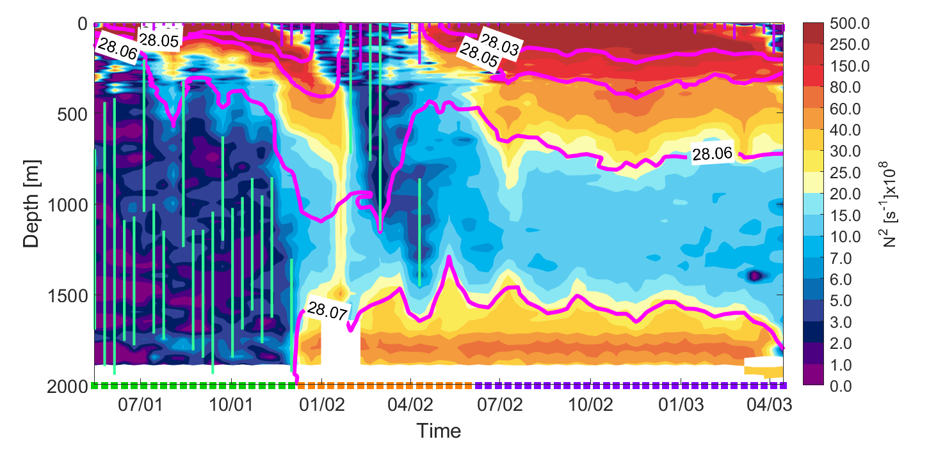
Background and motivation – Data and methods – Results – Conclussions – Future work
2001/2002 SCV
Summer 2001
Deployed into SCV
December 2001
Left the SCV
Jan/Jul-2002
Convection
Jul-2002
Apr-2003
Ambient Greenland Sea water
Aug-01 Oct-01 Jan-02 Apr-02 Jul-02 Oct-02 Jan-03 Apr-03

Slide 56
Background and motivation – Data and methods – Results – Conclussions – Future work
2001/2002 SCV
Summer 2001
Deployed into SCV
December 2001
Left the SCV
Jul-2002
Convection
Jul-2002
Apr-2003
Ambient Greenland Sea water
Aug-01 Oct-01 Jan-02 Apr-02 Jul-02 Oct-02 Jan-03 Apr-03

Slide 57
Background and motivation – Data and methods – Results – Conclussions – Future work
2001/2002 SCV
Summer 2001
Deployed into SCV
December 2001
Left the SCV
Jul-2002
Convection
Jul-2002
Apr-2003
Ambient Greenland Sea water
Aug-01 Oct-01 Jan-02 Apr-02 Jul-02 Oct-02 Jan-03 Apr-03

Slide 58
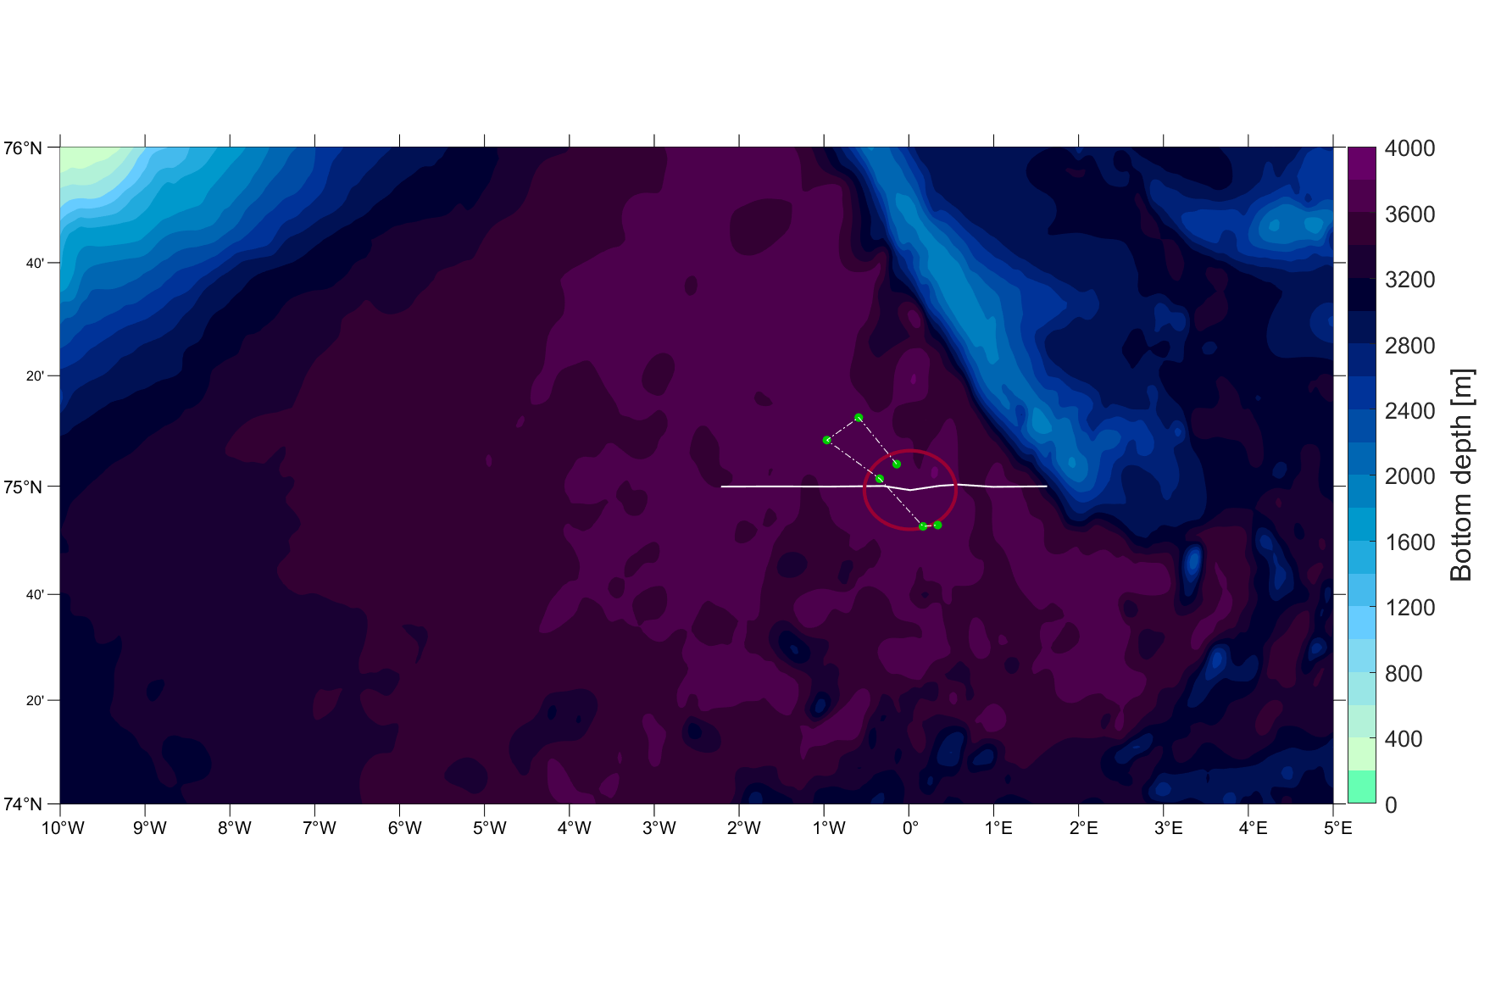
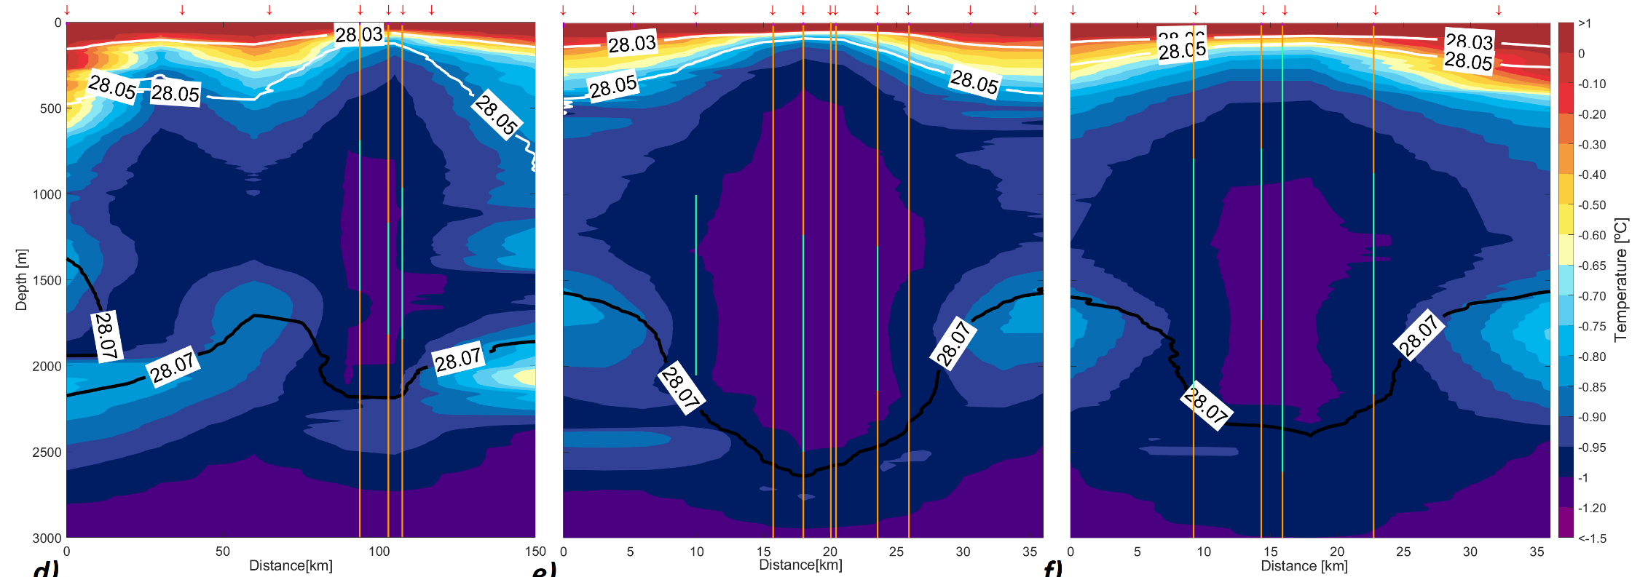
Background and motivation – Data and methods – Results – Conclussions – Future work
2001/2002 SCV
August 2001
September 2001
October 2001

Slide 59
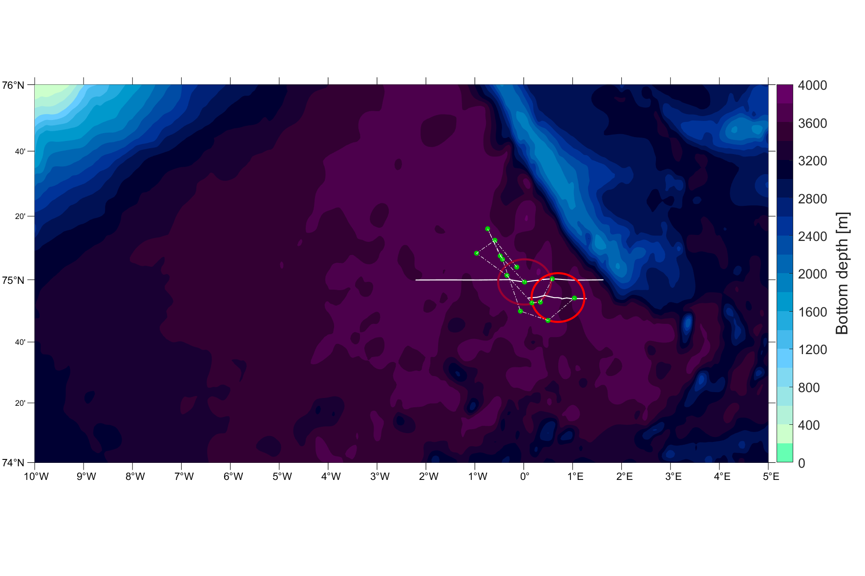
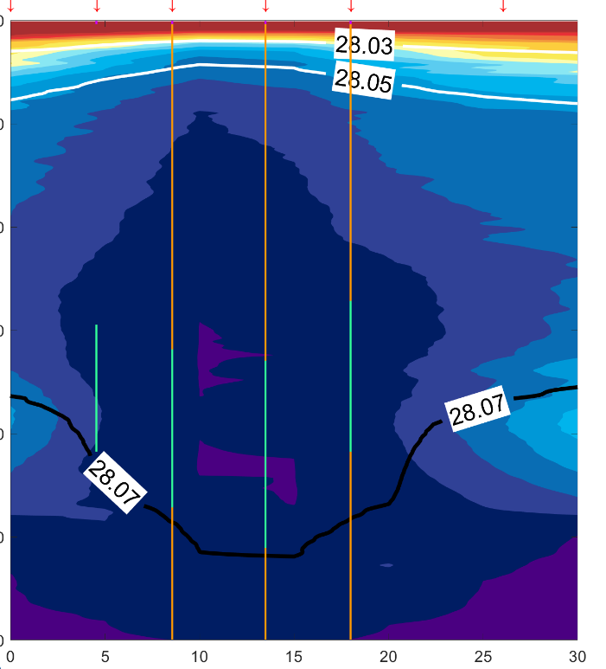

Background and motivation – Data and methods – Results – Conclussions – Future work
2001/2002 SCV
August 2001
September 2001
October 2001
August 2002
May 2003
September 2003

Slide 60

Background and motivation – Data and methods – Results – Conclussions – Future work
2001/2002 SCV
August 2001
September 2001
October 2001
August 2002
May 2003
September 2003

Slide 61

Background and motivation – Data and methods – Results – Conclussions – Future work
2001/2002 SCV
August 2001
September 2001
October 2001
August 2002
May 2003
September 2003

Slide 62
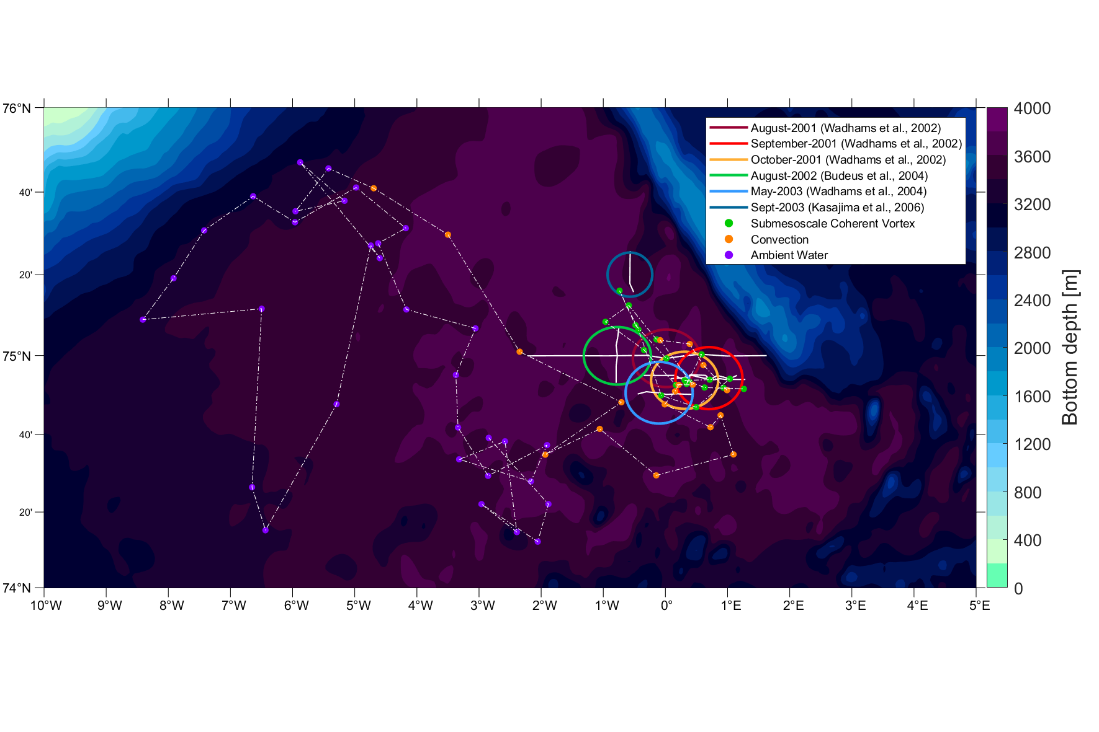
Background and motivation – Data and methods – Results – Conclussions – Future work
2001/2002 SCV
August 2001
September 2001
October 2001
August 2002
May 2003
September 2003

Slide 63
Background and motivation – Data and methods – Results – Conclussions – Future work
2001/2002 SCV
Lack of continuous measurements.
August 2001
September 2001
October 2001
August 2002
May 2003
September 2003

Slide 64
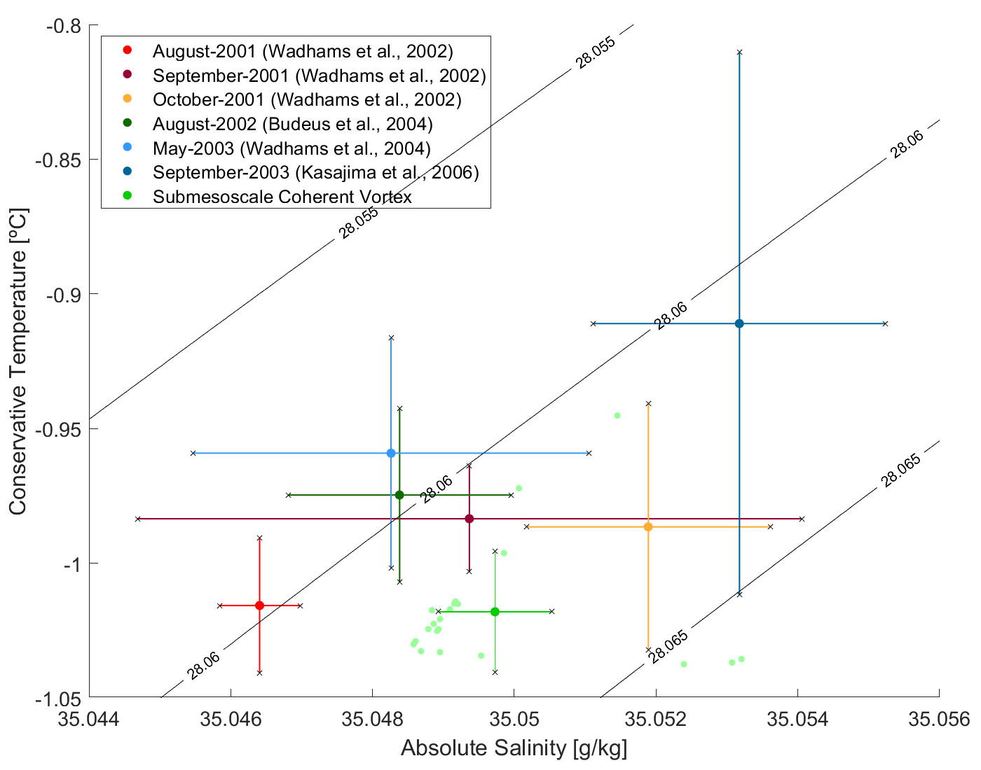
Background and motivation – Data and methods – Results – Conclussions – Future work
2001/2002 SCV
Lack of continuous measurements.
Hydrographic characteristics vary, not unique.
August 2001
September 2001
October 2001
August 2002
May 2003
September 2003

Slide 65
Background and motivation – Data and methods – Results – Conclussions – Future work
2001/2002 SCV
Lack of continuous measurements.
Hydrographic characteristics vary, not unique.
Similar processes lead to similar structures.
August 2001
September 2001
October 2001
August 2002
May 2003
September 2003

Slide 66
Background and motivation – Data and methods – Results – Conclussions – Future work
2001/2002 SCV
Lack of continuous measurements.
Hydrographic characteristics vary, not unique.
Similar processes lead to similar structures.
Most likely more than 1 SCV could populate the Greenland Sea.
August 2001
September 2001
October 2001
August 2002
May 2003
September 2003

Slide 67
Background and motivation – Data and methods – Results – Conclussions – Future work
Sampling bias
Undersampled:
Argo floats
  Deployed into the SCV
  Enter through the surface
Hydrographic survey
  High resolution sampling
The number of SCVs in the GS is underestimated.

Slide 68
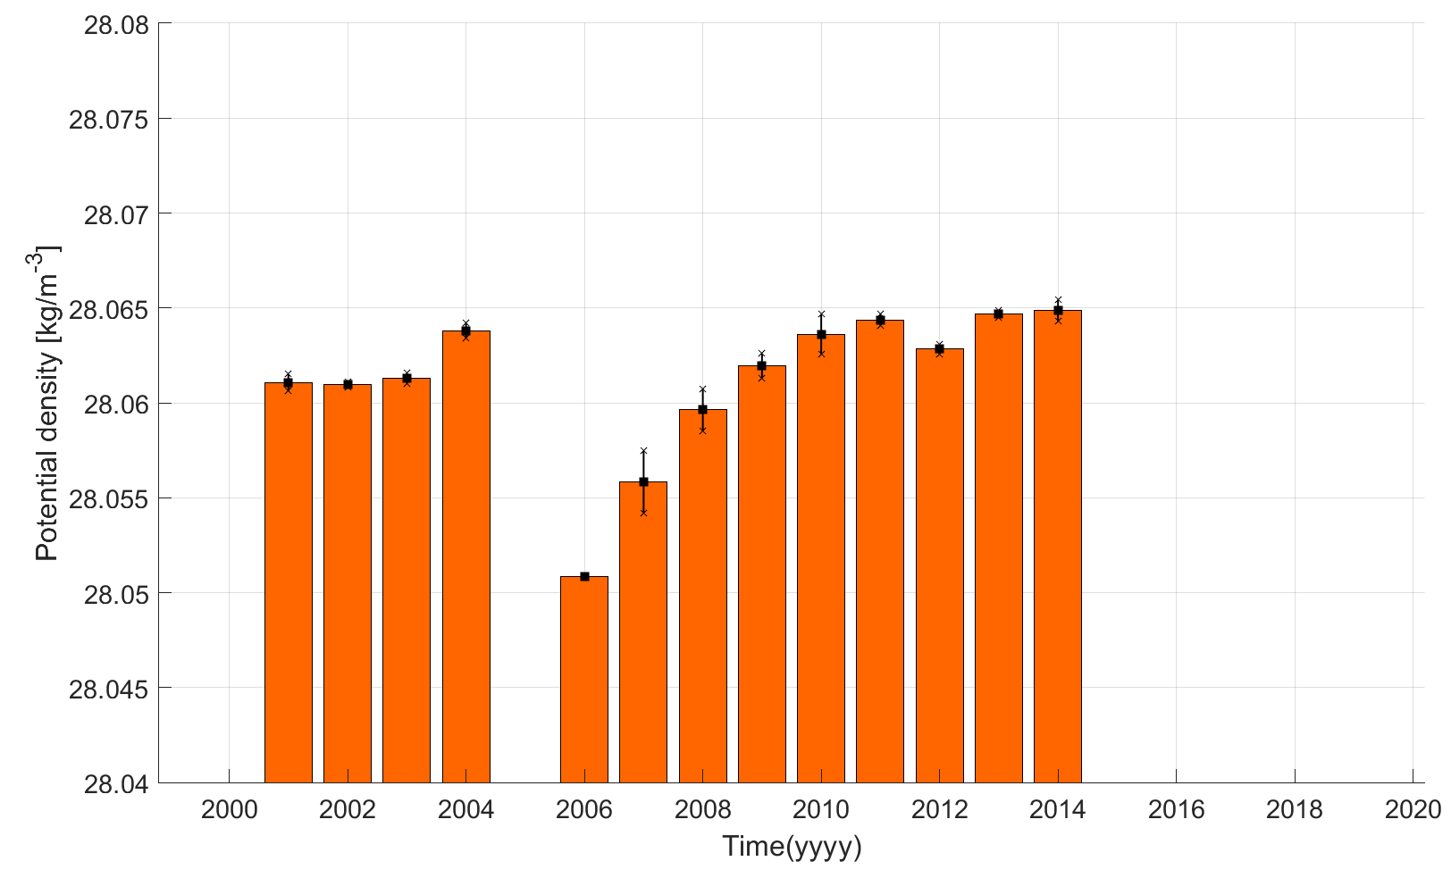
Background and motivation – Data and methods – Results – Conclussions – Future work
SCVs may contribute to the overflows
Core water σ_{ϴ} > 28.05 kg/m³

Slide 69
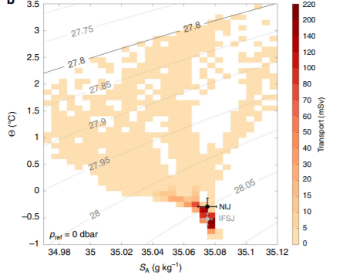
Background and motivation – Data and methods – Results – Conclussions – Future work
SCVs may contribute to the overflows
Core water σ_{ϴ} > 28.05 kg/m³
North Icelandic Jet
Iceland Faroe Slope Jet
Semper et al., (2020)

Slide 70
Background and motivation – Data and methods – Results – Conclussions – Future work
SCVs may contribute to the overflows
Core water σ_{ϴ} > 28.05 kg/m³
North Icelandic Jet
Iceland Faroe Slope Jet
How much do they contribute?
1 SCV → 0.002 Sv
20 SCVs→ 0.04 Sv
Semper et al., (2020)

Slide 71
Background and motivation – Data and methods – Results – Conclussions – Future work
A new method to identify deep weakly-stratified layers in the ocean has been developed.

Slide 72
Background and motivation – Data and methods – Results – Conclussions – Future work
A new method to identify deep weakly-stratified layers in the ocean has been developed.
My hypothesis is that deep surface mixed layers formed during strong wintertime convection in the Greenland Sea could be the origin of interior weakly-stratified layers forming the core of SCVs.

Slide 73
Background and motivation – Data and methods – Results – Conclussions – Future work
A new method to identify deep weakly-stratified layers in the ocean has been developed.
My hypothesis is that deep surface mixed layers formed during strong wintertime convection in the Greenland Sea could be the origin of interior weakly-stratified layers forming the core of SCVs.
SCVs have been poorly sampled due to their horizontal scales and vertical structure suggesting that the number of SCVs in the Greenland Sea has been underestimated.

Slide 74
Background and motivation – Data and methods – Results – Conclussions – Future work
A new method to identify deep weakly-stratified layers in the ocean has been developed.
My hypothesis is that deep surface mixed layers formed during strong wintertime convection in the Greenland Sea could be the origin of interior weakly-stratified layers forming the core of SCVs.
SCVs have been poorly sampled due to their horizontal scales and vertical structure suggesting that the number of SCVs in the Greenland Sea has been underestimated.
Even though the core water of the SCVs is dense enough to contribute to the overflows, they may have a very limited impact on the overturning in the Nordic Seas.

Slide 75
Background and motivation – Data and methods – Results – Conclussions – Future work
The project “Convective sub-mesoscale coherent vortices in the Greenland Sea” has been funded with a Fast Track Initiative.
Apply remote sensing techniques.
Further investigate SCVs evolution.
Further investigation about the hypothesis that deep surface mixed layers lead to the formation of SCVs.
Write a peer-reviewed paper about this work.

Slide 76
Takk for meg!

Slide 78
Background and motivation – Data and methods – Results – Discussion and outlook – Future work
Novel weakly-stratified layer routine
Weakly-stratified layers = nearly homogeneous regions of a profile
The σ_{ϴ} is discretized and the number of observations on each bin
are counted → σ_{ϴ} HISTOGRAM
Identification of a local maxima that satisifies the
minimum thickness requirement
  Recalculates σ_{ϴ} using as pressure reference
Bin width

Slide 79
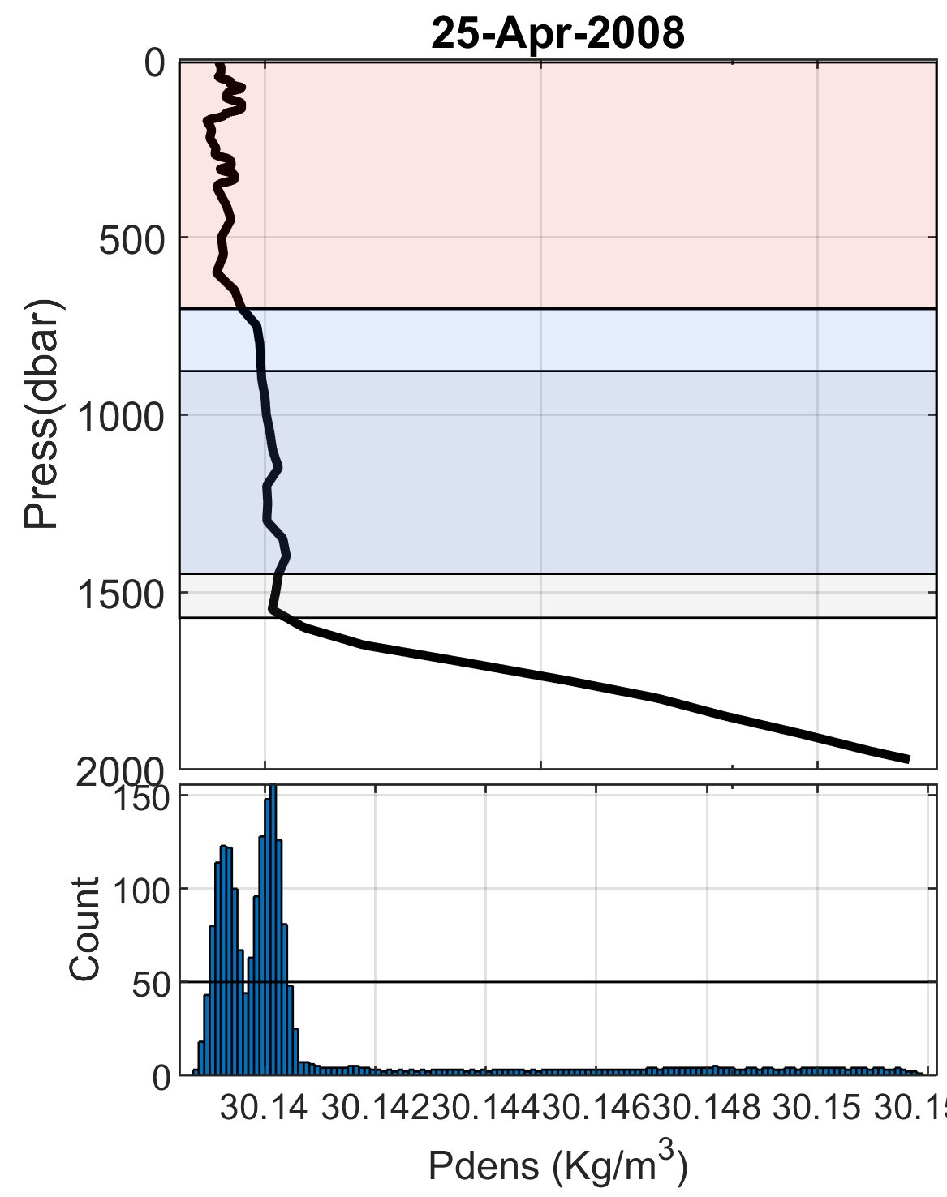
Background and motivation – Data and methods – Results – Discussion and outlook – Future work
Novel weakly-stratified layer routine
Weakly-stratified layers = nearly homogeneous regions of a profile
The σ_{ϴ} is discretized and the number of observations on each bin
are counted → σ_{ϴ} HISTOGRAM
Identification of a local maxima that satisifies the
minimum thickness requirement
  Recalculates σ_{ϴ} using as pressure reference
  Reconstructs the histogram
  Neighbouring bin addition

Slide 80
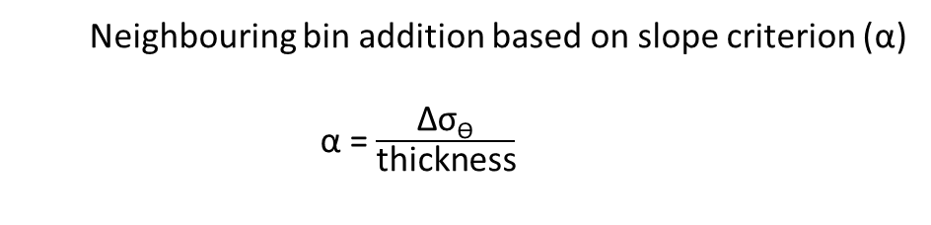
Background and motivation – Data and methods – Results – Discussion and outlook – Future work
Novel weakly-stratified layer routine
  Neighbouring bin addition based on slope criterion (α)
  α = $\frac{\text{Δ}\text{σ}\text{ϴ}}{\text{thickness}}$
If α ≤ α the bin is added.
If the new bin added does not satisfy this condition the iteration
STOPS

Slide 81
Background and motivation – Data and methods – Results – Discussion and outlook – Future work
Novel weakly-stratified layer routine
  Neighbouring bin addition based on slope criterion (α)
  α = $\frac{\text{Δ}\text{σ}\text{ϴ}}{\text{thickness}}$
If α ≤ α the bin is added.
If the new bin added does not satisfy this condition the iteration
STOPS

Slide 82
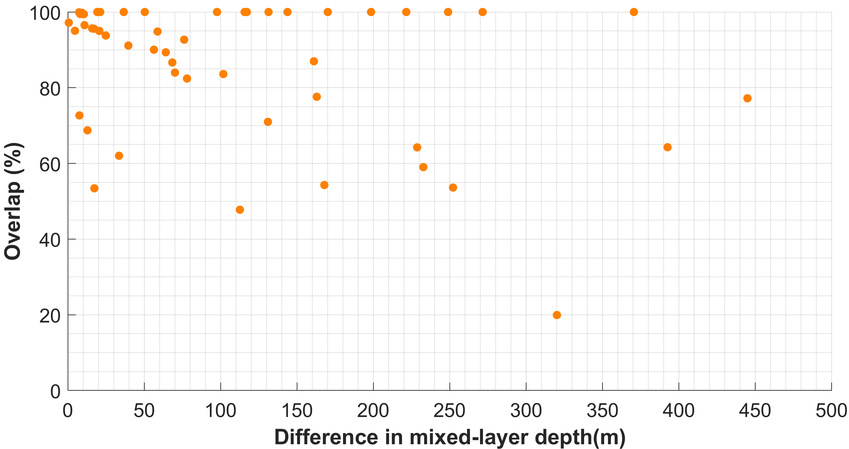
Background and motivation – Data and methods – Results – Discussion and outlook – Future work
Validation of the weakly-stratified layer routine
Mixed-layer depths determined by Brakstad et al (2019)
Good agreement.
Differences explained by:
  Density recalculation
  Automatic detection of the layers.

Slide 83
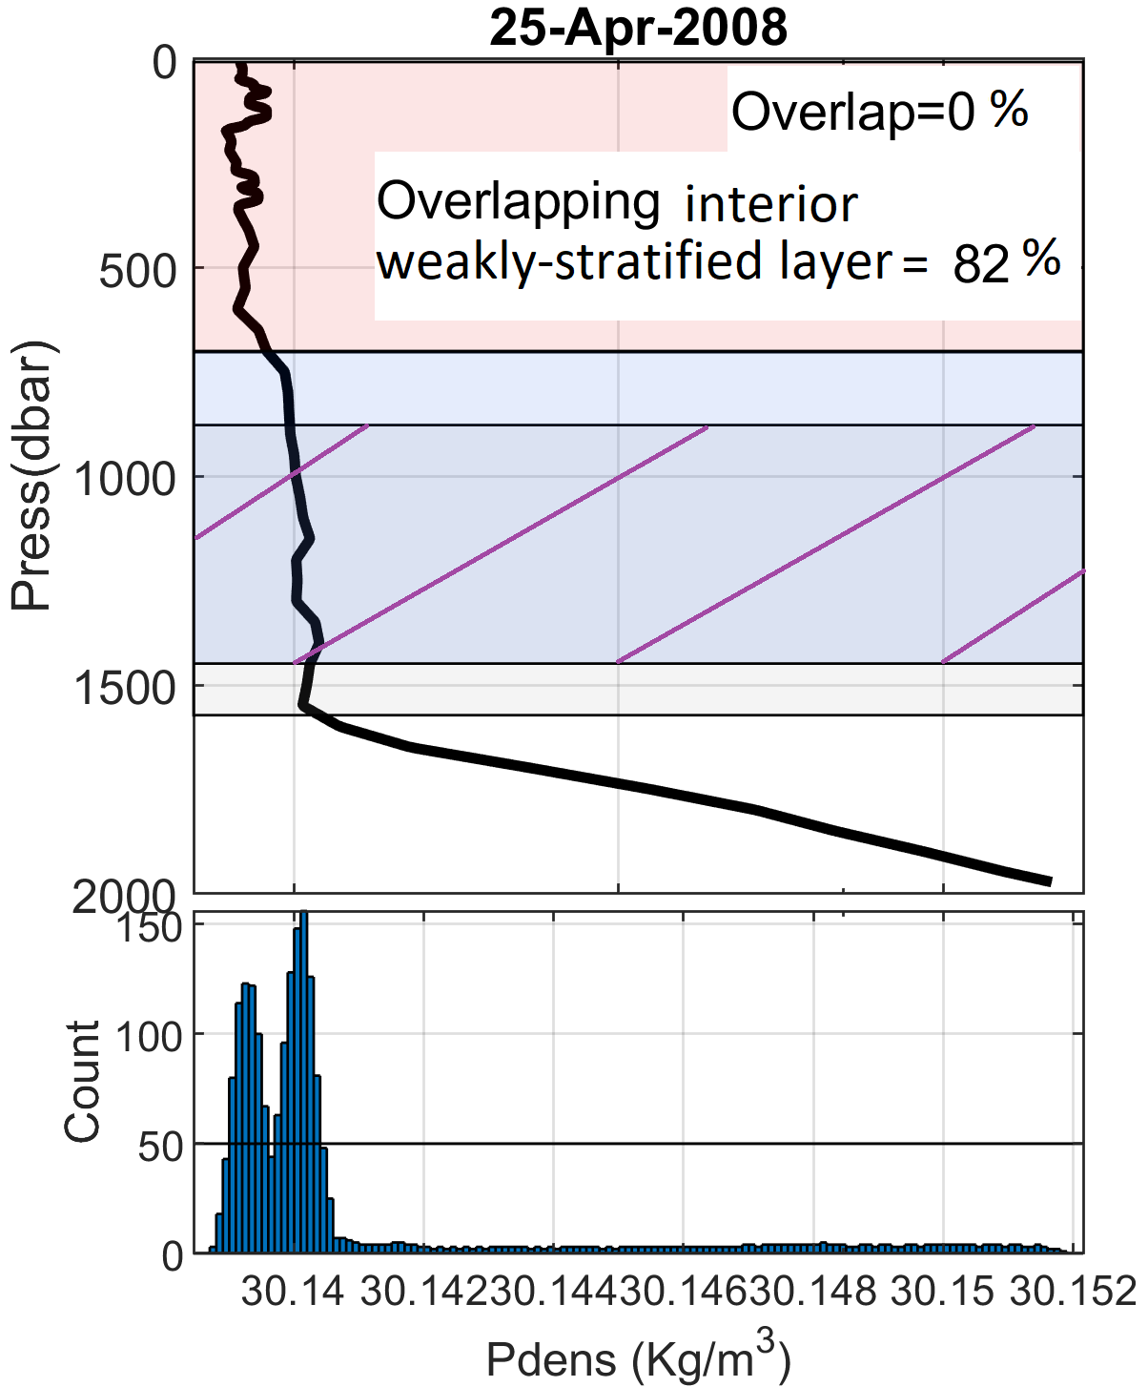
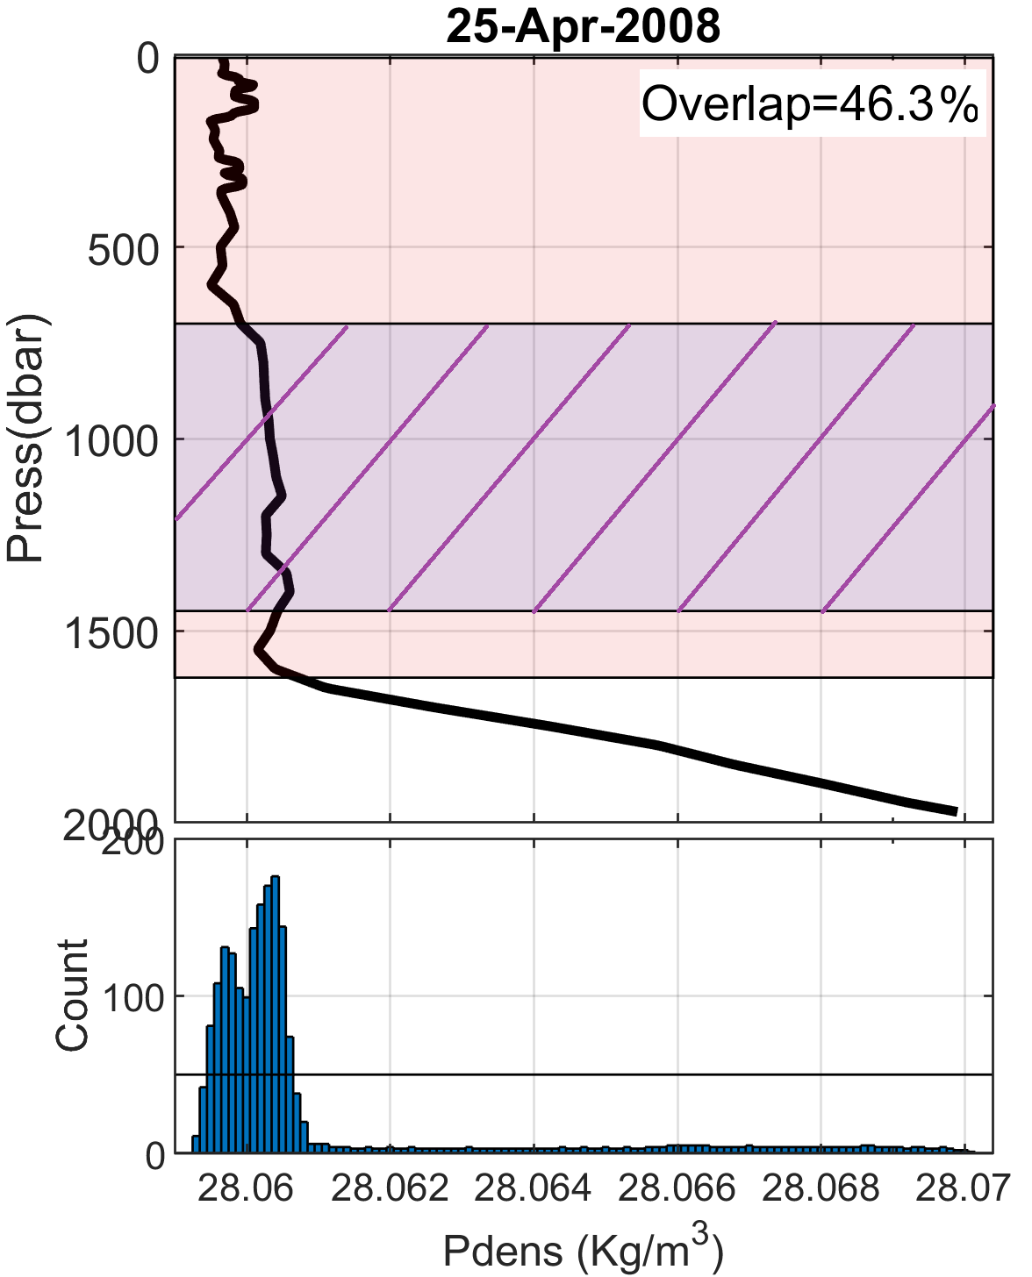
Background and motivation – Data and methods – Results – Discussion and outlook – Future work
Differences explained by:
  Density recalculation

Slide 84
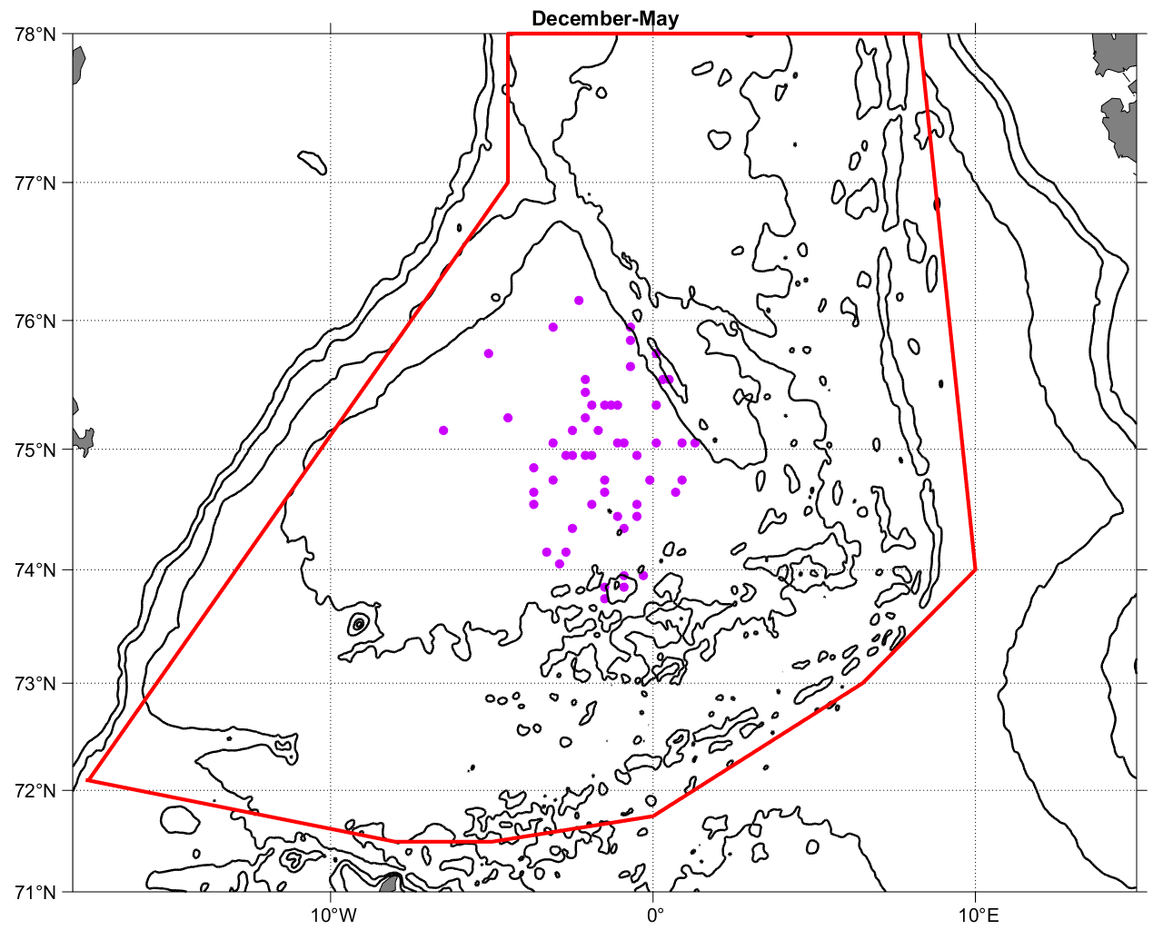
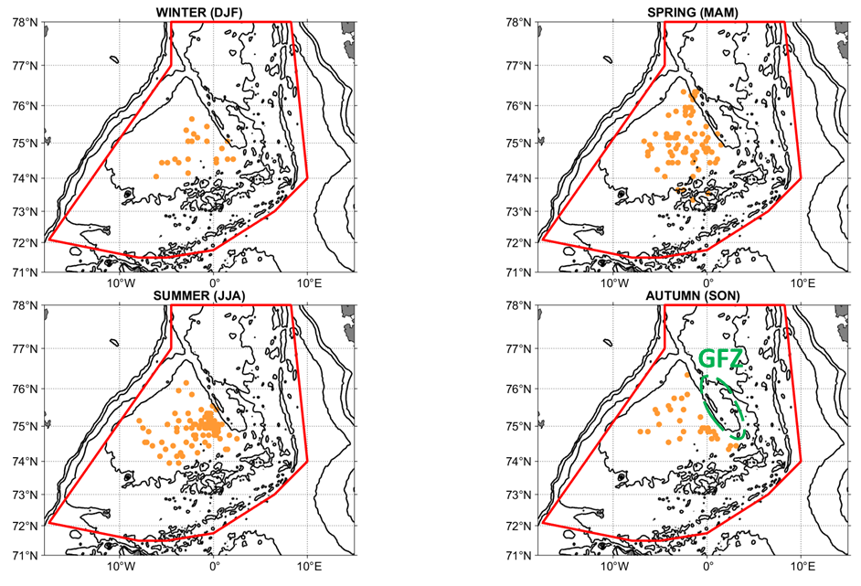
Background and motivation – Data and methods – Results – Discussion and outlook – Future work
SCVs may be formed as a result of deep SMLs in the Greenland Sea
Low EKE (Olivier et al., 2008)
Topography (Dewar., 2002)
Once formed they remain in the central Greenland Sea and some may remain trapped in the GFZ

Slide 85
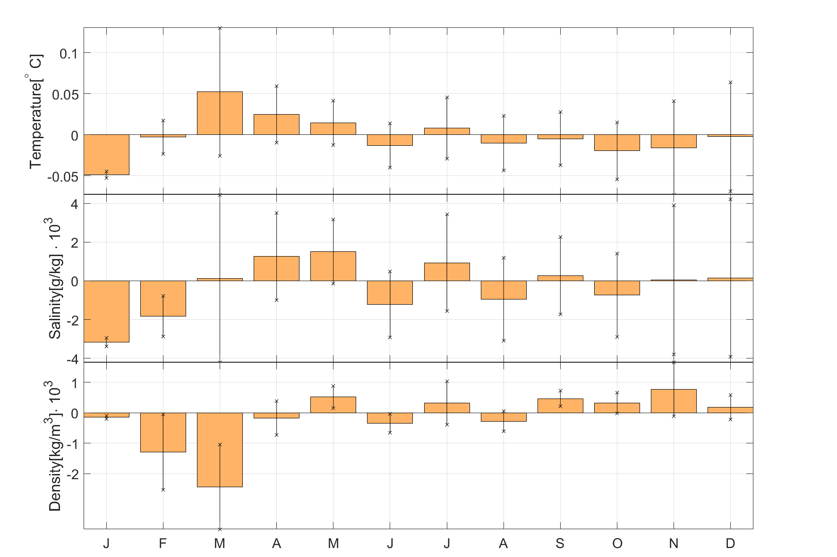
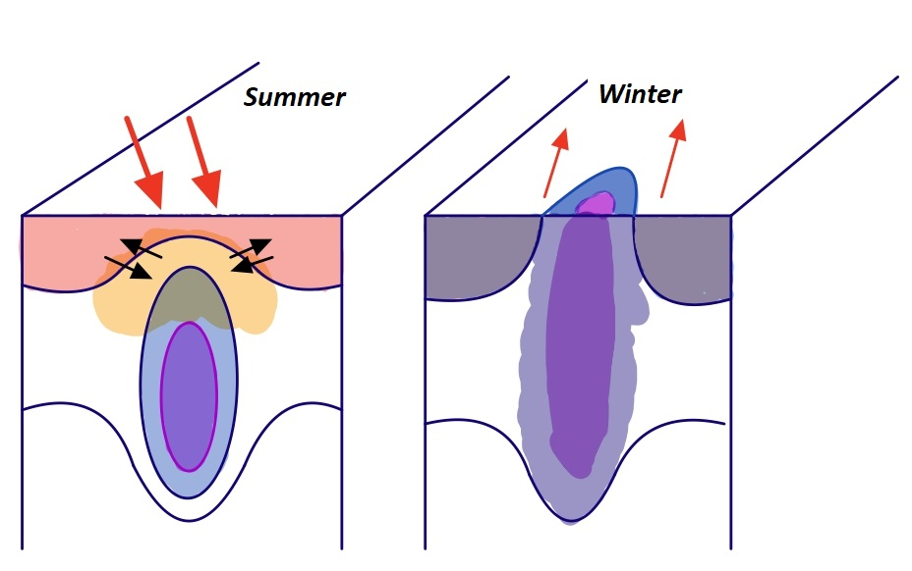
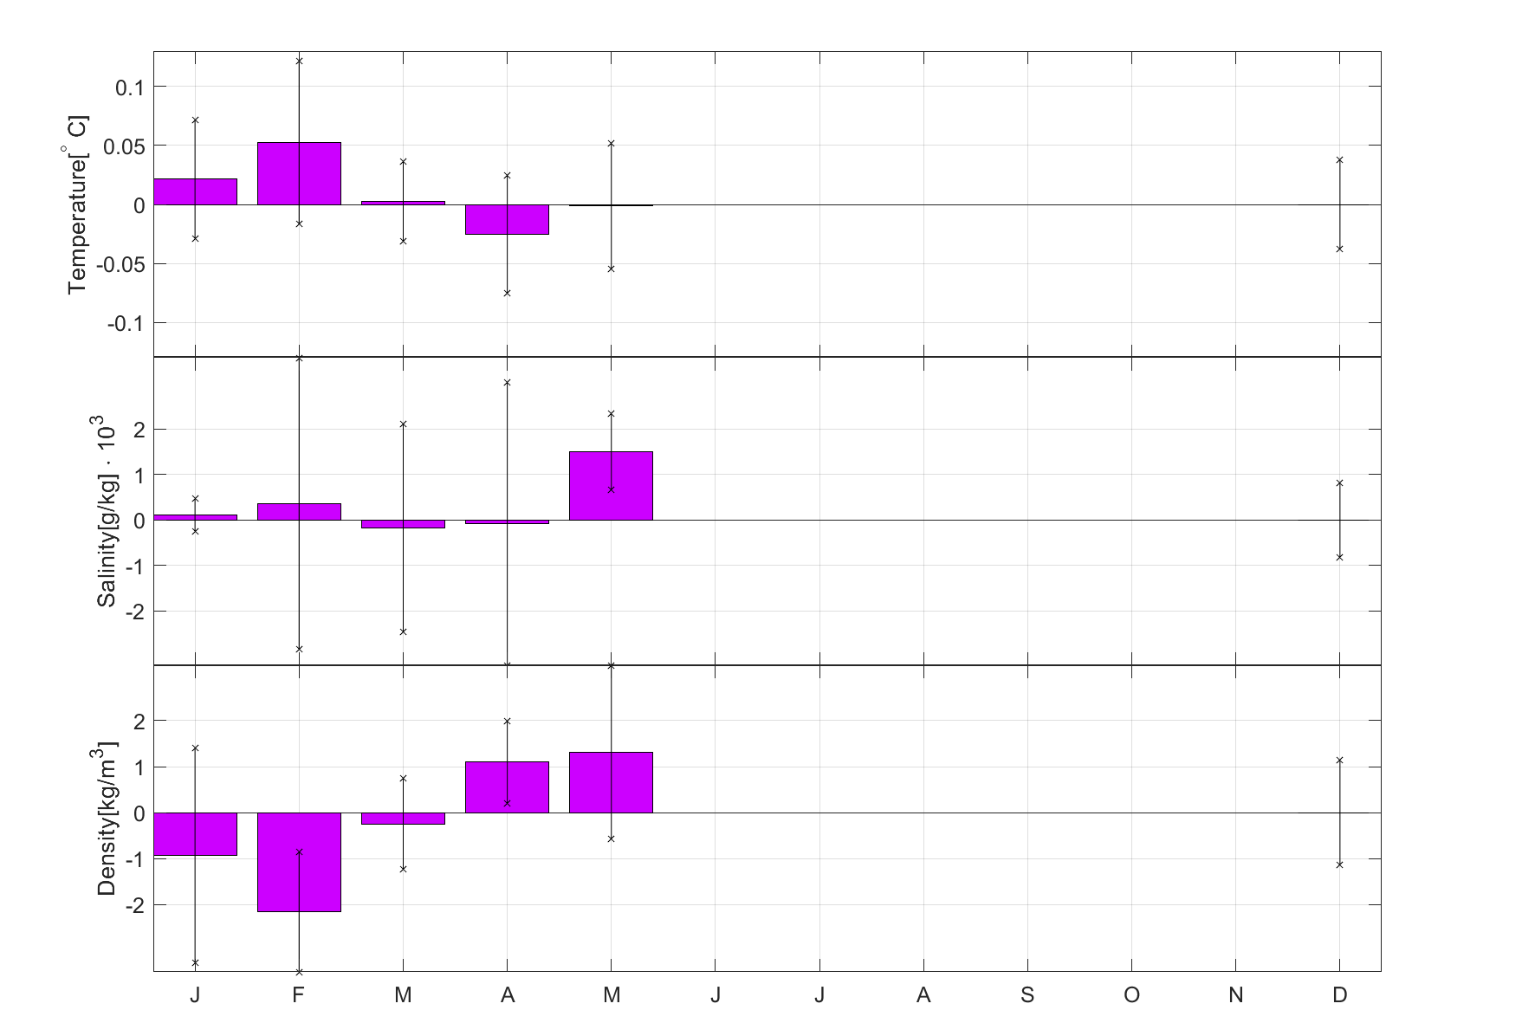
Background and motivation – Data and methods – Results – Discussion and outlook – Future work
How do SCVs persist?

