Slide 1
Idealized modelling of the circulation along the slope north of Iceland
Thorbjørn Østenby Moe
Supervisors: Kjersti Birkeland Daae, Kjetil Våge, Stefanie Semper, Vår Iren Hjorth Dundas

Slide 2
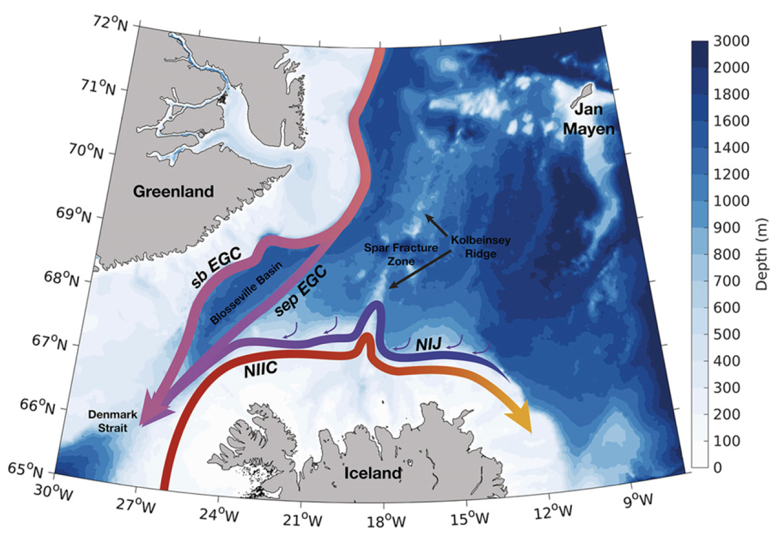
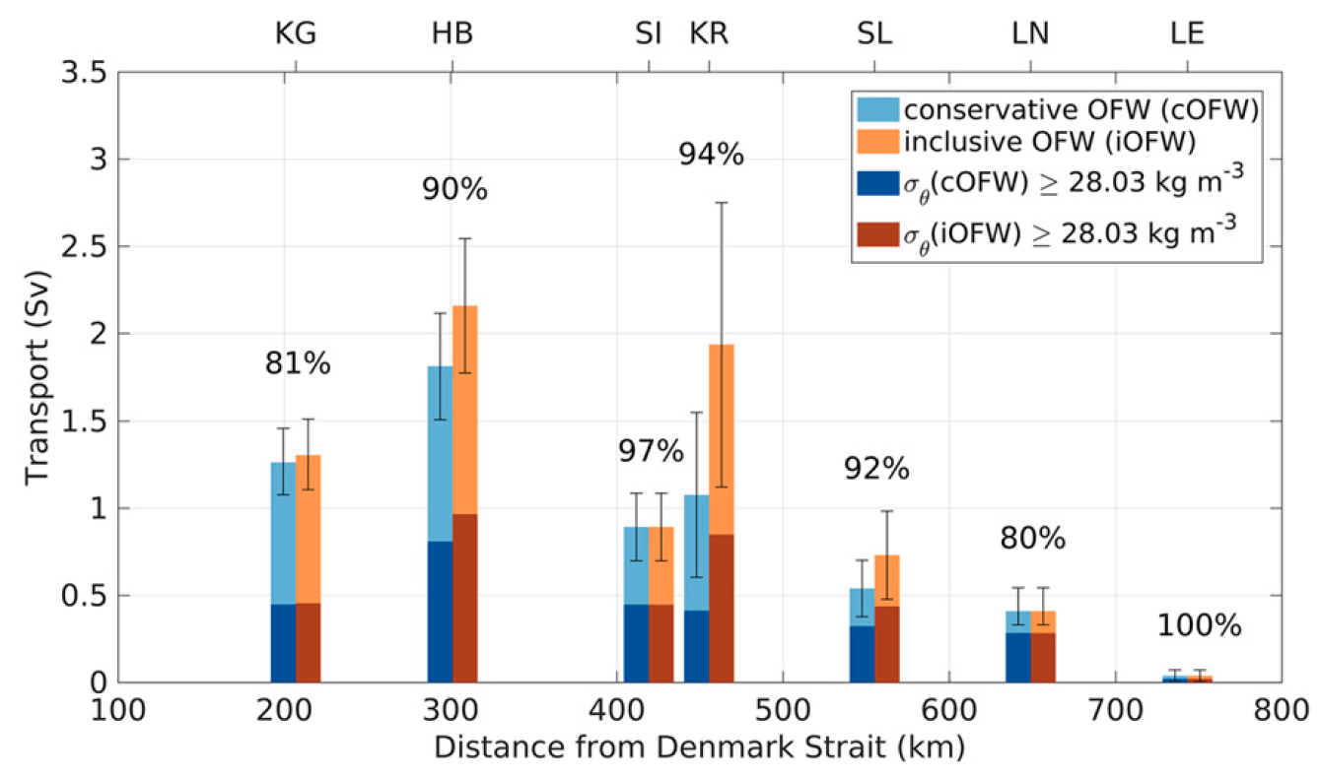
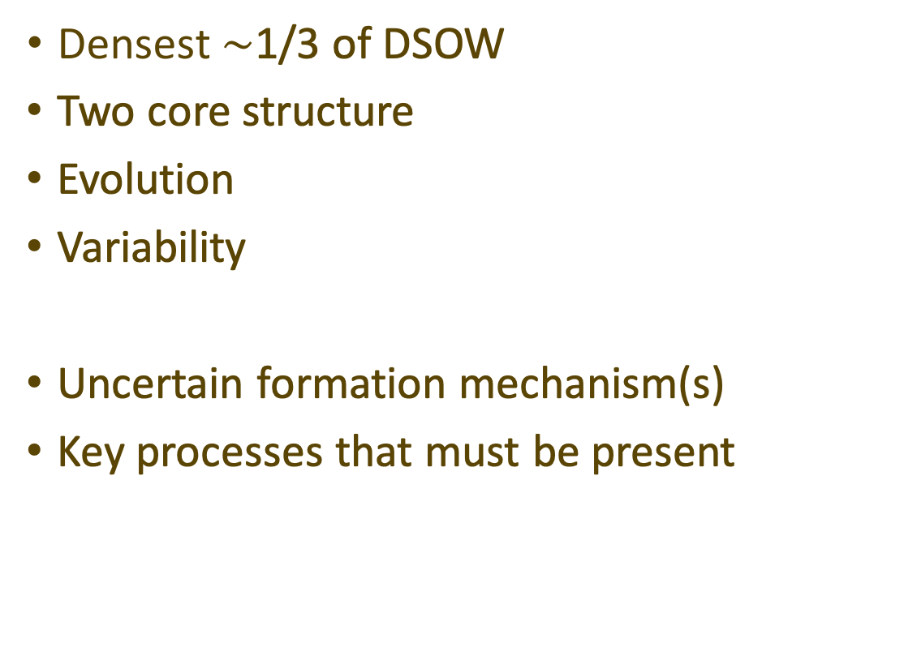
The North Icelandic Jet
$\text{Densest} \sim$1/3 of DSOW
Two core structure
Evolution
Variability
Uncertain formation mechanism(s)
Key processes that must be present
Semper et al., 2019
Notes:
Why is it interesting?
Why is this a good study area for my thesis?
What do I hope to ascertain about the current?

Slide 3
ROMS – Regional Ocean Modeling System
“ROMS is a free-surface, terrain-following, primitive equations ocean model”
Simplified modelling framework
Appropriate for less extensive projects
Daae et al. 2017 & Hattermann et al. 2014
Testing of hypotheses (e.g. dense water sink in western boundary)
Point to processes that needs to be present
Perhaps increase complexity

Slide 4
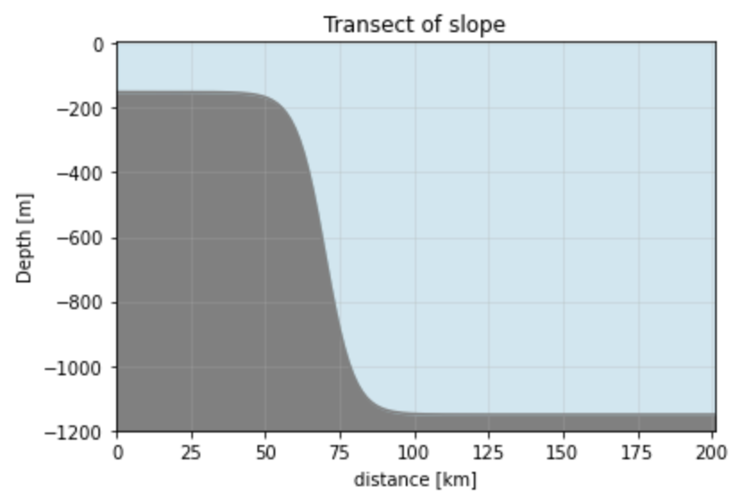
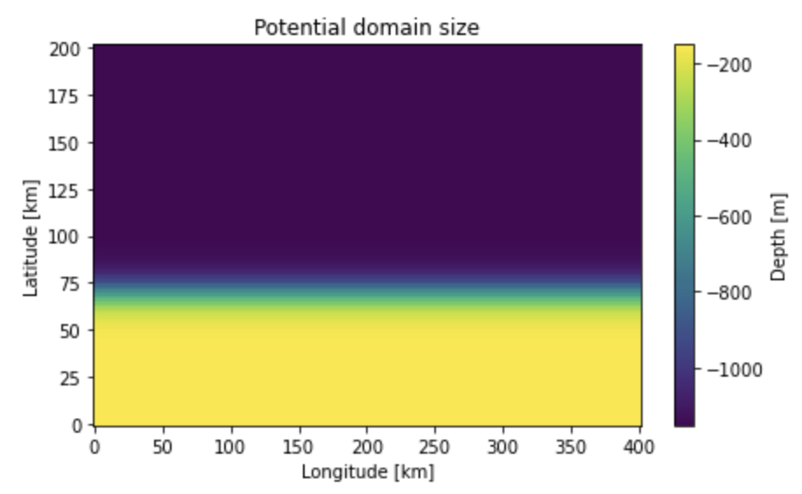
Progression
Slope
Grid script
Details less important
Notes:
What have I done so far?
How much of this is set in stone?
How much can be tweaked later?

Slide 5
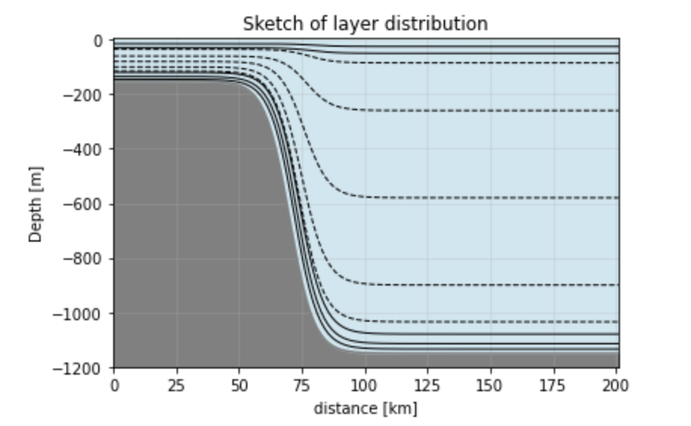
Progression
Interpolate to vertical grid
Apply horizontally uniform profiles -> test order of error due to terrain following grid
Tweak parameters
Establish reference run
Increase complexity

Slide 6
What can be achieved?
Test hypotheses
Indicate promising marine survey objectives/locations
Can something that resembles the NIJ be found using such a simple model?
How much of the currents structure could possibly be resolved?
Establish framework

Slide 7
References
Daae, K., Hattermann, T., Darelius, E., & Fer, I. (2017). On the effect of topography and wind on warm
water inflow—An idealized study of the southern Weddell Sea continental shelf system. Journal
of Geophysical Research: Oceans, 122(3), 2622–2641. https://doi.org/10.1002/2016JC012541
Hattermann, T., Smedsrud, L. H., Nøst, O. A., Lilly, J. M., & Galton-Fenzi, B. K. (2014). Eddy-
resolving simulations of the Fimbul Ice Shelf cavity circulation: Basal melting and exchange
with open ocean. Ocean Modelling, 82, 28–44. https://doi.org/10.1016/j.ocemod.2014.07.004
Semper, S., Våge, K., Pickart, R. S., Valdimarsson, H., Torres, D. J., & Jónsson, S. (2019). The
emergence of the north icelandic jet and its evolution from northeast Iceland to Denmark strait. Journal of Physical Oceanography, 49(10), 2499–2521. https://doi.org/10.1175/JPO-D-19-0088.1
Våge, K., Pickart, R. S., Spall, M. A., Valdimarsson, H., Jónsson, S., Torres, D. J., Østerhusand, S.,
& Eldevik, T. (2011). Significant role of the North Icelandic Jet in the formation of Denmark
Strait overflow water. Nature Geoscience, 4(10), 723–727. https://doi.org/10.1038/ngeo1234
More suggestions are appreciated (both modelling & NIJ related)

