Slide 1
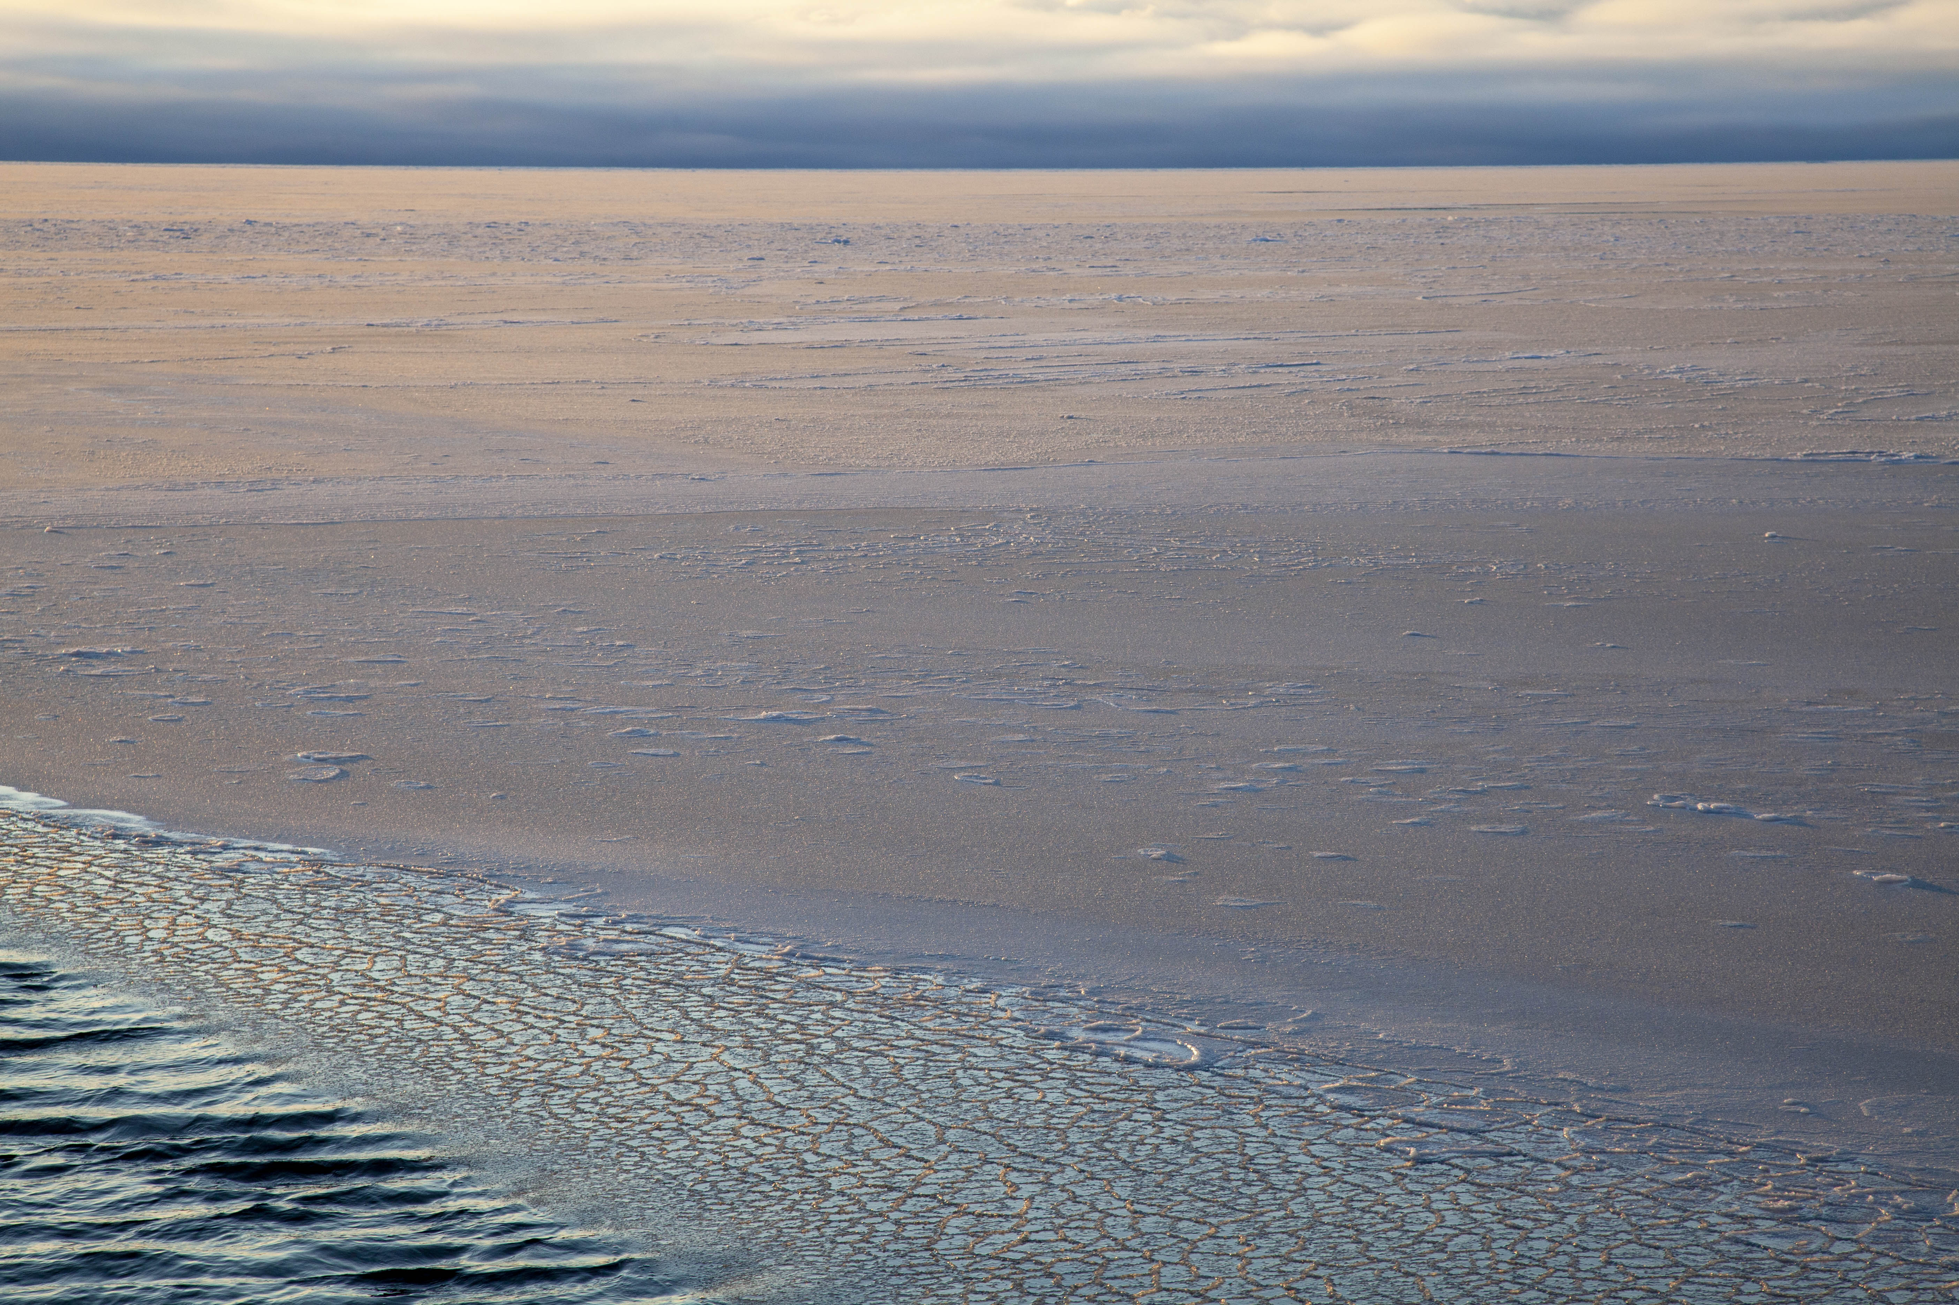
Evolution of the Alaska Coastal Current
as it traverses the Chukchi Sea
Robert S. Pickart and Peigen Lin
Woods Hole Oceanographic Institution
and 22 co-authors from 14 institutions
Freeze-up east of Barrow Canyon Nov 2020 (L. Juranek)

Slide 2
Outline
The Pacific Artic Group and the establishment of the Distributed Biological Observatory (DBO) Program
Brief background on the circulation of Pacific Water north of Bering Strait
The DBO shipboard data and methods
Resolving the Alaska Coastal Current: mean and seasonal variation
Nature of the mesoscale variability

Slide 3

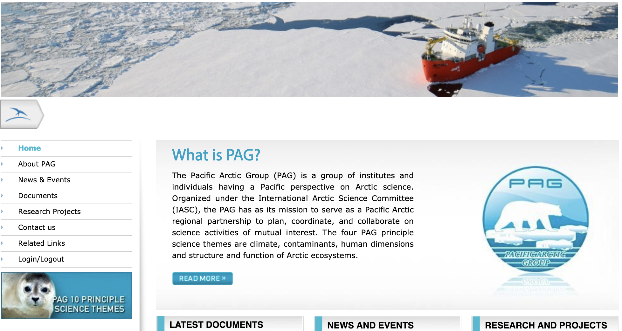

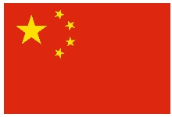
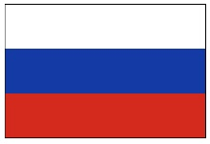
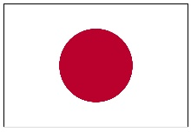
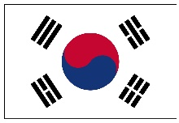
The Pacific Arctic Group

Slide 4
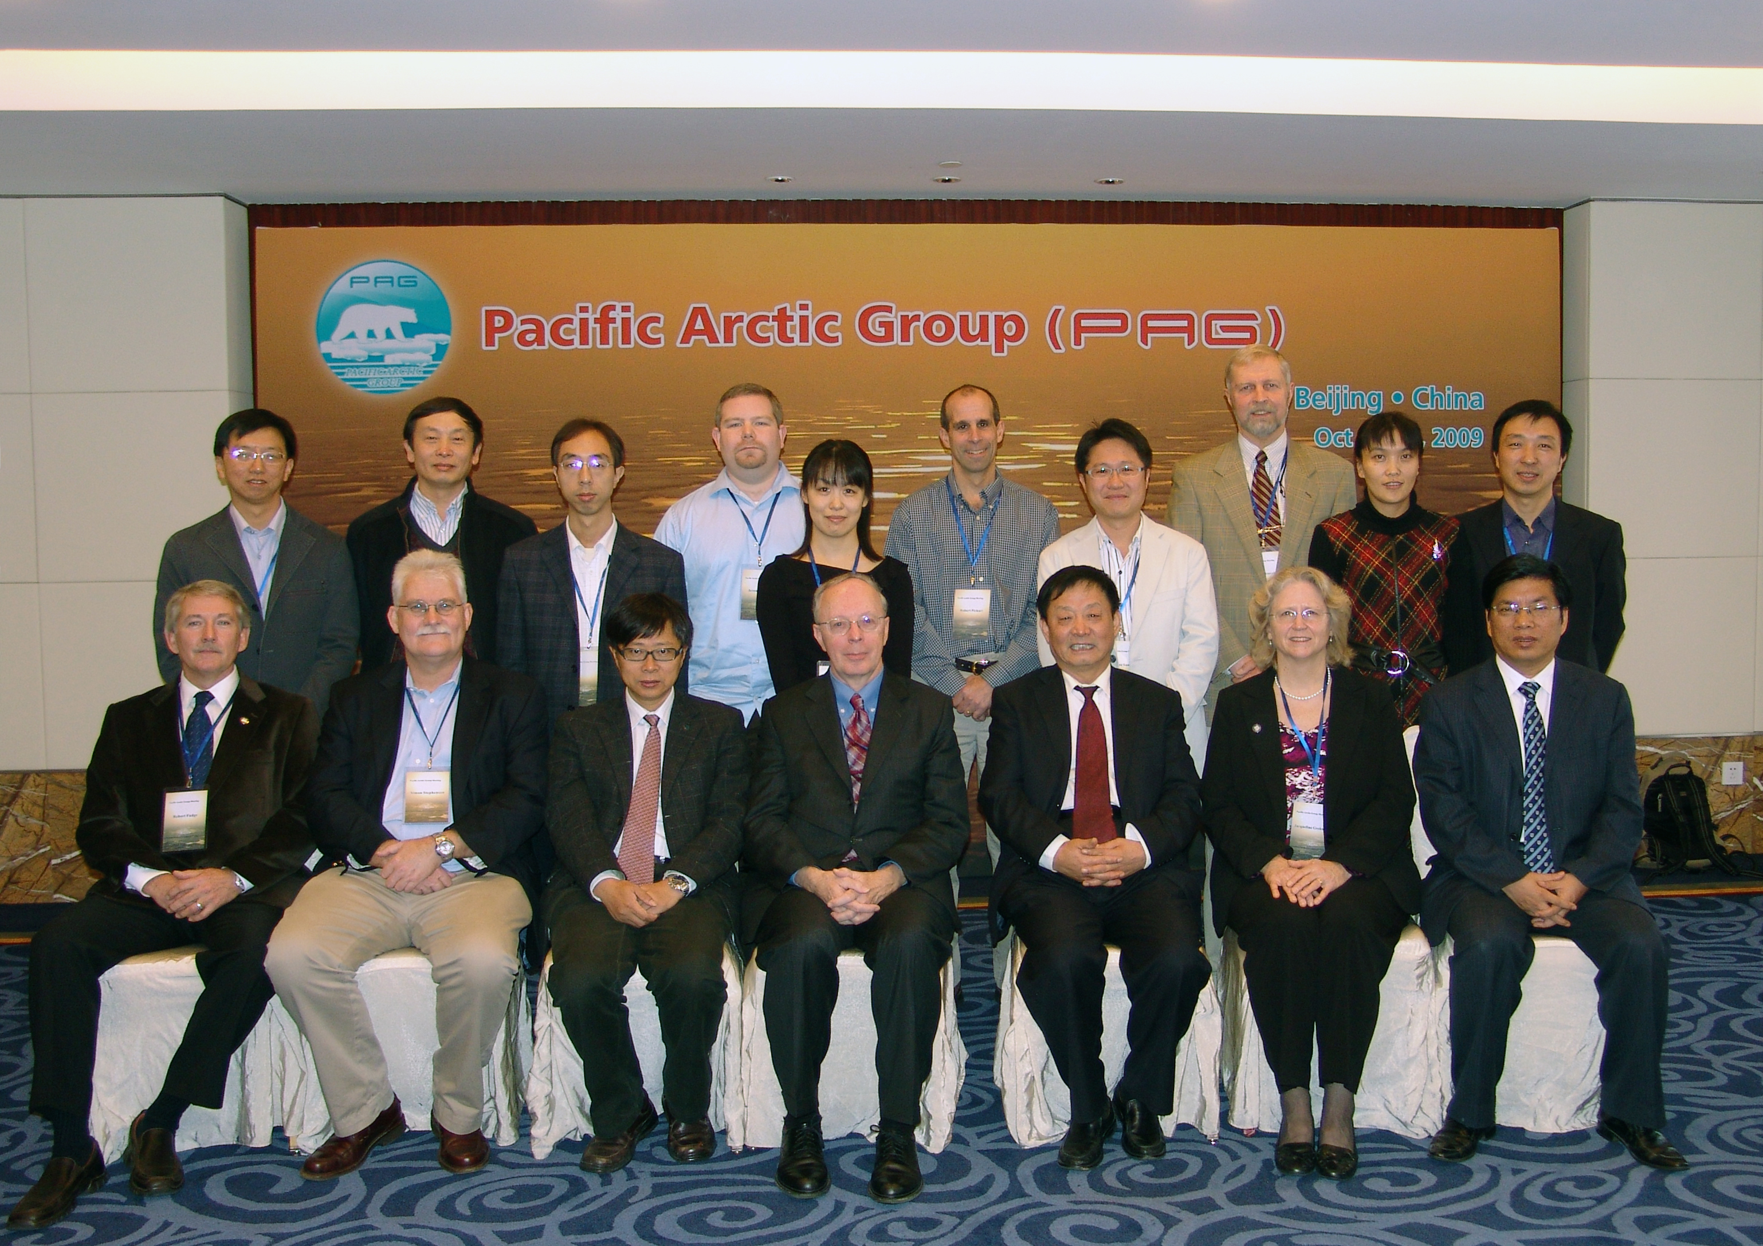
The Pacific Arctic Group
2009 PAG meeting in Beijing, China

Slide 5
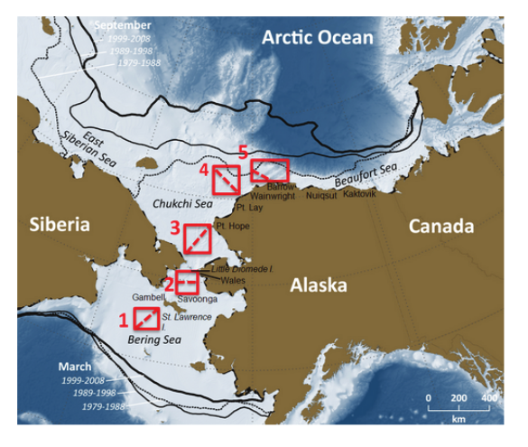
The Distributed Biological Observatory (DBO)
Original five DBO lines

Slide 6
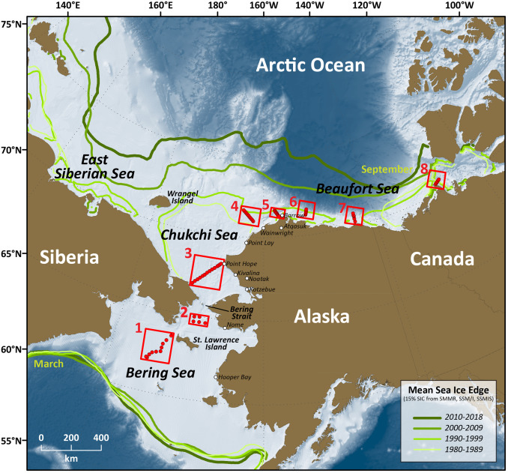
The Distributed Biological Observatory (DBO)
Expanded to 8 DBO lines

Slide 7
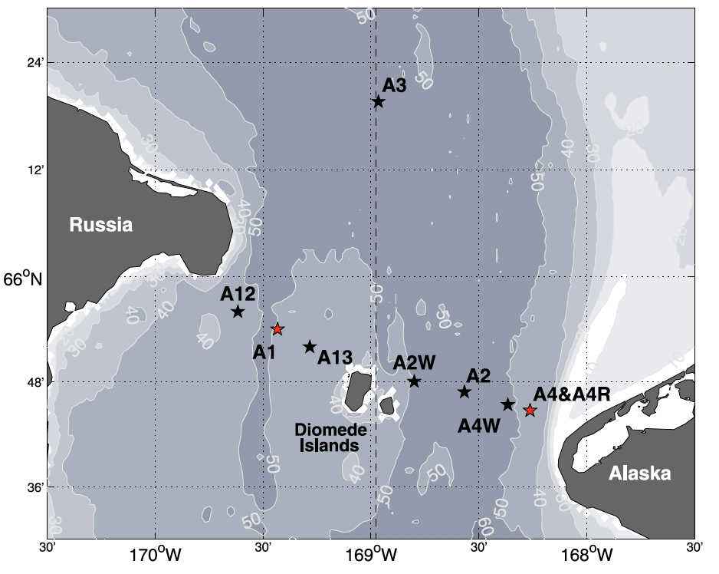
The Bering Strait Arctic Observing Network (AON) Program
PI: Rebecca Woodgate,
Univ. of Washington
Bering Strait moorings

Slide 8
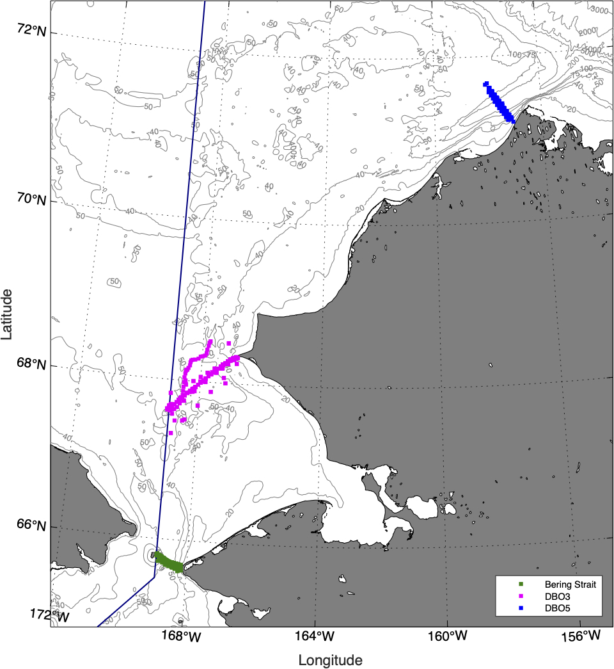
Data used in this study: hydrography
Barrow
Canyon
DBO5
n=45
All sections have
been interpolated
onto an identical grid
for each location
Russian EEZ
DBO3, n=55
Bering Strait, n=32

Slide 9
Data used in this study: hydrography
Bering St
DBO3
DBO5

Slide 10
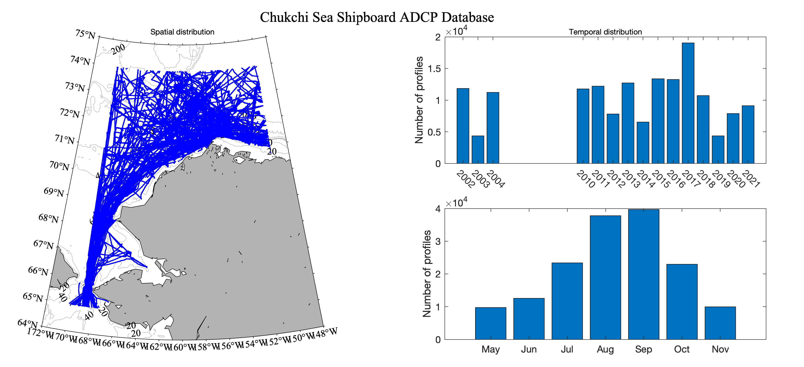
Data used in this study: velocity
The ChukSA climatology: shipboard ADCP data from 56 cruises 2002 – 2021

Slide 11
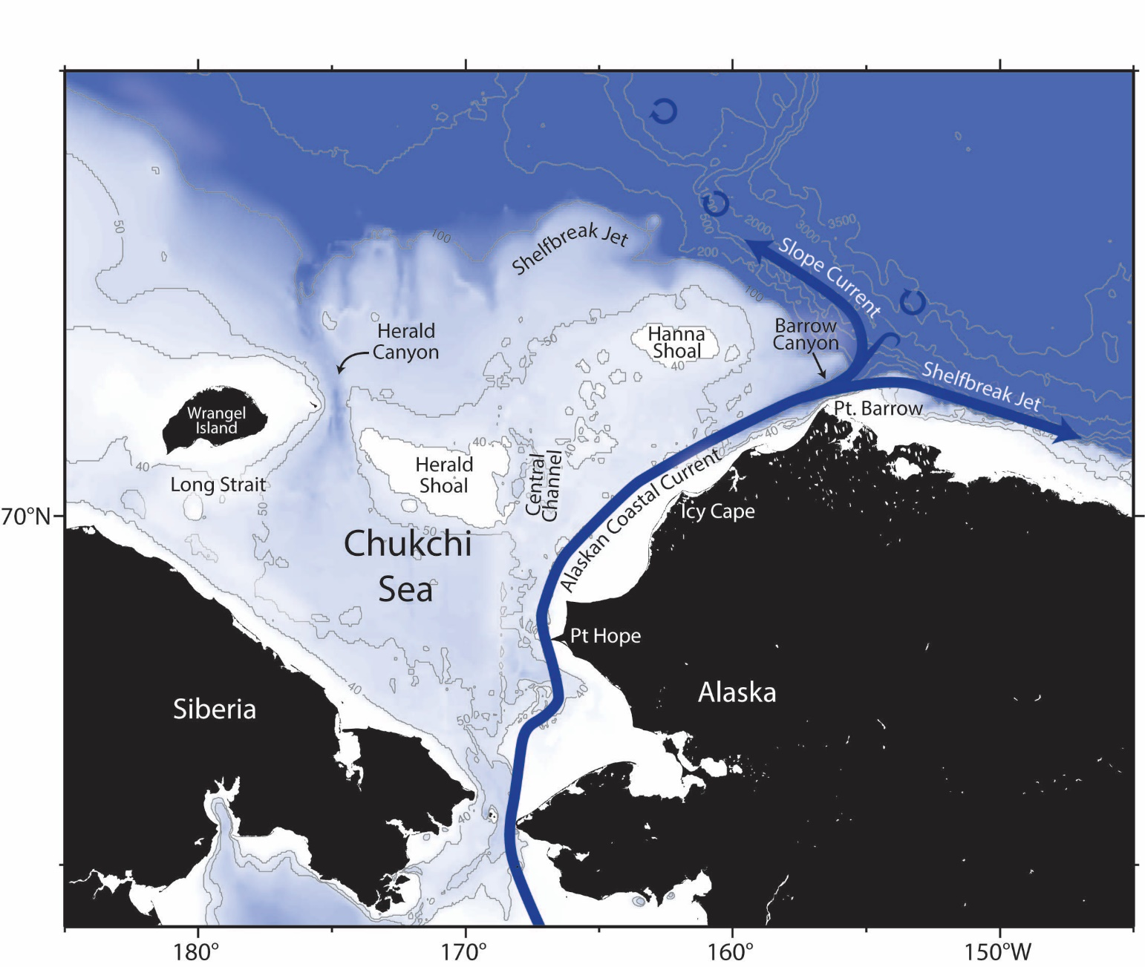
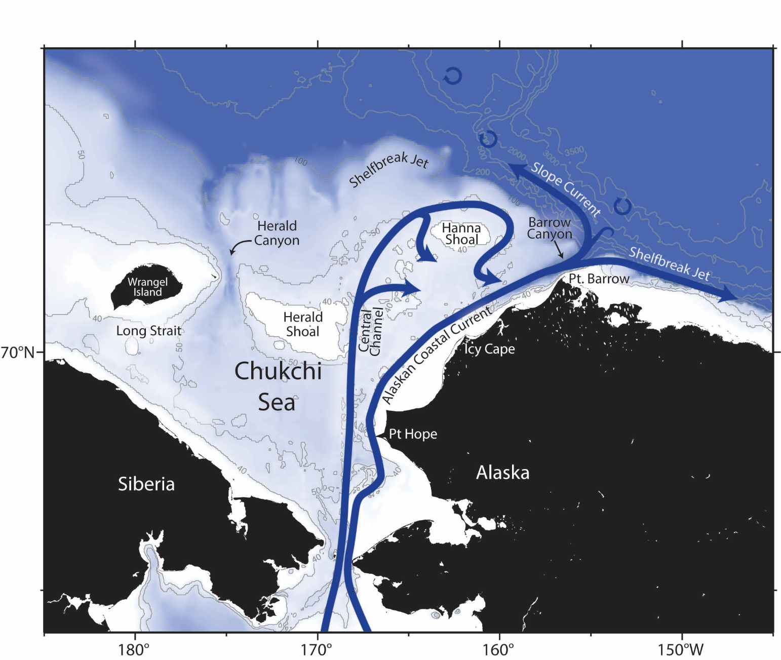
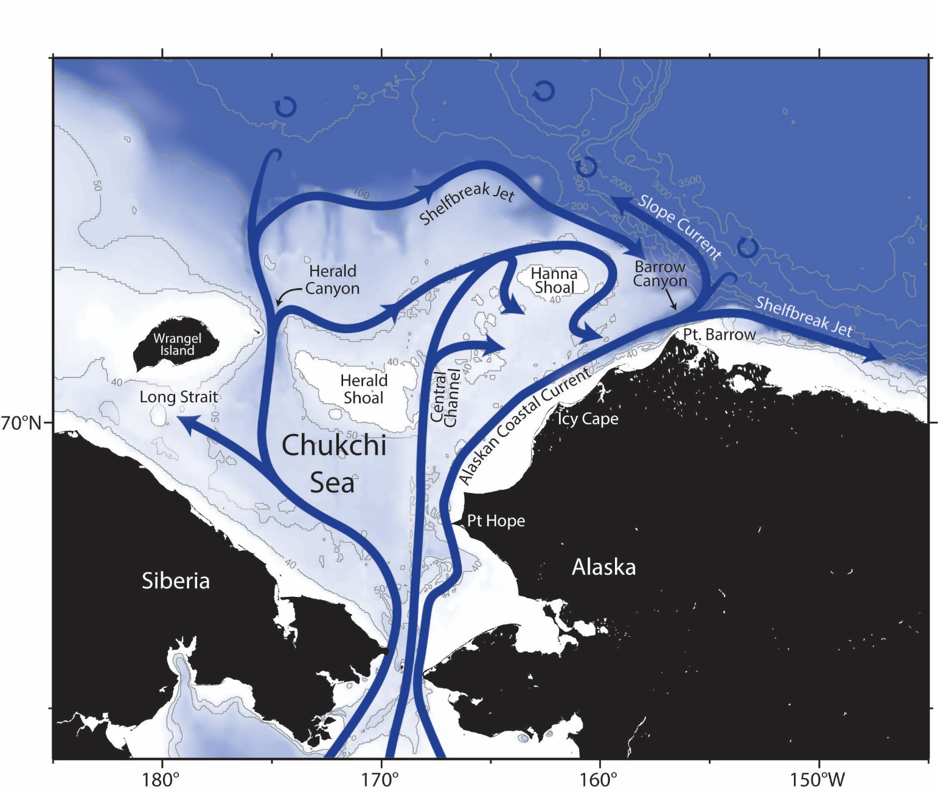
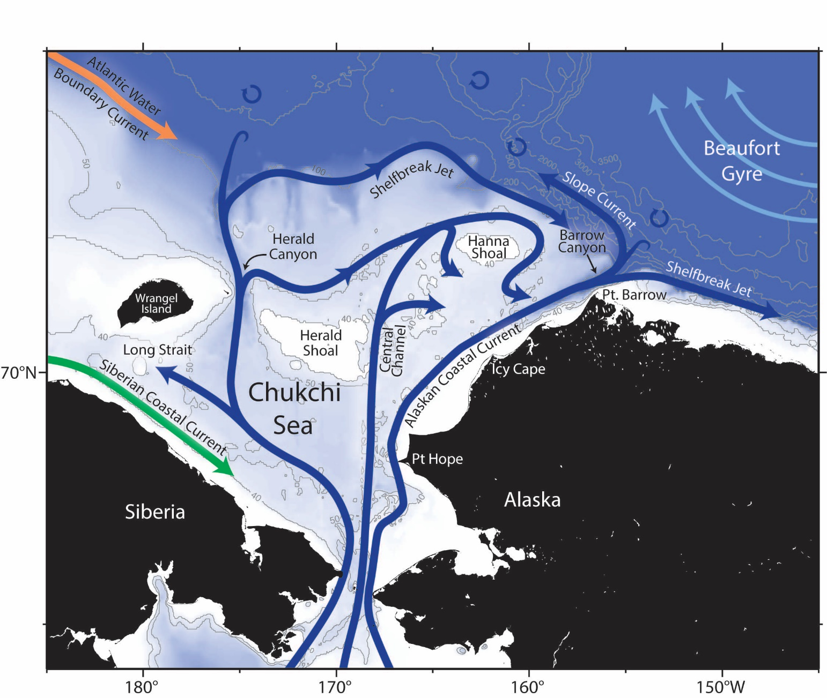
Pacific water inflow to the Arctic
~1 Sv

Slide 12
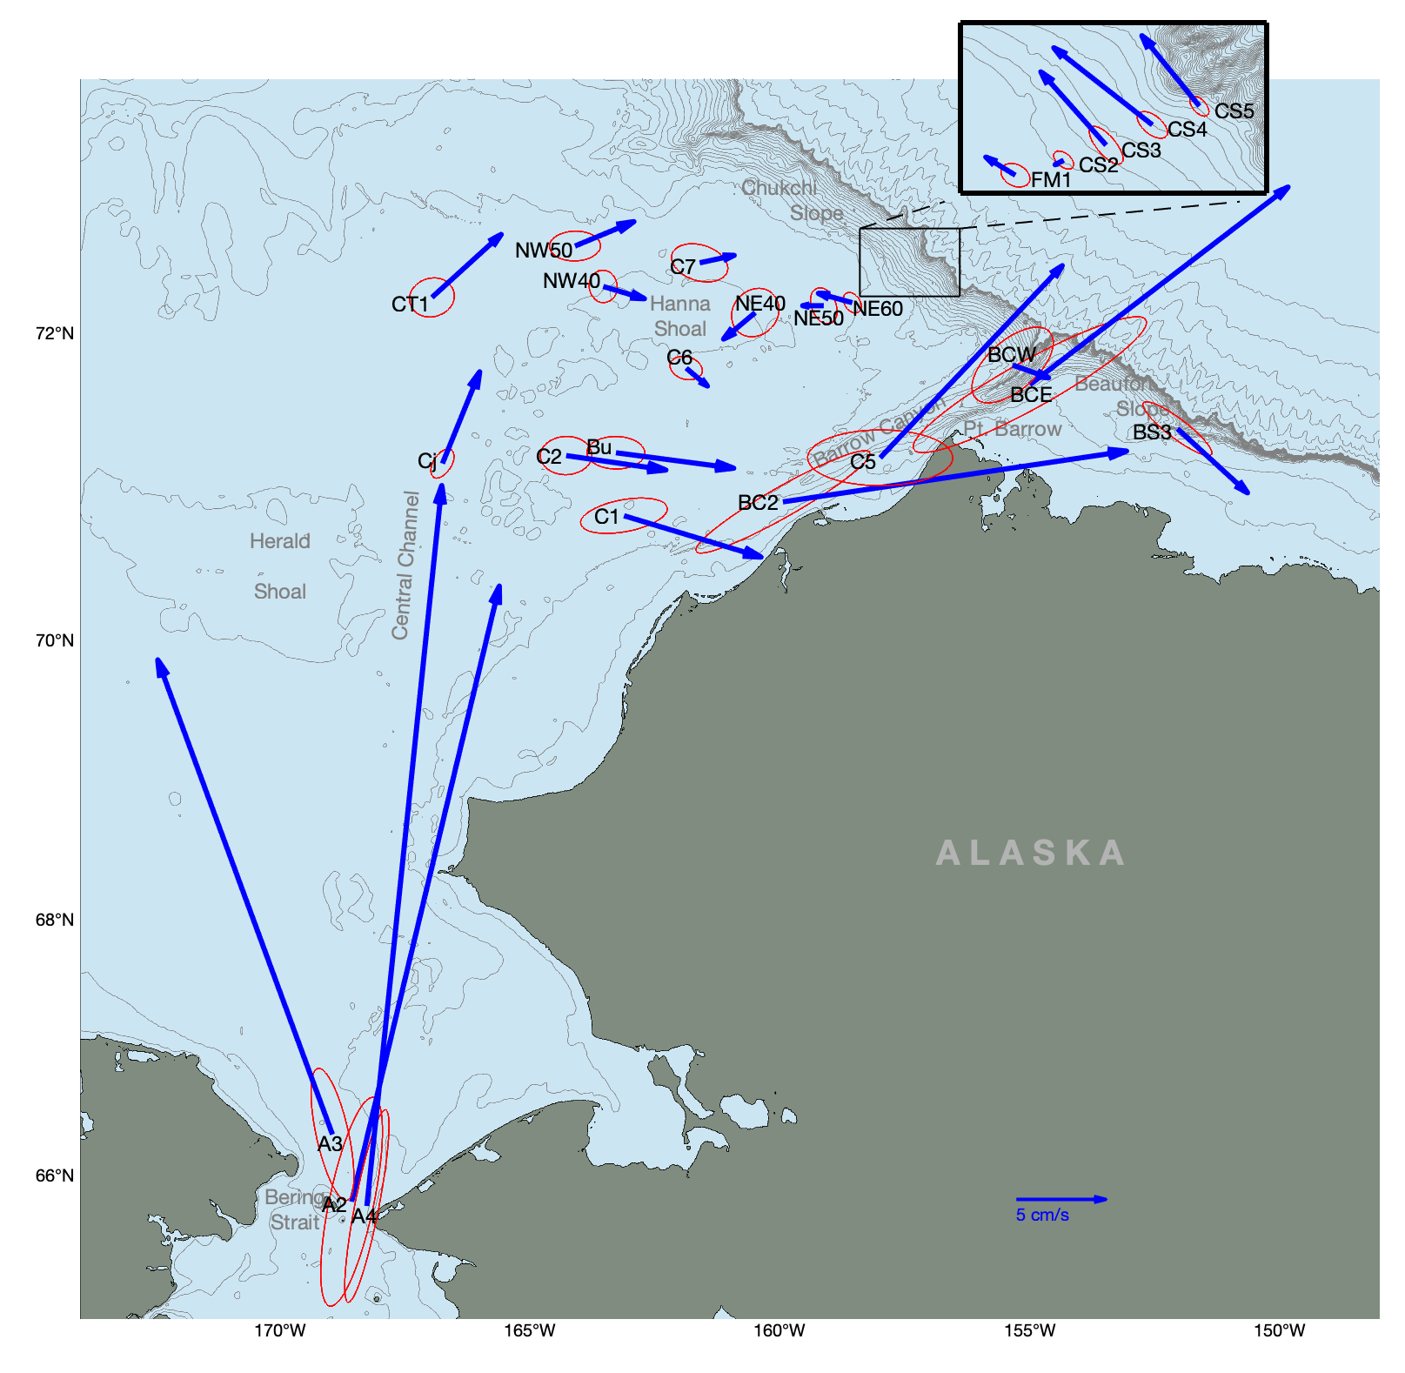
Pacific water inflow
to the Arctic
Year-long depth-mean vectors
for 2013-2014
Ovall et al. (2021)

Slide 13
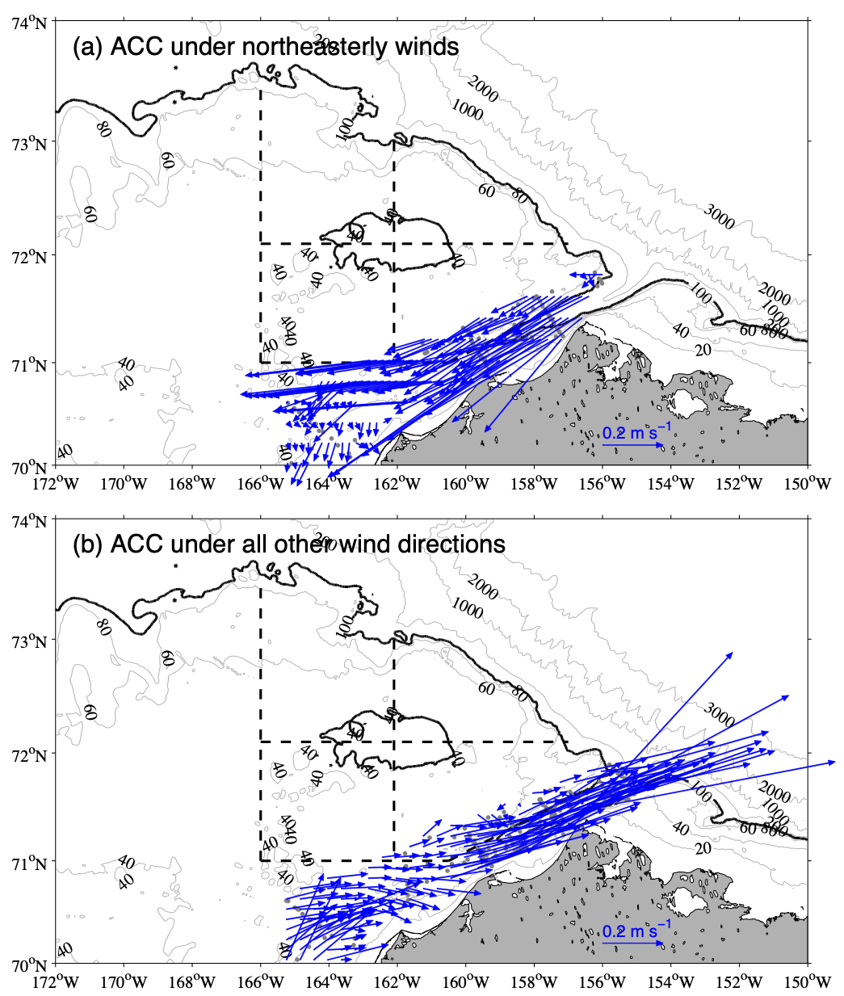
Sensitivity of flow to wind
Alaska Coastal Current
for all wind directions
except northeasterly
Lin et al. (2019)

Slide 14
Alaska Coastal Current
for northeasterly winds
exceeding 5 m s⁻¹
Alaska Coastal Current
for all wind directions
except northeasterly
Lin et al. (2019)

Slide 15
Alaska Coastal Current
for northeasterly winds
exceeding 5 m s⁻¹
Focus on non-upwelling periods
Alaska Coastal Current
for all wind directions
except northeasterly
Lin et al. (2019)

Slide 16
Use bottom salinity anomaly to identify upwelling realizations
DBO3
DBO5
S_{anom} > 0.1 corresponds to upwelling
DBO3
Bering Strait

Slide 17
DBO3 mean fields: non-upwelling vs. upwelling

Slide 18
DBO3 mean fields: non-upwelling vs. upwelling

Slide 19
Computing the non-upwelling vs. upwelling
mean absolute geostrophic velocities
To reference the mean thermal wind sections
we used the ChukSA historical velocity data

Slide 20
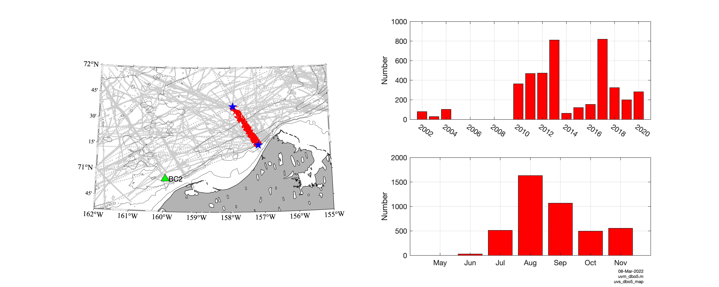
DBO5 line
Alongcoast direction = 56˚T based on mooring BC2
Upwelling: all times when alongcoast velocity < 0 in the coastal region, and the corresponding ±24hr period offshore
Non-upwelling: all remaining times

Slide 21
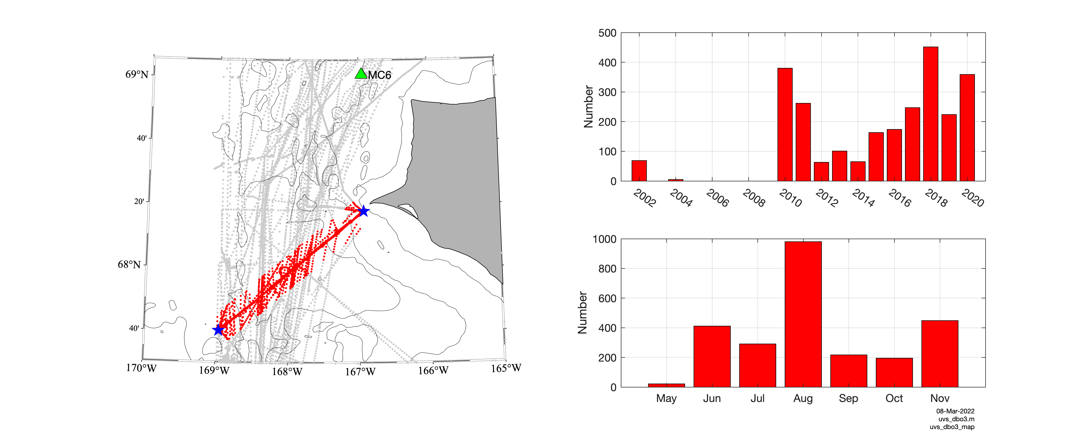
DBO3 line
Alongcoast direction = 6˚T based on mooring MC6
Upwelling: all times when alongcoast velocity < 0 in the coastal region, and the corresponding ±24hr period offshore
Non-upwelling: all remaining times

Slide 22
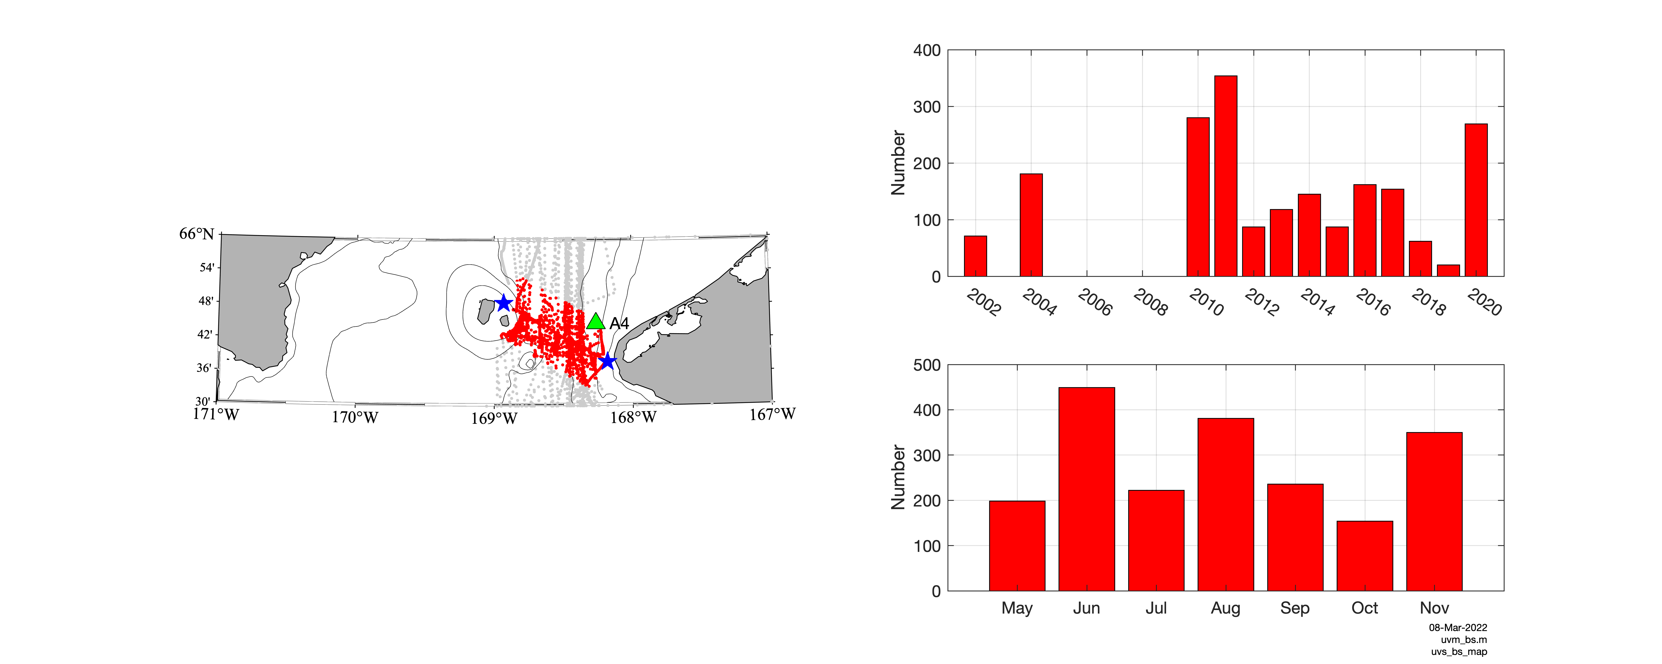
Bering Strait line
Alongcoast direction = 11˚T based on mooring A4
Upwelling: all times when alongcoast velocity < 25 cm s⁻¹ across the entire section
Non-upwelling: all remaining times

Slide 23
DBO5 mean fields:
non-upwelling vs. upwelling
Background
Upwelling

Slide 24
DBO3 mean fields:
non-upwelling vs. upwelling
Background
Upwelling

Slide 25
Bering Strait mean fields:
non-upwelling vs. upwelling
Background
Upwelling

Slide 26
Volume transports

Slide 27
Volume transports
Central Channel
Branch
ACC
ACC
ACC
Central Channel Branch
Central Channel
Branch

Slide 28
Volume transports
Central Channel
Branch
ACC
ACC
ACC
Central Channel Branch
Central Channel
Branch
ACC = 0.34 Sv
ACC = 0.37 Sv
ACC = 0.32 Sv

Slide 29
Volume transports
Central Channel
Branch
ACC
ACC
ACC
Central Channel Branch
Central Channel
Branch
ACC = 0.34 Sv
ACC = 0.37 Sv
CC = 0.87 Sv
CC = 0.81 Sv
ACC = 0.32 Sv
CC = 0.88 Sv

Slide 30
Volume transports
Central Channel
Branch
ACC
ACC
ACC
Central Channel Branch
Central Channel
Branch
ACC = 0.34 Sv
ACC = 0.37 Sv
CC = 0.87 Sv
CC = 0.81 Sv
Total transport = 1.20 ± 0.015 Sv
ACC = 0.32 Sv
CC = 0.88 Sv

Slide 31
Volume transports
Central Channel
Branch
ACC
ACC
ACC
Central Channel Branch
Central Channel
Branch
First time we have resolved/distinguished
these two flow branches
ACC = 0.34 Sv
ACC = 0.37 Sv
CC = 0.87 Sv
CC = 0.81 Sv
Total transport = 1.20 ± 0.015 Sv
ACC = 0.32 Sv
CC = 0.88 Sv

Slide 32
Volume transports
from R. Woodgate
Bering Strait monthly climatological transport

Slide 33
Volume transports
from R. Woodgate
Bering Strait monthly climatological transport

Slide 34
Volume transports
my value
from R. Woodgate
Bering Strait monthly climatological transport

Slide 35
Volume transports
from R. Woodgate
Bering Strait monthly climatological transport

Slide 36
Next: consider the properties of the ACC
First we need to objectively define the ACC water mass limits

Slide 37

Determining the ACC front
Define the ACC front as the isopycnal
corresponding to the max
$$\frac{∂ρ}{∂x}$$

Slide 38

Determining the ACC front
Define the ACC front as the isopycnal
corresponding to the max
$$\frac{∂ρ}{∂x}$$
$$\frac{∂ρ}{∂x}$$

Slide 39
ACW
Determining the ACC front
Define the ACC front as the isopycnal
corresponding to the max
$$\frac{∂ρ}{∂x}$$
$$\frac{∂ρ}{∂x}$$

Slide 40
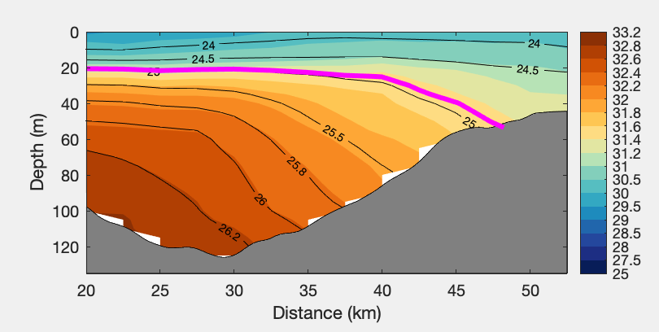
Mean DBO5 salinity
Determining the ACC front
Define the ACC front as the isopycnal
corresponding to the max
$$\frac{∂ρ}{∂x}$$
Caveat: at DBO5 the ACC frontal isopycnal does not outcrop

Slide 41
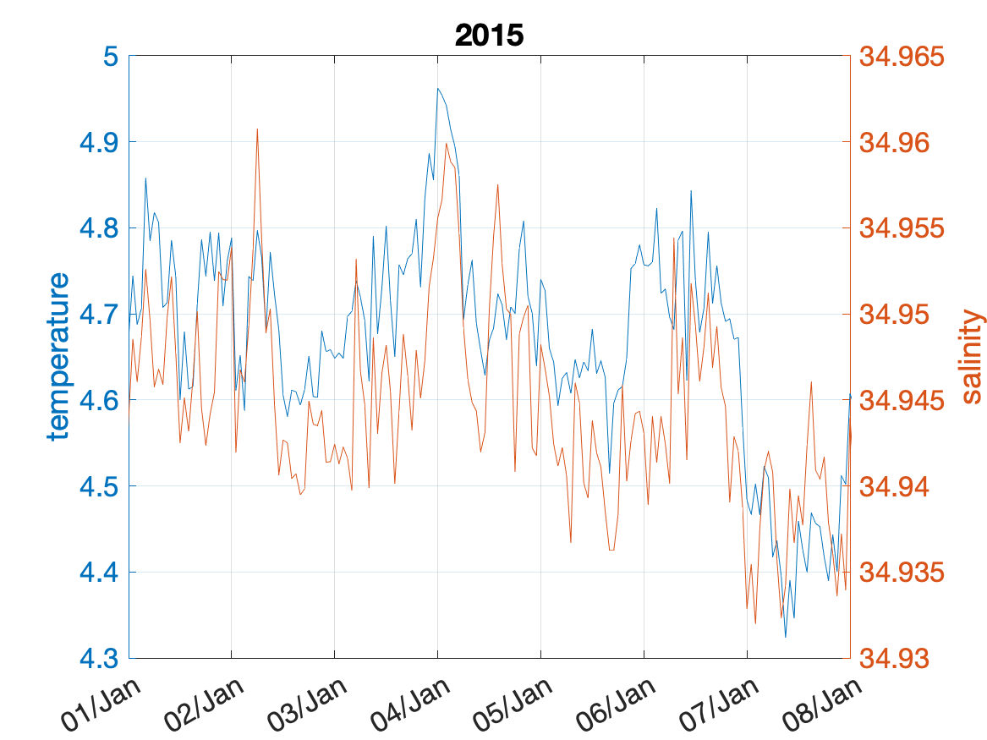
Relationship between T and S
T and S of Irminger Water highly correlated in the West Greenland Current
from Astrid

Slide 42
Properties of ACC at DBO3
No relationship between T and S in the Alaska Coastal Current

Slide 43
Properties of ACC at DBO3
Density determined by salinity in the Alaska Coastal Current

Slide 44
Seasonality of ACC
at Bering Strait

Slide 45
Seasonality of ACC
at Bering Strait

Slide 46
Seasonality of ACC
at Bering Strait

Slide 47
Seasonality of ACC
at Bering Strait

Slide 48
No evidence of
seasonality at DBO5

Slide 49
Next: consider the northward evolution of the ACC

Slide 50
Properties of ACC
Sea-ice melt / River Water
freezing point

Slide 51
Properties of ACC
Sea-ice melt / River Water
freezing point

Slide 52
Properties of ACC
Sea-ice melt / River Water
freezing point

Slide 53
Properties of ACC
Sea-ice melt / River Water
freezing point

Slide 54
Properties of ACC
Sea-ice melt / River Water
freezing point

Slide 55
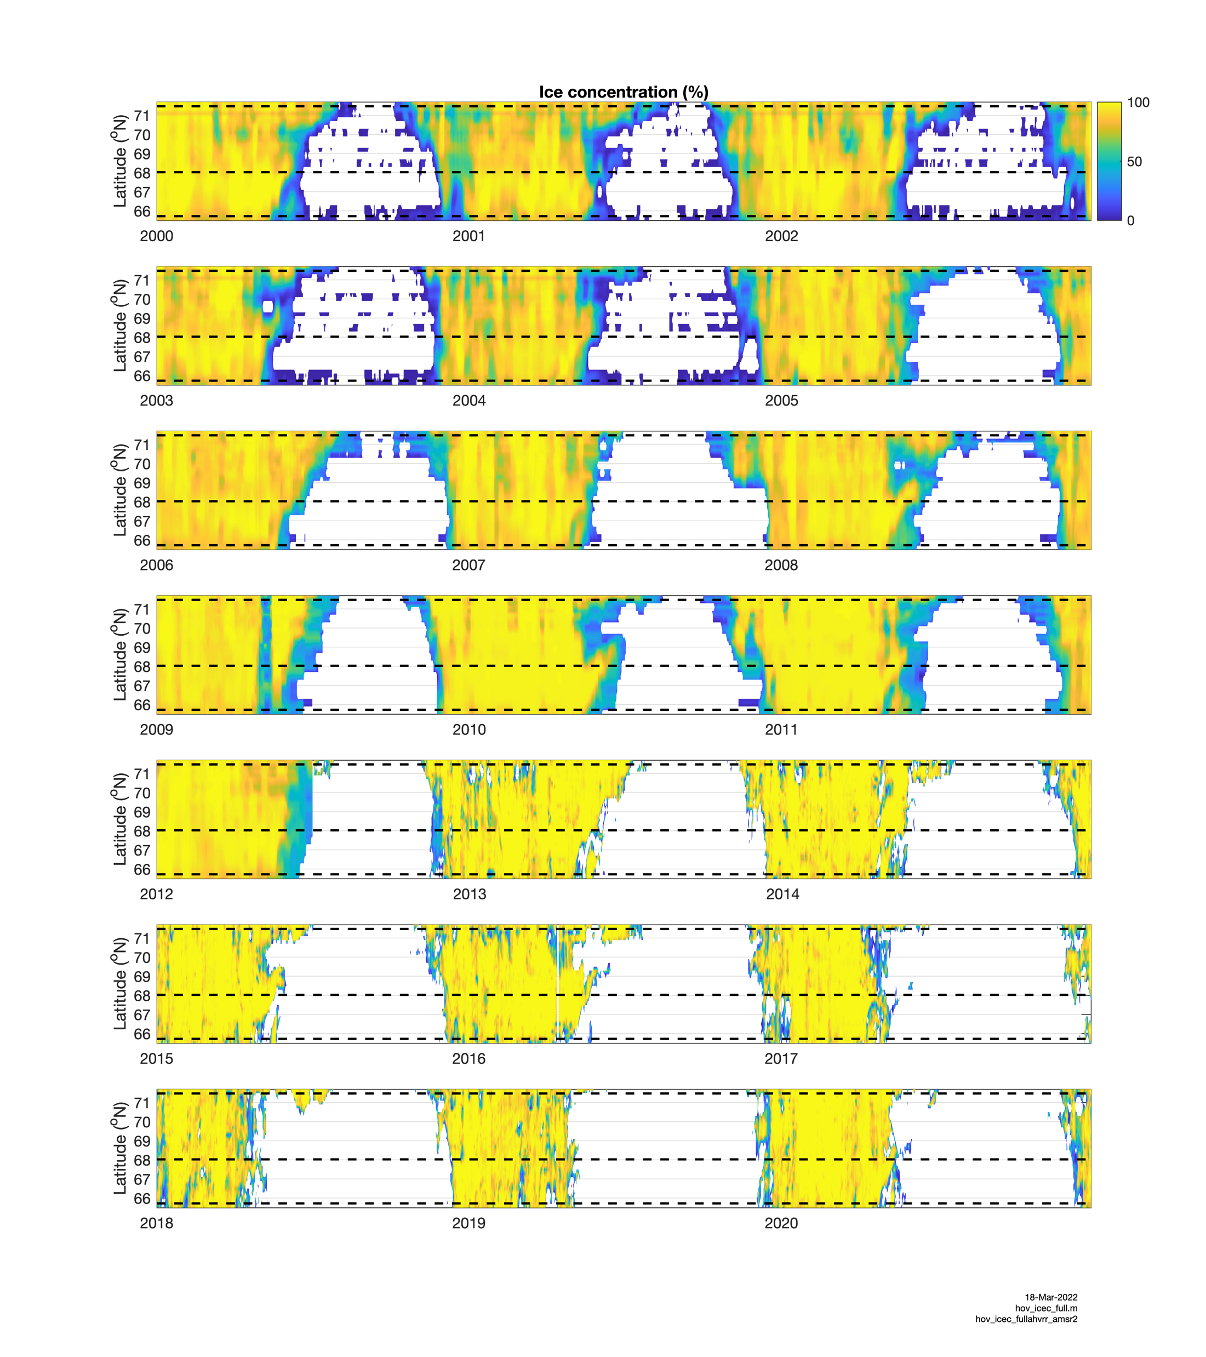
Hovmöller plot of
sea-ice concentration
versus latitude
DBO5
DBO3
BS

Slide 56
Hovmöller plot of
sea-ice concentration
versus latitude
DBO5
DBO3
BS
Percentage of sections occupied
with at least 10% ice cover:
BS = 6.5%
DBO3 = 1.8%
DBO5 = 24.4%

Slide 57
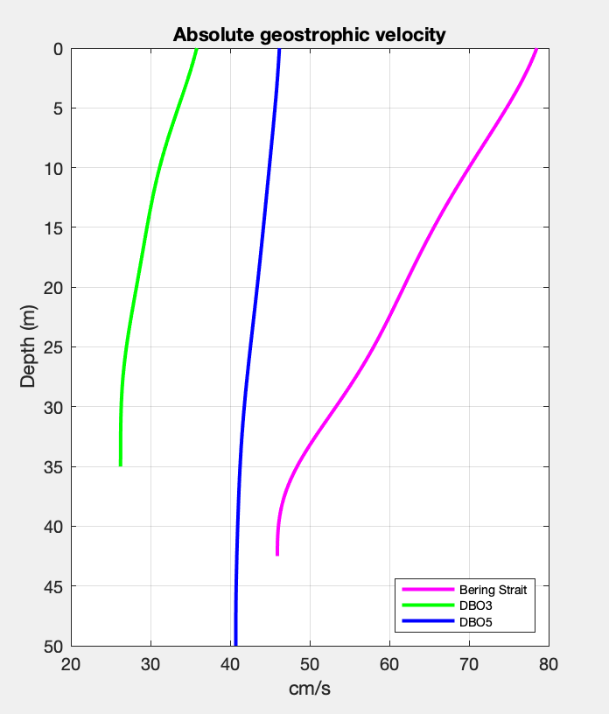
Properties of ACC
Vertical profiles of mean velocity

Slide 58
What is the nature of the scatter in properties
of the ACC?
Address this using EOFs…consider DBO3

Slide 59
Empirical Orthogonal Function analysis
DBO3 salinity
mode 1

Slide 60
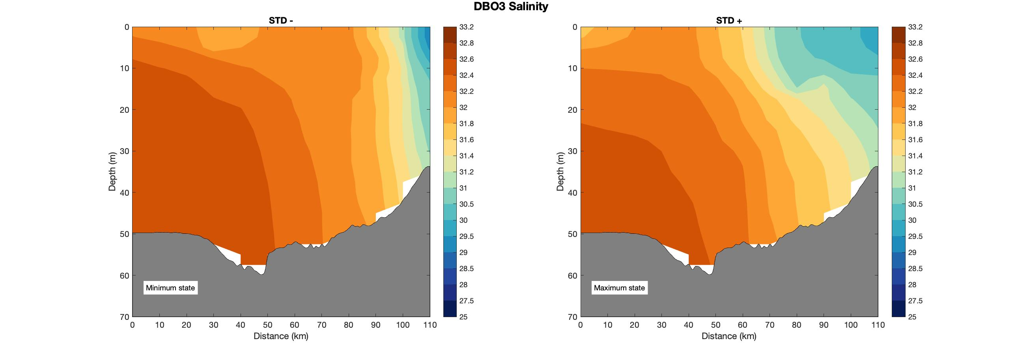
Empirical Orthogonal Function analysis
Mode 1
Minimum state
Maximum state

Slide 61
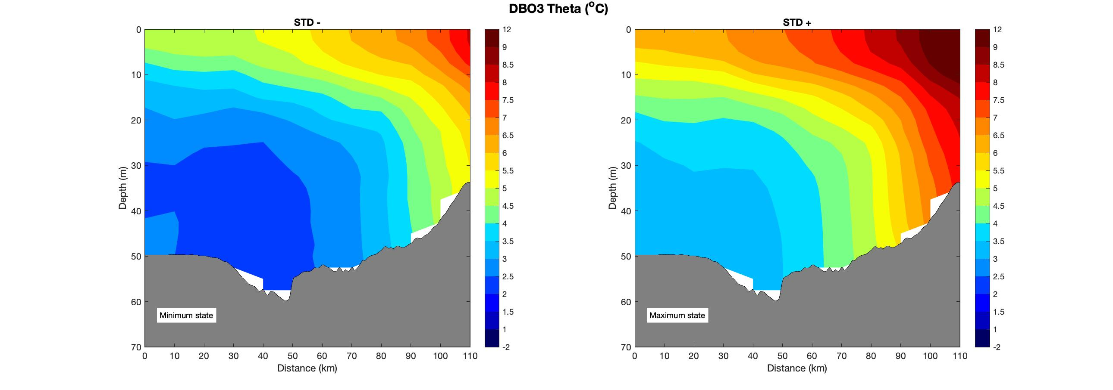
Empirical Orthogonal Function analysis
Mode 1
Minimum state
Maximum state
Mode 1
Minimum state
Maximum state

Slide 62
Empirical Orthogonal Function analysis
DBO3 temperature
mode 1

Slide 63
Empirical Orthogonal Function analysis
Minimum state
Maximum state
Minimum state
Maximum state

Slide 64
Empirical Orthogonal Function analysis
Minimum state
Maximum state
Minimum state
Maximum state

Slide 65
Empirical Orthogonal Function analysis
Minimum state
Maximum state

Slide 66
Empirical Orthogonal Function analysis
Minimum state
Maximum state
Minimum state
Maximum state

Slide 67
A closer look at the baroclinic velocity fields

Slide 68
A closer look at the baroclinic velocity fields
ACC
ACC
Central Channel Branch
Central Channel Branch
Maximum state

Slide 69
A closer look at the baroclinic velocity fields
ACC
ACC
Central Channel Branch
Central Channel Branch
Minimum state
Maximum state

Slide 70
A closer look at the baroclinic velocity fields
ACC
ACC
Central Channel Branch
0.07 Sv
Central Channel Branch
0.07 Sv
0.08 Sv
0.15 Sv
Minimum state
Maximum state
Mode 1: strengthening/weakening of Central Channel branch

Slide 71
A closer look at the baroclinic velocity fields
ACC
ACC
Central Channel Branch
Central Channel Branch
Mode 2: strengthening/weakening of ACC
DBO3 density and baroclinic velocity
ACC
Central Channel Branch
0.04 Sv
Central Channel Branch
ACC
0.12 Sv
0.11 Sv
0.10 Sv
Minimum state
Maximum state

Slide 72
Nature of the ACC mode

Slide 73
Nature of the ACC mode
Consider the two extreme states of Mode 2

Slide 74
Nature of the ACC mode
Composite mean sections
Strong ACC
Weak ACC

Slide 75
Using data from mooring MC6, upwelling commences at the DBO3 site
when the alongcoast windspeed exceeds 6.3 m s⁻¹.

Slide 76
Nature of the ACC mode
Number of days prior to the occupation of the section that an upwelling wind event occurred
Strong ACC
Weak ACC

Slide 77
Nature of the ACC mode
Number of days prior to the occupation of the section that an upwelling wind event occurred
Strong ACC
Weak ACC
Conclusion: The ACC mode is wind-driven

Slide 78
Remaining Work
Shorter term:
Is there similar variability of the ACC at the other two sites?
Does mesoscale variability explain the overall large scatter in ACC properties?
Address the properties, trends, and variability of the Central Channel branch
Is there evidence of signal propagation from Bering Strait to Barrow Canyon?
Longer term:
Address the relationship between the baroclinic and full velocity field for the ACC and CC
Consider the nutrient part of the story
Investigate the upwelling

Slide 79
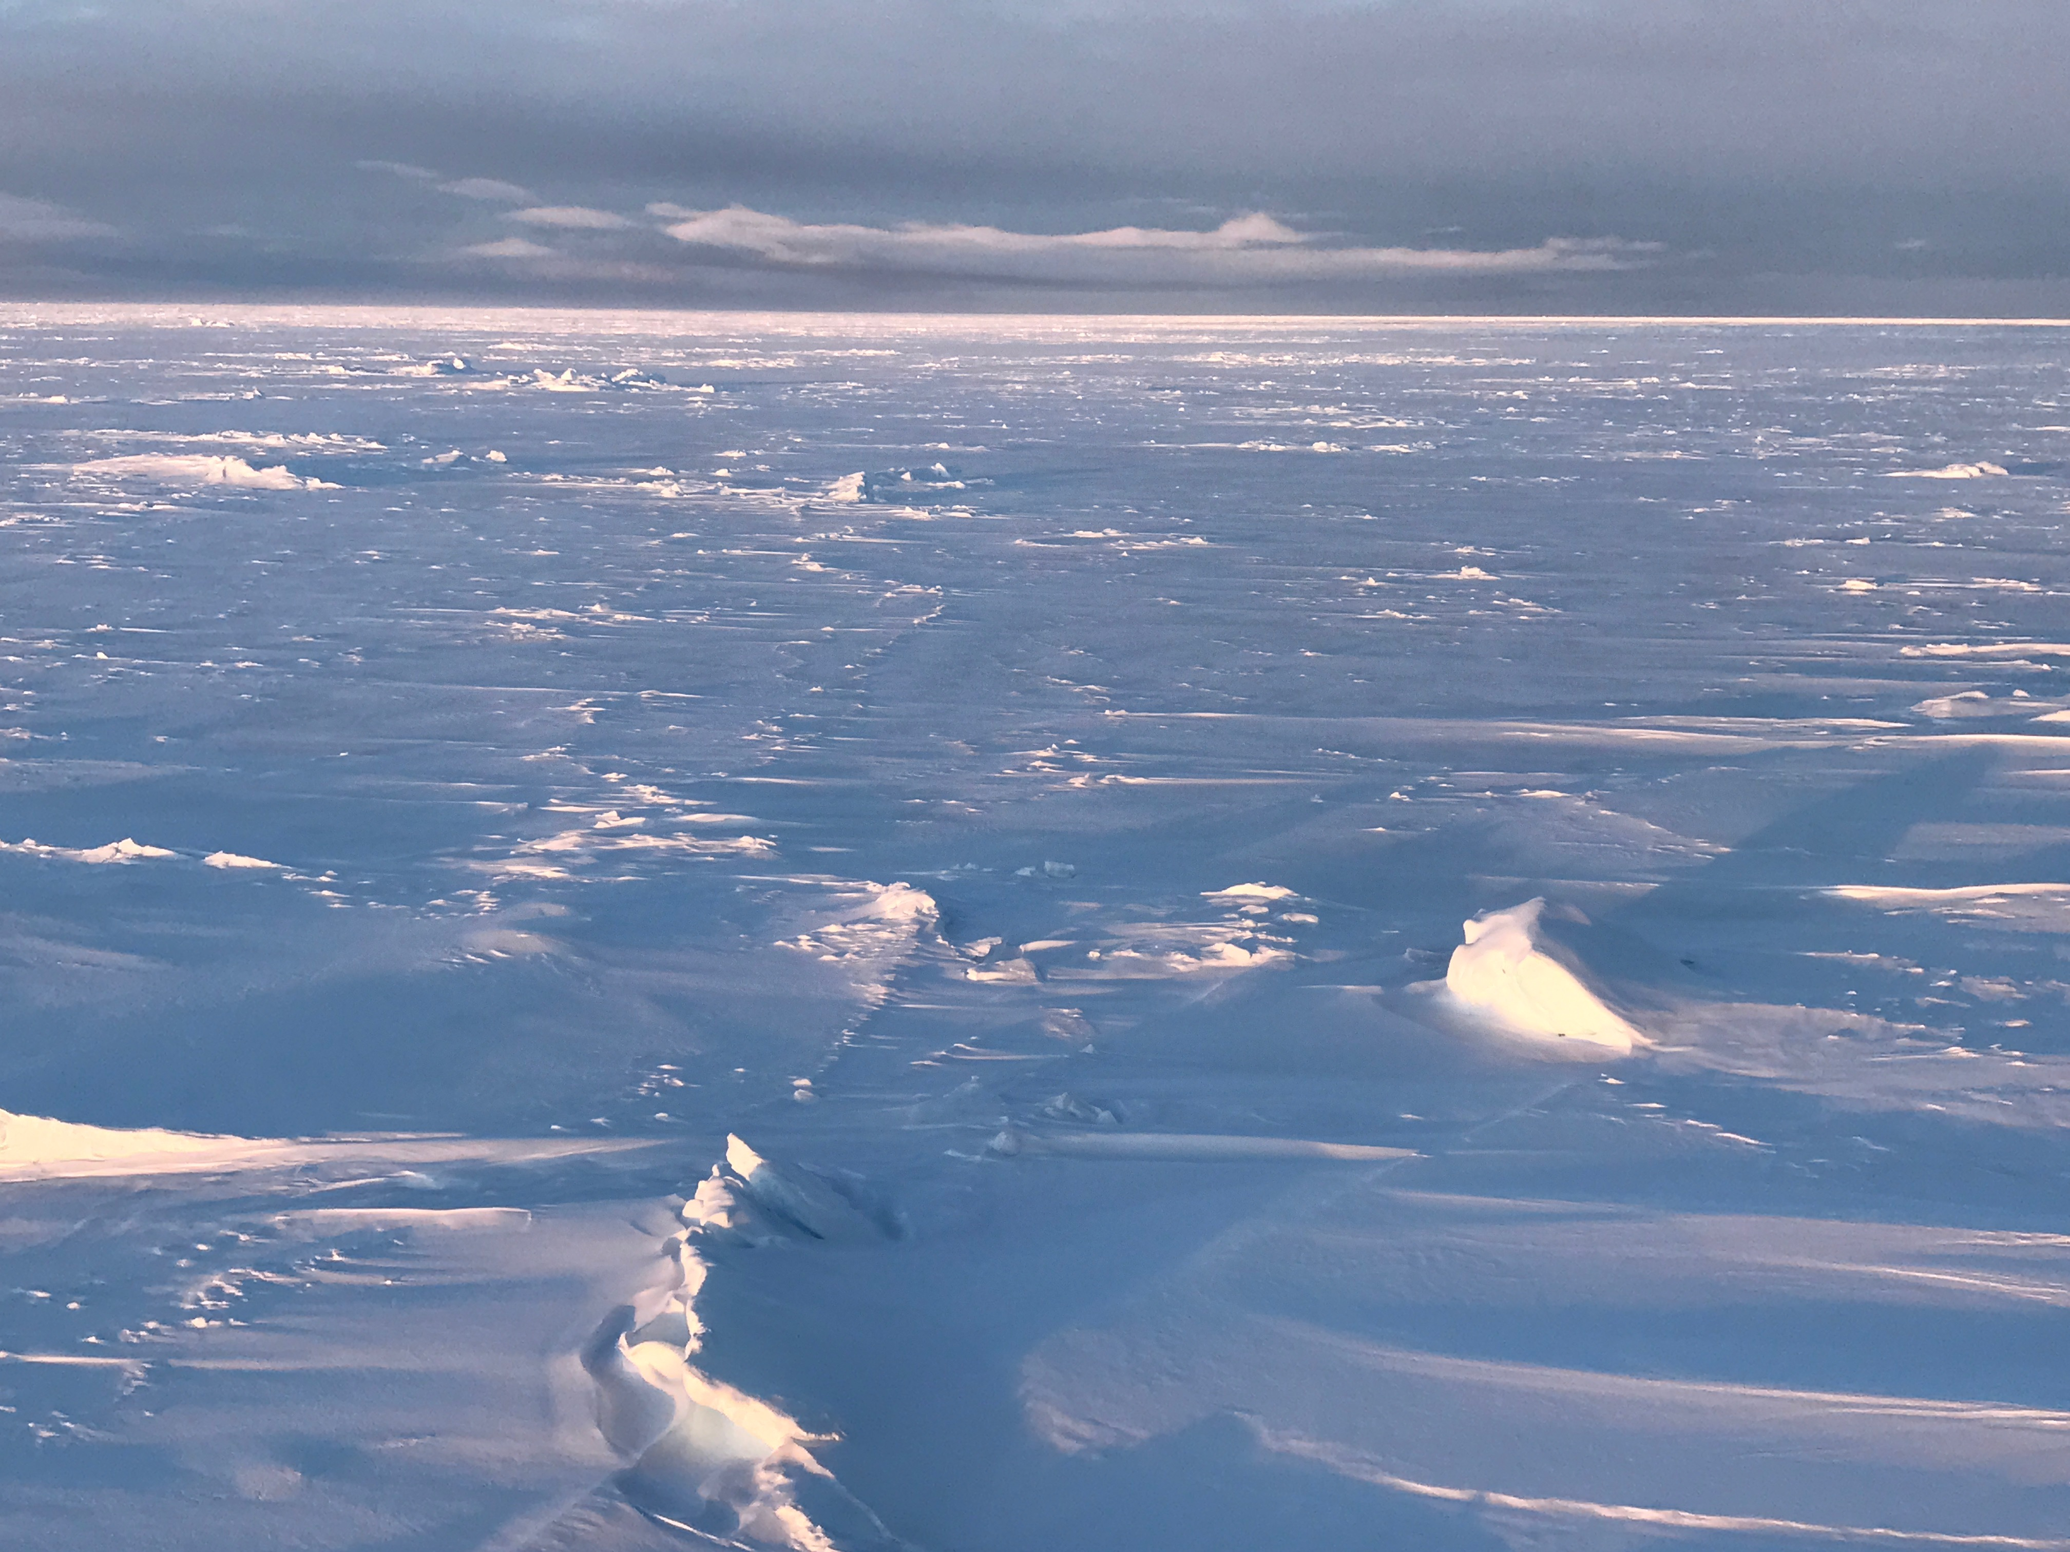
Thank you
The ice-covered Beaufort Sea in October

